Slide 1
CONVERSION RATE OPTIMIZATION
CRO Portfolio
Kemi Ghetia | CRO Growth Analyst
Turning behavioural signals into structured, revenue-driving experiments — for D2C, e-commerce & pharmacy-brand websites.
kemighetia@gmail.com • +91-7016210932 • https://www.linkedin.com/in/kemi-ghetia-4968a4263/

Slide 2
About Me
Why I think in experiments and structured logic, not opinions and guesswork
Currently: CRO Growth Analyst, running the day-to-day conversion program for an Indian D2C skincare brand — homepage, PDP, and checkout experimentation.
Own the full loop: digging into behavioural + quant data, qualitative and quantitative analysis, writing hypotheses, prioritising the backlog, briefing design/dev, and reading out results to stakeholders.
Comfortable with GA4 funnels and Microsoft Clarity / Hotjar for qualitative signal (recordings, heatmaps, rage-clicks); actively building formal A/B testing and statistics chops (this is the gap I'm closing right now).
What I bring: pattern-recognition from working inside a live D2C funnel every day, a bias for evidence over opinion, and comfort presenting findings to non-technical stakeholders.
CURRENT FOCUS
D2C Skincare
CRO
TOOLS
GA4 · Clarity
Hotjar · Shopify
LEARNING NOW
A/B Testing &
Stat. Significance

Slide 3
My Experimentation Framework
A repeatable loop — not one-off tests
1
2
3
4
5
Sense
Hypothesize
Prioritize
Test
Learn & Scale
Read GA4 funnels, Clarity/Hotjar recordings & heatmaps, reviews and support tickets & data to find friction.
→
Because we observed X, we believe change Y will drive Z, measured by [metric].
→
Score every idea on Impact / Confidence / Ease (ICE) so effort goes to the highest-leverage tests first.
→
Ship a controlled A/B or server-side test with a clear primary metric and minimum sample size.
→
Roll winners into the experience, retire losers, and feed the insight back into the next hypothesis.
Compounding by design: every completed test — win or lose — becomes an input for the next hypothesis, instead of a one-off result.

Slide 4

CASE STUDY
Dermatouch.com
Independent conversion audit of an Indian pharmacy-grade D2C skincare brand — Shopify storefront, ₹99–₹450 price band, sold direct + across 9 marketplaces.
₹149
9+
4-way
5,700+
Typical entry price point
Marketplaces incl. Zepto, Amazon, Blinkit
Menu split: Product / Concern / Skin Type / Ingredient
Reviews on top bestseller alone

Slide 5
What I Found: Friction Points
Heuristic + behavioural-signal review of homepage & navigation (mobile + desktop)
1
Four parallel navigation paths
Shop By Product / Concern / Skin Type / Ingredient all sit in the same mega-menu with no visible primary path — likely to cause decision paralysis for first-time, non-repeat visitors who don't yet know their "concern" language. Dermat trust badge is a missing opportunity to highlight priority products
2
Discovery vs. distraction on the HP
Marketplace badges (Zepto, Blinkit, Amazon, Myntra…) sit prominently on-site; for a price-sensitive ₹149 product this can pull ready-to-buy traffic off-domain and out of the direct-attribution funnel; which is exactly what we are doing at Dermatouch.
3
Trust signals are present but late
Strong review counts (1,000s per SKU) exist, but appear mainly in the homepage carousel — not consistently reinforced near the Add-to-Cart button on the PDP itself, where hesitation is highest.
4
Variant/pack-size choice adds a decision step
Multiple size + combo variants (30g / 50g / pack-of-2) are shown with per-unit pricing — good for value-shoppers, but adds cognitive load right before the primary CTA if no default/'most popular' is visually obvious. Offer slider receives the highest rage click count near the primary ATC CTA – redirect to checkout.

Slide 6
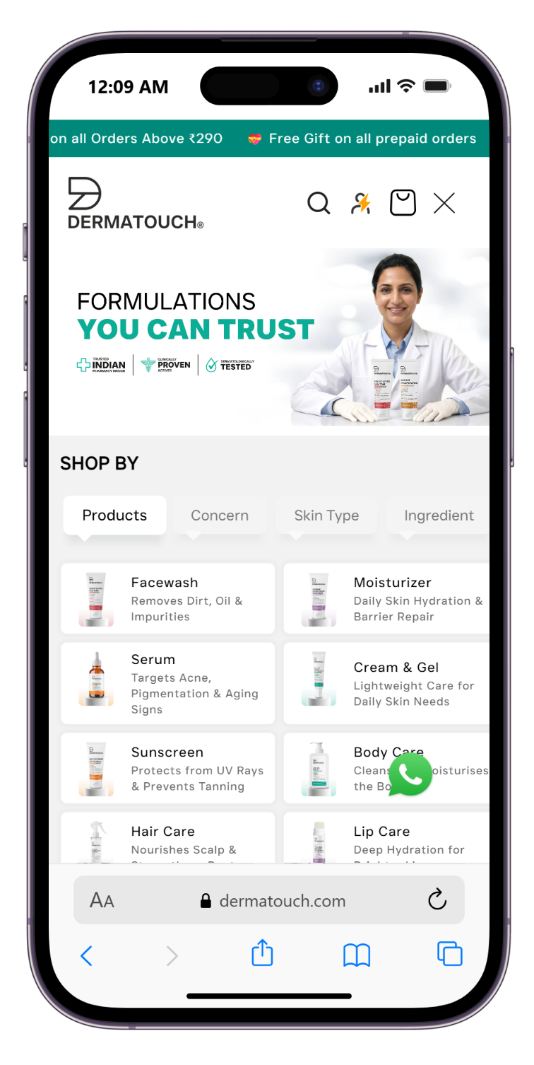
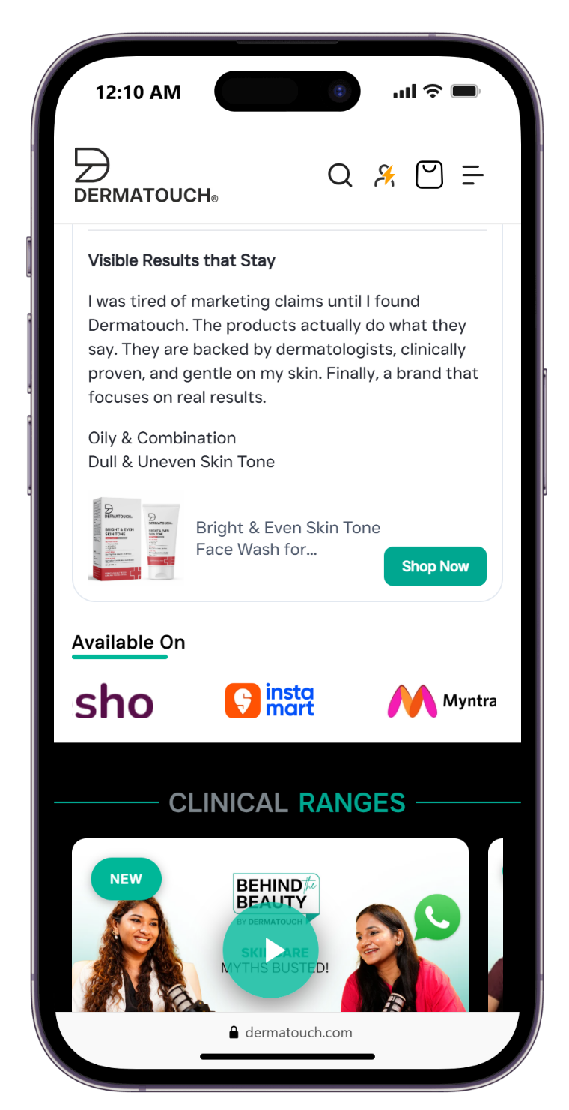
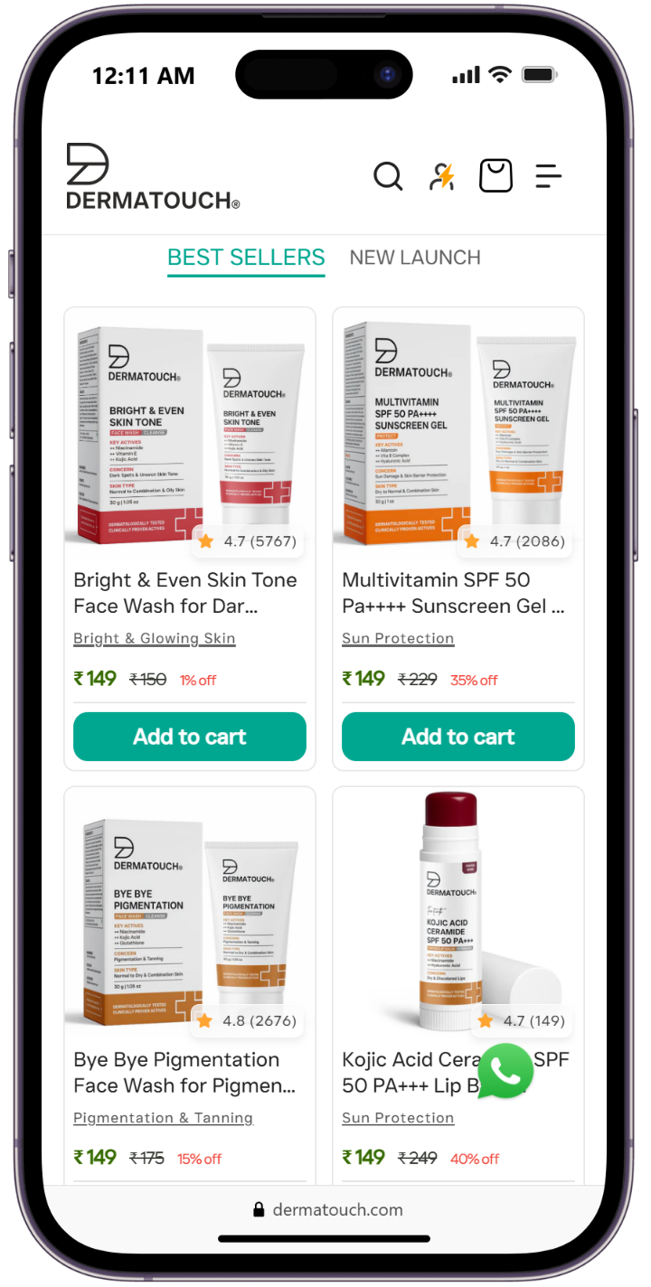
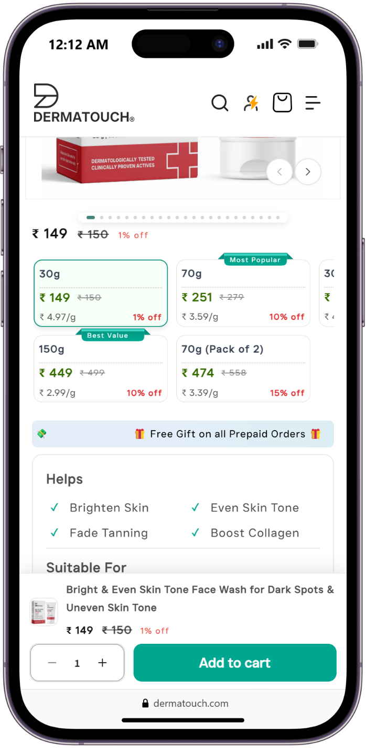
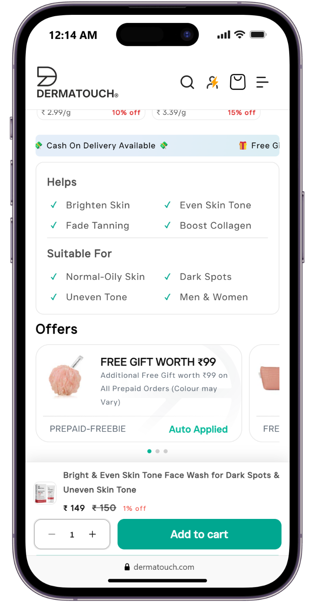

Slide 7
Hypotheses & Prioritization (ICE)
# | Hypothesis | Impact | Confidence | Ease | ICE
H1 | If we surface a single default “Most Popular” pack size on the PDP (pre-selected), then Add-to-Cart rate will increase, because fewer competing choices reduce decision friction before the primary CTA. | 8 | 7 | 9 | 8.0
H2 | If we add a trust badges (Dermat recommended, Cruelty-free etc., Clinically tested etc.) directly beside the Add-to-Cart button, then PDP-to-cart conversion will increase, because trust signals appear where hesitation peaks. | 8 | 8 | 8 | 8.0
H3 | If we simplify the mega-menu to one primary axis (Concern) with the other three as secondary filters, then category-page entry rate and bounce rate will improve, because new visitors aren't fluent in ingredient names. | 7 | 6 | 5 | 6.0
ICE = (Impact + Confidence + Ease) / 3. H1 and H2 ship first — high impact, high confidence, low build effort.

Slide 8
Test Design — H2: Trust Strip Near CTA
Ready to hand to design/dev as a build brief
CONTROL
VARIANT
Rating shown later on PDP & PDP header; nothing near the Add-to-Cart button itself.
A compact trust badge directly above the Add-to-Cart button: ★ 4.6 (5,767 reviews) + “Dermatologically tested”, “Cruelty-free”, “Clinically tested” badge.
Primary metric
Add-to-Cart rate (PDP → cart)
Secondary metrics
PDP → purchase rate, revenue per visitor
Guardrail metric
Page load time / Core Web Vitals (badge must not slow PDP)
Test type
Client-side A/B, 50/50 split, PDP template-level
Minimum runtime
2 full business cycles (incl. weekend) or until sample size reached — avoid peeking early

Slide 9
Expected Impact & Next Steps
+3–6%
1st
0
modeled Add-to-Cart lift from reduced PDP friction (H1+H2 combined)*
test to ship — smallest build, clearest read on trust-signal impact
new tech debt — reuses existing review data & badge assets
* Directional estimate based on published CRO benchmarks for above-the-fold trust signals on PDPs; to be validated against Dermatouch's own GA4 baseline once the test ships.
If it wins:
Roll to all PDP templates; reuse the trust-strip component for the mobile app view; feed the “review proximity matters” insight into checkout-page design.
If it loses/flat:
Don't discard the idea — test badge wording, placement (sticky vs. inline), or pair with a scarcity/social-proof cue instead of assuming “trust doesn't matter here.”

Slide 10

CASE STUDY
beminimalist.co
Independent audit of a well-known ingredient-led D2C skincare brand, for contrast against Dermatouch's PDP-heavy model.
5+
AI
Bundle
Auto-apply
Stacked promo banners visible pre-scroll
WhatsApp chat as primary support channel
“Build Your Own Bundle” cross-sell mechanic
Free-gift offers applied silently at checkout

Slide 11
Friction Points & Hypotheses
What I noticed
Hypotheses to test
The homepage announcement bar rotates through 4 different value props (bundle discount, sitewide %, buy-3-get-1, gift-with-purchase) before a first-time visitor sees a single product — and the cart drawer then surfaces a 5th, different offer (₹799 free-sunscreen threshold) that was never mentioned earlier. No single offer gets to “land”, and messaging is inconsistent across touchpoints.
Multiple auto-applied free-gift offers are only confirmed at checkout, which is good for AOV but can feel like a surprise rather than a reason to buy earlier in the funnel since no offer education present on PDP.
The AI assistant is a strong AOV/cross-sell engine — one query returns 5+ relevant product & kit options with inline “Add” buttons. But that same breadth is a double-edged sword: a user who was ready to buy can get pulled back into browsing/comparing instead of checking out, so the bot may quietly trade a fast conversion for a wider (but riskier) one.
H1 — If we pick the single strongest offer (e.g. the bundle discount) and keep it consistent across the homepage banner, PDP, and cart drawer — instead of rotating through 4-5 different offers — then homepage-to-category click-through will increase, because one clear, consistent value prop is easier to act on than several competing, rotating ones.
IMPACT 7 CONFIDENCE 6 EASE 8 — ICE 7.0
H2 — If we cap the AI assistant's recommendations to 1 primary pick + 2 alternatives (instead of 5+ parallel options) or make it interactive where user can choose his own routine sequence (like 3,4,5 products) and add a persistent “Continue to Checkout” nudge after any “Add,” then chat-to-checkout conversion will increase, because fewer competing options reduce the risk of a ready-to-buy user drifting back into browsing instead of completing the purchase the bot already nudged them toward.
IMPACT 8 CONFIDENCE 6 EASE 6 — ICE 6.7
Scored the same way as the Dermatouch backlog — ICE = (Impact + Confidence + Ease) / 3.

Slide 12
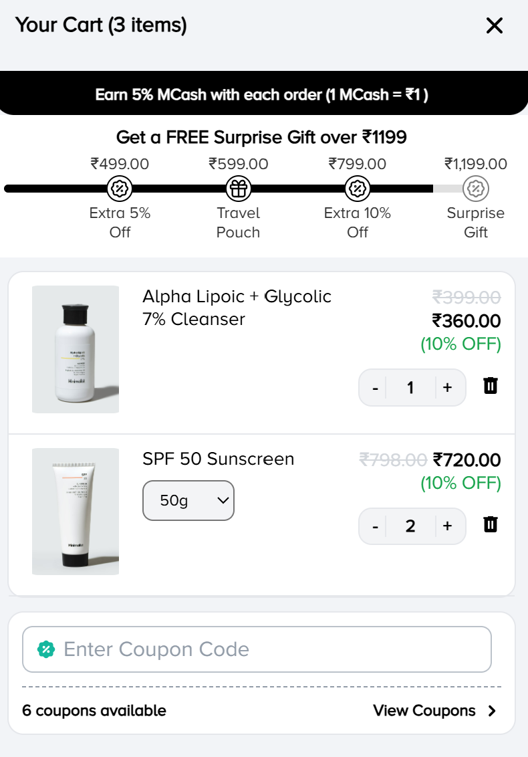
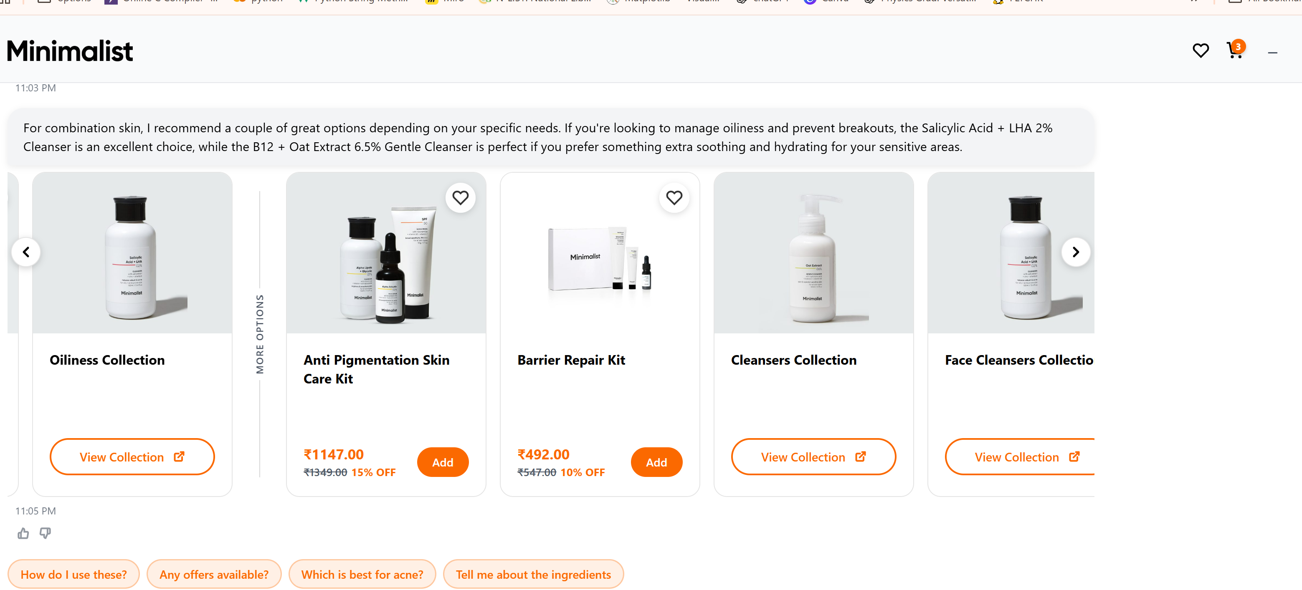

Slide 13
Test Design — H1: One Consistent Offer, Not a Rotation
Highest ICE score (7.0) — ships first
CONTROL
VARIANT
Homepage banner auto-rotates through 4 different offers (bundle %, sitewide %, buy-3-get-1, gift-with-purchase); cart drawer then shows a 5th, unrelated offer (free sunscreen at ₹799) never mentioned upstream.
One offer (the bundle discount) picked as the hero value prop and repeated identically in the homepage banner, PDP, and cart drawer; other offers moved to a single “more offers” link instead of rotating on the cart page.
Primary metric
Homepage → category page click-through rate (CTR)
Secondary metrics
Homepage bounce rate, avg. session duration, cart-page offer engagement rate
Guardrail metric
Average Order Value — must not drop when offers move to cart
Test type
Client-side A/B, 50/50 split, homepage template-level
Minimum runtime
2 full business cycles (incl. weekend) or until sample size reached — no early peeking

Slide 14
Expected Impact & Next Steps
+4–6%
+2–5%
0
modeled homepage→category CTR lift (H1) from one consistent offer vs. a 4-5 way rotation*
modeled chat-to-checkout lift (H2) once AI recs are capped + nudged*
new tech debt — both tests reuse existing banner & chat components
* Directional estimates from published CRO benchmarks on message consistency and guided-recommendation flows; to be validated against Minimalist's own analytics once each test ships.
If it wins:
Roll the single-offer pattern to the app homepage and category pages; apply the same “one primary CTA” logic to the AI chat's recommendation cards (instead of “Add”, “View Collection”; feed both learnings into checkout-page messaging hierarchy.
If it loses/flat:
Don't conclude offer consistency doesn't matter — test which single offer to feature first (bundle vs. sitewide %), and test nudge copy/placement variants (sticky vs. inline “Continue to Checkout”) before shelving H2.

Slide 15
Tools & Skills
Analytics/RCAs & Signal
Execution & Platform
Process & Communication
Google Analytics 4 (funnels, exploration reports), Shopify, GoKwik
Microsoft Clarity (heatmaps, session recordings, rage-clicks)
Hotjar (heatmaps, feedback widgets)
Shopify storefront structure & PDP mechanics
Basic wireframing for test variants, Figma
Actively learning: A/B test tooling, statistical significance & sample-size math, VWO
Hypothesis writing (Because/We believe/Measured by)
ICE / PIE prioritization scoring
Stakeholder read-outs & test/impact/outcome documentation

Slide 16
Let's keep converting. Turn browsers into buyers at every step of the journey.
Thank you for the opportunity to walk through this. I'd love to bring this same rigor — sense, structured reasoning, business acumen, hypothesize, prioritize, test, learn — to OptiPhoenix's client programs.
Kemi Ghetia • kemighetia@gmail.com • +91-7016210932 • https://www.linkedin.com/in/kemi-ghetia-4968a4263

