Slide 1
INDEPENDENT CRO AUDIT REPORT
Neeman's
Sustainable footwear D2C brand — independent conversion audit of the homepage, PLP, and PDP experience.
This is independent, outside-in research based only on publicly visible pages on neemans.com. It does not draw on any insider knowledge of Neeman's actual CRO program, prior test results, or internal data, and any specific figures cited are illustrative estimates, not measured outcomes.
Prepared by Kemi Ghetia • CRO Growth Analyst • July 2026

Slide 2
01 — EXECUTIVE SUMMARY
Diagnosis
Most websites leak 10-20% of potential revenue through friction, hesitation, or misaligned messaging — this audit locates where that's most likely happening for Neeman's.
Neeman's has a strong foundation: a clear sustainability story (recycled plastic bottles turned into shoes), a 4.7-star rating, and an omnichannel presence with physical stores. But two things work against that foundation converting as well as it could: policy messaging is inconsistent across pages (return/exchange windows are stated differently in different places), and near-constant 40-76% discount framing across almost every product risks eroding the price credibility a sustainability-led premium brand needs. Inconsistent placement of product cards on collection page underserves the actual purpose.
4.7★
40-76%
7 vs 30
3.2M+
Average product rating shown sitewide
Discount range shown on nearly every product
Conflicting exchange-window figures across pages
Plastic bottles recycled (brand's own claim)
Top-line recommendation
Fix policy-messaging consistency first (near-zero cost, removes a real anxiety trigger), then test a credibility-first pricing approach before assuming deeper discounts always win.
Neeman's — Independent CRO Audit
Slide 2 of 10

Slide 3
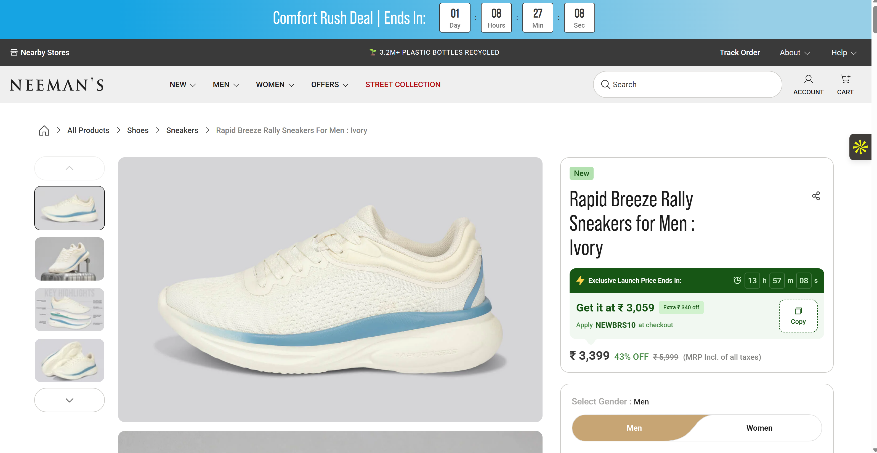
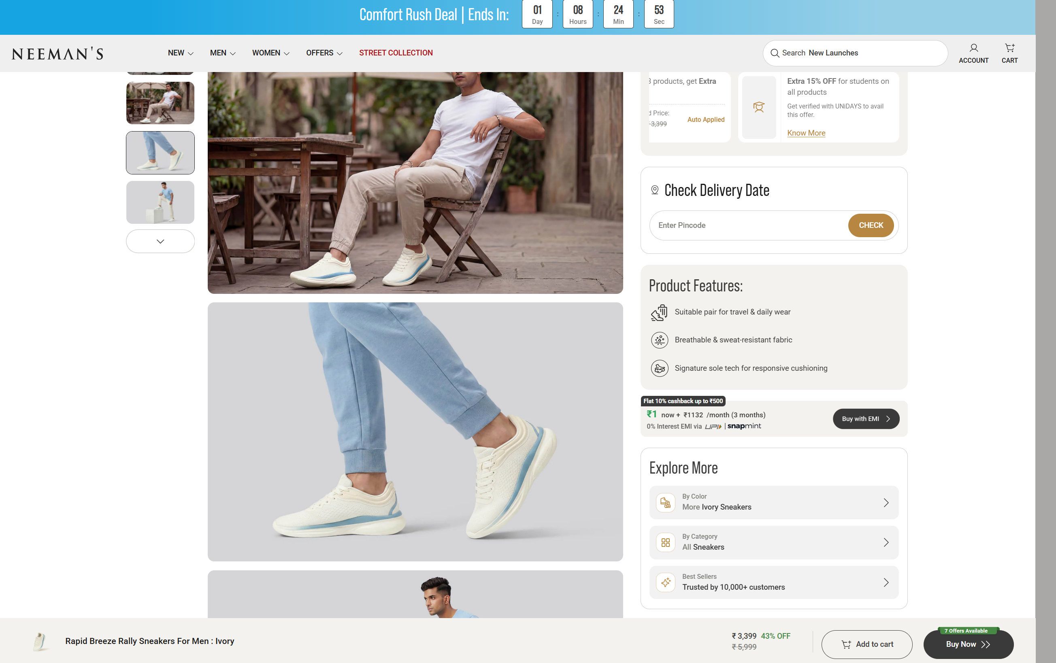
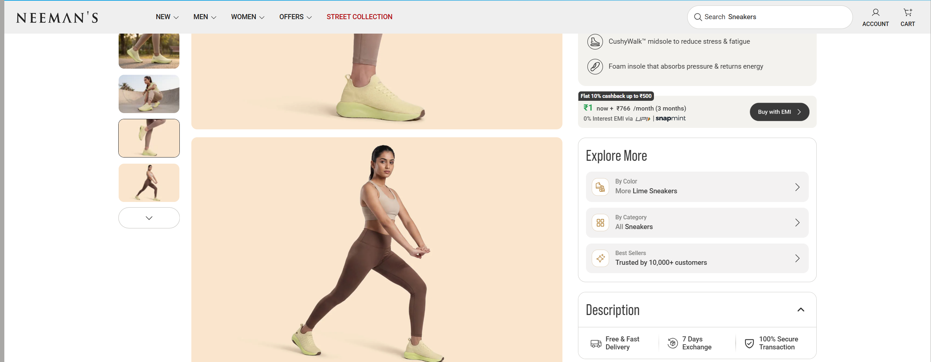
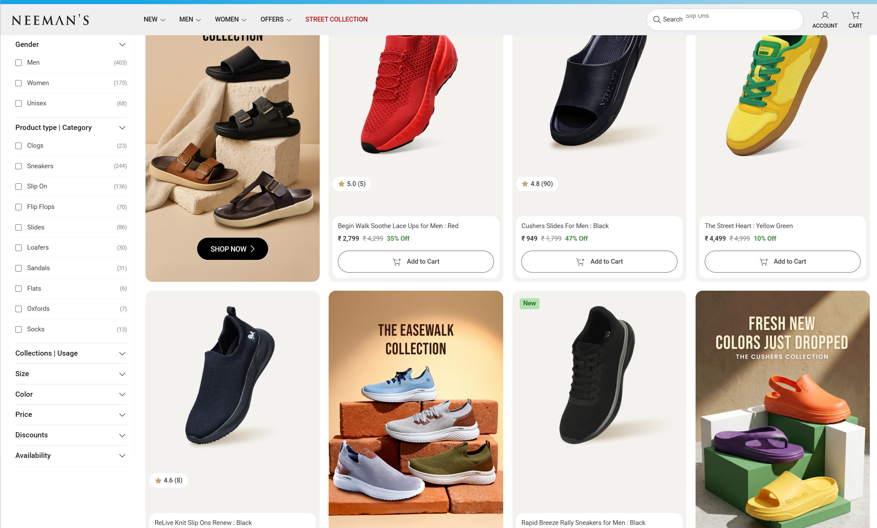


Slide 4
What I Found: Friction Points
Heuristic + behavioural-signal review of homepage & navigation (mobile + desktop)
1
The "Sale Exclusion" clause likely voids returns for most real customers
Issue: The shipping/return policy says orders placed during a "Sale period" are exchange-only (size/defect), not eligible for standard returns — but the homepage runs 40-76% off almost constantly. If most purchases happen "during a sale," most customers may be unknowingly forfeiting return rights they think they have. Fix: Show the applicable return policy dynamically at the exact price/cart level ("This order is exchange-only, no refund" shown before checkout), not buried in a separate policy page. Logic: Surfacing the real policy at the moment of decision — not after purchase — turns a hidden "gotcha" into an informed choice, which reduces disputes and rebuilds trust rather than eroding it. Likely a leading factor in order cancellations post-purchase. Impact: Fewer post-purchase support tickets/refund disputes; likely a small dip in checkout rate short-term, but a real gain in repeat-purchase trust & reviews.
2
Post-purchase support is split across three disconnected systems
Issue: Returns can be initiated via returns.neemans.com, neemans.returnscenter.com (AfterShip), or phone/WhatsApp — with no clear single default, right at the highest-anxiety moment (something's already gone wrong). Fix: Pick one canonical returns portal and route every other channel to it as the "start here" link. Logic: Post-purchase problems are already stressful; forcing a "which system do I use" decision compounds the friction at the worst possible moment. Impact: Faster resolution times, fewer duplicate/abandoned return attempts, lower support-ticket volume.

Slide 5
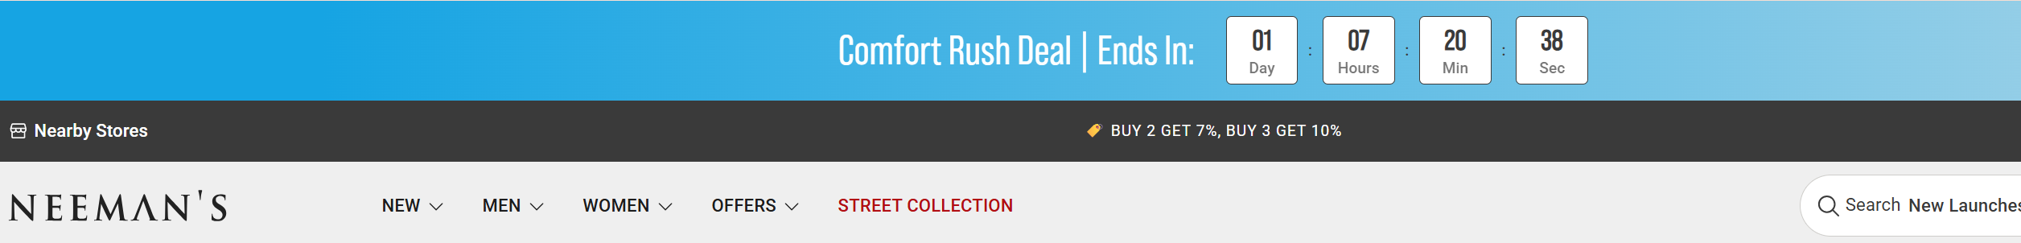
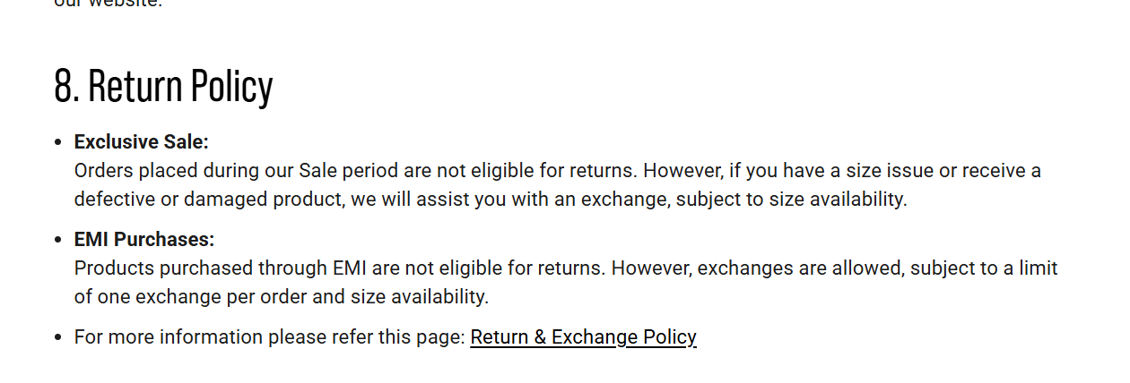
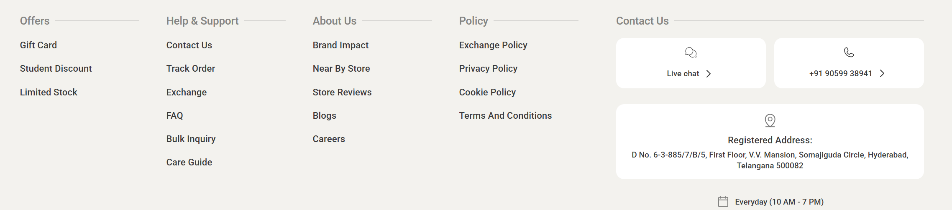
"constant sale" + "no returns during sale"

Slide 6
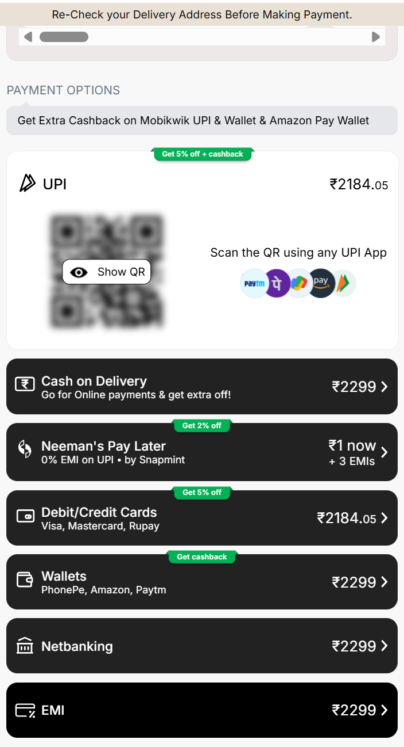
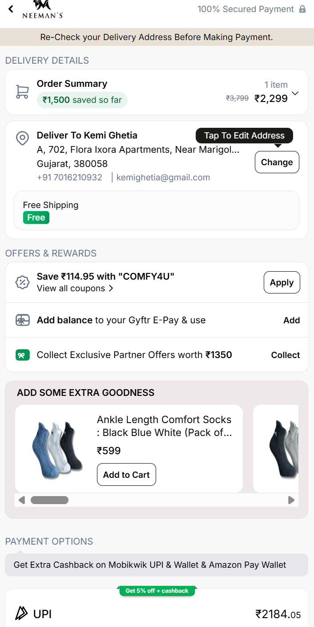
3
Checkout — Payment Method Framing (LIFT: Urgency / Clarity)
Issue: UPI/Cards are priced at ₹2,184.05 (5% off), COD/Wallets/Netbanking/EMI at full ₹2,299 — a real ₹115 gap — but it's only signaled by a small green badge, never stated in rupees. Also corrects an earlier finding: there's no separate COD fee, just a foregone discount. Fix: Change online-payment badges to name the amount ("Save ₹115 — pay online"); keep COD neutral/amber with plain cost disclosure ("Costs ₹115 more"), not red or penalized — footwear is fit-risk, and COD buyers are often the same trust-hesitant customers affected by the return-policy issue mentioned earlier. Logic: Naming the exact rupee loss anchors better than a % badge — to nudge users towards a prepaid purchase. Impact: Shifts marginal price-sensitive buyers to prepaid (cuts Neeman's COD/RTO handling cost too) — guard against a drop in overall checkout completion, and reduce chances of abandonment for first-time anxious buyers.

Slide 7
02 — METHODOLOGY
How this audit was built
Quantitative + qualitative + heuristic — the same three-pronged approach used in a structured CRO program
Quantitative lens
No direct GA4 access for this audit — in a live engagement, this stage would pull funnel drop-off by step (PLP → PDP → cart → checkout) and flag the highest-leakage step first. Here, structural signals from the site itself stand in for that quantitative layer.
Qualitative lens
Simulated the first-time buyer path across Men/Women/New/Trending/Best Sellers/Offers, read PDP FAQ accordions (sizing, care, material), and cross-checked policy statements across the FAQ, PDP, and dedicated policy pages for consistency.
Heuristic lens — the LIFT Model
Every page was scored against WiderFunnel's LIFT Model: Value Proposition, Relevance, Clarity, Anxiety, Distraction, and Urgency — the same framework used industry-wide to structure heuristic CRO evaluations.
Scope note
Everything here came from browsing neemans.com as a customer would — no account access, no internal dashboards. Where a figure is an estimate rather than something measured directly, it's flagged as such.
Neeman's — Independent CRO Audit
Slide 3 of 10

Slide 8
03 — HEURISTIC EVALUATION
LIFT Model Scorecard
Average score: 6.1/10 — scored the same way across all audits for comparability
7/10
Value Proposition
Sustainability + comfort narrative is clear and differentiated, but constant deep discounting partially undercuts the premium/considered-purchase framing.
9/10
Relevance
Clear Men/Women split and use-case categories (Sports, Formal, Casual) match how footwear shoppers actually search.
5/10
Clarity
New Launches / Trending / Best Sellers / Offers overlap heavily with no clear primary path, and policy language is inconsistent across pages.
5/10
Anxiety
Conflicting return-window claims (7-day vs. 30-day) is exactly the detail an anxious first-time buyer checks before purchase.
6/10
Distraction
Heavy, repeated discount badges on nearly every card compete with the sustainability story for attention.
5/10
Urgency
Sale framing is present but generic (no countdown on checkout, no stock-level indication), so it doesn't create real time pressure.
Neeman's — Independent CRO Audit
Slide 4 of 10

Slide 9
04 — KEY FINDINGS
Friction Points
Tied back to the LIFT factor each one violates
1
Return/exchange policy is stated inconsistently across pages
ANXIETY
One product-facing page states a 7-day exchange window; the general FAQ separately states a 30-day return and exchange policy. A buyer who checks both encounters a direct contradiction at the exact moment they're deciding whether to trust the brand with their money.
2
Near-universal 40-76% discounting risks price-credibility erosion
VALUE PROP / CLARITY
Almost every product card shows a struck-through 'original' price alongside a 40-76% off badge. When a discount is present on effectively everything, the crossed-out price stops functioning as a credible reference point altogether.
3
Redundant category paths dilute a clear first path for new visitors
CLARITY
New Launches, Trending, Best Sellers, Exclusives and Offers substantially overlap. A first-time visitor has no single obvious 'start here' path.
What's already working
The sustainability narrative (recycled plastic bottles, plastic-free packaging) is differentiated in the footwear category and is reinforced by real customer testimonials on comfort and durability — a strong foundation to build pricing and trust fixes on top of.
Neeman's — Independent CRO Audit
Slide 5 of 10

Slide 10
05 — CATEGORY BENCHMARK
How severe is this, really?
Contextualizing findings against public industry benchmarks — not competitor-specific data
Published e-commerce benchmarks put average conversion rates in the 2-3% range, with fashion/footwear typically at the lower end because fit-risk (sizing, comfort) is a bigger purchase barrier than in most other categories. Return/exchange clarity matters more in footwear specifically, since the single biggest objection is answered entirely by policy language, not by product description.
Why this matters here specifically
Because footwear buyers over-index on checking return policy before purchase, a policy inconsistency here is likely to cost more conversion than the same inconsistency would on a lower fit-risk product like a skincare serum or a jewelry piece.
Neeman's — Independent CRO Audit
Slide 6 of 10

Slide 11
06 — PRIORITIZED BACKLOG
Quick Wins vs. Long-Term Experiment Backlog
ICE = (Impact + Confidence + Ease) / 3 — scored consistently across all audits
QUICK WINS — ship within 1 sprint
LONG-TERM BACKLOG — needs design/eng scoping
QW1 — Standardize one return/exchange policy statement (e.g., '30-day hassle-free returns') and replace every conflicting mention sitewide — a content-ops fix, not a design one.
LT1 — Redesign discount presentation: reserve 60%+ discounts for genuine time-boxed sale events with a real countdown, and use a smaller, consistent 'member price' for everyday items.
ICE 8.3
ICE 6.7
QW2 — Add a single 'New Here? Start With Our Bestsellers' entry point on the homepage to cut through the New/Trending/Best Sellers/Offers overlap.
LT2 — Consolidate New/Trending/Best Sellers/Offers into a single, filterable discovery page with clear sort options.
ICE 7.0
ICE 6.3
Neeman's — Independent CRO Audit
Slide 7 of 10

Slide 12
07 — TEST DESIGN
Test Design — QW1: One Consistent Return Policy
Highest ICE score (8.3) — ships first, near-zero build cost
CONTROL
VARIANT
Exchange window shown as '7 days' on product-facing pages; the general FAQ separately states a 30-day policy — a first-time buyer checking both sees a contradiction.
One policy statement ('30-day hassle-free returns & exchanges') used identically across product pages, FAQ, and footer, with a single linked policy page as the source of truth.
Primary metric
PDP → Add-to-Cart rate
Secondary metrics
Cart abandonment rate, policy-page exit rate
Guardrail metric
Return/exchange request rate — must not spike if the window is effectively extended
Test type
Content/copy correction — low enough risk to ship as a global update rather than a split test
Minimum runtime
2 full business cycles to observe stable PDP-to-cart rate before/after
Neeman's — Independent CRO Audit
Slide 8 of 10

Slide 13
08 — EXPECTED IMPACT & ROADMAP
What happens next
+2-4%
1st
0
modeled PDP→cart lift from removing policy contradiction (QW1)
fix to ship — content-only, no design or dev dependency
new tech debt — this is a copy correction, not a new build
The lift figure above is a working estimate, not a measured result — based on published research linking purchase anxiety to policy clarity in fit-risk categories. Worth confirming against Neeman's own before/after numbers once shipped.
If it wins: Extend the same policy-consistency audit to shipping, sizing, and warranty language sitewide; feed the discount-credibility finding into a longer-term pricing-presentation redesign (LT1).
If it loses/flat: Don't conclude policy language doesn't matter — test whether the issue is visibility (buyers not seeing the policy) rather than trust, before shelving the fix.
Neeman's — Independent CRO Audit
Slide 9 of 10

Slide 14
Let's keep converting. Turn browsers into buyers at every step of the journey.
Thank you for the opportunity to walk through this. I'd love to bring this same rigor — sense, structured reasoning, business acumen, hypothesize, prioritize, test, learn — to OptiPhoenix's client programs.
Kemi Ghetia • kemighetia@gmail.com • +91-7016210932 • https://www.linkedin.com/in/kemi-ghetia-4968a4263

