Slide 1
Regular Expressions
The Black Magic of Text Manipulation

Slide 2
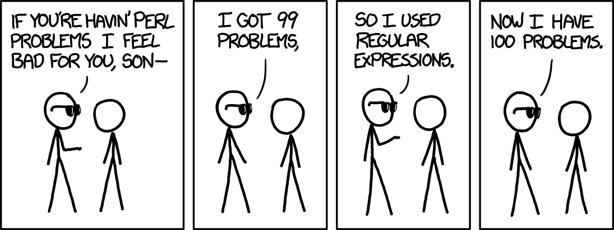
What most people think about Regular Expressions

Slide 3
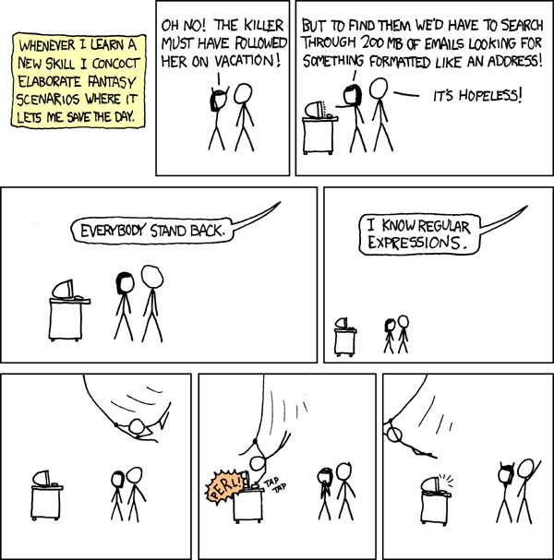
Why Use Regular Expressions

Slide 4
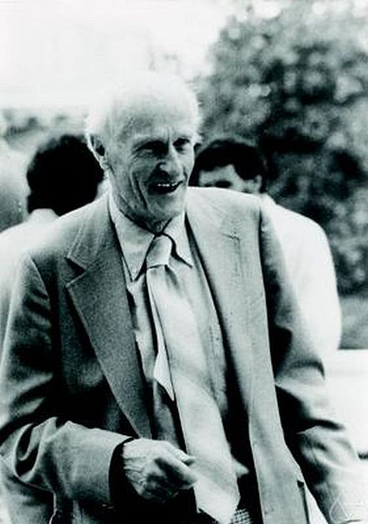

History
Created in 1956
Stephen Cole Kleene
Became popular in 1968

Slide 5
Engines
2 Types
Finite State Machine
Backtracking
Many Different Implementations
https://en.wikipedia.org/wiki/Comparison_of_regular_expression_engines

Slide 6
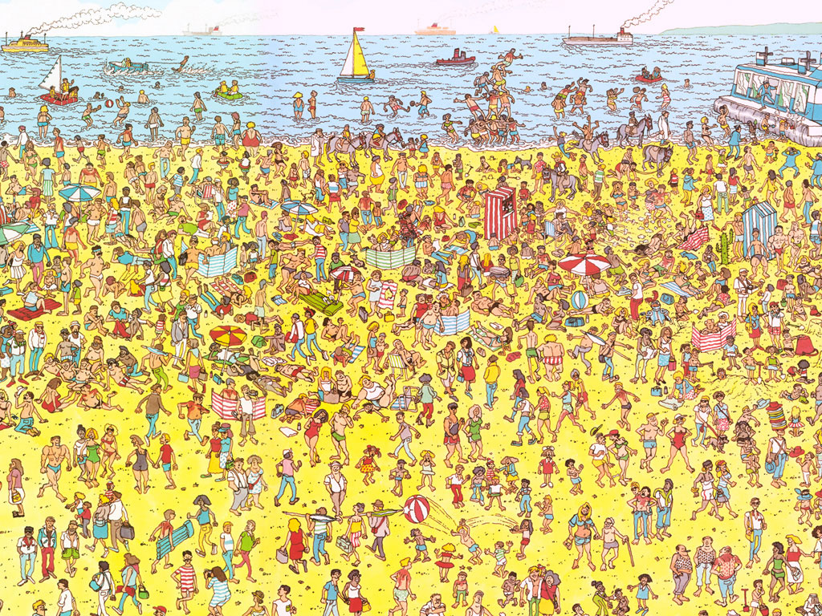

Slide 7

Regular Expression Cheatsheet
http://bit.ly/1NgWBbL

