Slide 1
Waiting for gestalt
The Psychology of Design

Slide 2
History
1920s
Unified whole
Max Wertheimer, Kurt Koffka and Wolfgang Kohler

Slide 3
Law of figure/ground

Slide 4
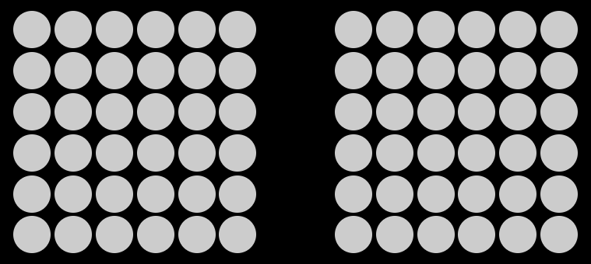
Law of Proximity

Slide 5



Law of Proximity

Slide 6

Law of Proximity

Slide 7
Law of similarity

Slide 8

Law of similarity

Slide 9
Law of common fate

Slide 10
Law of continuation

Slide 11
Law of closure

Slide 12
Law of Uniform correctedness

Slide 13
Law of pragnanz

Slide 14
Law of synchrony

