Slide 1

Waiting for gestalt
The Psychology of Design

Slide 2
History
1920s
Unified whole
Max Wertheimer, Kurt Koffka and Wolfgang Kohler

Slide 3
Laws of gestalt
Figure/Ground
Proximity
Similarity
Common Fate
Uniform Correctedness
Continuation
Closure
Pragnanz

Slide 4



Law of figure/ground

Slide 5

Law of figure/ground

Slide 6
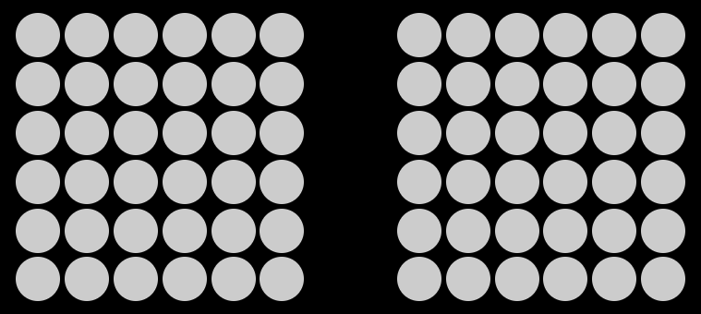
Law of Proximity

Slide 7


Law of Proximity

Slide 8
Law of Proximity

Slide 9
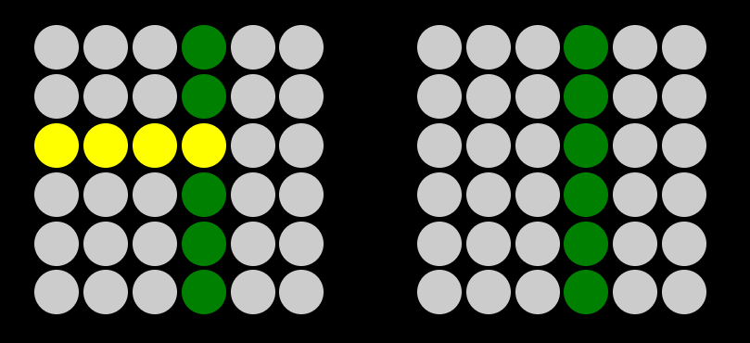
Law of similarity

Slide 10
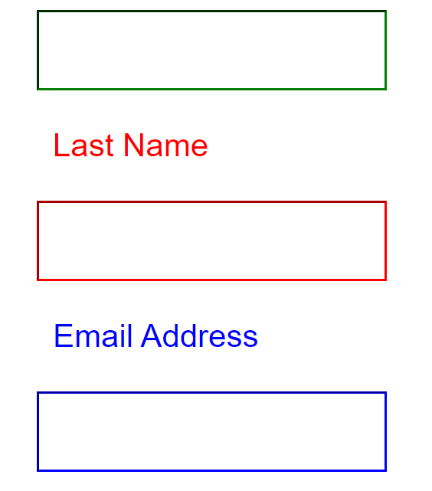
Law of similarity

Slide 11
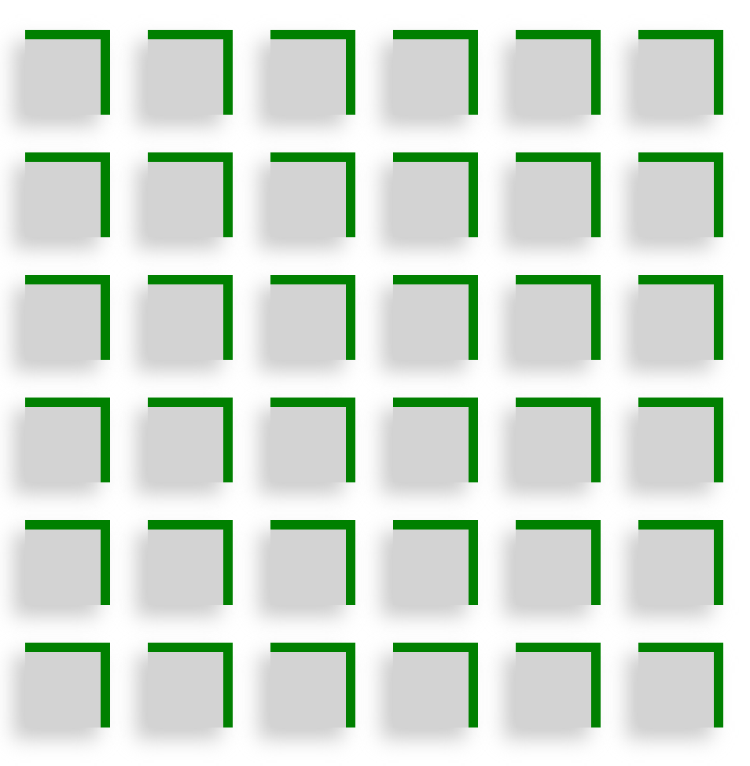
Law of common fate

Slide 12
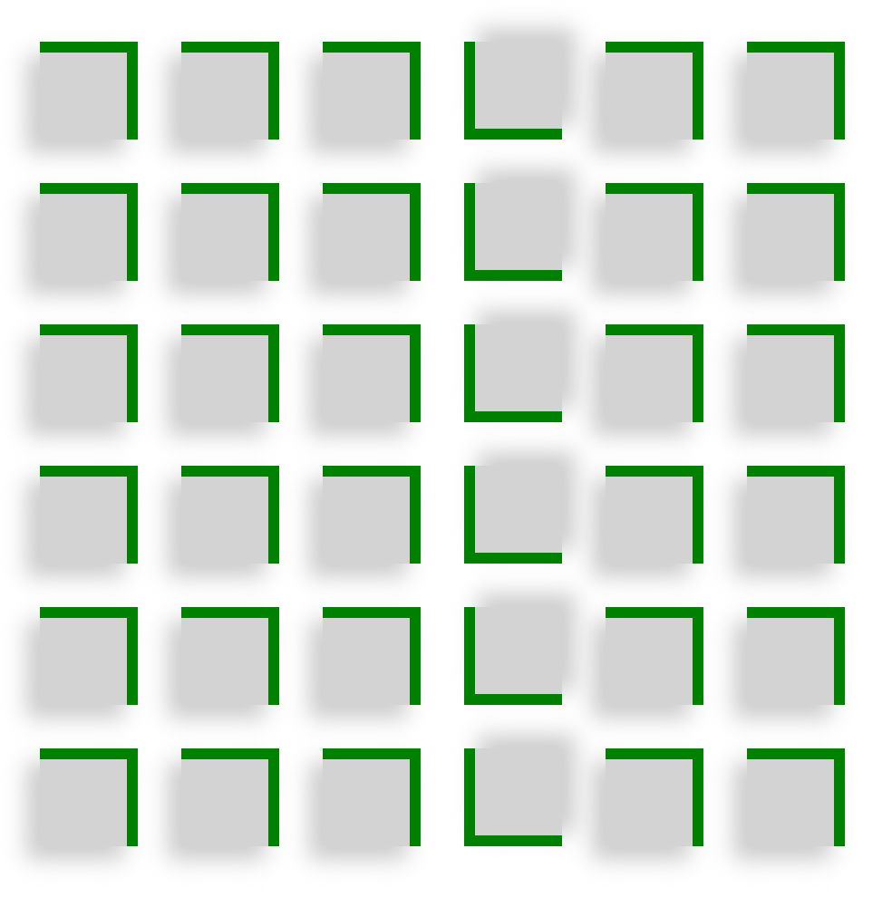
Law of common fate

Slide 13
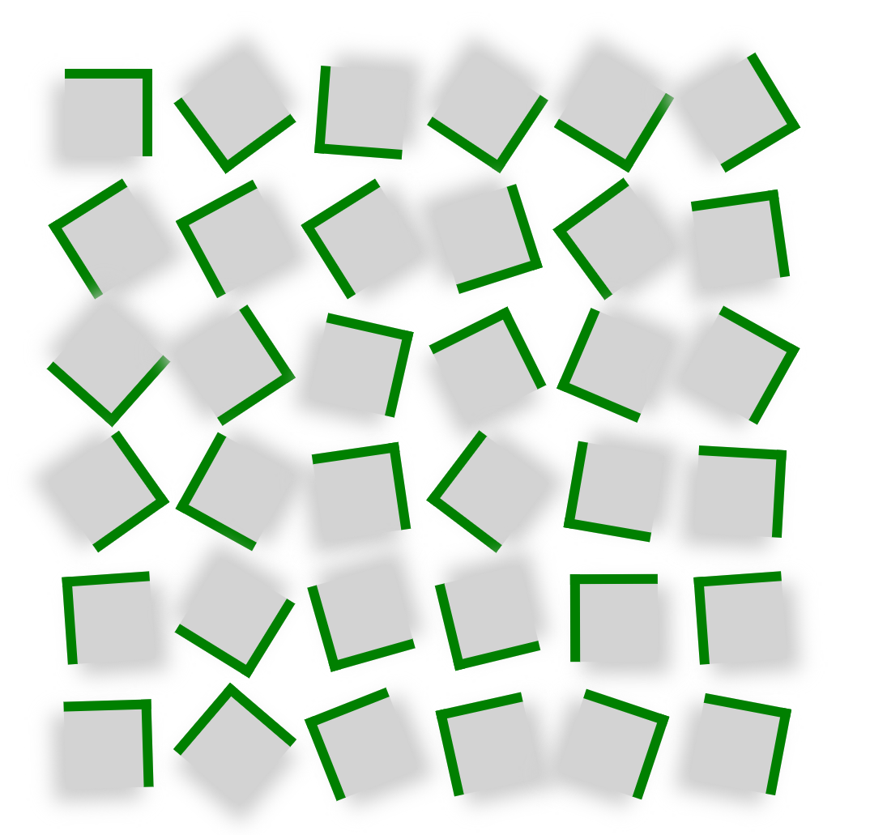
Law of common fate

Slide 14

Law of continuation

Slide 15

Law of continuation

Slide 16
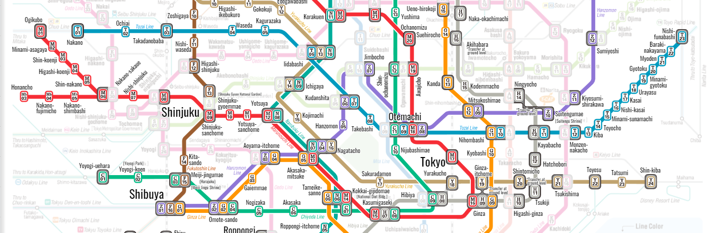
Law of Uniform CorrectedNess

Slide 17
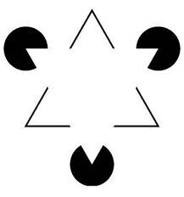
Law of closure

Slide 18

Law of closure

Slide 19
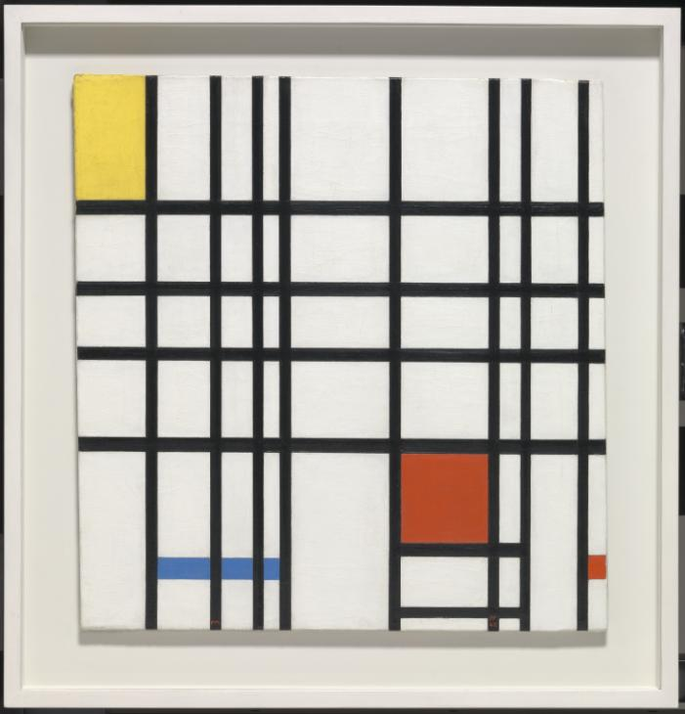
Law of pragnanz
Notes:
Piet Mondrian Composition with Yellow, Blue and Red 1937–42 Tate

Slide 20

Law of pragnanz

