Slide 1
Waiting for gestalt
The Psychology of Design

Slide 2
History
1920s
Unified whole
Max Wertheimer, Kurt Koffka and Wolfgang Kohler

Slide 3



Law of figure/ground

Slide 4

Law of figure/ground

Slide 5
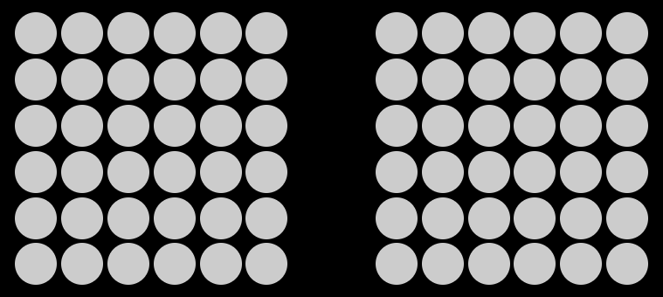
Law of Proximity

Slide 6

Law of Proximity

Slide 7

Law of Proximity

Slide 8
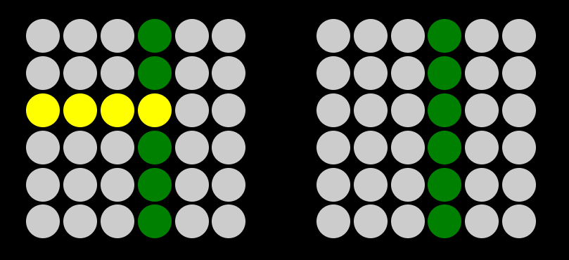
Law of similarity

Slide 9
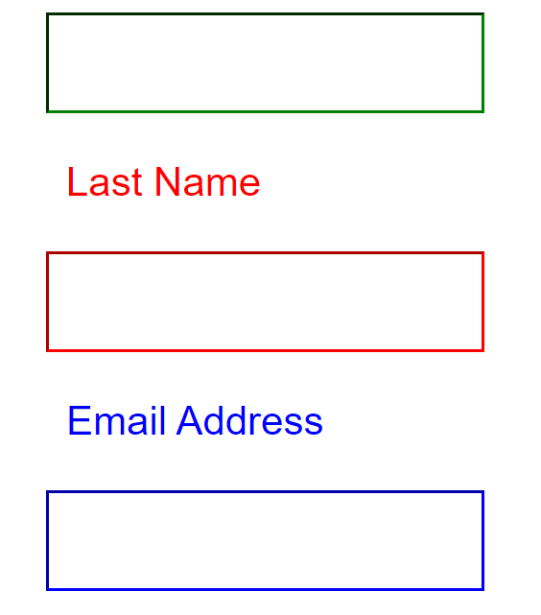
Law of similarity

Slide 10
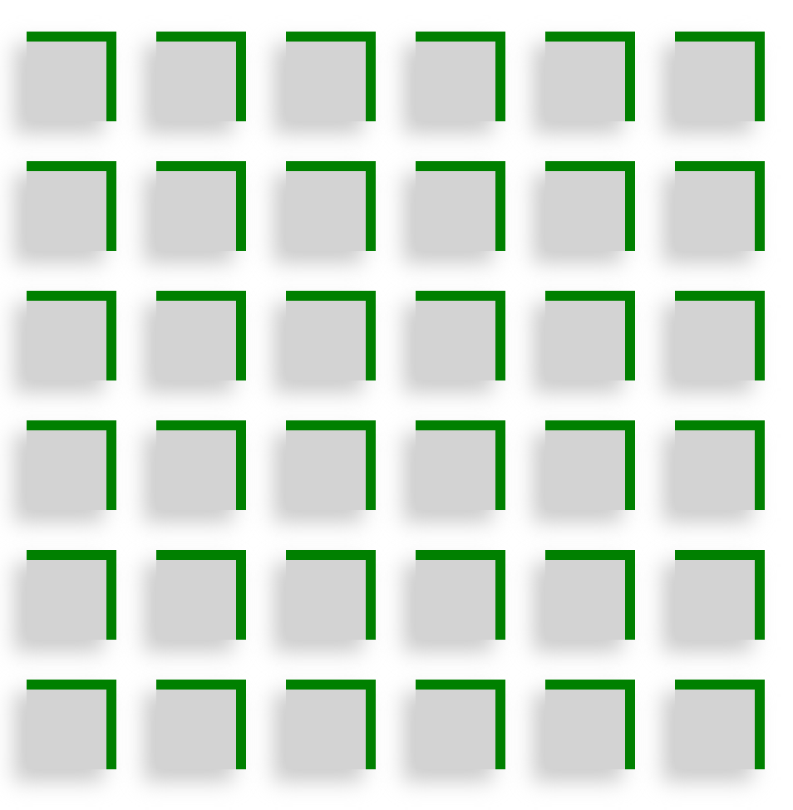
Law of common fate

Slide 11
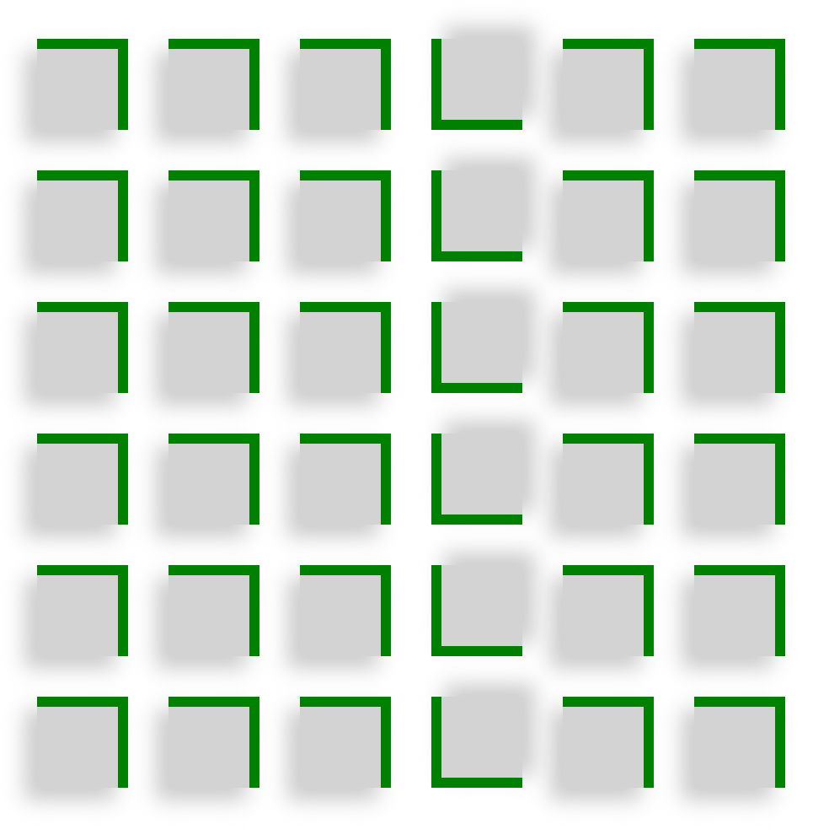
Law of common fate

Slide 12
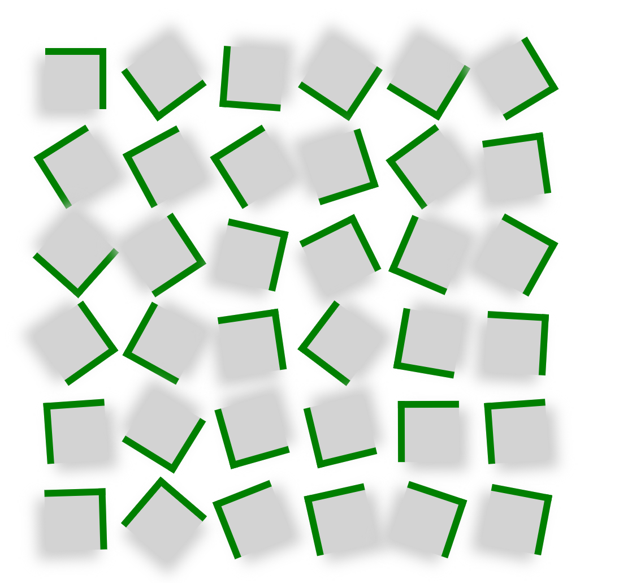
Law of common fate

Slide 13
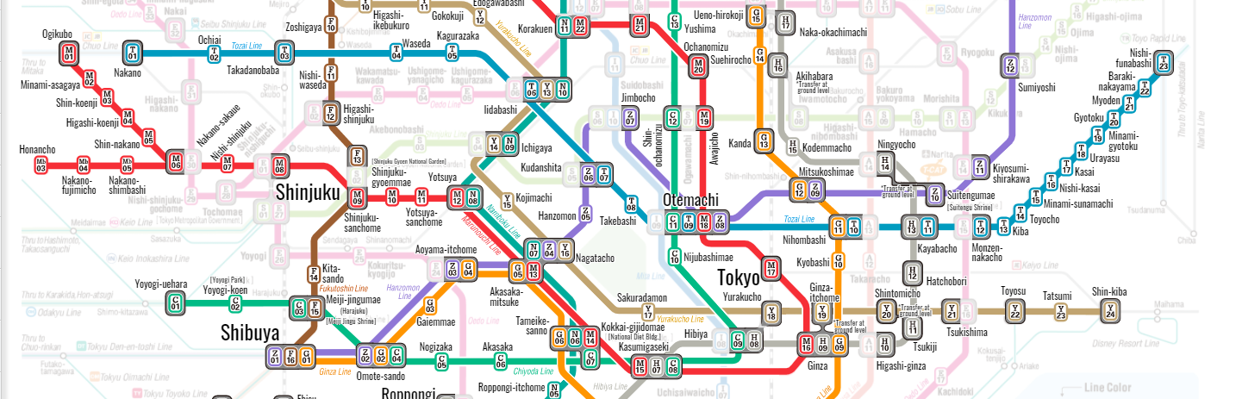
Law of Uniform CorrectedNess

Slide 14
Law of continuation

Slide 15
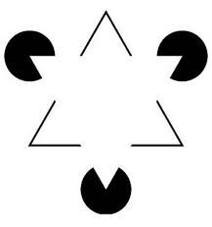
Law of closure

Slide 16

Law of pragnanz

