Slide 1

MoNads
and you

Slide 2
Monad History
Created by Roger Godement in the 1950’s
Eugenio Moggi first to link category theory monad to functional programming

Slide 3
Why care about Monads
Abstraction
Code reuse
We already use them

Slide 4
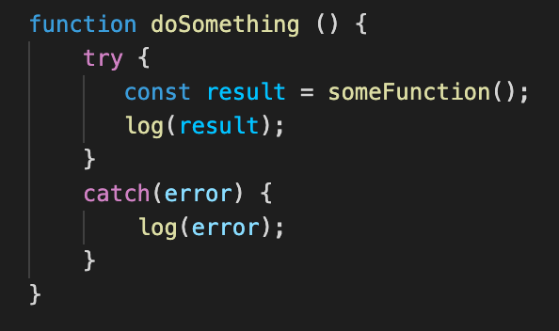
How many times do we Write this?

Slide 5
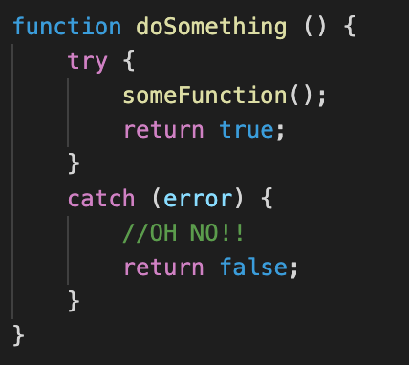
How many times do we Write this?

Slide 6
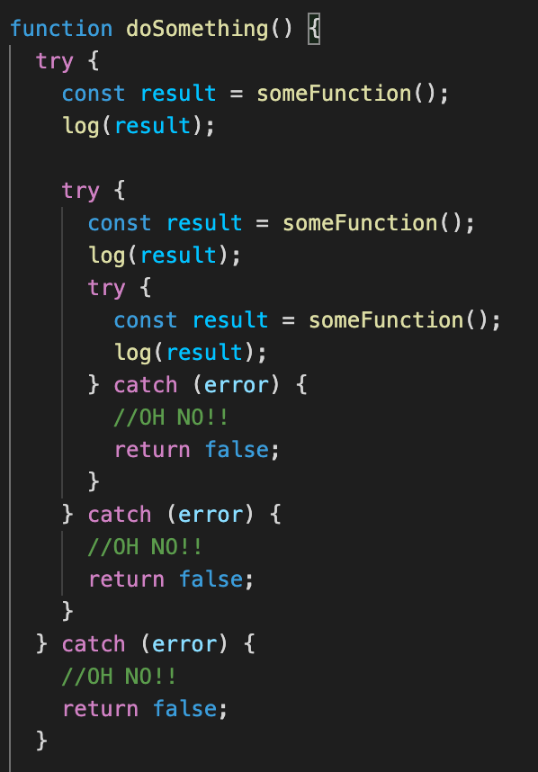
We end up with something like this

Slide 7

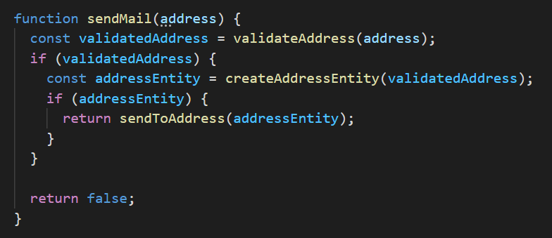
One More Example

Slide 8
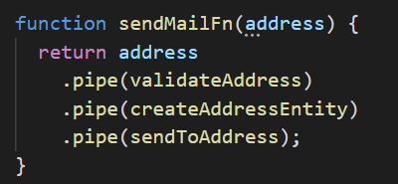
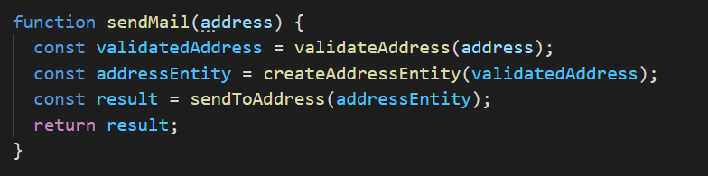
We can change it to something like this

Slide 9

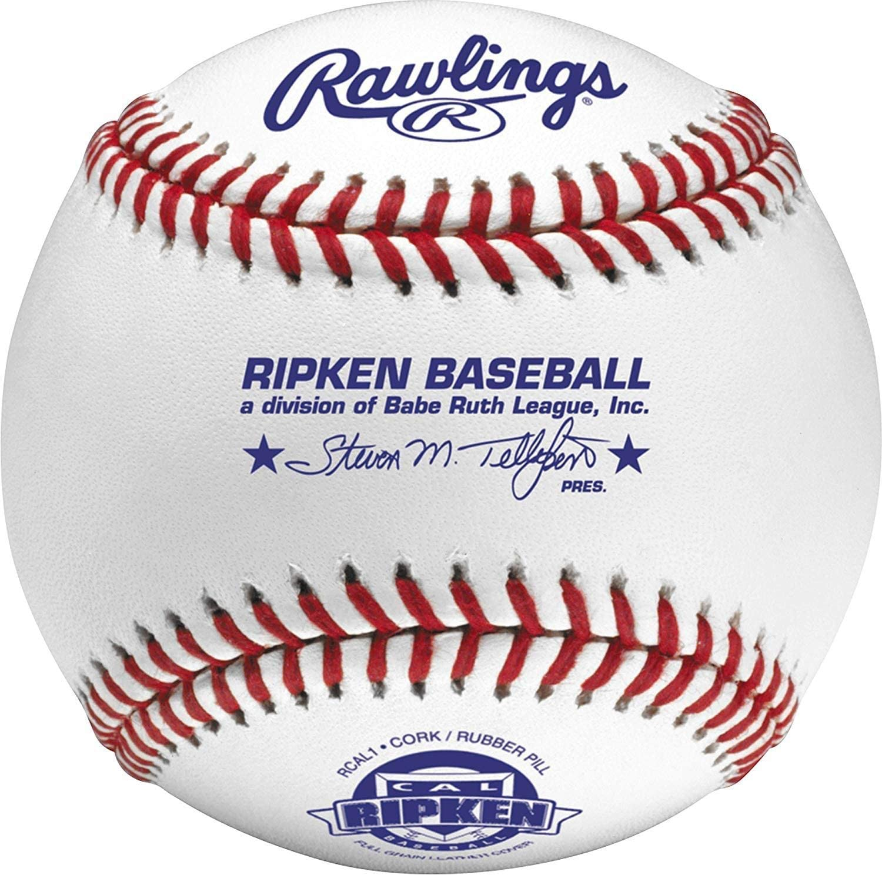

Compose

Slide 10
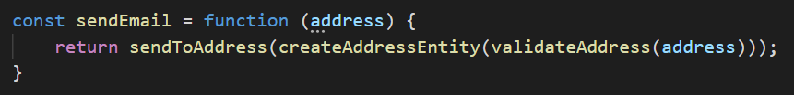
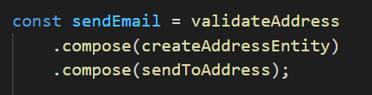
Compose

Slide 11
Compose
?

Slide 12

Adapt to Another Type
?
?
?

Slide 13
What is a Monad
Effect
Bind
Unit

Slide 14
3 Monad Laws
Left Identity
Right Identity
Associativity

Slide 15
Effect
Option<T>
Try<T>
Writer<T>

Slide 16
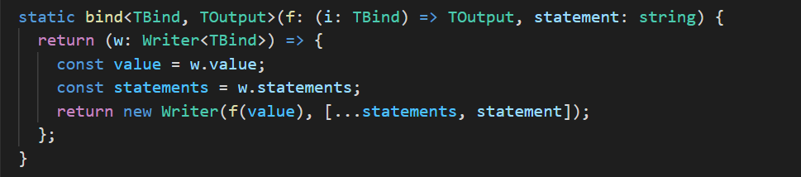
Bind
Function -> (Effect -> Function -> Effect)

Slide 17

Unit
Type -> Effect<Type>

Slide 18
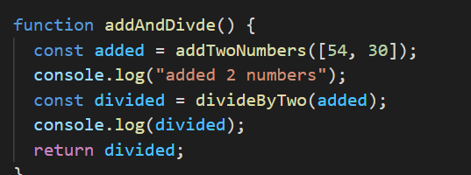
Example

