Slide 1

MoNads
and you

Slide 2
Why care about Monads
Abstraction
Code Reuse

Slide 3
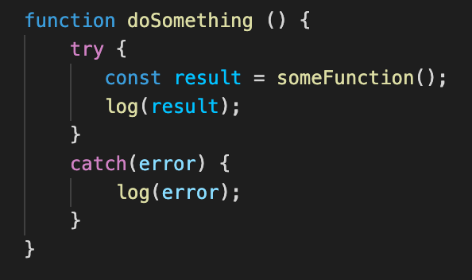
How many times do we Write this?

Slide 4
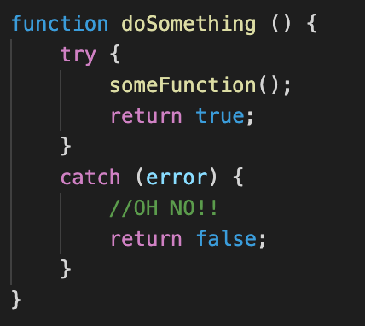
How many times do we Write this?

Slide 5
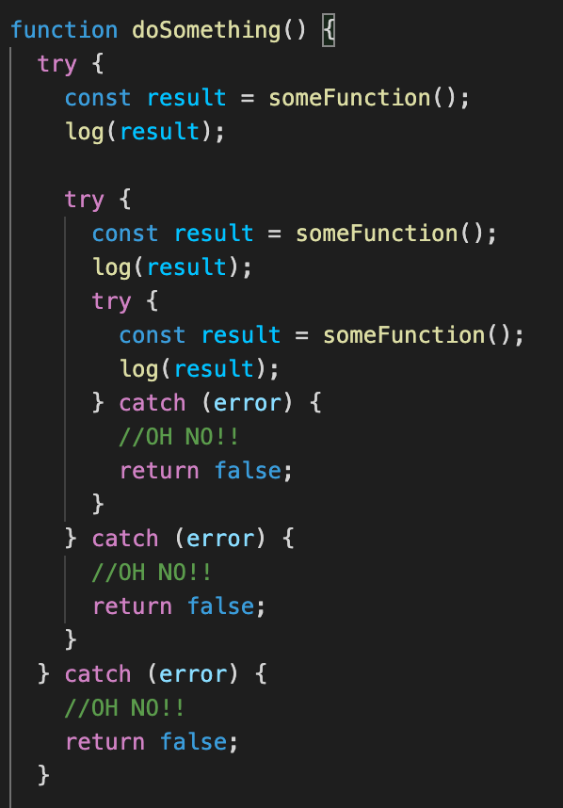
We end up with something like this

Slide 6

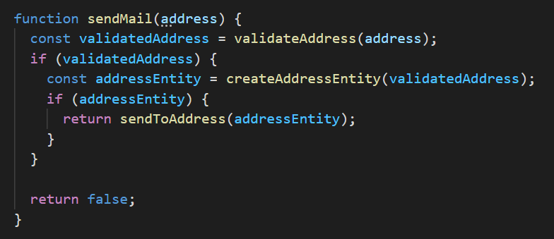
One More Example

Slide 7
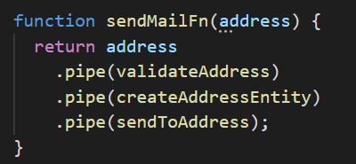
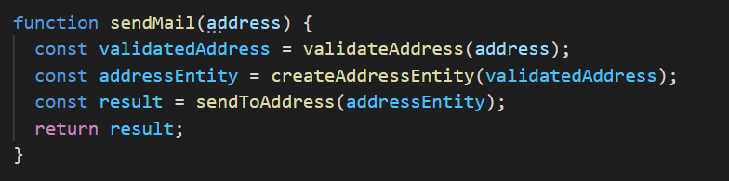
We can change it to something like this

Slide 8



Compose

Slide 9
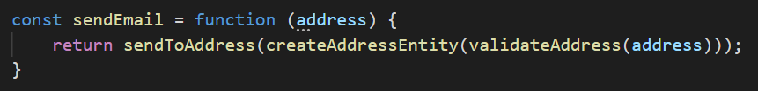
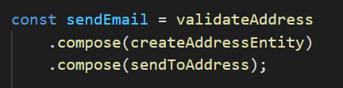
Compose

Slide 10
Compose
?

Slide 11

Adapt to Another Type
?
?
?

Slide 12
What is a Monad
Effect
Bind
Unit

Slide 13
3 Monad Laws
Left Identity
Right Identity
Associativity

Slide 14
Effect
Option<T>
Try<T>
Writer<T>

Slide 15
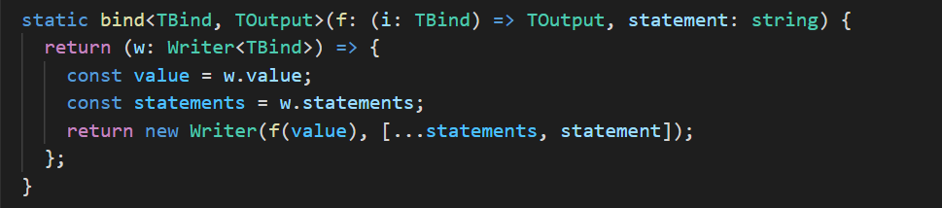
Bind
Function -> (Effect -> Function -> Effect)

Slide 16

Unit
Type -> Effect<Type>

