Slide 1

MoNads
and you

Slide 2
Why care about Monads
Abstraction
Code Reuse

Slide 3
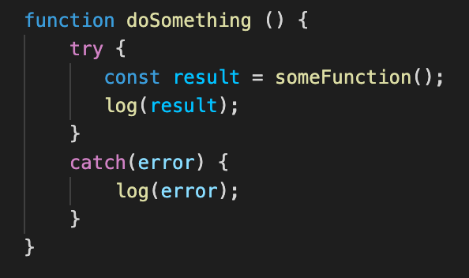
How many times do we Write this?

Slide 4
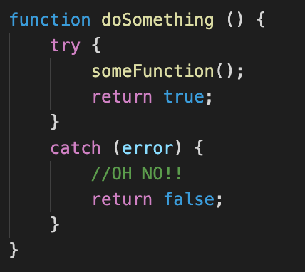
How many times do we Write this?

Slide 5
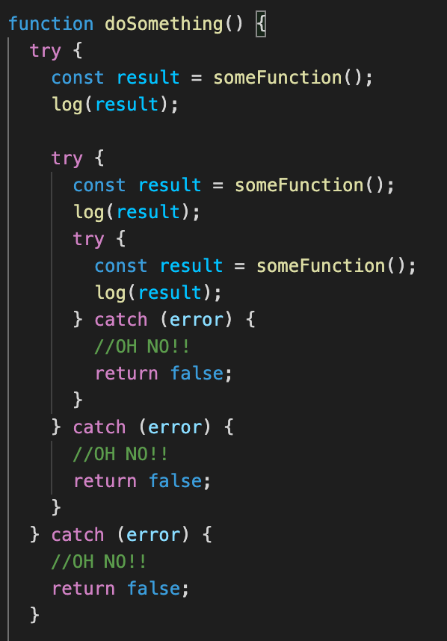
We end up with something like this

Slide 6
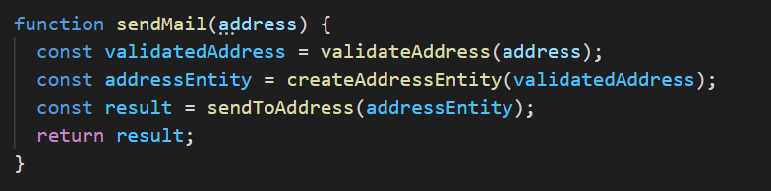
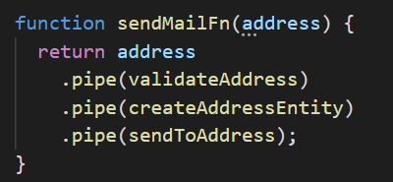
We can change it to something like this

Slide 7
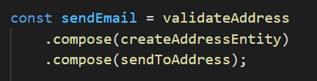
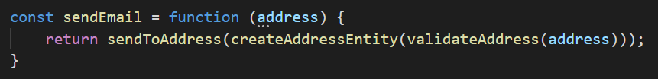
Or in a more reusable fashion

Slide 8
What is a Monad
Effect
Bind
Unit

Slide 9
Effect
Generic

