Slide 1
Sistemes Intel·ligents Distribuïts
Aplicacions de la Intel.ligència Artificial
SID
AIA
Ontologies
2013

Slide 2
JENA: Introduction I
Framework to build semantic web applications
  Set of libraries to support dealing with data in RDF (and OWL) format
  Provides a SPARQL engine
Developed by HP labs (Bristol) in 2000
Adopted by the Apache Software Foundation as open source project in 2010
Transforms RDF triples in graphs
  Nodes: Subject and object
  Arch: Predicate
Supports adding, removing, updating and saving information on the graphs
{ia, igomez, jvazquez}@lsi.upc.edu
02-03/05/13

Slide 3
JENA: Introduction II
Transforms RDF triples in graphs
  Nodes: Subject and object
  Arch: Predicate
Supports adding, removing, updating and saving information on the graphs
Main elements:
  Resource: Subject, object or predicate
  Literal: Value (String, integer…)
    In Owl, associated to a…
  Statement: RDF triplet
  Model: Whole graph
{ia, igomez, jvazquez}@lsi.upc.edu
02-03/05/13

Slide 4
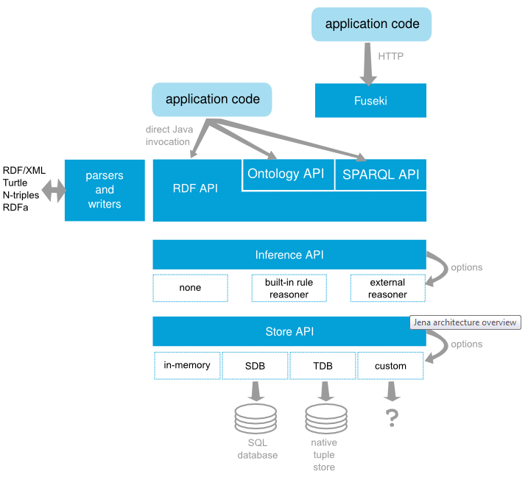
JENA: Architecture
{ia, igomez, jvazquez}@lsi.upc.edu
02-03/05/13

Slide 5
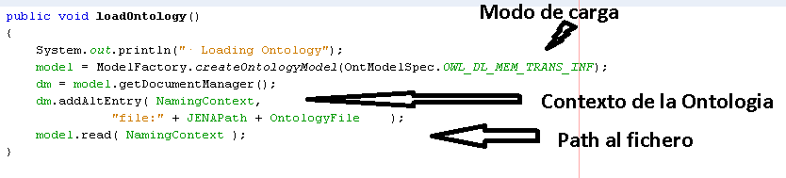
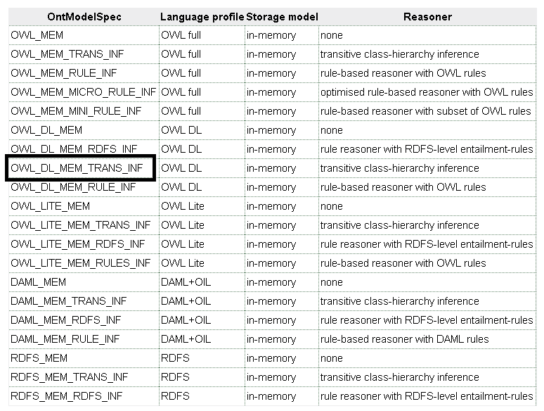
JENA: Loading a model
{ia, igomez, jvazquez}@lsi.upc.edu
02-03/05/13

Slide 6
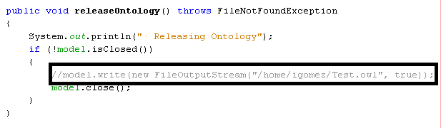
JENA: Releasing a model
{ia, igomez, jvazquez}@lsi.upc.edu
02-03/05/13

Slide 7
JENA: RDF Graph navigation
Operations on a model:
  listAllOntProperties
  listAnnotationProperties
  listClasses
  listComplementClasses
  listDataRanges
  listDatatypeProperties
  listEnueratedClasses
  listFunctionalProperties
  listHierarchyRootClasses
  listImportedOntologyURIs
  listIndividuals
  listIntersectionClasses
  listInverseFunctionalProperties
  listNamedClasses
  listObjectProperties
  listOntologies
  listOntProperties
  listRestrictions
  listSymmetricProperties
  listTransitiveProperties
  listUnionClasses
{ia, igomez, jvazquez}@lsi.upc.edu
02-03/05/13

Slide 8
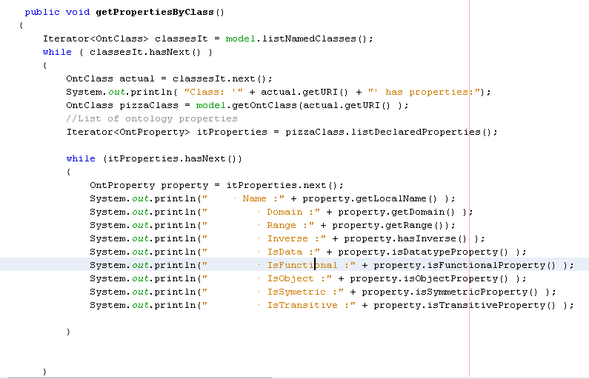
JENA: Query classes and their properties
{ia, igomez, jvazquez}@lsi.upc.edu
02-03/05/13

Slide 9
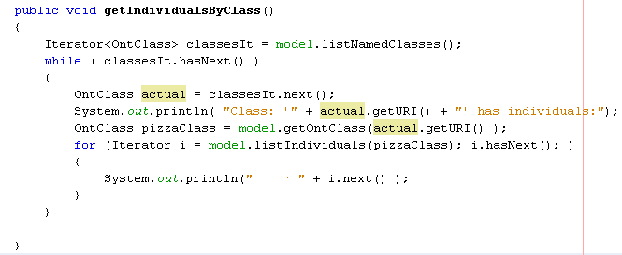
JENA: Query individuals
{ia, igomez, jvazquez}@lsi.upc.edu
02-03/05/13

Slide 10
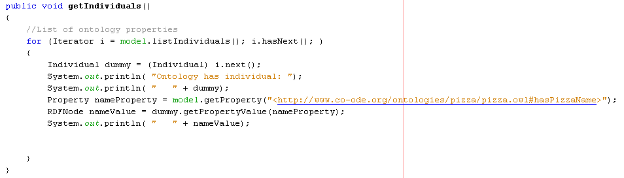
JENA: Query individuals
{ia, igomez, jvazquez}@lsi.upc.edu
02-03/05/13

Slide 11
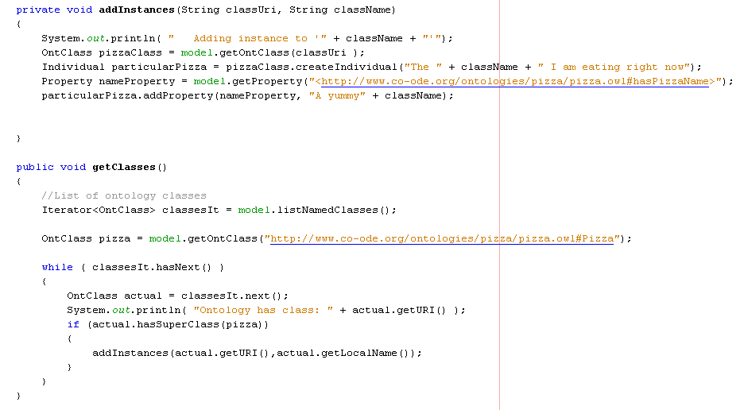
JENA: Adding instances
{ia, igomez, jvazquez}@lsi.upc.edu
02-03/05/13

Slide 12
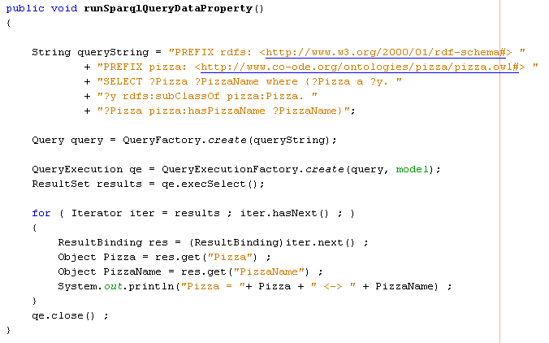
JENA: SPARQL Engine I
{ia, igomez, jvazquez}@lsi.upc.edu
02-03/05/13

Slide 13
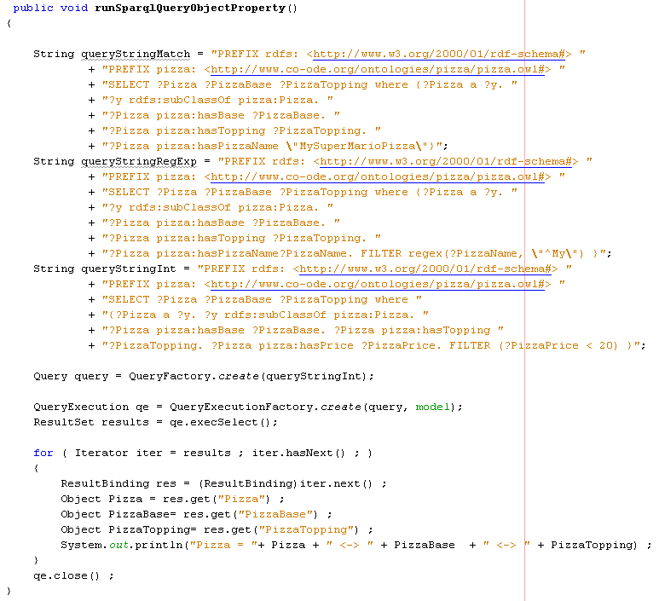
JENA: SPARQL Engine II
{ia, igomez, jvazquez}@lsi.upc.edu
02-03/05/13

Slide 14
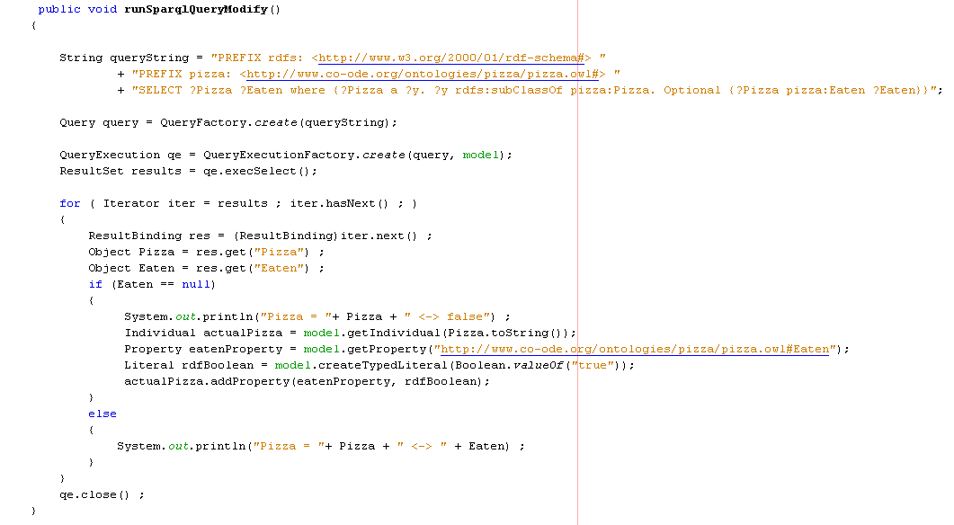
JENA: SPARQL Engine III
{ia, igomez, jvazquez}@lsi.upc.edu
02-03/05/13

