Slide 1
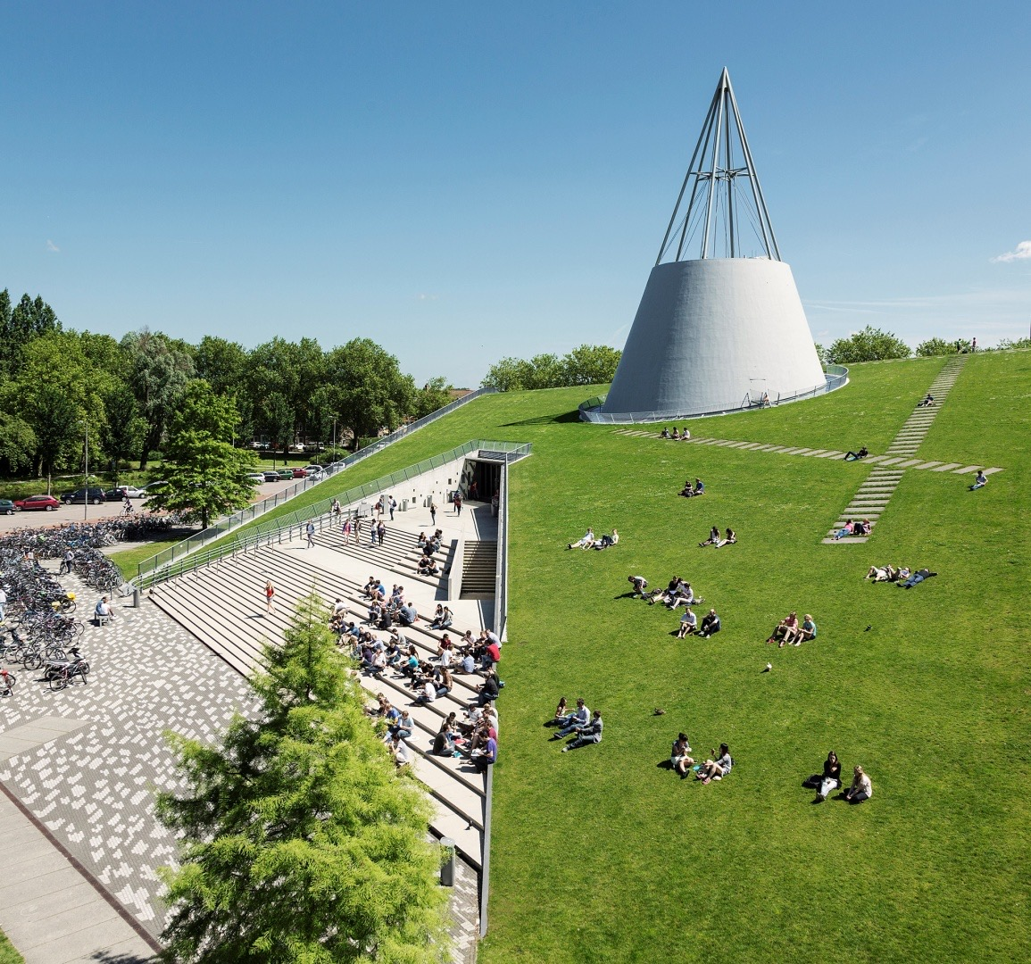
Indoor Localization with Multi-Rate Extended Kalman Filtering
Based on Elisa-3
Yiting LI 5281873
January 13 2023
Notes:
Hi everyone, my name is Yiting LI, this is my midterm presentation about my thesis, Indoor Localization with Multi-Rate Extended Kalman Filter.

Slide 2
Outlines
Research questions
System Description
Sensor Data Fusion
Simulations & Next Tasks
Notes:
Im gonna divide the presentation into 4 parts

Slide 3
1. Research Questions

Slide 4
1. Localization
Robot’s state estimation
Multiple sensors are available, but information is not always trustful
Data fusion methods were widely applied for state estimations
Based on data fusion method to construct an indoor localization architecture with specific sensors coming in different sampling rate and missing or biased measurement
Notes:
The main idea of the topic is how can we make the robot localizes itself better inside the room with certain sensors. If we set the coordination and heading angle as the state vector, the problem becomes a state estimation problem.
Meanwhile, lots of sensors are available for the state estimation task, but information is not always trustful, those measurement sometimes is absent, or with drift or wrong reading, moreover they are coming in different rate. How can we make full use of them?
Data fusion methods such as Kalman filter have been widely applied for state estimations, Integrated information from various sources often reduces the effect of biased measurement, therefore, often enhances the estimation accuracy.
So the main task is to based on data fusion method to construct an indoor localization architecture with multi-rate sensors and missing or biased measurement

Slide 5
2. System Description
Notes:
The next part, I will give the system model

Slide 6
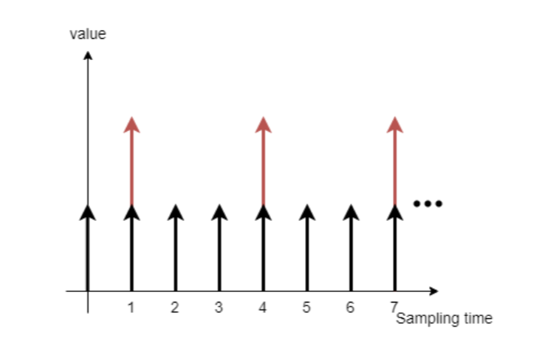
1. Multi-sensor
Notes:
First is the multi-sensor diagram
Robots have multiple sensors, odometry, laser scanner, or camera, GNSS. In this task, we have odometry and camera.
Those sensor won’t have the same sampling rate, this picture illustrate a possible case on the robots, the black arrow can be an odometry its period is 1, and the red arrow is the camera, due to the communication limiation, we might make it slower than odometry, the period is set as 3.
// Even more, sensor’s reading might got lost, this behaviour will be modelled later.

Slide 7
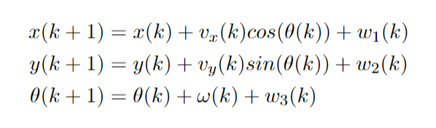
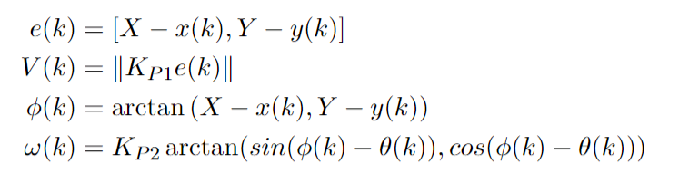
2. System Dynamic Model
Unicycle-type Robot’s Kinematic Model
Go-to-goal P controller
Notes:
Next is the system dynamic model. Here is the equation of the unicycle-type robot’s kinematic model
With this model, we can use current location x y theta and given velocity u and turning angle omega to determine the coordination and heading angle on the next time step.
The w stands for the noise in state transition, which is assumed as a zero-mean white noise, and unrelated with each other.
This kinematic model will be used as the system estimation.
The control input u(k), velocity and turning angle, are decided by a go-to-goal controller, the u(k) basically equals to the error between current location and desired location times a factor K_p

Slide 8
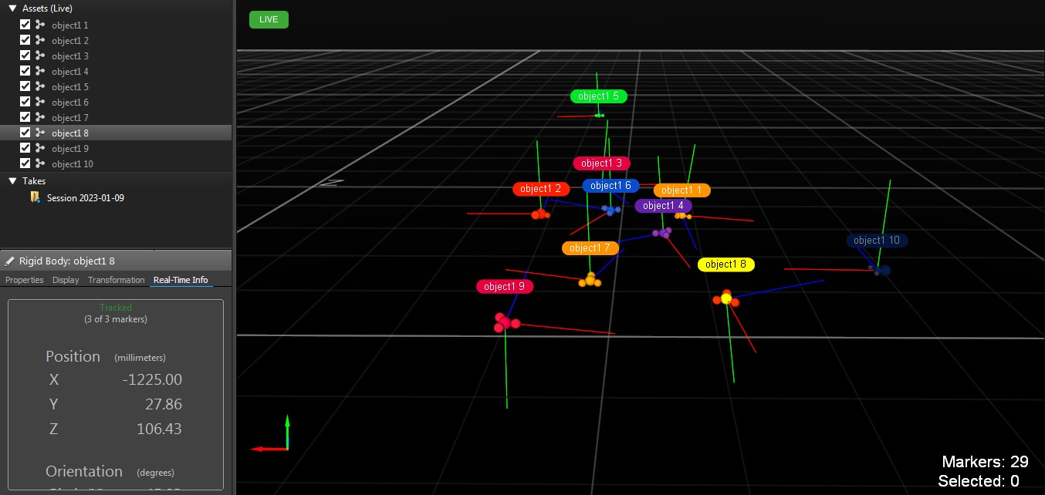
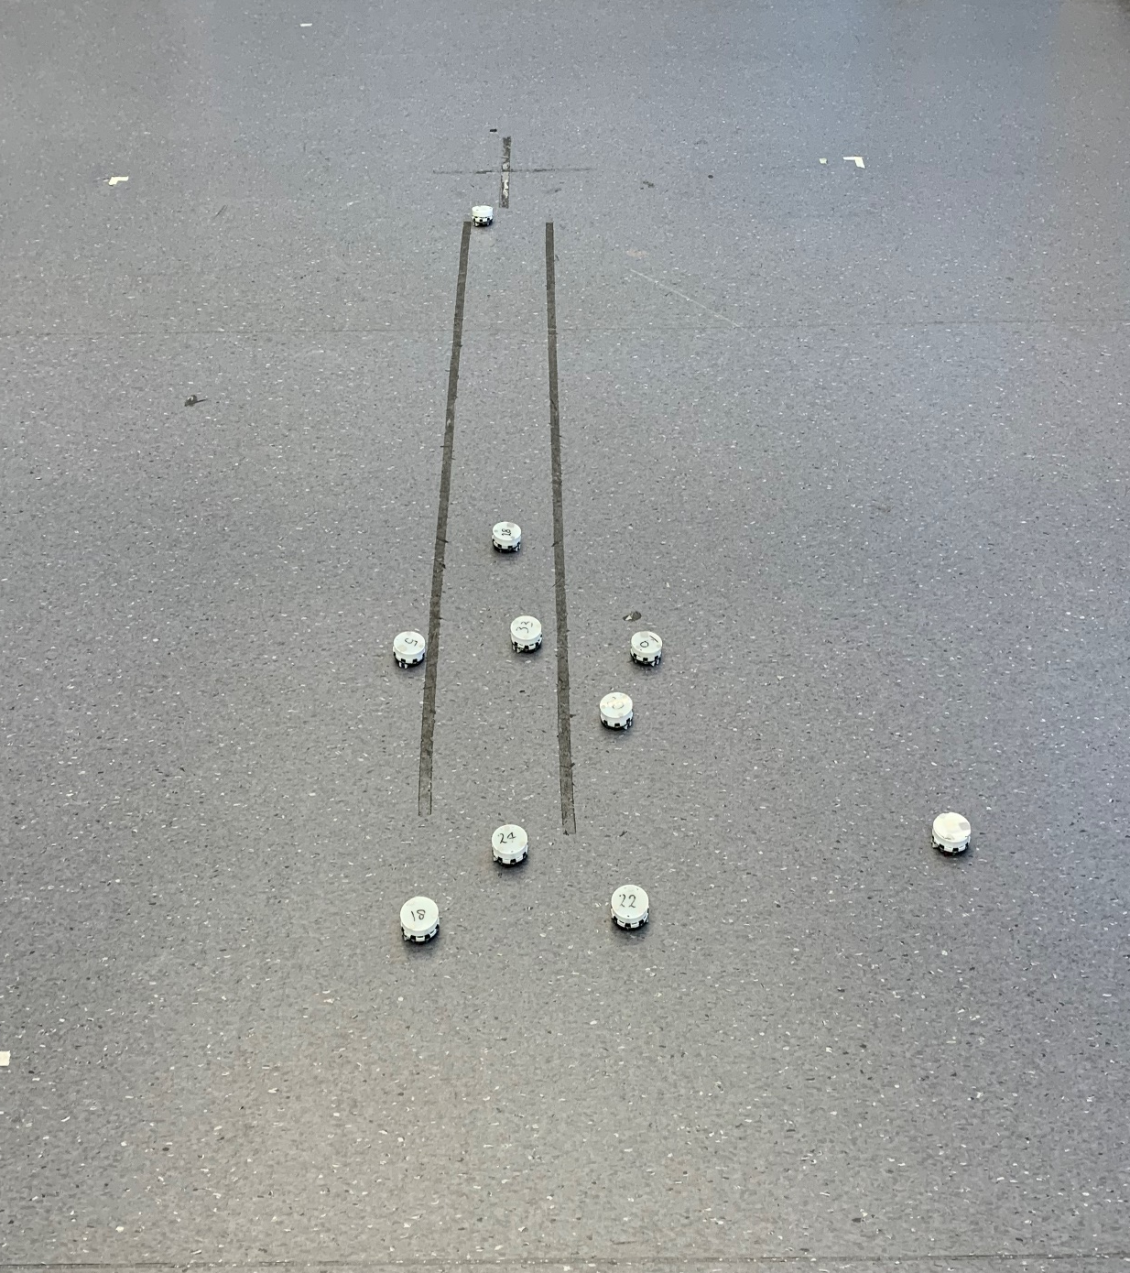
3. Optitrack System
Overview
Notes:
The camera system in the Lab is Optitrack system, utilize the refraction to track the object
When placing 10 robots, the tracking overview is shown in the right side

Slide 9
3. Optitrack System
Overview
Notes:
All the robot are tracked successful by the camera.

Slide 10
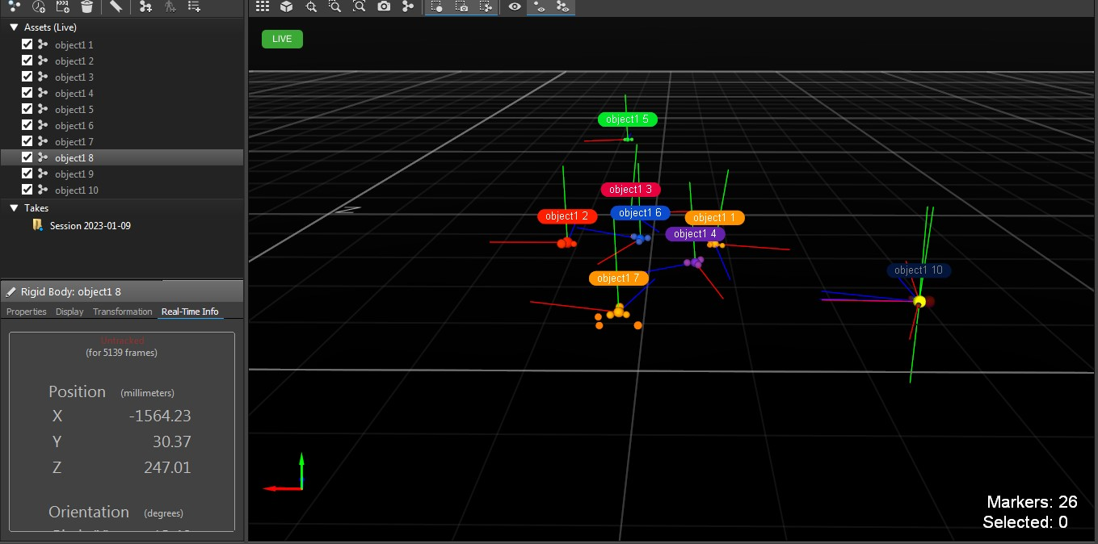
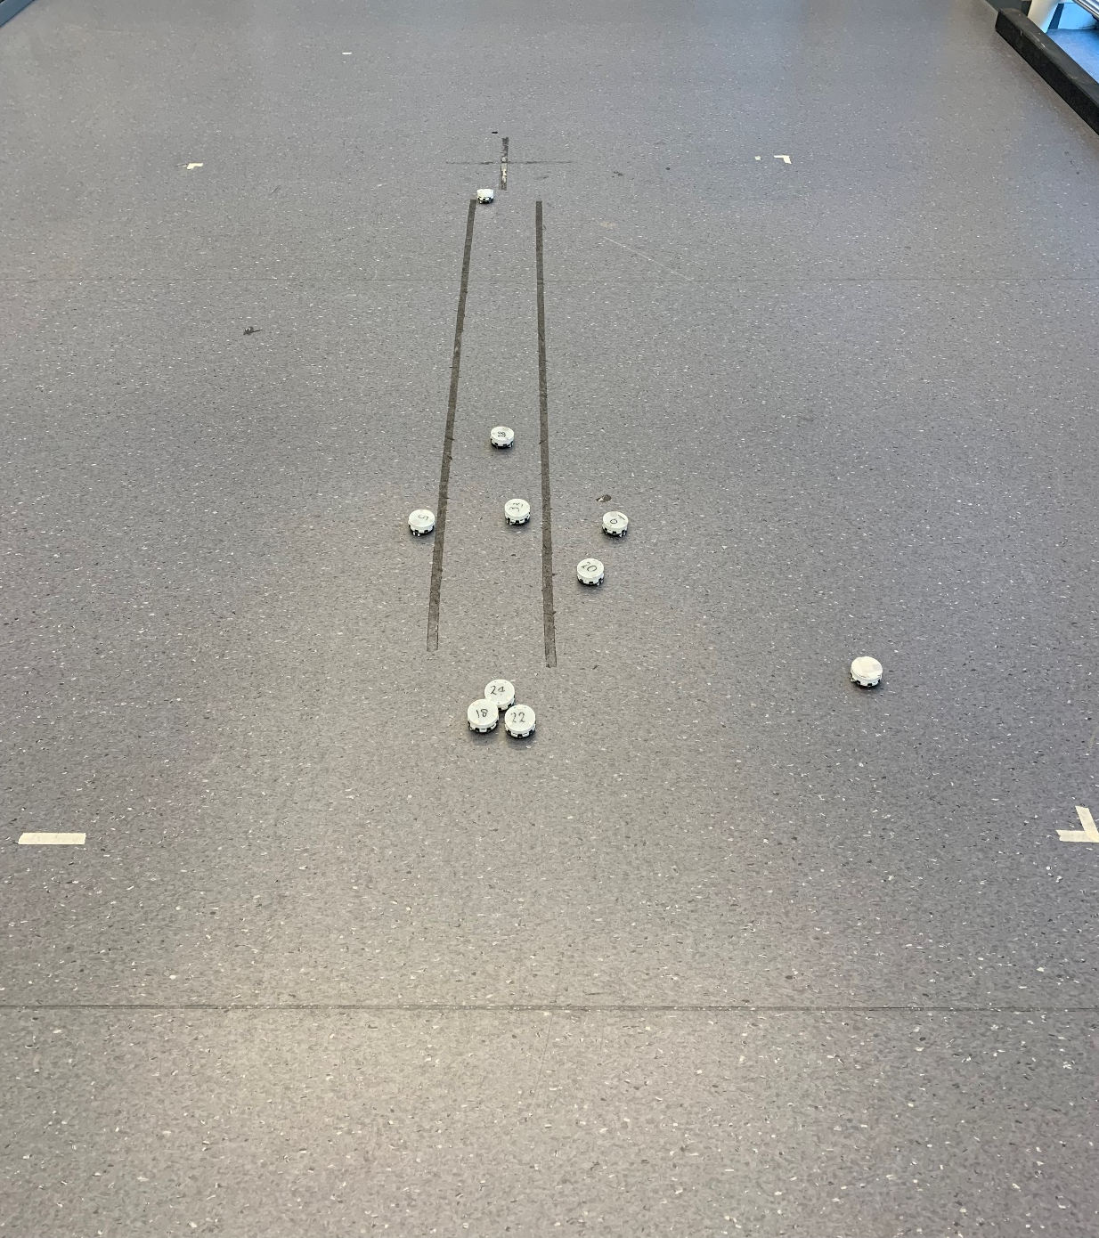
3. Optitrack System
Merging
Notes:
However, those cameras are not 100% reliable.
when objects are too close to each other, the camera can’t identify them, they are merged into one single object, causing some robot being untracked.

Slide 11
3. Optitrack System
Merging
Notes:
Moreover, data missing sometime happen due to the environment light.

Slide 12
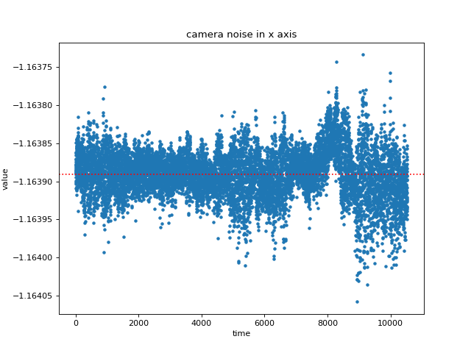
3. Optitrack System
Noise
Notes:
The camera noise is relatively small, so the main bias from the camera side is the merging situation.

Slide 13
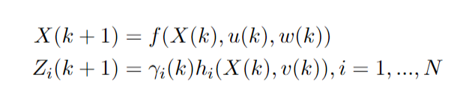
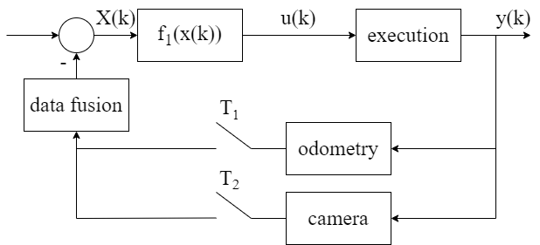
4. State-space model & System Block Diagram
State-space model
System Block Diagram
Notes:
Based on above description, we can give the state-space model of the robot, and localization system block diagram.
The first line is the state transition function. The second line is the observation function, since we have multiple sensors, the i stands for the sensor index.
The gamme i of k here is stochastic process, it models the sensor data drop, this factor could be 1 or 0, showing whether the measurement is missing.
With this state-space model, we can give the system block diagram, for a given termination, robot will generate control input u(k) through f_1
after the execution, the system output, location can be sensed by both odometry and camera. By applying a data fusion technique, we can generate a relatively accurate estimation to create the new control input u(k+1).

Slide 14
3. Sensor Data Fusion
Notes:
The third part discuss the fusion method

Slide 15
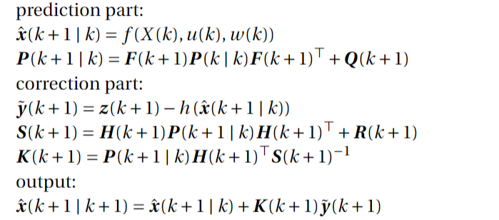
1. Single-rate Extended Kalman Filter
Notes:
The single rate Extended Kalman filter is widely used in many cases.
Why extended Kalman filter not the normal, because the system model is nonlinear, the normal one won’t work here.
The basic idea of the EKF is first predict the next state vector and covariance based on system model.
Then using the error between actual measurement z and system model h to correct the prediction.
With the corrected estimation x hat, we can use it to generate the control input.

Slide 16
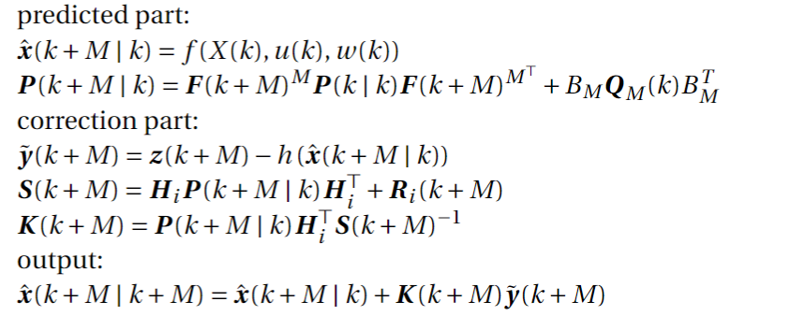
2. Multi-rate Extended Kalman Filter
Notes:
There are many sensor giving measurement in different rate
Multi-rate EKF shares the same idea with the single rate EKF, the main different is in the prediction part.
For a lower rate sensor, the state space model is slightly different

Slide 17
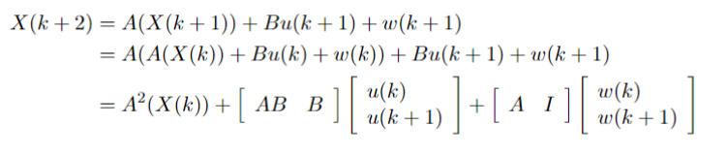

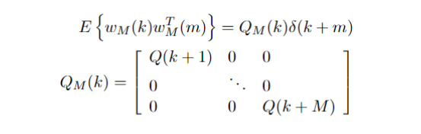
2. Multi-rate Extended Kalman Filter
Extend the state space model
The covariance matrix of the block noise
Notes:
For one sensor, we can extend the state-space model in this iterative way
And we can write it in a compact form, the M here is the delay compared to fastest sensor, e.g. odometry has period of 1, and camera is 5, then the M is 5 for the camera
The noise w(k) in the transition function is assumed to be a zero-mean white noise, we can drive the covariance matrix Q(k) of the block noise
Then we can substitute the AM and QM to the algorithm

Slide 18

2. Multi-rate Extended Kalman Filter
Dealing with missing data
Notes:
As mentioned before, the sensor has a dropping rate, for example, the camera will loss track of some robots.
When facing the missing data situation, the only source is the estimation from system dynamic model, so we skip the correction part in the mr-EKF.

Slide 19
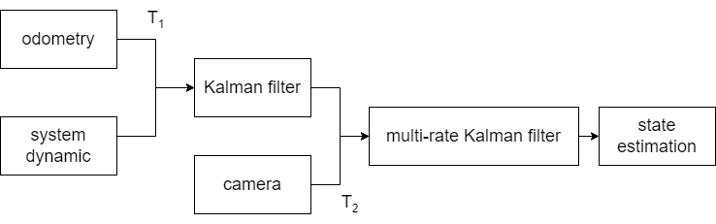
3. State Estimation Architecture: mr-EKF
Cascade style
Notes:
Since we have two sources of information, we have different way to construct the estimation architecture.
First one is the cascade style, the odometry has the same speed as the system dynamic, so it can generate an estimation at rate T1.
If the camera measurement is present, then either single rate EKF or multi rate EFK can be applied
the final estimation is made by combining camera information and previous filter output.

Slide 20
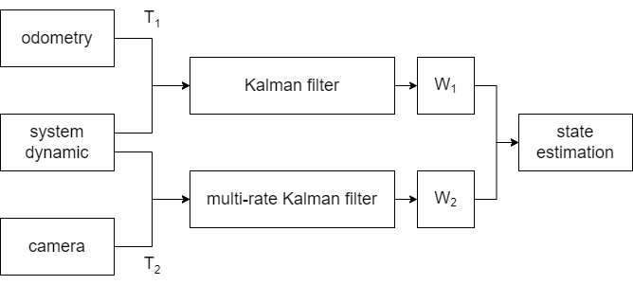
3. State Estimation Architecture: mr-EKF
OWA style
Notes:
The alternative is using a Ordered Weighted Averaging operator to combine two estimation
The OWA operator will work when both measurement are available.

Slide 21
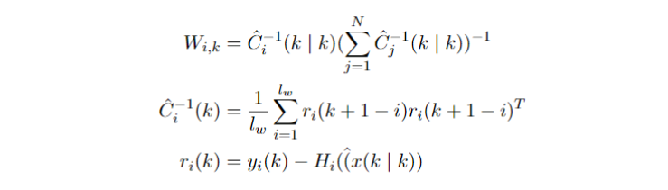
3. State Estimation Architecture: mr-EKF
OWA style, weight determination
Notes:
The weight of each branch can be determined using the following way.
The main idea of this is if one sensor has larger accumulated error, the weight will decrease.
With the OWA style, the estimation may outperform than the estimation made by cascade style, because the error from odometry will grow larger while the camera are more accurate than the odometry. So the adaptive OWA operator might behave better than cascade style.

Slide 22
4. Simulation
Notes:
Based on previous discussion, several experiments were conducted

Slide 23
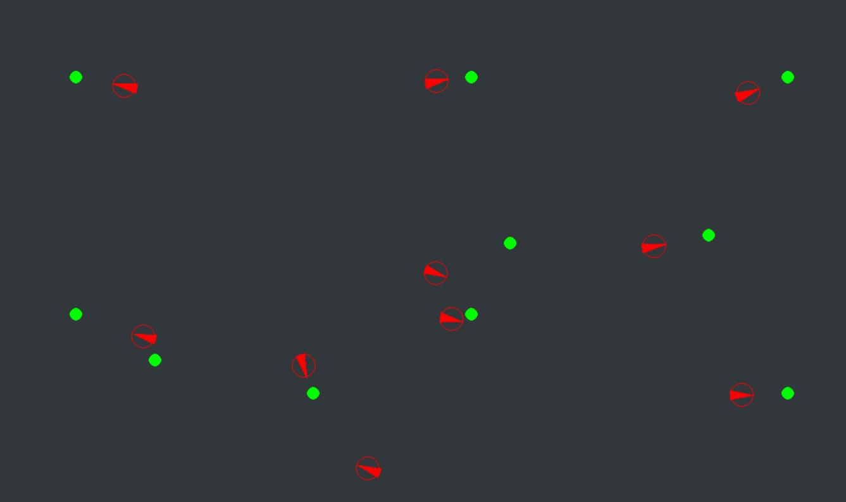
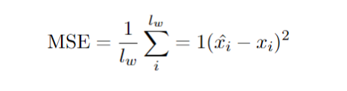
1. Simulation Setup
pygame
1080x640 ground size, 10 robots, init positions are known, randomly move
10 rounds
Metrics: mean square error (MSE)
Notes:
The simulation is based on pygame and 10 robots were released, they are far from each other at the beginning, we are assuming they know their initial state, then they moving randomly, and no obstacles avoiding method is applied.
The simulation are performed in Monte Carlo style, but due to limitation only 10 rounds are performed here.
To compare the localization accuracy improvement, we compare the mean square error between estimation and true position of each robot.

Slide 24
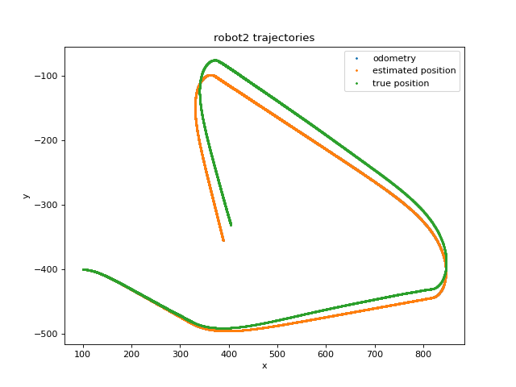
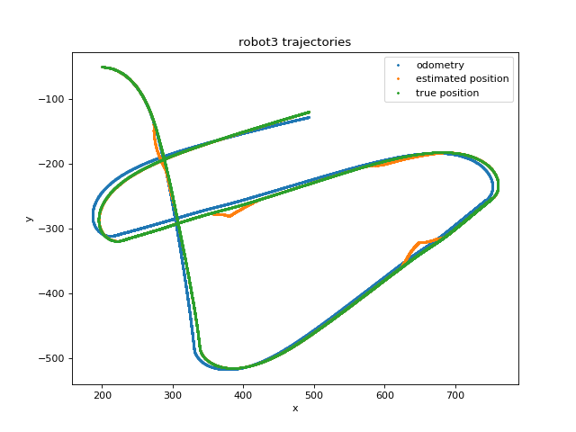
2. Result
Trajectory
Odometry only
OWA mr-EKF
Notes:
We first check the trajectory,
The left side shows the odometry has large drift, without other information, the estimation will have large bias.
The right-side shows that applying OWA style multi-rate EKF, the estimation is basically follows the true trajectory.
The orange raising indicates at that time, the merging situation happened, with the OWA multi-rate EKF, the localization system can overcome this disturbance.

Slide 25
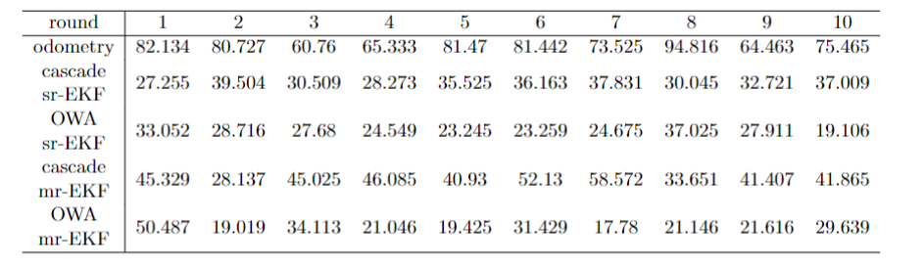
2. Result
Metrics: mean square error (MSE) comparison
Average MSE comparison(including outliers)
Notes:
Then we compare the MSE under different localization method.
Each block of data in the upper table, stands for the average MSE of 10 robots in one round under one method.
In each row, data are relatively close to each other, but some biased data also exist, for example, in the last row, with the OWA multi-rate EKF, in the first round, the MSE is larger than other. This is because the random processing noise and random moving, when lots of robots are gathering, the only reliable source is odometry, and the odometry is drifted, in that case, outliers might show up.
Then we take the average MSE among all rounds, we can get the table below.
These results show that by applying data fusion method, the estimation accuracy is improved.
The multi-rate EKF doesn’t outperform the single-rate EKF, but the way we combining different Kalman filter do make a difference.
The OWA adaptive style is better than the cascade style, and performance gap might be enlarged in long term application, because the drift will be become larger as time goes by.

Slide 26
3. Next Tasks
Implementation on Elisa-3 robots
More things
Notes:
With above result, we can say that the above architectures raise the estimation accuracy, the tasks on the coming months would be first implement the localization into real robot, and conduct experiment on real object.

Slide 27
Thank you for your attention
Notes:
Thanks for your attention

Slide 28
Q & A

