Slide 1
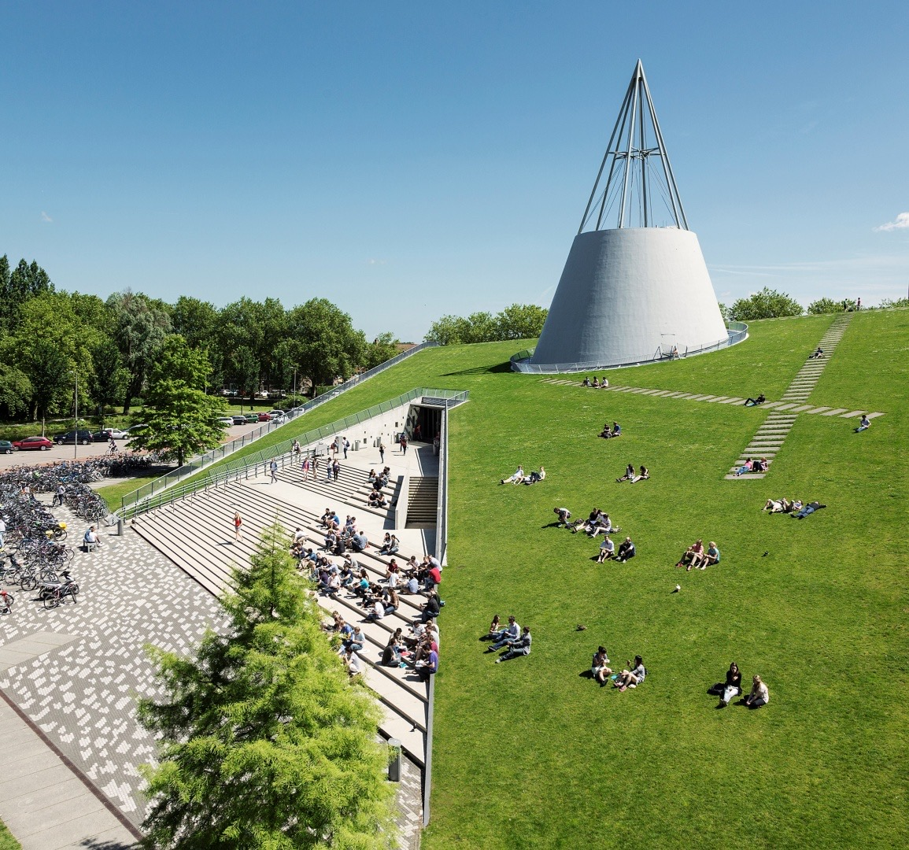
Indoor Localization with Multi-Rate Extended Kalman Filtering
Yiting LI 5281873
January 13 2023
Notes:
Hi everyone, my name is Yiting LI, this is my midterm presentation about my thesis, the indoor localization with multi-rate kalman filter

Slide 2
Outlines
Research questions
System Description
Sensor Data Fusion
Simulations & Next Tasks
Notes:
The presentation will be given in 4 parts:

Slide 3
1. Research Questions

Slide 4
1. Localization
How
Integrated information from various sources often enhances the estimation accuracy and consequently strengthens the robustness of observations
Notes:
Definitions are important. The entry point for the question is the morphology, thus the shapes of ideal hierarchy networks

Slide 5
2. System Description

Slide 6
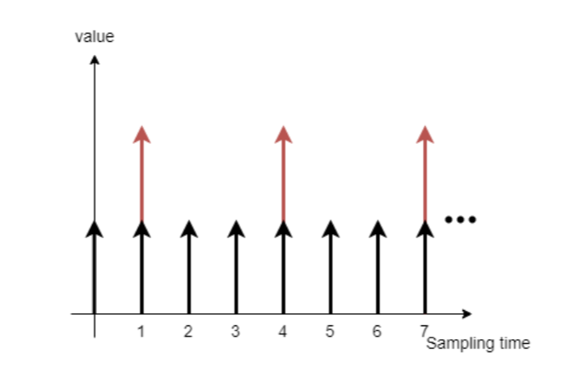
1. Multi-sensor
Notes:
Robots have multiple sensors, some are set on the robot such as odometry, laser scanner, other are global sensors, like GNSS, camera.
Those sensor won’t have the same sampling rate, this picture illustrate a possible case on the robots, the black arrow can be an odometry its period is 1, and the period of red arrow is the camera, due to the communication, we might make it slower than odometry, the period is set as 3.
Even more, sensor’s reading might got lost, this behaviour will be modelled later.

Slide 7
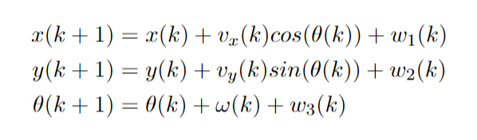
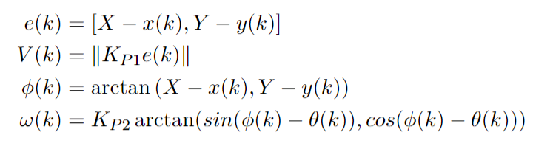
2. System Model
Unicycle-type Robot’s Kinematic Model
Go-to-goal P controller
Notes:
Here is the equation of the unicycle-type robot’s kinematic model
With this model, we can use current location x y theta and given velocity u and turning angle omega to determine the coordination and heading angle on the next time step.
The w stands for the noise in state transition, which is assumed as a zero-mean white noise, and unrelated with each other. Their covariance can be measurement through multiple experiments.
This kinematic model will be used as the system estimation.
The velocity and turning angle which is the control input u(k), is decided by a go-to-goal controller, the u(k) basically equals to the error between current location and desired location times a factor K_p

Slide 8
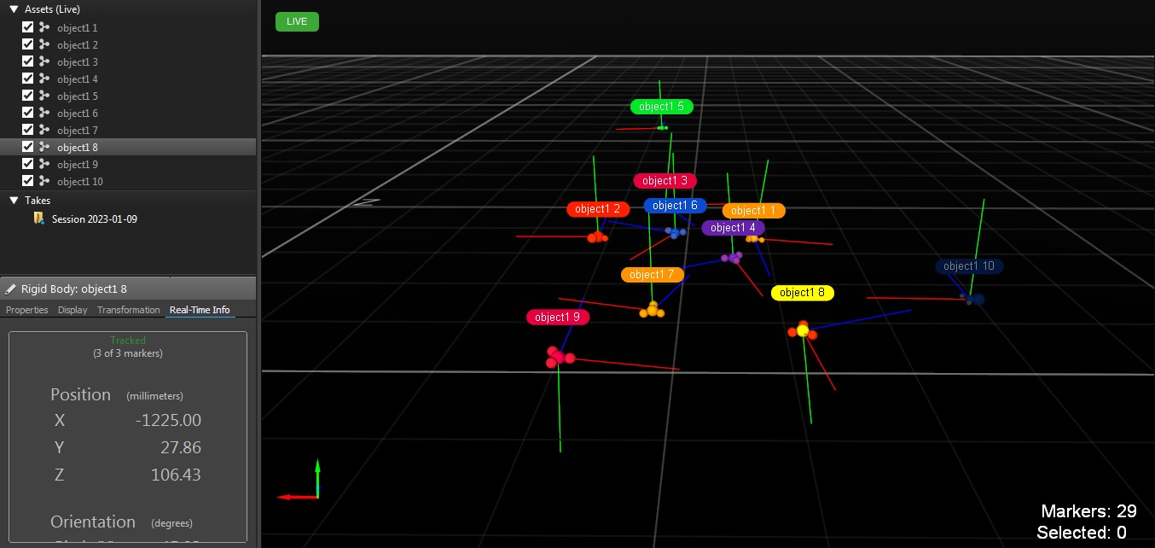
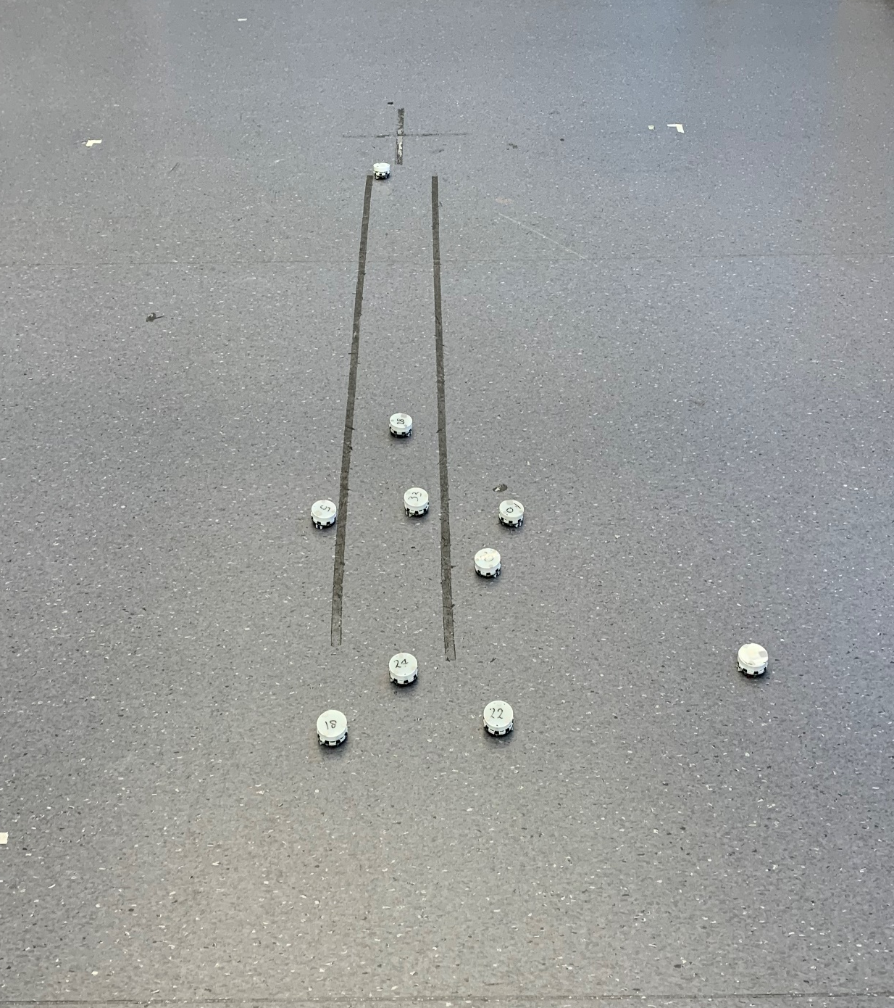
3. Optitrack System
Overview
Notes:
The camera system in the Lab is Optitrack system, utilize the refraction to track the object
When placing 10 robots, the tracking overview is shown in the right side

Slide 9
3. Optitrack System
Overview
Notes:
The real-time measurement can be checked in the software.

Slide 10
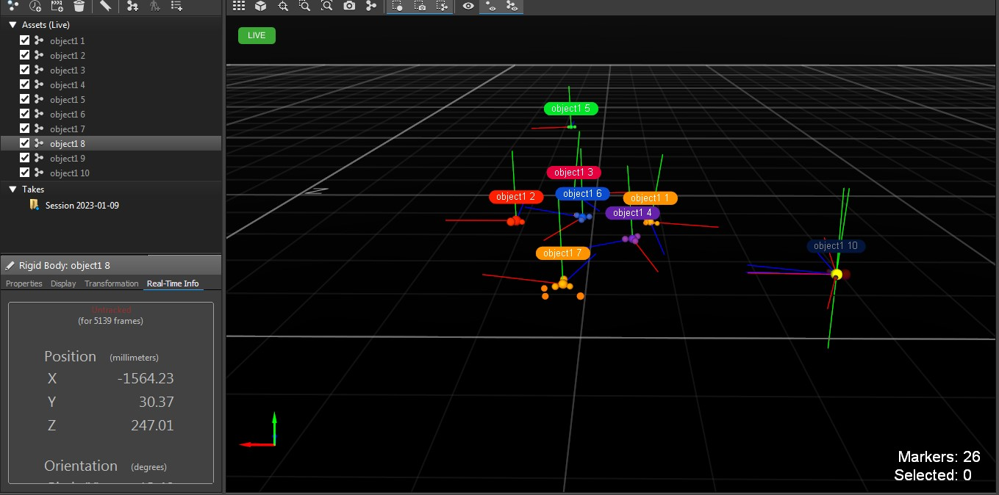
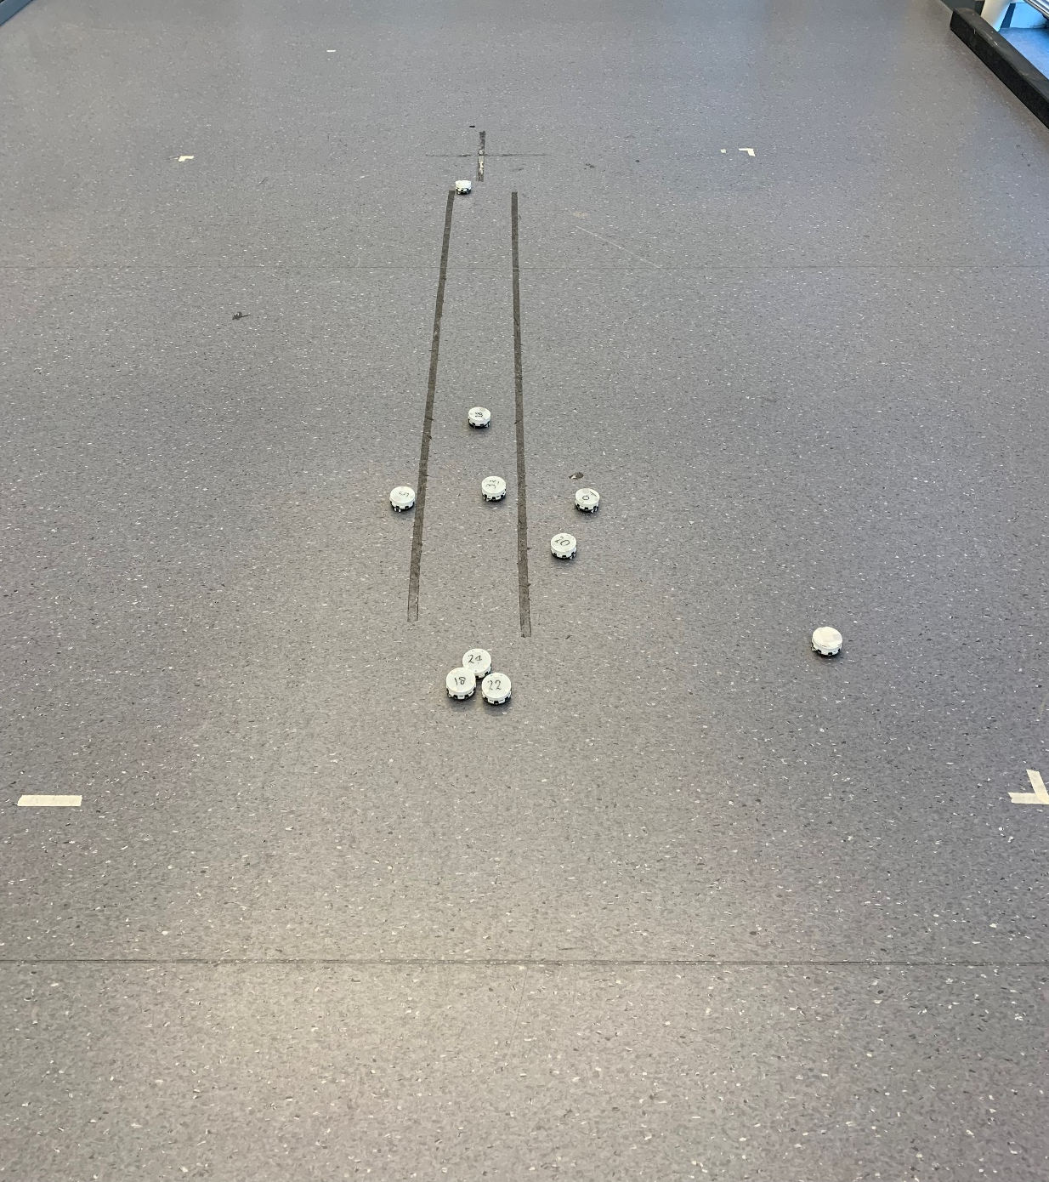
3. Optitrack System
Merging
Notes:
However, those cameras are not 100% reliable.
when objects are too close to each other, the camera can’t identify them, they are merged into one single object, causing some robot being untracked.
Moreover, data missing sometime happen due to the environment light. And noise is also exists.

Slide 11
3. Optitrack System
Merging
Notes:
The real-time information become untracked if objects are too close

Slide 12
3. Optitrack System
Noise
Notes:
The camera noise is relatively small, so the main bias from the camera side is the merging situation.

Slide 13
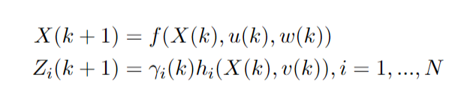
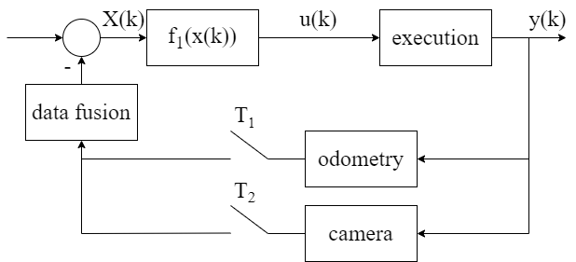
4. State-space model & System Block Diagram
State-space model
System Block Diagram
Notes:
Based on above description, we can give the state-space model of the robot, and localization system block diagram.
The first line is the state transition function. The second line is the observation function, since we have multiple sensors, the i stands for the sensor index.
The gamme i of k here is stochastic process, it models the sensor data drop, this factor could be 1 or 0, showing whether the measurement is missing.
With this state-space model, we can give the system block diagram, for a given termination, robot will generate control input u(k) through f_1
after the execution, the system output, location can be sensed by both odometry and camera. By applying a data fusion technique, we can generate a relatively accurate estimation to create the new control input u(k+1).

Slide 14
3. Sensor Data Fusion
Notes:
The third part discuss the fusion method

Slide 15
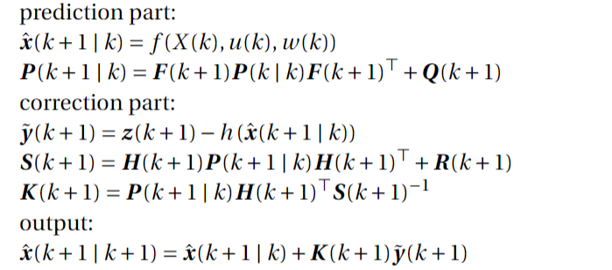
1. Single-rate Extended Kalman Filter
Notes:
The single rate Extended Kalman filter is widely used in many cases.
The basic idea of the EKF is first predict the next state vector and covariance based on system model.
Then using the measurement to correct the prediction.
With the corrected estimation we can use it to generate the control input.

Slide 16
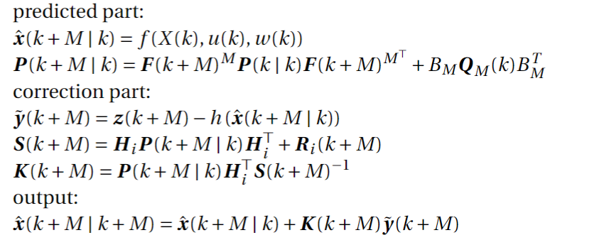
2. Multi-rate Extended Kalman Filter
Notes:
There are many sensor giving measurement in different rate
Multi-rate EKF shares the same idea with the single rate EKF, the main different is in the prediction part.
For a lower rate sensor, the state space model is slightly different

Slide 17
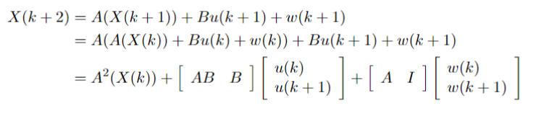

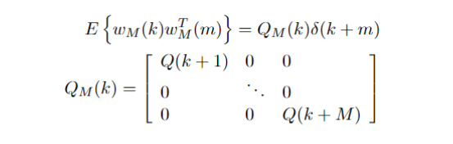
2. Multi-rate Extended Kalman Filter
Extend the state space model
The covariance matrix of the block noise
Notes:
For one sensor, we can extend the state-space model in this iterative way
And we can write it in a compact form, the M here is the delay compared to fastest sensor, e.g. odometry has period of 1, and camera is 5, then the M is 5 for the camera
The noise w(k) in the transition function is assumed to be a zero-mean white noise, we can drive the covariance matrix of the block noise

Slide 18

2. Multi-rate Extended Kalman Filter
Dealing with missing data
Notes:
As mentioned before, the sensor has a dropping rate, for example, the camera will loss track of some robots.
When facing the missing data situation, the only source is the estimation from system dynamic model, so we skip the correction part in the mr-EKF.

Slide 19
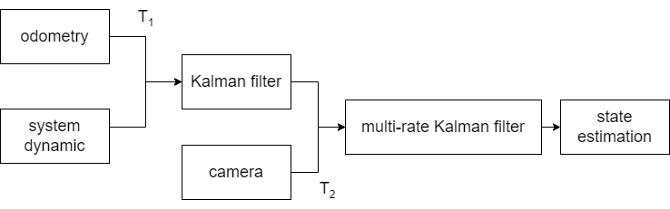
3. State Estimation Architecture: mr-EKF
Cascade style
Notes:
Since we have two sources of information, we have different way to construct the estimation architecture.
First one is the cascade style, the odometry has the same speed as the system dynamic, so it can generate an estimation at rate T1.
If the camera measurement is present, then either single rate EKF or multi rate EFK can be applied to make the final estimation.

Slide 20
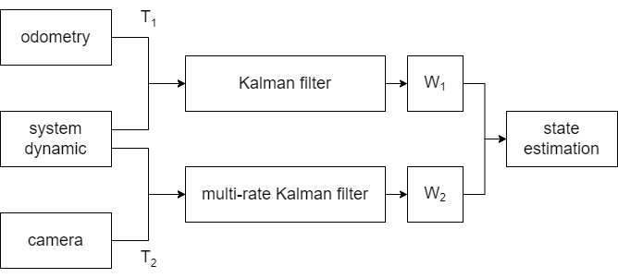
3. State Estimation Architecture: mr-EKF
OWA style
Notes:
The alternative is using a Ordered Weighted Averaging operator to combine two estimation
The OWA operator will work when both measurement are available.

Slide 21
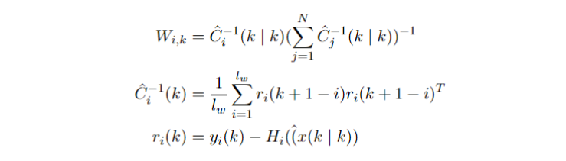
3. State Estimation Architecture: mr-EKF
OWA style, weight determination
Notes:
The weight of each branch can be determined using the following way.
The main idea of this is if one sensor has larger accumulated error, the weight will decrease.
With the OWA style, the estimation may outperform than the estimation made by cascade style, because the error from odometry will grow larger while the camera are more accurate than the odometry.

Slide 22
4. Simulation
Notes:
Based on previous discussion, several experiments were conducted

Slide 23
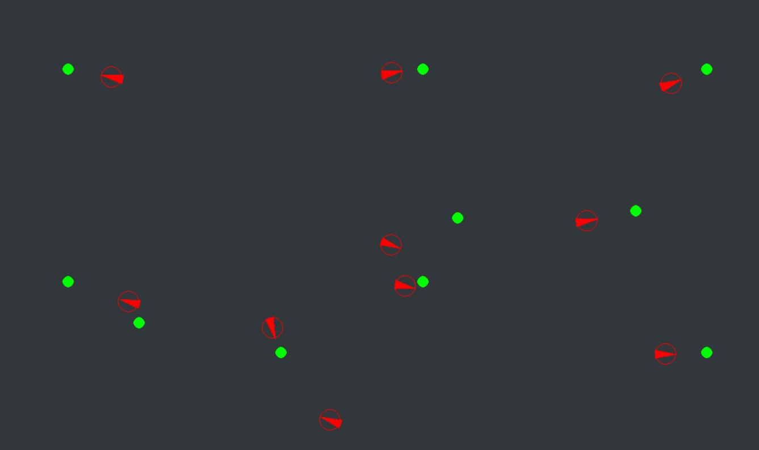
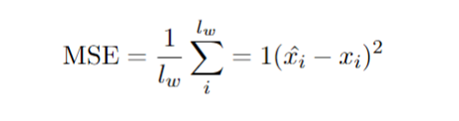
1. Simulation Setup
pygame
1080x640 ground size, 10 robots, init positions are known
10 rounds
Metrics: mean square error (MSE)
Notes:
The simulation is based on pygame and 10 robots were released, they are far from each other at the beginning, then 10 sequances of random termination were assigned to each robots.
The simulation are performed in 10 rounds.
To compare the localization accuracy improvement, we compare the mean square error between estimation and true position of each robot.

Slide 24
2. Result
Metrics: mean square error (MSE)

Slide 25
3. Next Tasks
Implementation on Elisa-3 robots
More things
Notes:
With above work, the tasks on the coming months would be first implement the localization into real robot

Slide 26
Thank you for your attention
Notes:
Thanks for your attention

