Slide 1
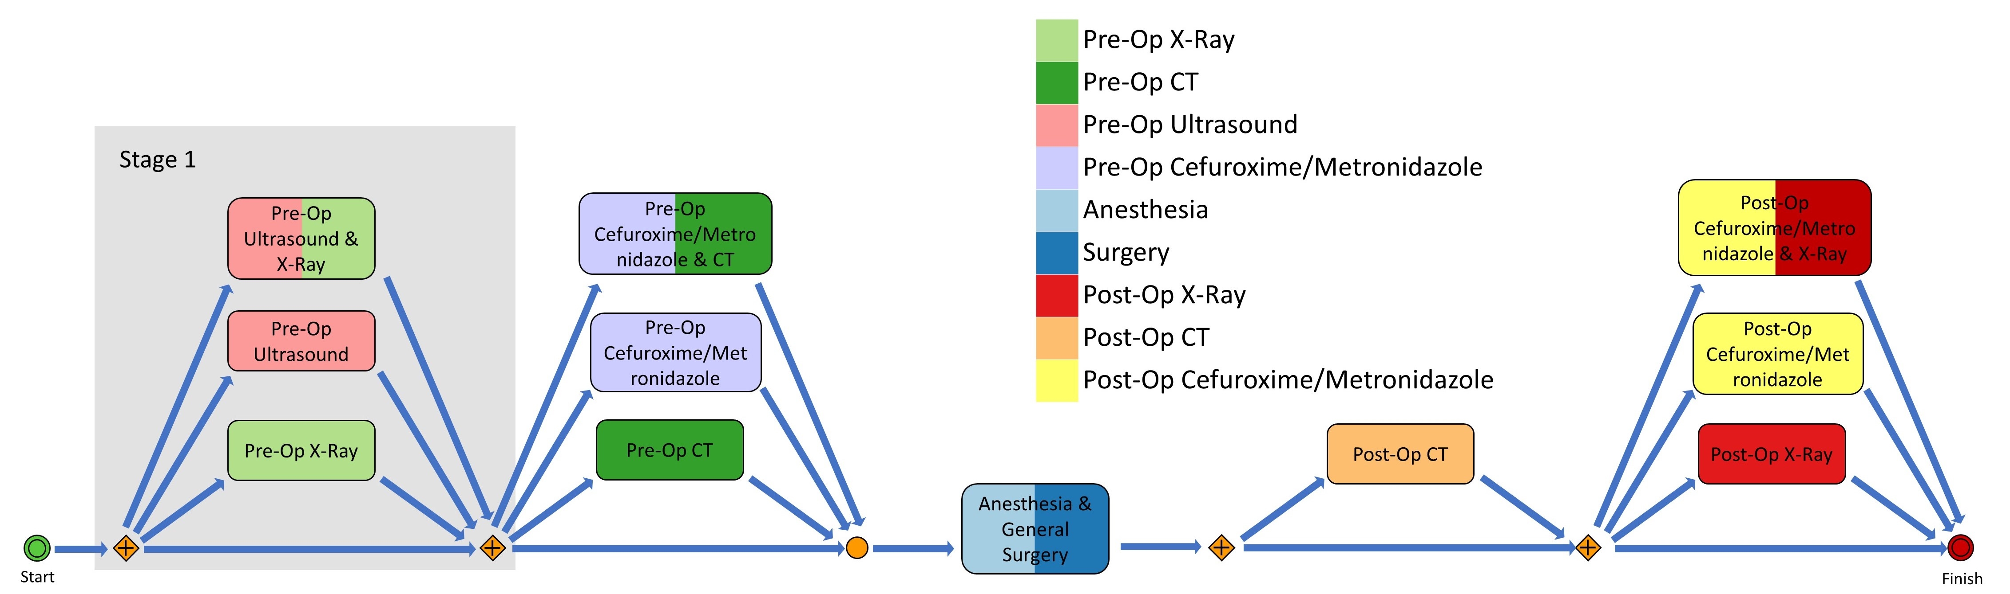
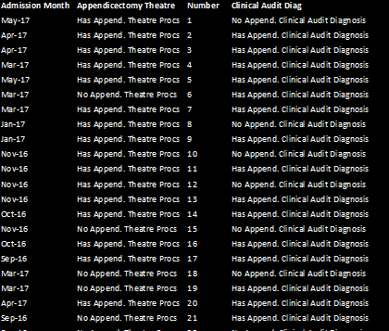
Business Process Modelling
Hospital Database
Healthcare Pathway

Slide 2
Business Process Modelling
Hospital Database
Healthcare Pathway

Slide 3
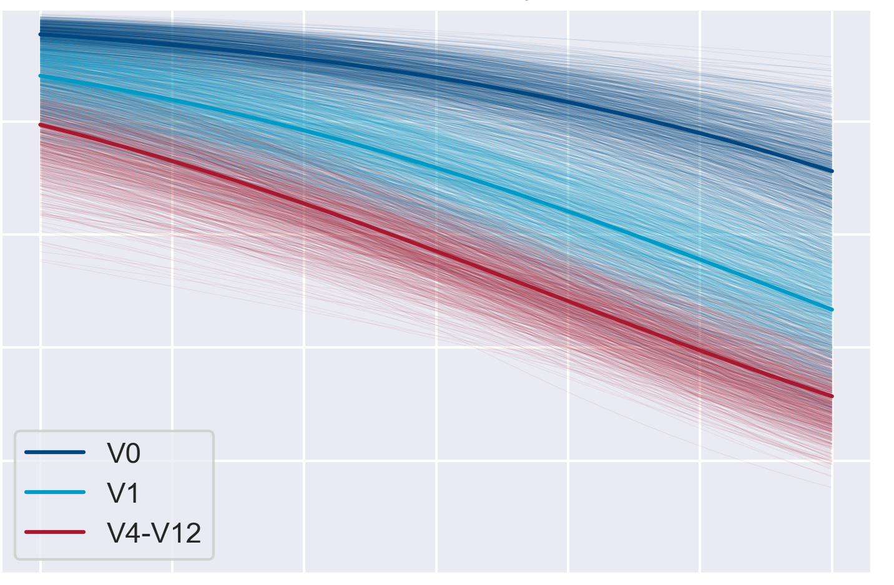
Predictive Model
Business Process Modelling
Probabilistic Machine
Learning
Hospital Database
Healthcare Pathway

