Slide 1
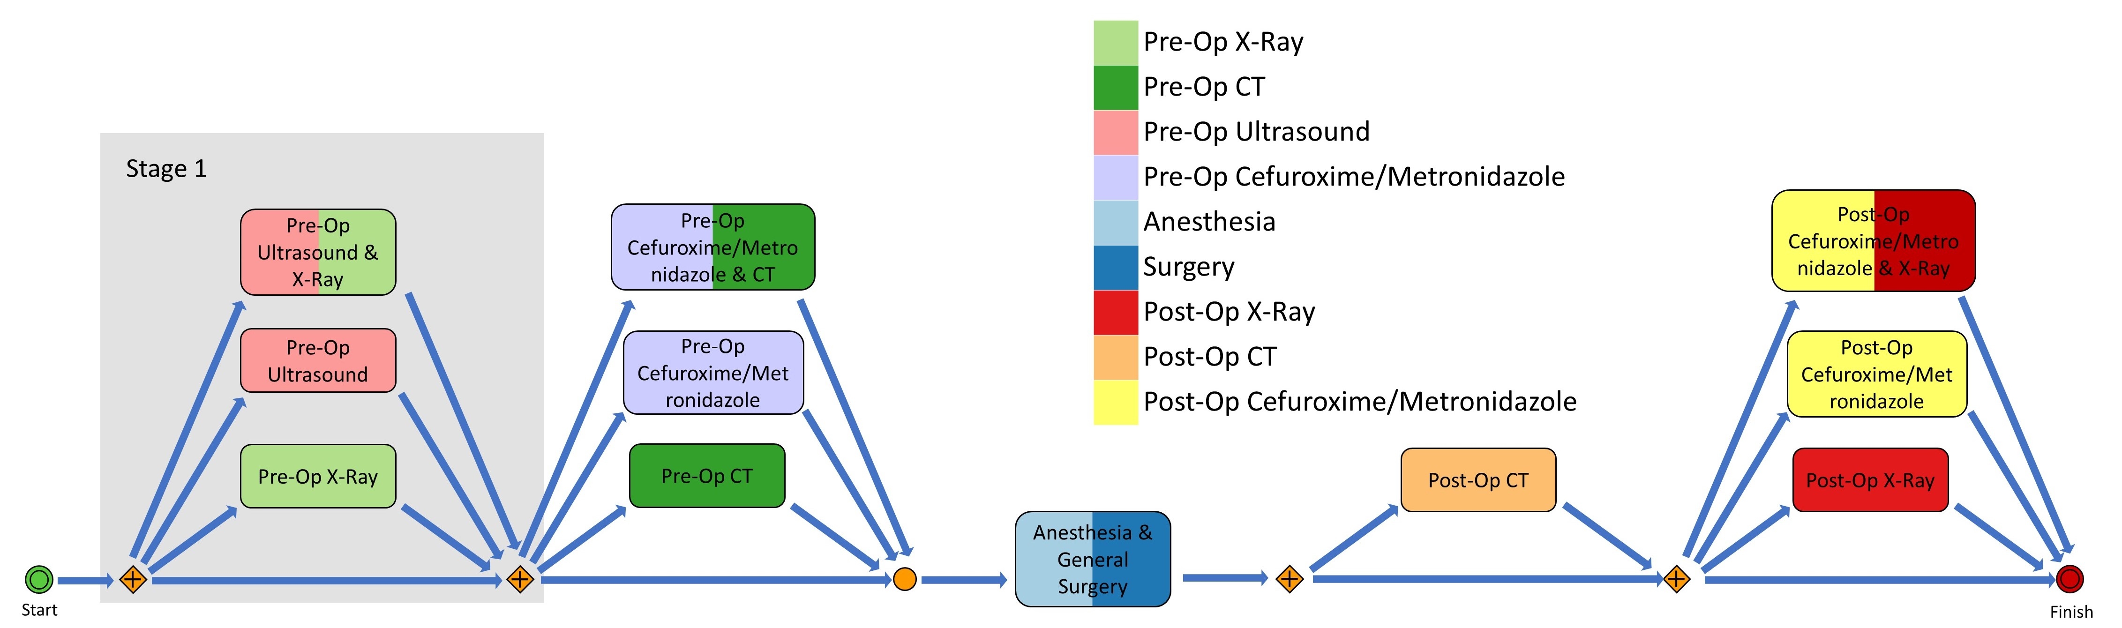
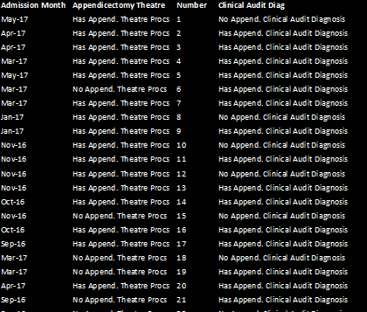
Business Process Modelling
Hospital Database
Healthcare Pathway

Slide 2
Business Process Modelling
Hospital Database
Healthcare Pathway

