Slide 1
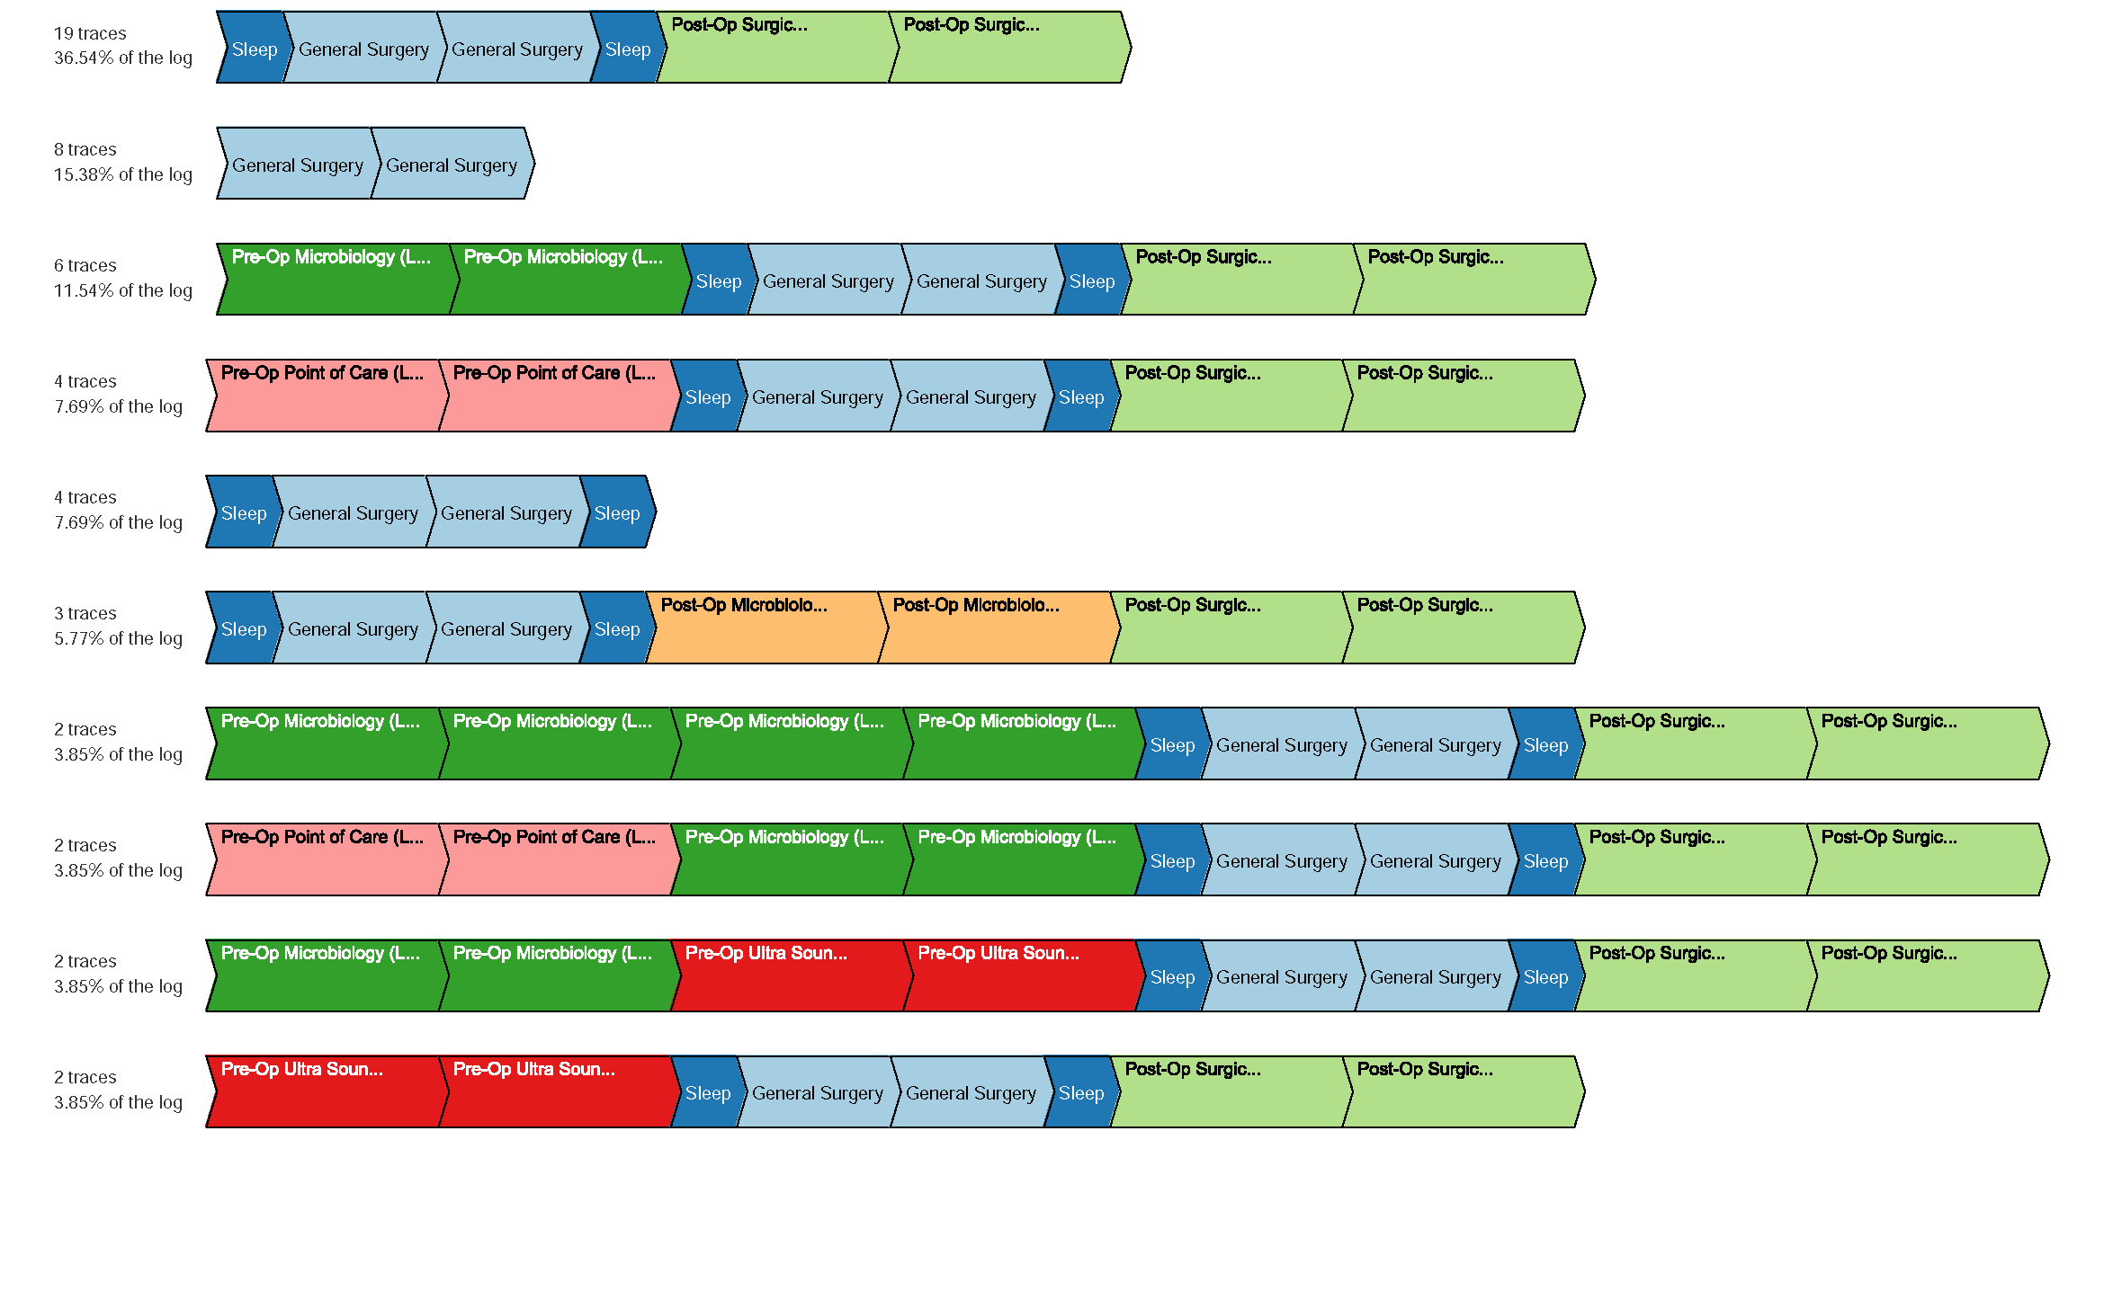
Index
0
 | Pre-Op Microbiology Lab
 | Pre-Op Point of Care Lab
 | Pre-Op Ultrasound
 | Sleep
 | Surgery
 | Post-Op Microbiology Lab
 | Post-Op Surgical Pathology Lab
1
2
3
4
5
6
7
8
9

Slide 2
Index
0
 | Pre-Op Microbiology Lab
 | Pre-Op Point of Care Lab
 | Pre-Op Ultrasound
 | Anesthesia
 | Surgery
 | Post-Op Microbiology Lab
 | Post-Op Surgical Pathology Lab
1
2
3
4
5
6
7
8
9

