Slide 1
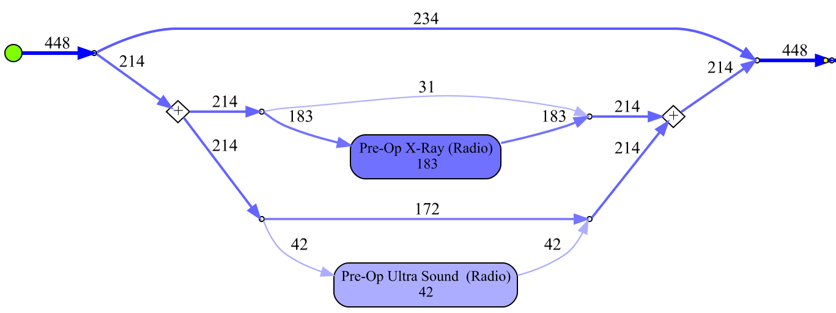
Split
Concurrent

