Slide 1
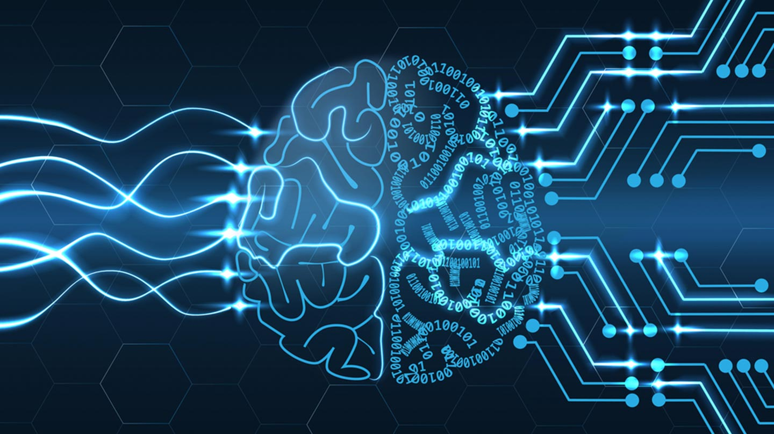


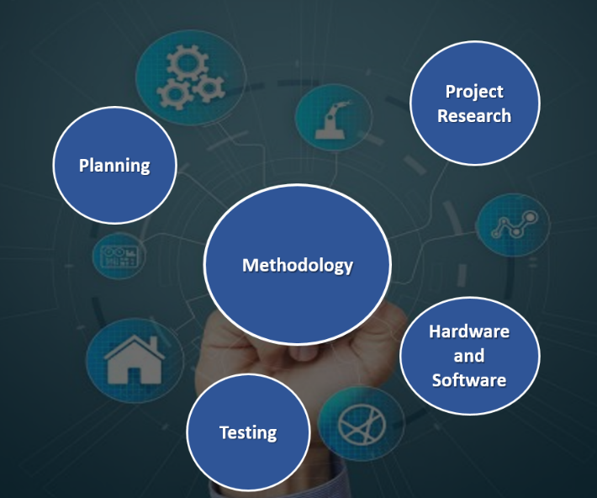

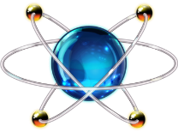
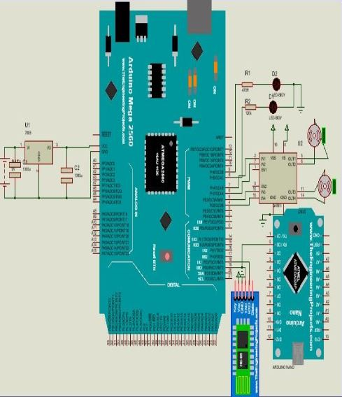
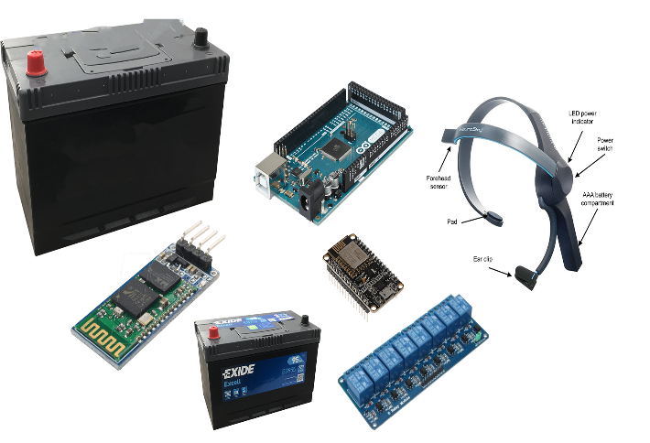
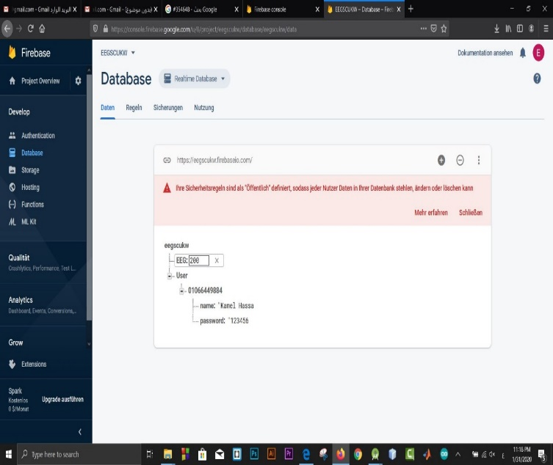
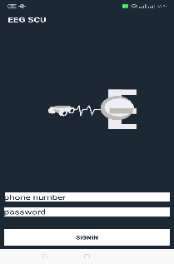
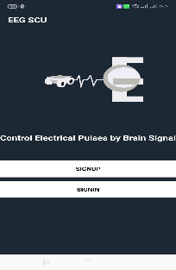
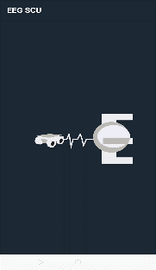
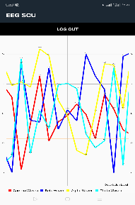
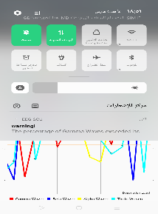
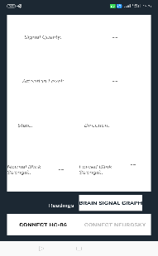
Electroencephalogram System
Abstract
Methods & Tools
Conclusions
During the technological progress that we have now, we used the technique of brain pulses and converted them to electrical signals and then we made a portable application to receive and store these pulses to apply to them the application on artificial intelligence which is neural networks, applied the project to an unoccupied vehicle, the field of Internet of things, the field of leadership The project was first tested on the unmanned vehicle, which we have provided with many capabilities to keep pace with contemporary technological progress, and then we have applied it to smart homes, and given the negatives that exist in the cerebral pulsation helmet, we have supplied He was appalled by the database associated with the EEG application, and therefore to avoid signal scattering through neural networks (Supervised / Un supervised). The application also provided us with a chart to represent the four brain signals ( Alpha - Beta - gamma – Theta(
We designed an integrated system of brain pulses through an organized life cycle, and we initially used a brain signal helmet and we linked it to an Android application and then linked it to a database to accommodate and store the readings and provide the project with the neural network technology, which is an application on artificial intelligence to learn new signals and store and identify and save them until they are used once Others, the application was in the military field to assist soldiers and the Internet of Things field for special needs and self-driving in in order to protect drivers from accidents involving sleep while driving
Android
Studio
Firebase
Arduino
proteus
Project Team / Supervisor
Screenshots
Objectives
Kamel hassan kamel Soliman
Fares Ahmed Hassan
Abdelrahman El araby
Supervisor:
Dr ghada Eltaweel
Dr Basem Elhady
Facilitating the transfer of military supplies in a technological manner other than those presently available.
Assist the soldiers in surveying the suspected mines.
- Reducing the number of traffic accidents, which are caused by sleeping while driving.
- Helping people with special needs in dealing with matters of their lives.

