Slide 1
Speed v. Security: A Comparison of DNS, DoT, and DoH
Kendra Joachim
Computer Networks Final Project

Slide 2

Overview of DNS
Domain Name System
The “phonebook” of the Internet
DNS resolvers translate human-readable domain names into machine-readable IP addresses
Usually run in plaintext over UDP, but that is not the only way

Slide 3
Standard DNS
DNS over TLS
DNS over HTTPS
DNS queries and responses are sent in plaintext via UDP.
UDP over port 53
No encryption; vulnerable to attacks and monitoring
DNS using the same protocol (Transport Layer Security) that HTTPS websites use to encrypt and authenticate communications.
TCP with TLS over Port 853
Encrypted on dedicated DoT port; can be monitored
DNS queries and responses are encrypted with TLS and sent via HTTP.
TCP with TLS over Port 443
Encrypted and hidden among other HTTP traffic

Slide 4
If DoT and DoH have better security, why use Standard DNS?
Still the default on many devices
Claims to be faster than DoT and DoH
Better for low bandwidth due to smaller response size without the encryption overhead

Slide 5
Questions to Answer
How much faster is Standard DNS?
How much added bandwidth do the other options carry?

Slide 6
Testing
Limitations
Done in Python on Visual Studio Code
Used various Python libraries (dns.resolver, httpx, subprocess) to send DNS queries
Measure latency and amount of bytes in the responses over 50 trials for each variation
Only performed on A records
A records are the most common type of records and are the ones that resolve domain names to IP addresses
DoT only simulates the handshake
Could only be ran “cold”
Cannot test response size

Slide 7
Variations to Test (DNS and DoH)
“Cold”
“Warm”
“Real World”
No cache; each query is sent as if it is a brand new query
Query used was “example.com”
Similar to worst case scenario
Cache; established connection besides the first
Query used was “example.com”
Similar to best case scenario
Cache; established connection besides the first
Used a variety of urls with different domains (.com, .edu, .uk)
Simulate what queries would actually be like
Resolvers/Endpoints (DNS/DoH/DoT)
Cloudflare | 1.1.1.1
Google | 8.8.8.8

Slide 8
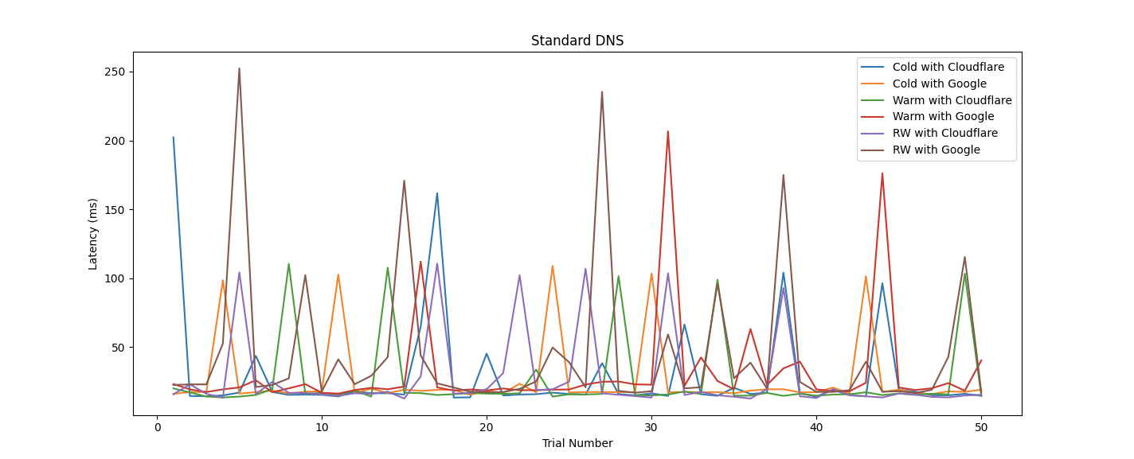
Standard DNS Latency

Slide 9
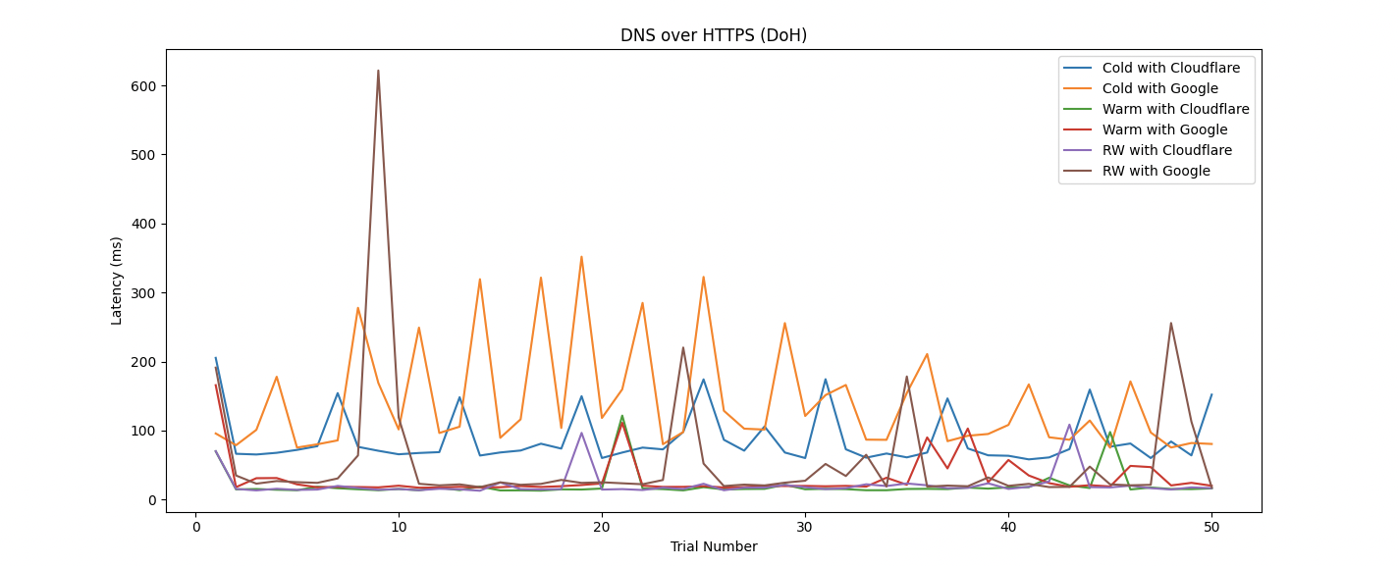
DoH Latency

Slide 10
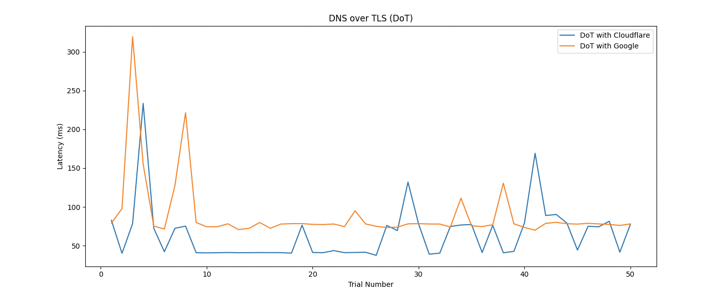
DoT Latency

Slide 11
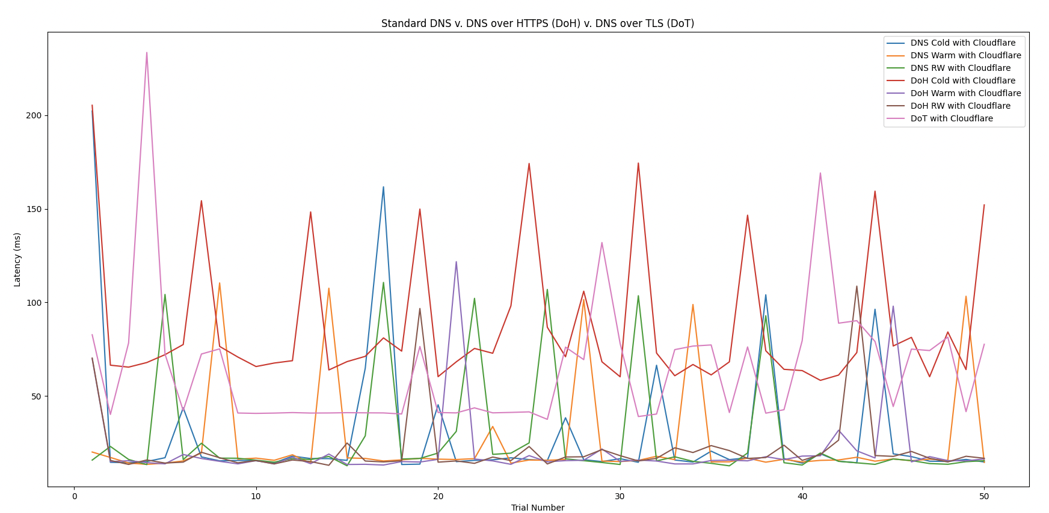
Latency Comparison (Cloudflare)

Slide 12
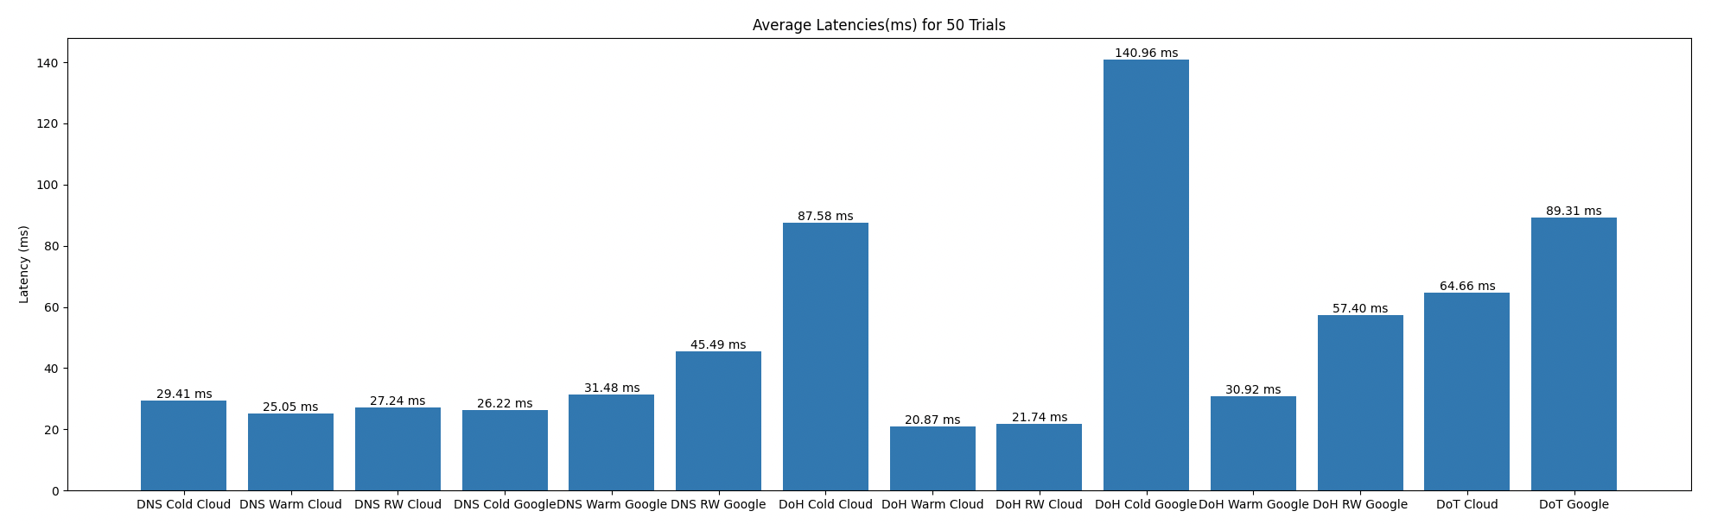
 | DNS | DoH | DoT
Cold | 27.81 | 114.27 | 76.98
Warm | 28.27 | 25.90
Real World | 36.36 | 39.57
Latency Averages

Slide 13
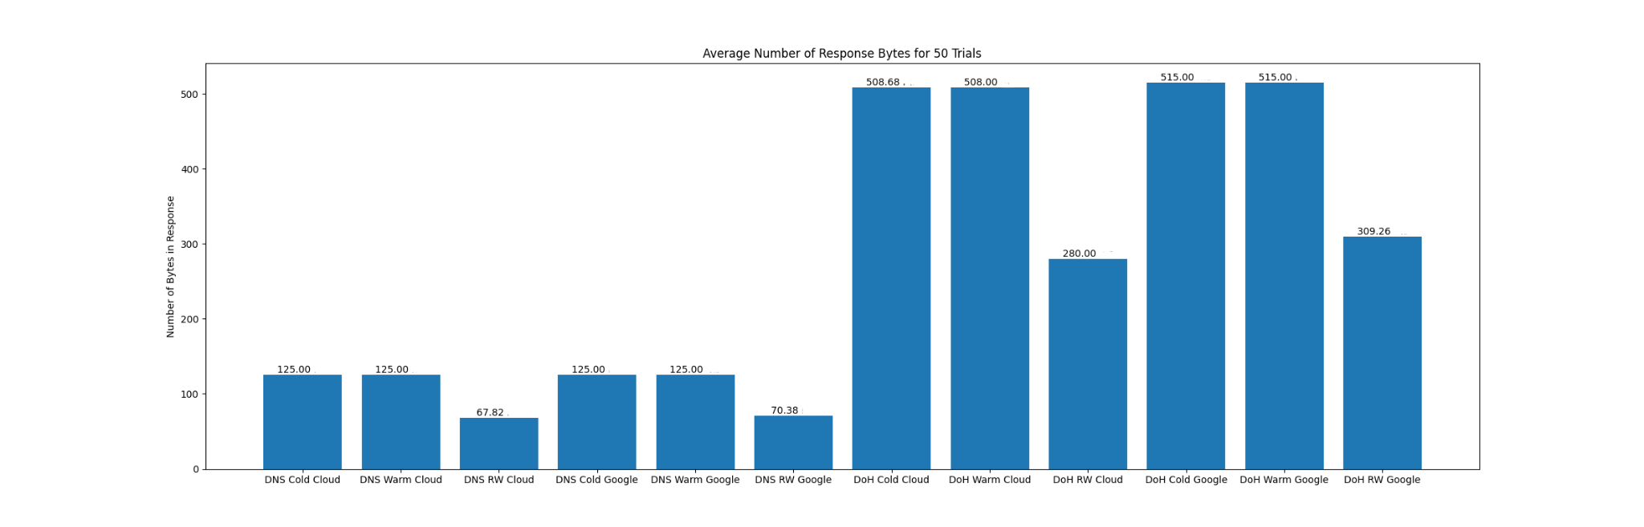
DNS | 106.4 bytes
DoH | 439.3 bytes
Response Bytes Averages

Slide 14
Conclusions
Overall, Standard DNS over UDP is faster and has a smaller number of response size
However, with DoH being faster in the “warm” scenario and only being 3ms slower in the “real world” scenario, DoH still performs well
Given the added security benefits of DoH over DNS, DoH seems like the better choice of the two
Though unable to test DoT on the more likely scenarios (warm and real world), it appears that its performance is likely similar to that of DoH if not a little better
Thus, due to the added security benefits of DoH and DoT, they should be implemented when possible

Slide 15
How do you choose DoT or DoH?
The difference lies in what Port is being used
DoT has a dedicated port, so anyone with network visibility can see DoT traffic coming and going
Good for network security; bad for privacy
DoH queries and responses are camouflaged within other HTTP traffic
Good for privacy; bad for network security

