Slide 1
GOTYME · FINANCIAL SERVICES II
CaseFlow
CF
Turns an AML/KYT alert into a cited decision packet—and knows when not to decide.
Evidence-first · Human-controlled
Synthetic prototype

Slide 2
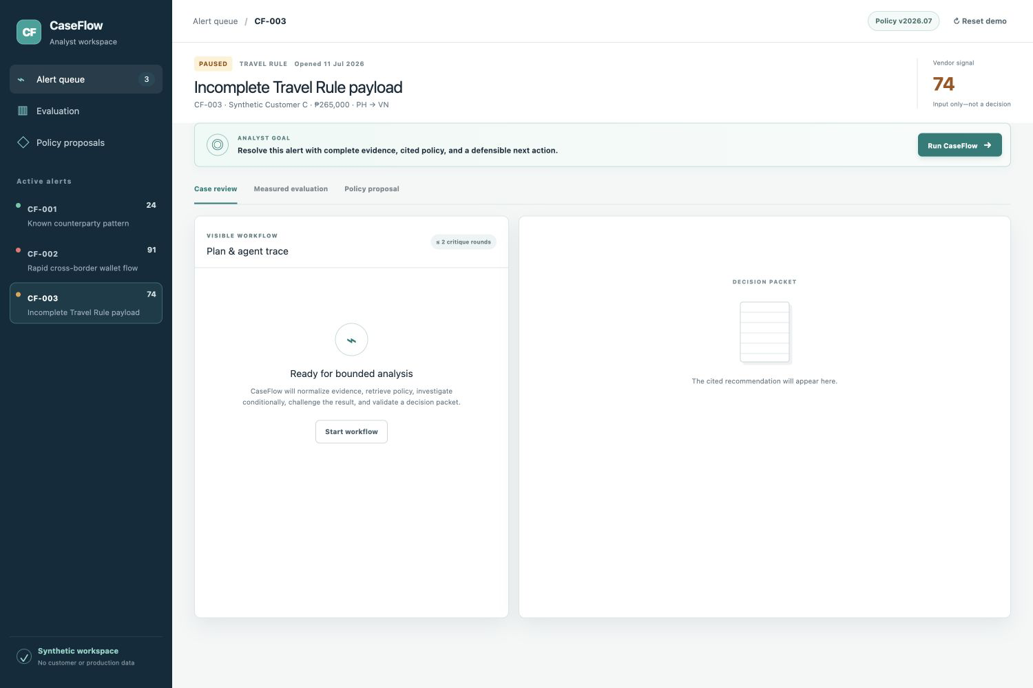
THE PROBLEM INSIGHT
The alert is not the bottleneck. Resolution is.
Analysts still reconstruct the case across customer, transaction, wallet, Travel Rule, policy, and prior-case evidence.
Vendor scores signal risk. They do not create a defensible next action.
CaseFlow starts at the alert—not at raw monitoring—and assembles the review record around the analyst's actual job.
SYNTHETIC DATA
02

Slide 3
AGENTIC WORKFLOW
A live LLM calls tools to investigate; a second LLM is paid to disagree.
1
2
3
4
5
INTAKE
TRIAGE
INVESTIGATE
CHALLENGE
VERIFY
Normalize typed evidence
Rules + cited policy
Run only when needed
Attack assumptions
Seal one decision
get_customer_profile
search_policy
get_wallet_intelligence
raise_objection
validatePacket
Bounded autonomy: exactly 3 recommendations · ≤2 critique rounds · human owns every action
03

Slide 4
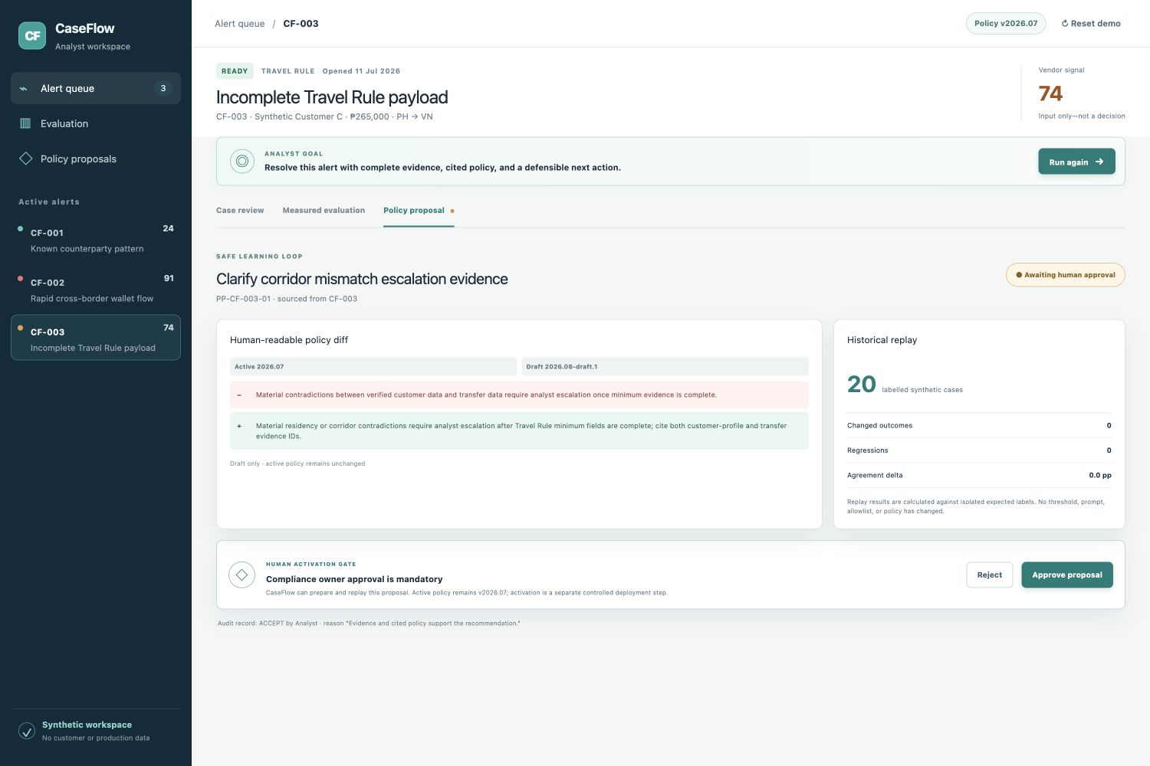
WHY IT WINS
CaseFlow learns without changing policy behind your back.
Analyst feedback
becomes a versioned proposal—not an invisible prompt or threshold mutation.
Historical replay
shows changed outcomes, regressions, and agreement delta on isolated labels.
Human activation gate
keeps active policy unchanged until a compliance owner approves and deploys it.
04

Slide 5
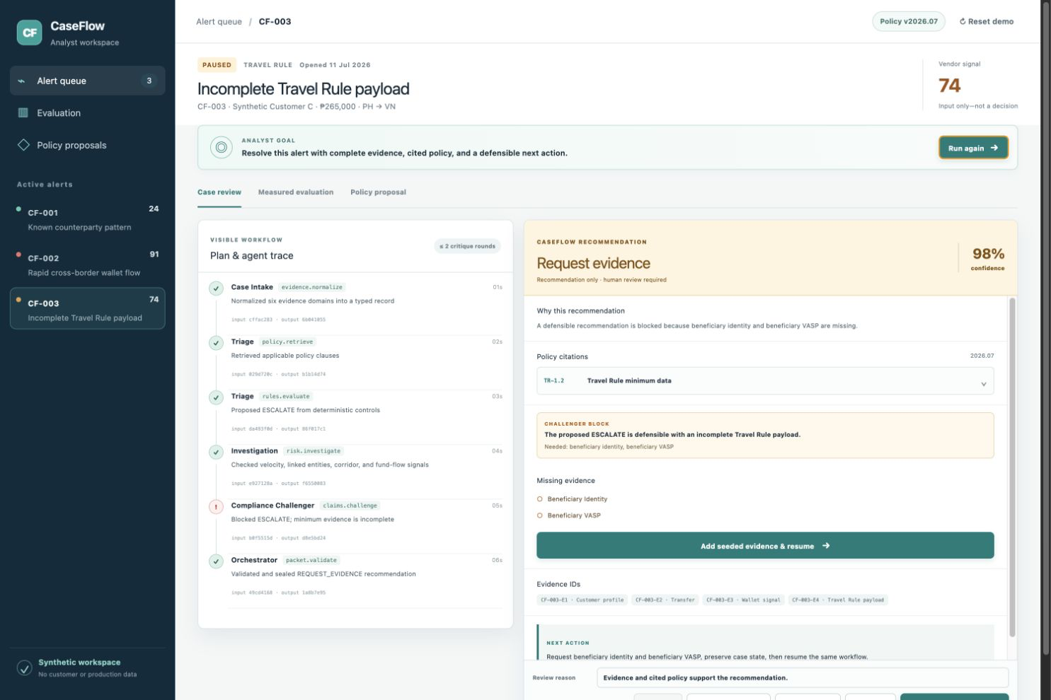
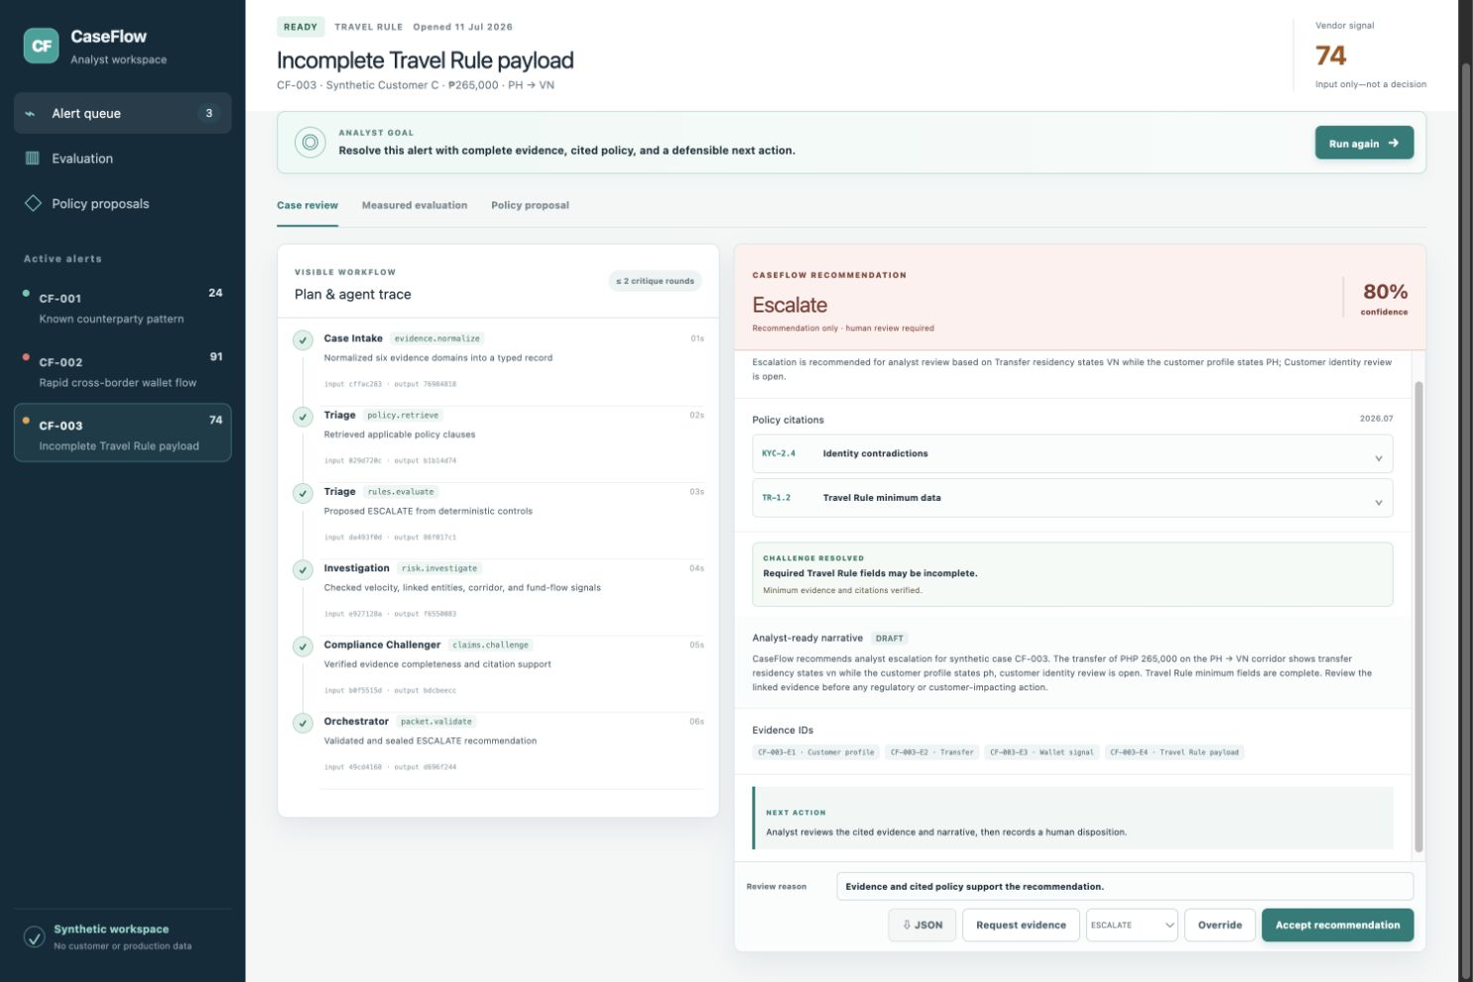
THE 60-SECOND PROOF
When evidence is missing, the correct action is to stop.
→
REQUEST_EVIDENCE
Beneficiary identity + VASP missing
ESCALATE
Same case · evidence added · audit preserved
05

Slide 6
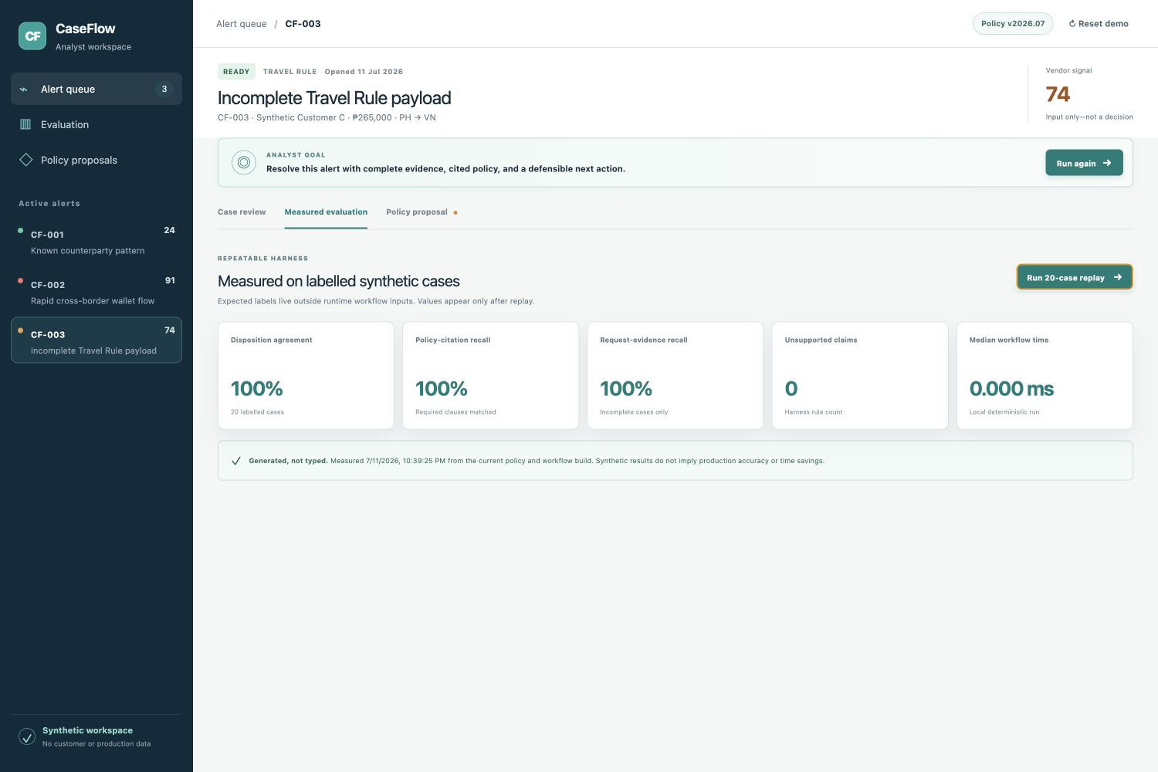
MEASURED EVIDENCE + NEXT STEP
Synthetic evidence proves the workflow contract—not production impact.
18 / 20
disposition agreement (measured, live agent)
100%
required policy-citation recall
0
fabricated packets (guardrails held)
NEXT: PILOT WITH GOTYME
Alert + policy schemas. Analyst-owned outcomes.
Synthetic fixture results only. No production accuracy, false-positive reduction, time-savings, or ROI claim.
06

