Slide 1

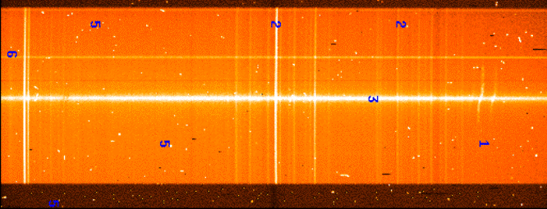
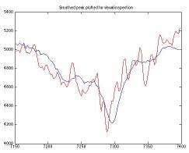


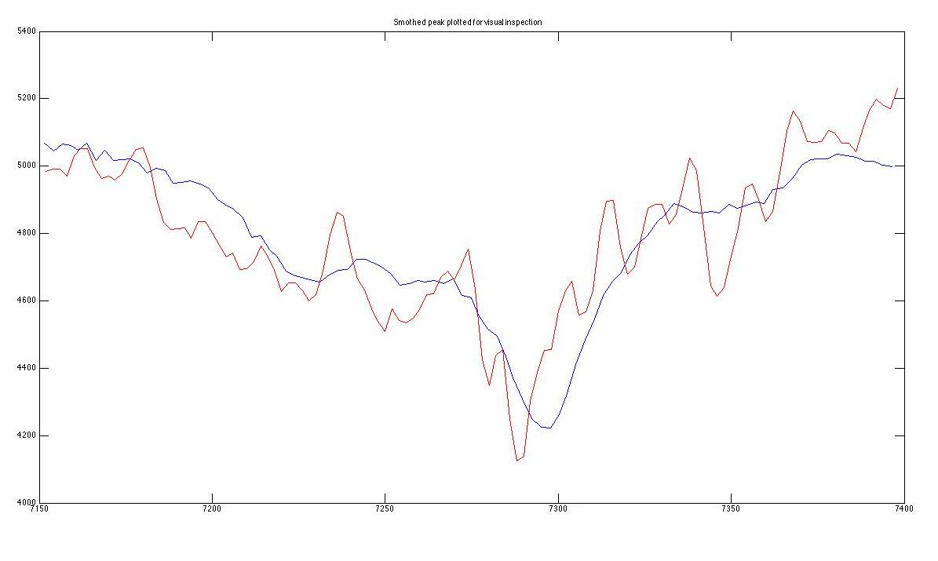
Basic Poster Creation
Joshua Bowen¹
Northern Arizona University¹; Murky Research Inc., Cambridge, MA^{2;}
Abstract
NAU/College/??? Logos
Charts and Graphs
Figure 3: This image was enlarged 130% using MSOffice-Picture manager prior to insertion in this poster.
Purpose: To establish guidelines for a poster layout which will most suitably represent the school, its research, and print well.
Method: If we are printing your poster, we require the use of PowerPoint as then the printer operator can easily make any minor edits to improve the quality, and more importantly the time required to print the poster. Avoid dark backgrounds, as they take a lot of ink.
Please remember that this layout is only an example template: other than page size, it is not fixed, and you may manipulate it as you see fit. It is only limited by your creativity!
Page Size: 34 x 43.5 inches.
The printer paper is 36-inches high including ½-inch margins. If the smallest dimension of your poster is larger than 35.5-inches, the printer software will scale the poster down, but this increases the time required to print.
NOTE: PowerPoint has a 56-inch limit in both dimensions.
Before starting to create your poster, please be sure to check the page size is 34 by 44. Go to Design and then Page Setup in .pptx to check this out.
Large format NAU and college logos can be found at:
http://www.physics.nau.edu/~anderson/LOGOS/posterlogos.html
The gif, jpg and tif logos can be reduced down to fit nicely into your poster. The png logos may be reduced or enlarged.
If you copy a logo from a webpage, you may find that when enlarged to fit your poster, it becomes pixilated to the point of distraction. For example:
The important thing about including charts and graphs is to create them at a size equal to or slightly greater than the size they need to be in the poster. Having to enlarge anything results in pixilation.
Hints
Use the grid lines to help keep your objects lined up.
If you are going to use a background color or image, make sure to keep it light: so you can clearly see all the text, and to save printer ink (posters with backgrounds cost an extra $10.00).
Always be sure to examine the final poster at a zoom of 100%: at anything lower than 100% you do not see the text, objects, etc. in their true places―don’t be fooled.
Figure 1: Imported graphics file that was enlarged by 375%.
How To Cite References
Resized png from the logo web page.
Enlarged gif from copied from a web site.
Use a smaller font size for the references.
Journal article: Author, Author, & Author. Year, Journal abbreviated title, Volume number, First page of article
Martín, E. L., Rebolo, R., & Zapatero Osorio, M. R. 1996, ApJ, 469, 706
Book: Author, & Author. Year, Title, Volume if a multivolume work (Edition or series, if any; City of publication: Publisher) --- Where specific pages of a book are cited, these should be given at the text citation, not in the reference list.
Donat, W., III, & Boksenberg, A. J. 1993, The Astronomical Almanac for the Year 1994, Vol. 2 (2nd ed.; Washington, DC: GPO)
Article or chapter in an edited collection:
Author(s). Year, in Collection Title, ed. Editors (City of publication: Publisher), first page of article
Huchra, J. P. 1986, in Inner Space/Outer Space, ed. E. W. Kolb et al. (Chicago: Univ. Chicago Press), 65
Conference proceedings: Author(s). Year, in Conference series title [ASP Conf. Ser., AIP Conf. Proc., IAU Colloq., IAU Symp., etc.] and number, Volume title, ed. Editors (City of publication: Publisher), first page of article, URL if any
Salpeter, E. E., & Wasserman, I. M. 1993, in ASP Conf. Ser. 36, Planets around Pulsars, ed. J. A. Phillips, S. E. Thorsett, & S. R. Kulkarni (San Francisco: ASP), 345
Electronic conference proceedings (published only online): Author(s). Year, in Conference series title and number (if any), Volume title, ed. Editors (if any given) (Place: Site Host), first page of article (if paginaged) or article number, URL
Gomez, M. 2000, in Cosmology 2000, ed. M.C. Bento, O. Bertolami, & L. Teodoro (Lisbon: Inst. Superio Tecnico), 57, http://alfa.ist.utl.pt/~bento/cosmo2000/proc/proceedings.html
Electronic newsletter ( published only online)
Hermoso, D. 1996, ESA IUE Electron. Newsl. 46, http://www.vilspa.esa.es/iue/nl/newsl_46.html.
Instrument documentation: Author(s) [or Issuing Agency]. Year, Title, Document number (Place: Issuing agency), URL (if any)
Gussenhoven, M. S., Mullen, E. G., & Sagalyn, R. C. 1985, CRRES/SPACERAD Instrument Description, Document AFGL-TR-85-0017 (Hanscom: Air Force Geophys. Lab.)
Spitzer Science Center. 2004, Spitzer Observers' Manual (Pasadena: SSC), http://sirtf.caltech.edu/SSC/obs/
Preprints: Author(s). Year, [series name if unusual] preprint (number)
Smith, A. B. 1999, preprint (astro-ph/9812345)
Lockwood, G. W., & Skiff, B. A. 1988, Air Force Geophys. Lab. preprint (AFGL-TR-88-0221)
Papers submitted or in press
Wolk, S. J., & Walter, F. M. 1999, ApJ, submitted
Wolk, S. J., & Walter, F. M. 1999, ApJ, in press
Tables
Table can be constructed directly in PowerPoint or imported from Word or Excel via copy/paste.
The following table was constructed in Word at the desired size, with appropriate font sizes, desired box outlines, etc. It was then put into this PowerPoint file via copy/paste.
Fonts
Your poster is being read from an average distance of 4-ft away. Choose a font that is not crowded and remember that there are two spaces after the period at the end of a sentence. This poster is using Helvetica font with a font size of 28 for most of the text.
bullets help to draw attention to important points.
For certain fonts, using bold helps to make the poster more easily read from a distance.
An easy way to check the readability of your poster is to set zoom level to 100% and stand 4-ft away from your computer screen.
Remember: Your poster is a summary of your work; not every little detail needs to be included. ☺
Column 1 | Column 2 | Column 3
Item 1 | A | 1.23
Item 2 | B | 2.35
Item 3 | C | 3.46
Item 4 | D | 4.57
Figure 2: Imported graphics file that was reduced by 25%.
Note that the font sizes for the axis labels should have been made larger prior to exporting the graph from MatLab.
Images
This table was created with Excel.
The important thing about including images (gif/jpg/tiff) is to resize them to the desired size prior to inserting them into the PowerPoint file (this will save the printer hours of time, and will be very much appreciated by the operator!).
As shown with the logos, png images can be resized in PowerPoint without adverse affects on the file size or the printer efficiency.
Select one of the three categories in this box and delete the other two.
Leave at bottom-left to indicate the judging category. Delete this box and leader.
Engineering Design
Research
Internships/ENV Capstone
Free Poster Printing for UGRADS participants, courtesy of CEFNS and the Dept. of Physics & Astronomy.
Email posters to Ed.Anderson@nau.edu by the deadline listed on the website: http://nau.edu/CEFNS/Research/UGRADS/
Details and templates are available at http://nau.edu/CEFNS/Research/UGRADS-How-To/
Acknowledgments
Remember to acknowledge any grants, internships, etc., that have helped to support your research.

