Slide 1
112-1 SoC Design Laboratory Lab4-1 submission guide
Teacher：Jiin Lai
TA：楊岭騏、蘇子源

Slide 2
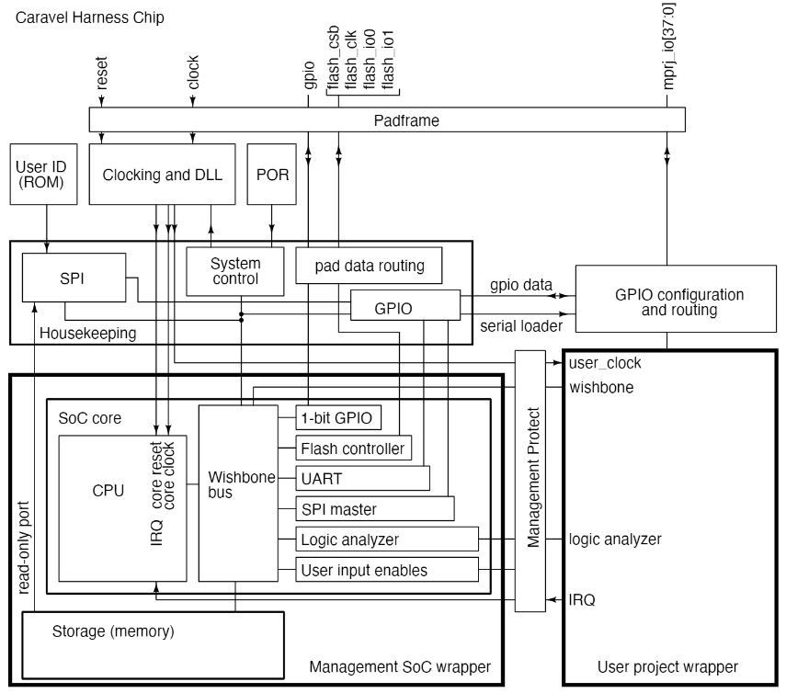
Requirements
FIR C code
fir.c
fir.h
Interface between user BRAM and wishbone
Synthesize user project
Interface
User BRAM
Wishbone

Slide 3
FIR Specification
Tap number = 11
Input signal number = 11
Start mark = ‘hAB40
End mark = ‘hAB51
Check_bits = ‘hAB40
Tap
*
Input signal
+
Timeline
*
*
…
+
+
+
+
+
+
+
+
+
+
*
*
*
*
*
*
*
*
*
*
*
Check_bits = ‘hAB51

Slide 4
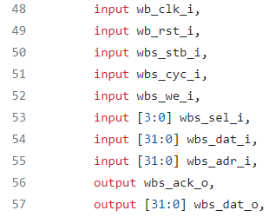
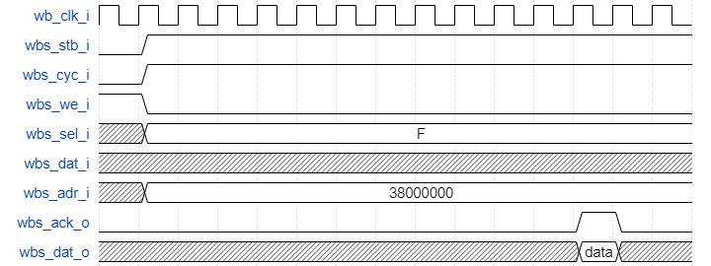
Interface

Slide 5
Submission (1/2)
Hierarchy:
StudentID_lab4-1/
Report.pdf
.hex
fir.c
fir.h
User
bram.v
user_proj_example.counter.v
Github link
Your Github link should attach the file
Design, Synthesis report(Including FF, LUT, Bram ), Waveform, simulation.log, makefile,…etc.
Report

Slide 6
Submission (2/2)
Compress all above files in a single zip file named
StudentID_lab4-1.zip
Submit to Submit to eeclass
Deadline: 11/2 (Thu.) 23:59
‐ 20% off for the late submission penalty within 3 days

Slide 7
What is included in the report
Explanation of your firmware code
How does it execute a multiplication in assembly code
What address allocate for user project and how many space is required to allocate to firmware code
Interface between BRAM and wishbone
Waveform from xsim
FSM
Synthesis report
Other discoveries

