Slide 1
SoC Design Lab
Final Project – Workload Optimized SOC
Group 6
112061611 陳伯丞
112061524 葉又菘
110063553 張傑閔

Slide 2
Outline
Hardware Accelerators
  - Matrix Multiplication
UART FIFO
SDRAM
Compiler Optimization

Slide 3
Hardware Accelerators

Slide 4
Hardware Accelerators
User Project Memory Starting: 3800_0000
User Project MM Base Address: 3200_0000
WB Decode
WB-interface
WB-interface
MM
exmem
bram

Slide 5
Hardware Accelerators - Matrix Multiplication
Shift register
A Matrix 4x4
Shift register
C Matrix 4x4
Matrix
element
… …
… …
… …
MUX
Shift register
B Matrix 4x4

Slide 6
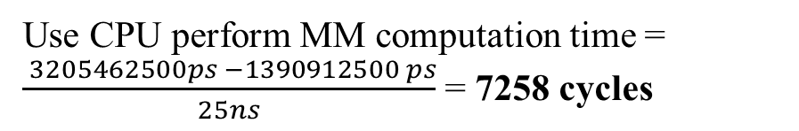
Hardware Accelerators - Matrix Multiplication
Description: First store B matrix and A matrix, then do MAC operation on A matrix and B matrix, finally output them in sequence.
Use CPU perform MM computation time = $\frac{ 3205462500ps −1390912500 ps}{25ns}$ = 7258 cycles
Output one element result per cycle!
Fig. SW Waveform
Fig. HW design Waveform

Slide 7
UART FIFO

Slide 8
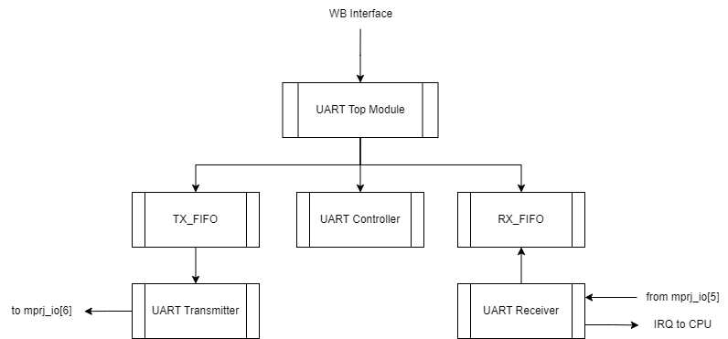
UART FIFO
UART FIFO Structure: add TX_FIFO & RX_FIFO
Fig. UART FIFO Block Diagram

Slide 9
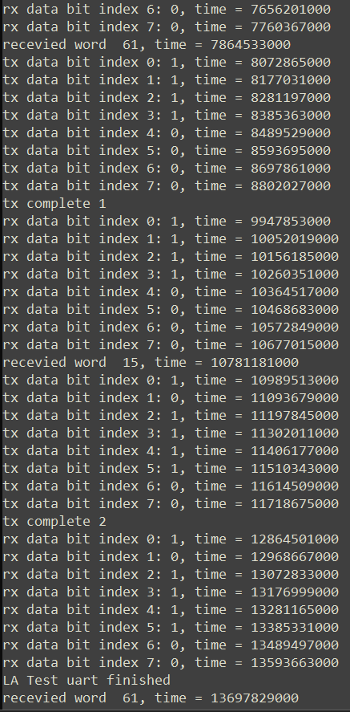
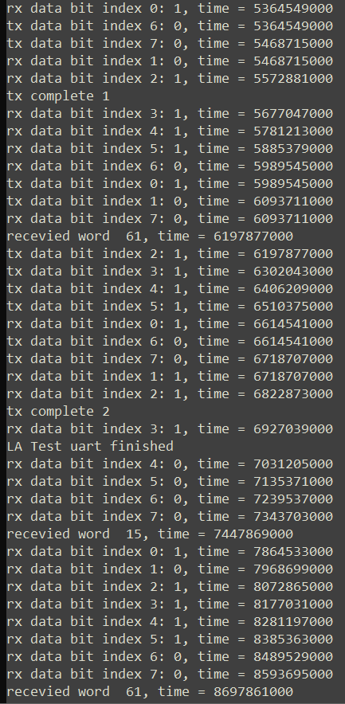
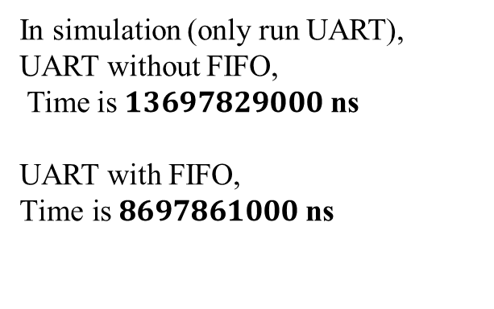
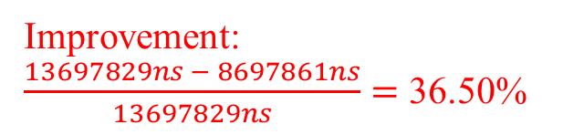
UART FIFO
In simulation (only run UART),
UART without FIFO,
Time is $13697829000$ ns
UART with FIFO,
$\text{Time} \text{is} 8697861000$ ns
TX
RX
RX
TX
Improvement:
$\frac{13697829ns − 8697861ns}{13697829ns}=$ 36.50%
TX
RX
RX
It is improvement 36.50 % !
Fig. UART w/o FIFO
Fig. UART w/ FIFO

Slide 10
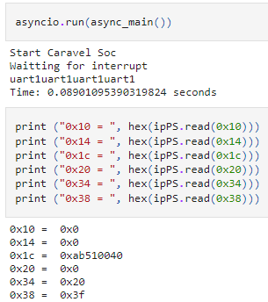
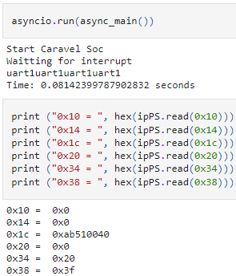
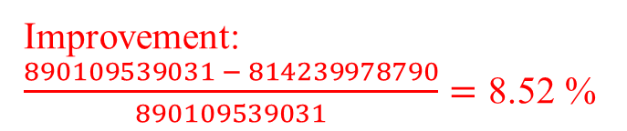
UART FIFO
In Online-FPGA verification:
Improvement: $\frac{890109539031 − 814239978790}{890109539031}=\text{8.52 \%}$
It is improvement 8.52 % !
Fig. UART w/o FIFO
Fig. UART w/FIFO

Slide 11
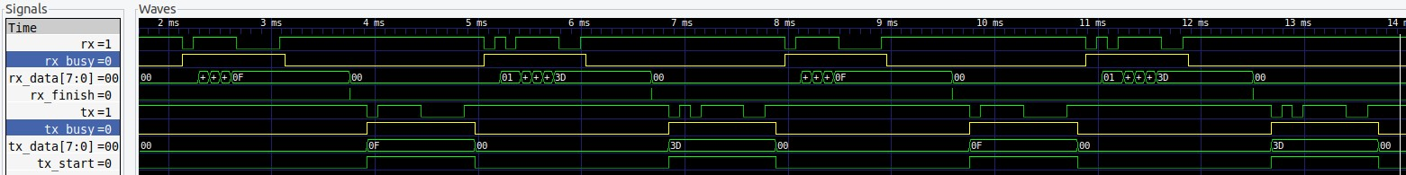
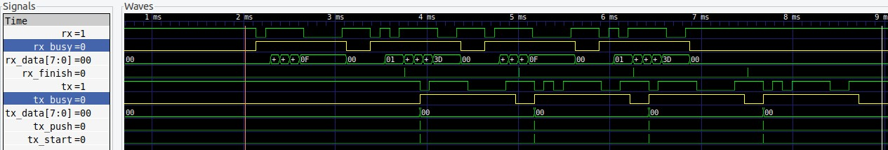
UART FIFO
Waveform:
UART with FIFO, CPU can send and receive data concurrently.
RX
RX
TX
TX
Fig. UART w/o FIFO Waveform
Fig. UART w/ FIFO

Slide 12
SDRAM

Slide 13
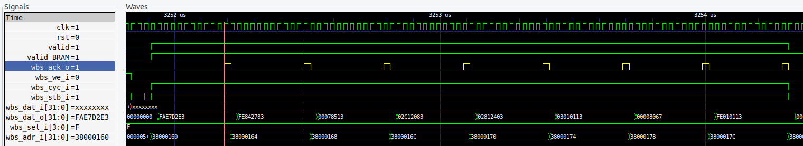
SDRAM
In wlos baseline, we put user_program in user BRAM
Without any optimization, the access time per data is 12T.
12T access time
Fig. BRAM Waveform

Slide 14
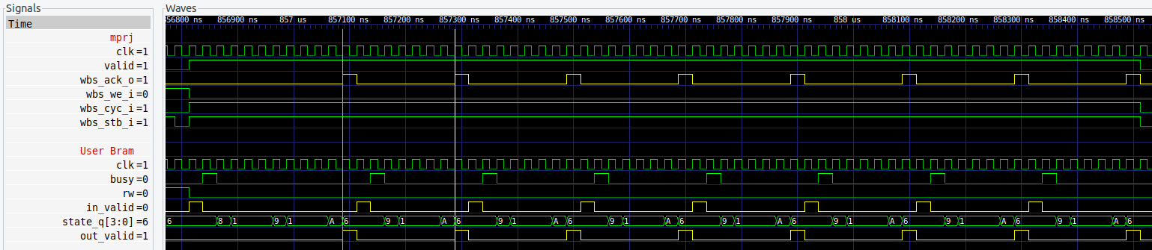
SDRAM
We change the user BRAM to SDRAM in LabD.
The access time per data is 8T. If there is row activate, the access time is 8T+3T=11T.
11T access time
8T access time
Fig. SDRAM Waveform

Slide 15
Other Optimization

Slide 16
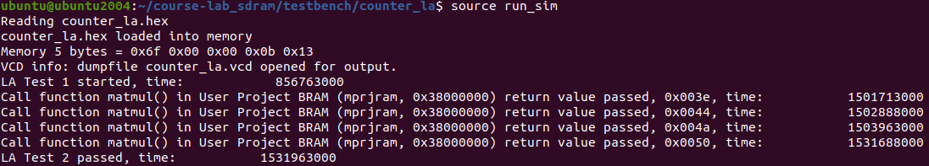
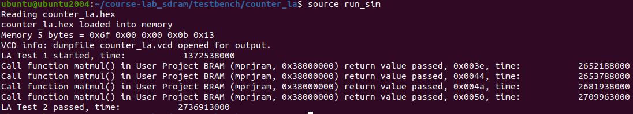
Compiler Optimization
Reference to other group’s lab presentation, we try to change the compiler mode in run_sim.sh.
Fig. Simulation time with -Os
Fig. Simulation time without any optimization

Slide 17
Thanks

