Slide 1
HAN x CKIP
Legal Tech Hackathon
人工智慧
自由團隊
Reporter : You-Qian Lee
AI . FREE Team
Copyright © AI . Free Team 2021. all rights reserved.
aifreeblog.herokuapp.com

Slide 2
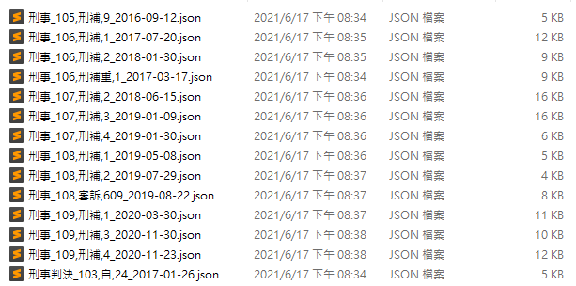
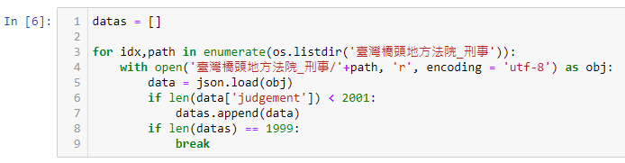
Dataset
先用判決資料來測試
(No specific type)

Slide 3
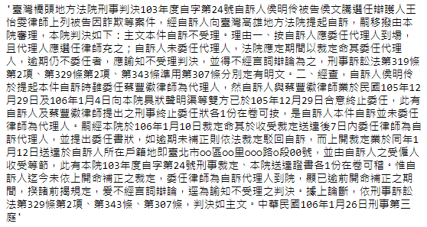
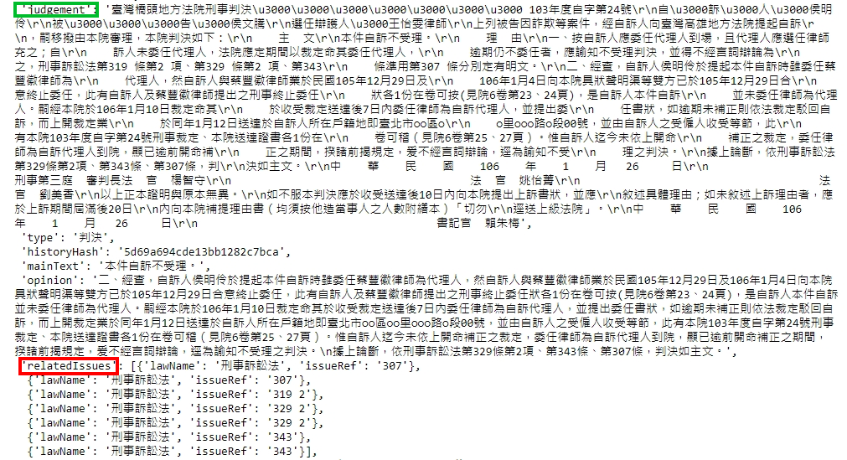
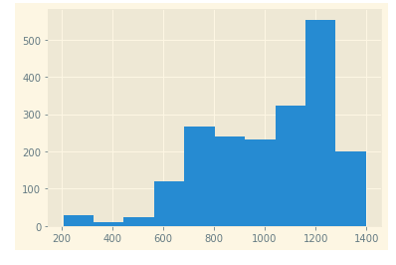
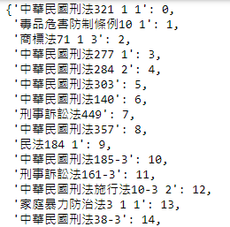
Dataset

Slide 4
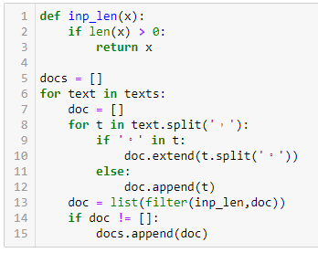
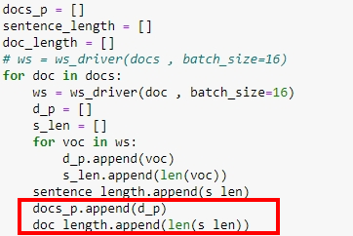
CKIP-Transformers
中文沒有斷句toolkit
Customized Sentence Segmentation
Word Segmentation
Pad & Packed

Slide 5
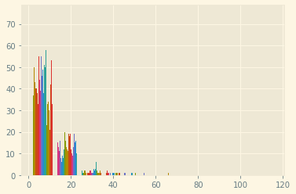
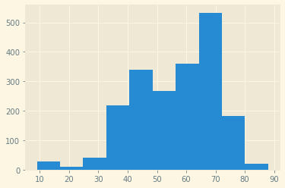
CKIP-Transformers
每一句的長度
每一篇的長度

Slide 6
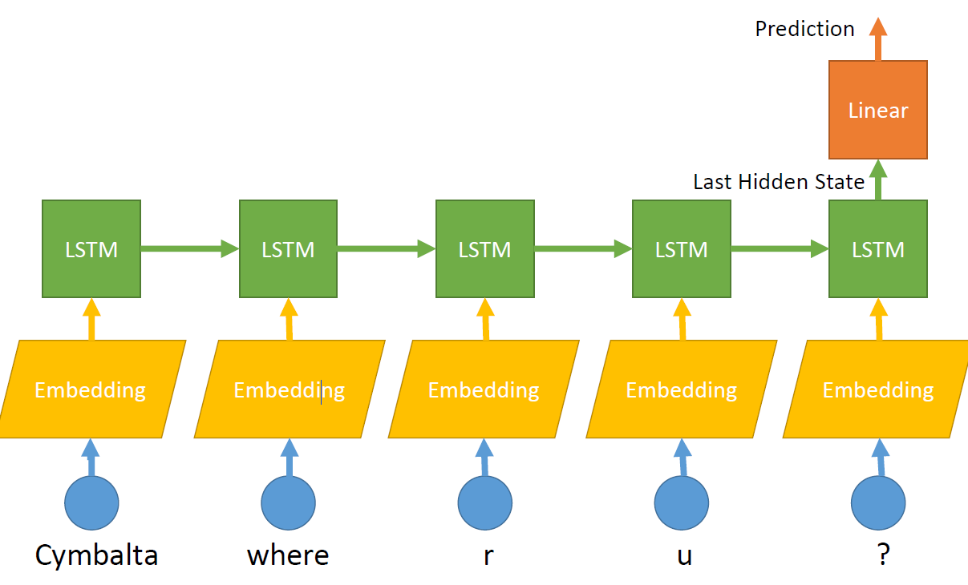
Traditional Document Classification
Image Credit : 人工智慧 戴鴻傑 13AI-CUP

Slide 7
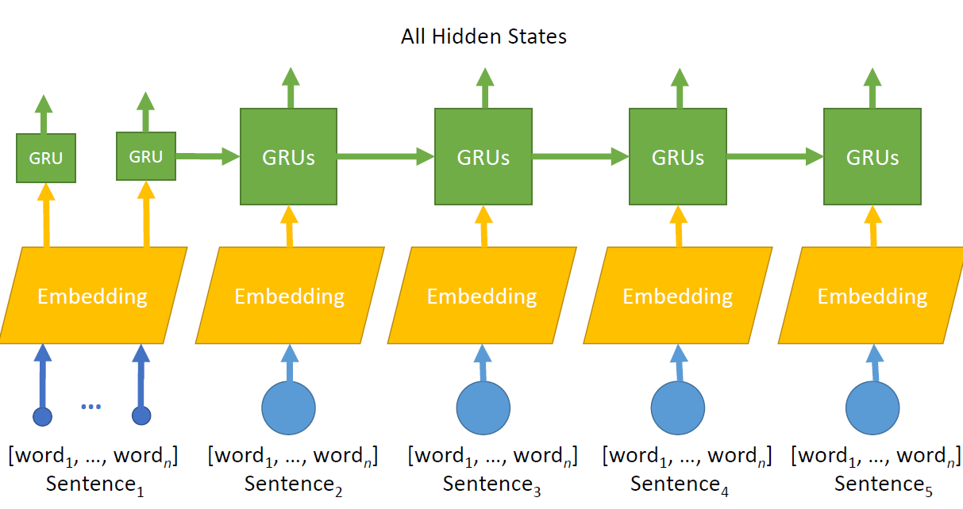
Traditional Document Classification
Image Credit : 人工智慧 戴鴻傑 13AI-CUP

Slide 8
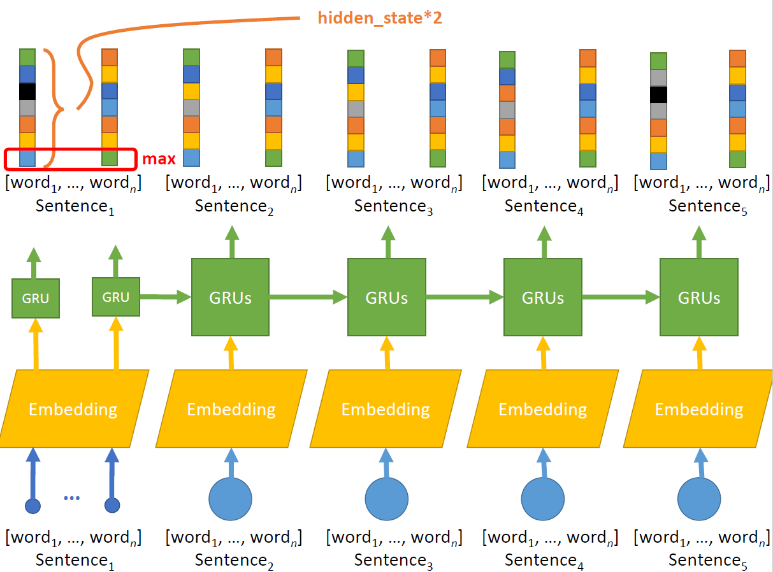
Traditional Document Classification
Image Credit : 人工智慧 戴鴻傑 13AI-CUP

Slide 9
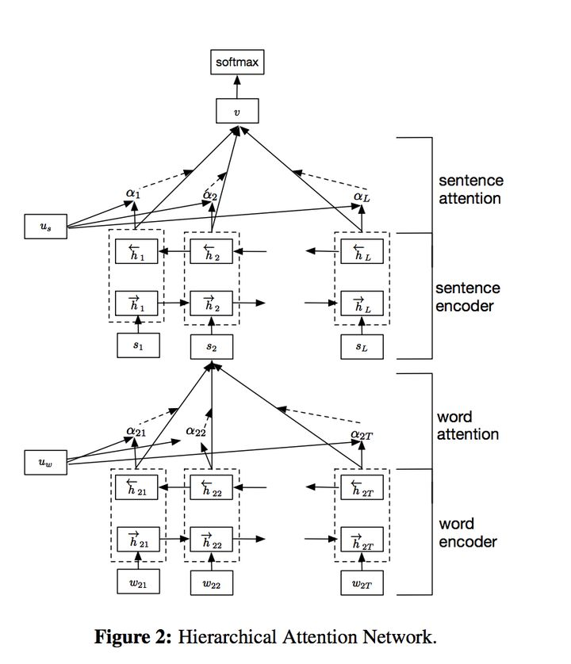
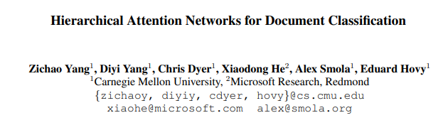
HAN for Document Classification
Publisher : NAACL 2016
Association for Computational Linguistics
https://www.cs.cmu.edu/~./hovy/papers/16HLT-hierarchical-attention-networks.pdf

Slide 10
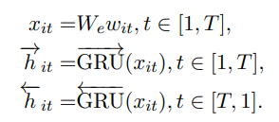
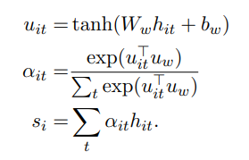
HAN for Document Classification
https://www.cs.cmu.edu/~./hovy/papers/16HLT-hierarchical-attention-networks.pdf

Slide 11
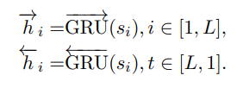
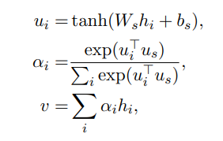
HAN for Document Classification
https://www.cs.cmu.edu/~./hovy/papers/16HLT-hierarchical-attention-networks.pdf

Slide 12
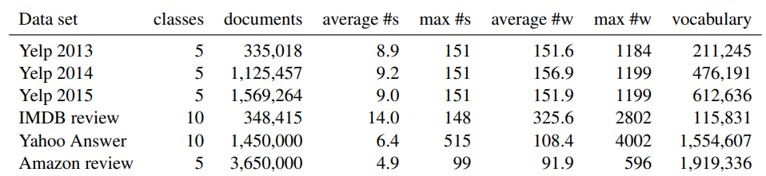
HAN for Document Classification
https://www.cs.cmu.edu/~./hovy/papers/16HLT-hierarchical-attention-networks.pdf

Slide 13
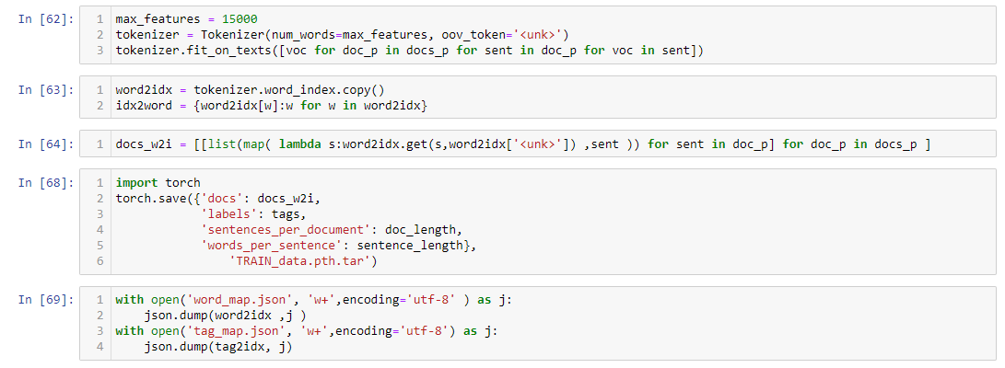
HAN Implementation

Slide 14
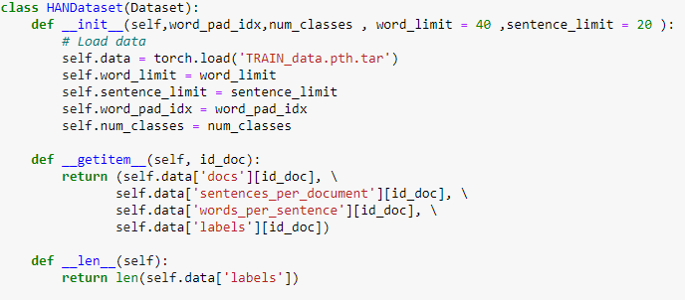
HAN Implementation
To Pack the Sequence

Slide 15
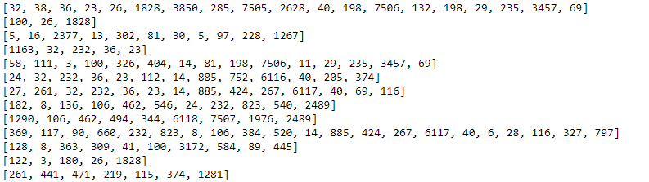
HAN Implementation
docs
sentences_per_document
words_per_sentence
labels

Slide 16
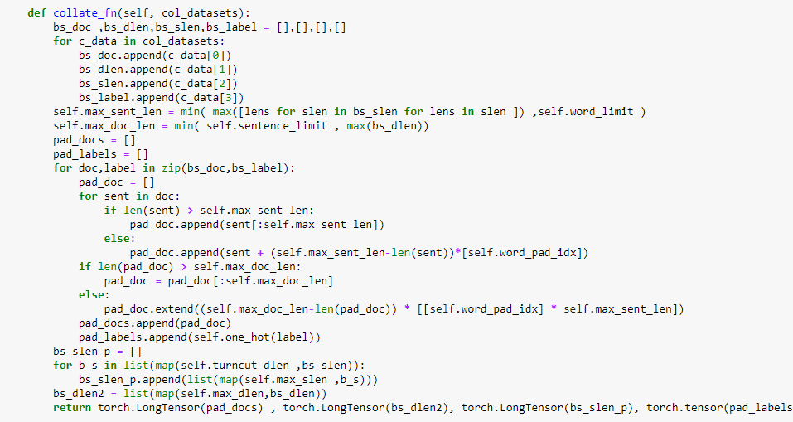
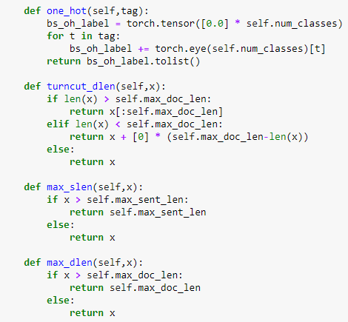
HAN Implementation
Batch for each element
Padding each sentence and document
Revise the exceed number

Slide 17
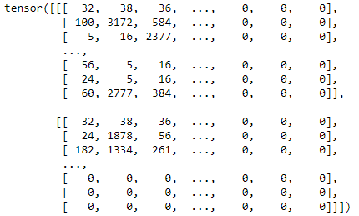
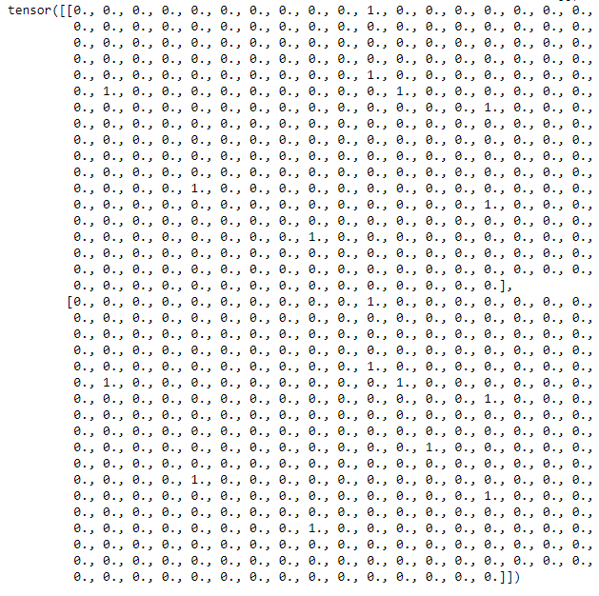
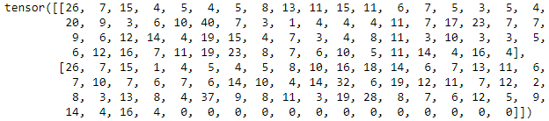
HAN Implementation
labels
docs
Padding the sentence
Padding the document
words_per_sentence

