Slide 1



DOAA CA1
THE GPA GENIE
by Kenneth Chen (2100072)

Slide 2



Objective
Using Machine Learning to predict the effects of health and alcohol on GPA
2022 PRESENTATION

Slide 3
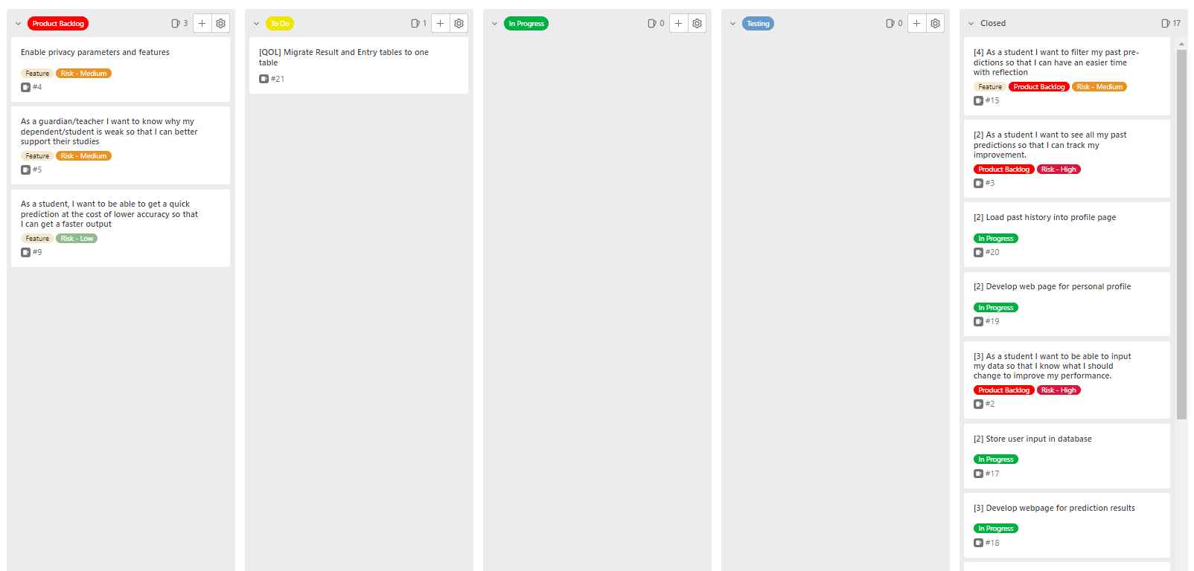

Scrum Board
A look at the
Used
GitLab's milestones for sprints
2022 PRESENTATION

Slide 4



General Information
Automatic Deployment on render at:
https://ca1-the-gpa-genie.onrender.com
Authentication required for non-public pages.
Bypassing the authentication by typing in direct link is addressed and is prevented.
Responsive + Animated website design
using
Tailwind CSS
and JS
username: student
password: student
2022 PRESENTATION

Slide 5


Navbar to move to other pages
Landing page. Click on the lamp to begin the ritual!

Slide 6
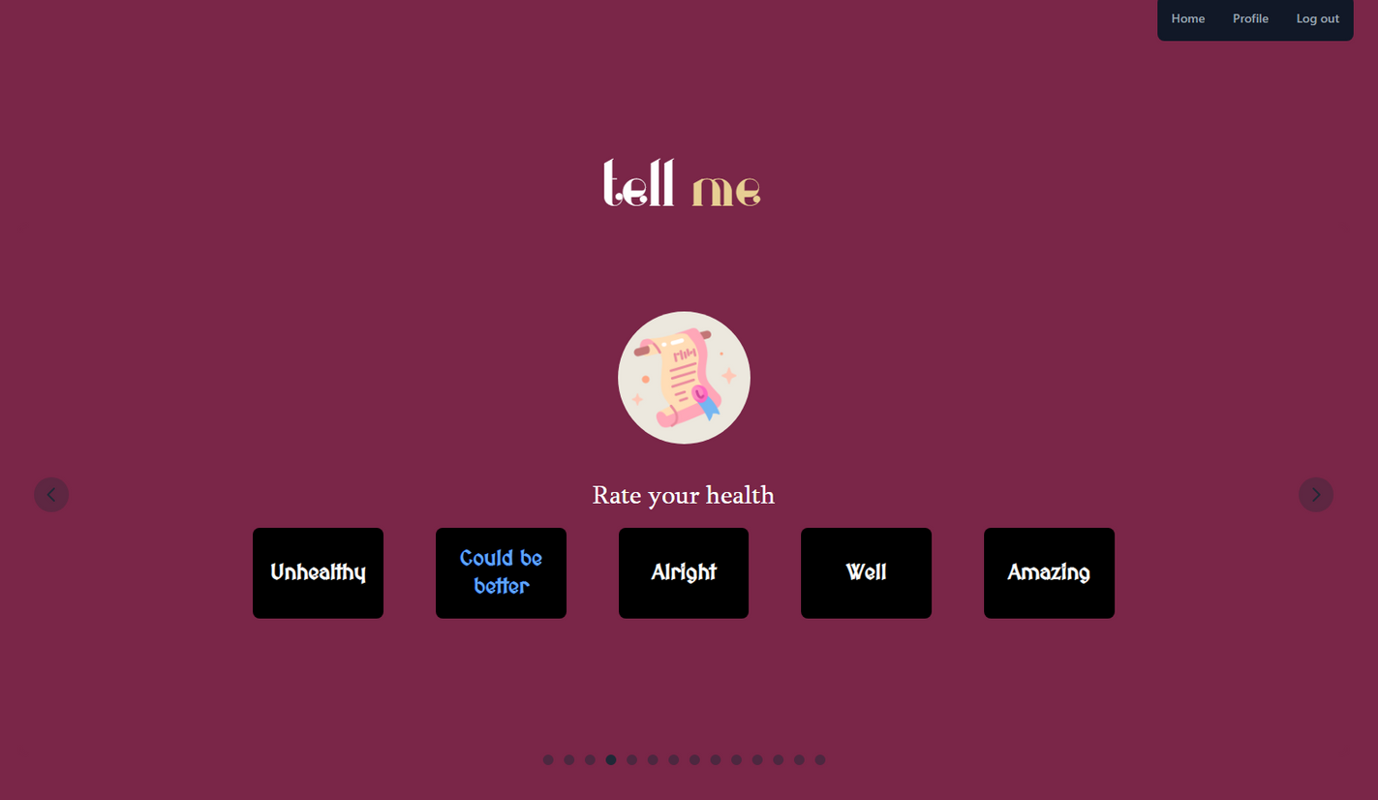
A non-traditional approach for tackling forms.
Click to choose and use the arrows to navigate!

Slide 7
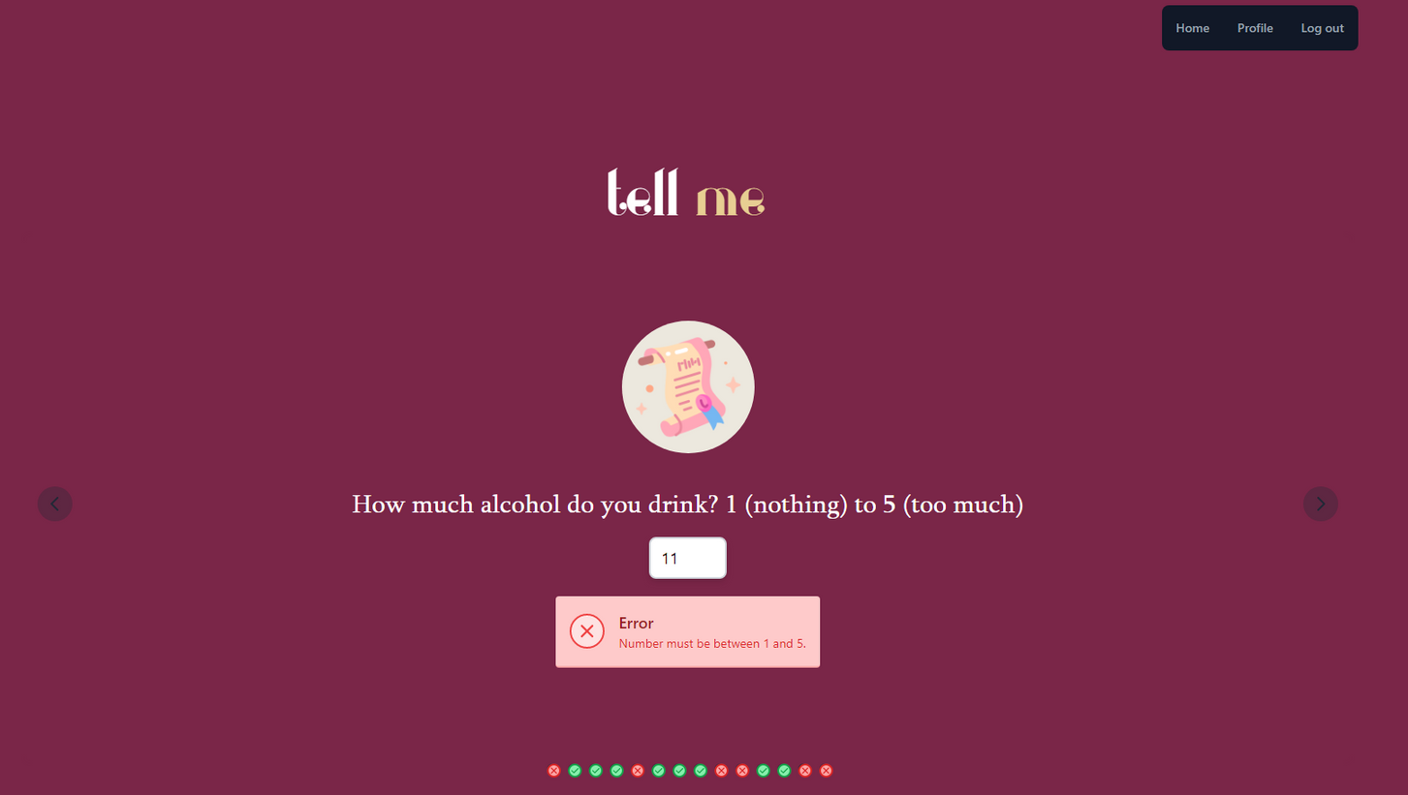

Detailed errors are displayed using Flask's flash() function.
Indicators are also provided to show which questions are valid and which aren't!

Slide 8
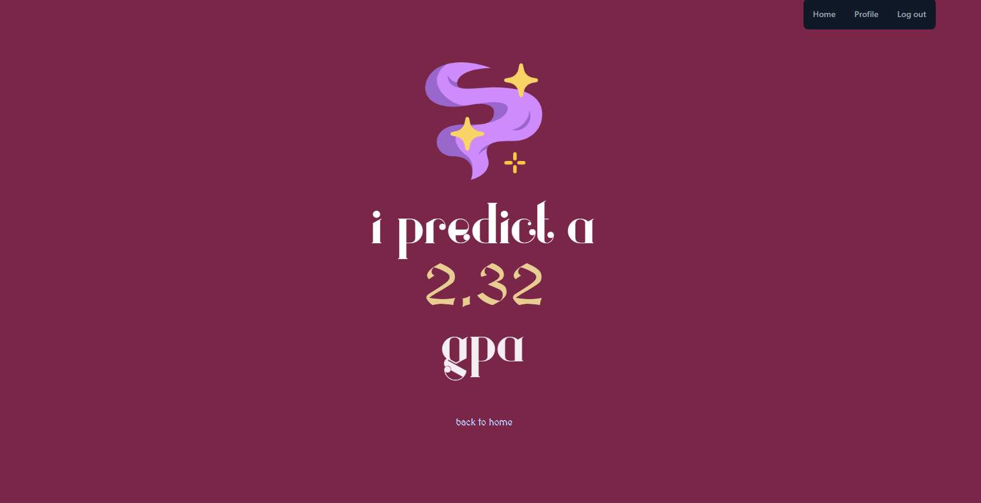
Prediction results are
displayed with a simple
animation

Slide 9
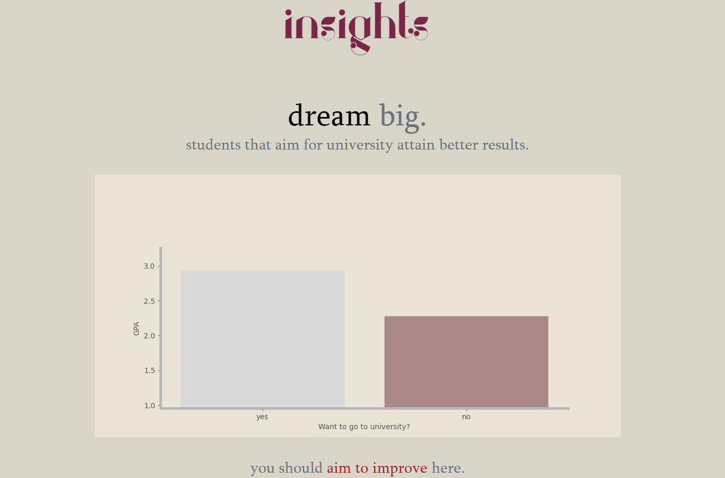
Scroll down to find input-specific insights, showing what went well and what didn't go well.

Slide 10
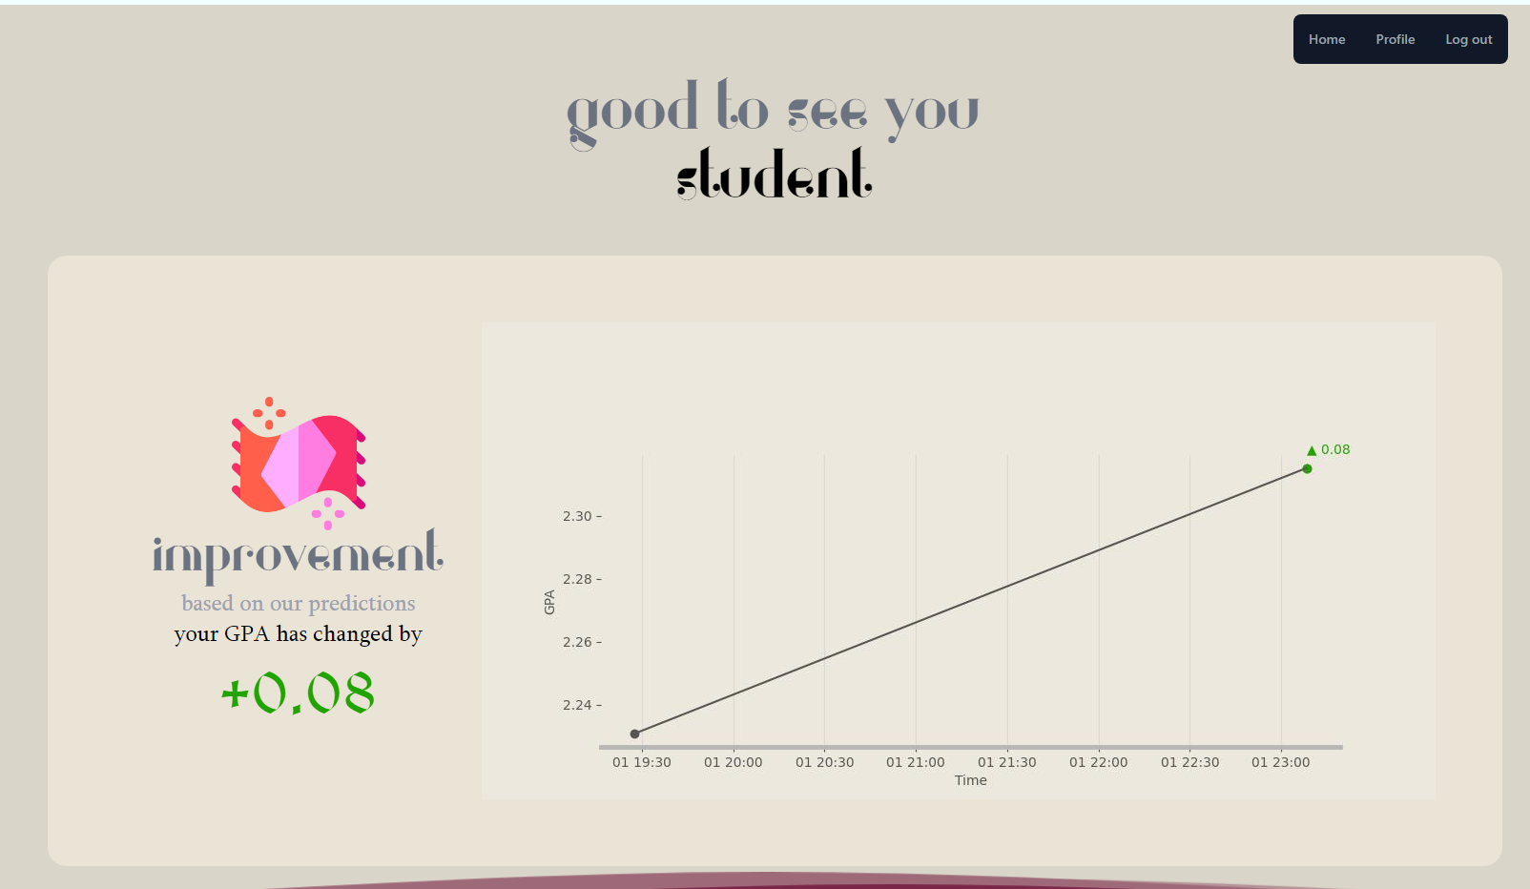
Visit your profile to see your progress!

Slide 11
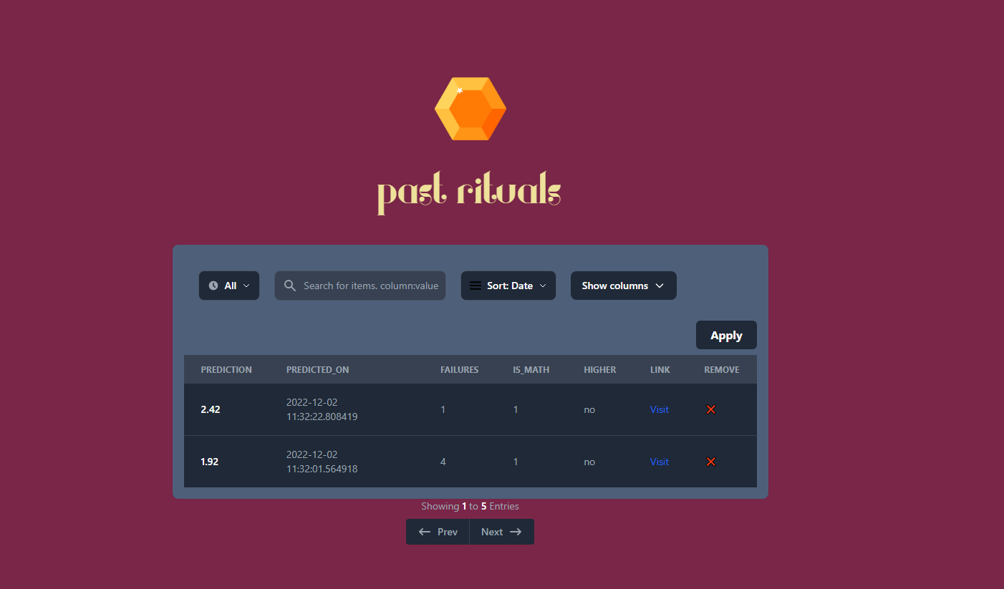


Sort by GPA or Date
Search for keywords
Filter by the previous number
of days
Choose columns to display
Pagination for easy viewing

Slide 12
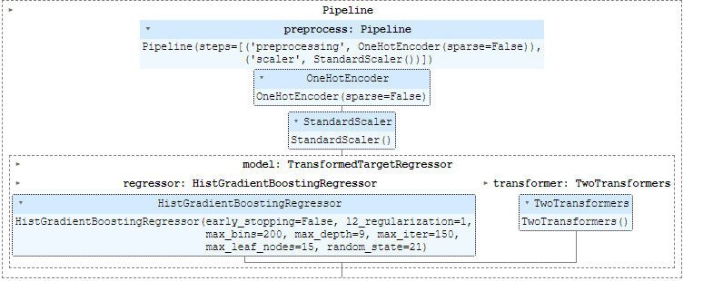
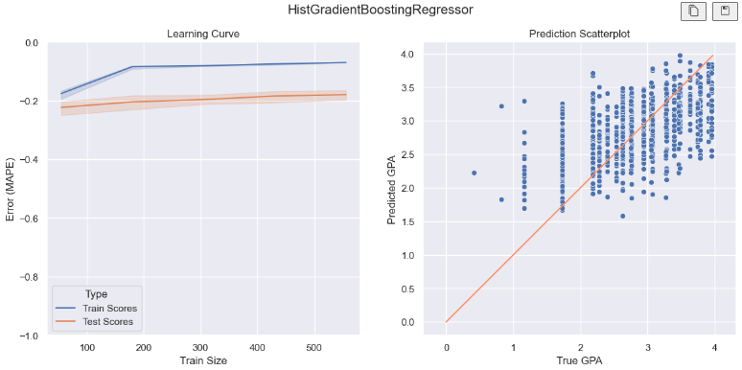
The
Machine Learning Model
Feature Engineering Performed:
Used NUS Bell Curve statistics to transform the original dataset containing the exam marks of the Spanish system to a 4.0 GPA Singapore Polytechnic system.
Standard Scaling
Log Transform on GPA
Total Alcohol = Weekday Alcohol x Weekend Alcohol
Achieved
Test MAPE: 0.165
2022 PRESENTATION

Slide 13
Web APIs
Developed
GET /api/image/<filename>
DELETE /api/image/<filename>
POST /api/predict
API used to perform prediction and gain graphical insights. Token is needed.
Retrieve the image given the filename. Token is needed if the
image is considered sensitive.
Delete the image given the filename. Token is needed.
GET /api/result/<entryid>
GET /api/history
DELETE /api/history/<id>
Retrieve all history of a user with advanced filters and sorting applied. Token is needed.
Given the ID of some history, delete it from the user. Token is needed.
Retrieve information of a specific result given the ID.
2022 PRESENTATION

Slide 14
272 tests performed. Totaling 5,000+ checks
Testing with
PyTest
Validity Testing
Range Testing
Consistency Testing
Expected Failure Testing
Tested on valid data to determine if ordinary data can be used. Referred to examples of data from the dataset.
Negative values for columns such as time, rating and number of failures.
Tested out of bound limits for ratings (e.g. only accepts 1 - 5)
Given identical inputs, checked if the prediction and output are the same.
Tested XFAIL on:
Invalid image names
Non existent images
Non existent data ids
Invalid spellings
Empty strings
Null values
Invalid image format
2022 PRESENTATION

Slide 15

THANK YOU
2022 PRESENTATION

