Slide 1
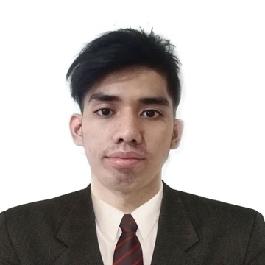
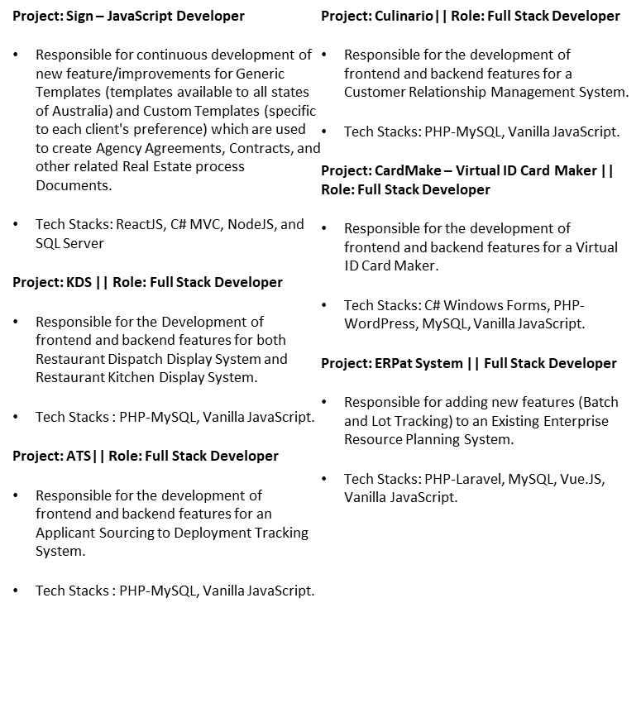
TECHNICAL PROFILE
Ken Lucky Capistrano Application Development Analyst
Manila, Philippines
+639052354143
ken.lucky.capistrano@accenture.com
Relevant Project Experience
An Application Development Analyst with 2-year experience in IT industry specializing in JavaScript(NodeJS, ReactJS, VanillaJS), SQL (MSSQL, MySQL), PHP(Laravel) and C#(.net MVC) Development. Exposed in different fields ranging from Property Tech, Restaurants and Retail Industry.
Qualifications and Certifications
Bachelor of Science in Information Technology, STI College Batangas
Technical Skills
•PHP Laravel – 2 years
•C# MVC – 1 year
•Node.js – 1 year
•Vanilla JavaScript – 2 years
•React.js – 1 year
•MSSQL – 1 year
•MySQL – 2 years
•HTML5, CSS, Bootstrap – 2 years
•Rest API - 2 years
•JIRA – 1 year
•GIT – 2 years
•MS Visual Studio – 1 year

