Slide 1
A Framework for
Text Categorization
Ken Williams, ME(R)
Rafael Calvo, Supervisor

Slide 2
Framework Goals(1)
General design requirements
  Customizable
  Broadly applicable (with people actually using it)
  Interfaces easily with existing TC solutions
  Interfaces easily with other frameworks/tools
  Rapid application development
  Rapid research cycle
  Separable component design
  Open license terms

Slide 3
Framework Goals(2)
Support customization of TC considerations:
  Document format/structure
  Tokenizing, stemming
  Feature selection/extraction
  TF/IDF
  Machine Learning methods
  etc.
Support many use-cases:
  Single-label vs. multi-label categorization
  Single-document vs. batch operations
  “Hard” vs. rank-based categorization
  Client-server vs. monolithic applications
  Text vs. non-text data
  Start-to-finish vs. saved-state scenarios
  On-line vs. batch training

Slide 4
Text Categorization
… the activity of labeling natural language texts with thematic categories from a pre-defined set
[Sebastiani, 2002]
Also called “Text Classification,” “Topic Spotting”
Subfield of Information Retrieval (sometimes)
Cross-pollinates with Computer Science, Linguistics, Mathematics, Statistics, Cognitive Science, among others

Slide 5
Text Categorization
Before 1980’s, TC was mainly only of academic interest
Before early 1990’s, TC was primarily a Knowledge Engineering task (hand-written rules)
Modern approaches use Machine Learning (ML) to induce a categorizer from a training set

Slide 6
Text Categorization
Typical TC applications/buzzwords:
  Data Mining
  Knowledge Management (KM)
  Information Retrieval (IR)
  Expert Systems
  Topic detection and tracking
Related ML fields:
  Clustering
  Recognition
  Filtering

Slide 7
Framework Design
Why create a TC framework?
Two main TC groups: research and industry
These groups do listen to each other, a little
Still, not many reusable TC components, outside of a few commercial systems
  Researchers tend to emphasize results over products
  Industry developers tend to create ad-hoc solutions to their own problems - these don’t generalize
  Generic commercial systems are expensive
This leaves TC inaccessible to the rest of us

Slide 8
Framework Design
What is a framework?
Hierarchy of Object-Oriented (OO) classes providing reusable, customizable solutions to generic problems
More structured than libraries, more concrete than patterns
Frameworks can be combined to make larger frameworks or applications
  Example: an email application may use a messaging framework, a windowing framework, a text categorization framework, and an application framework

Slide 9
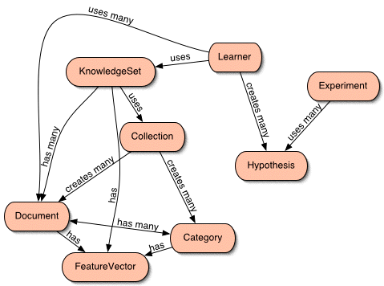
AI::Categorizer Framework

Slide 10
Using AI::Categorizer
Highest-level interface
use AI::Categorizer;
my $c = new AI::Categorizer(...parameters...);
# Run a complete experiment - training on a
# corpus, testing on a test set, printing a
# summary of results to STDOUT
$c->run_experiment;

Slide 11
Using AI::Categorizer
More detailed:
use AI::Categorizer;
my $c = new AI::Categorizer(...parameters...);
# Run the separate parts of $c->run_experiment
$c->scan_features;
$c->read_training_set;
$c->train;
$c->evaluate_test_set;
print $c->stats_table;

Slide 12
Using AI::Categorizer
Uses the Class::Container package, so all parameters can go to the top-level object constructor:
my $c = new AI::Categorizer
(progress_file => 'my_progress',
data_root => 'my_data',
features_kept => 10_000,
threshold => 0.1,
);
Helps create simple config files and command lines, with strict type checking
To Categorizer
To KnowledgeSet
To Learner

