Slide 1

Spring Cloud
Micro services coding session

Slide 2
Agenda
First a (provokingly short) introduction using PowerPoint slides
Then a tutorial that will present and discuss concepts while you build them

Slide 3

Spring Boot
Create stand-alone Spring applications that can be started using java –jar app.jar
Embed Tomcat, Jetty or Undertow directly (no need to deploy in application servers)
Provides opinionated 'starter' dependencies to simplify build configuration
Automatically configure Spring and 3rd party libraries whenever possible
Provides production-ready features such as metrics, health checks and externalized configuration

Slide 4
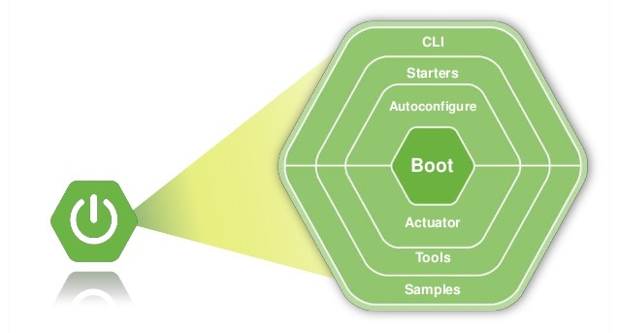
Spring Boot

Slide 5
Spring Cloud
”Spring Cloud provides tools for developers to quickly build some of the common patterns in distributed systems”
”Spring Cloud takes a very declarative approach, and often you get a lot of features with just a classpath change and/or an annotation”

Slide 6
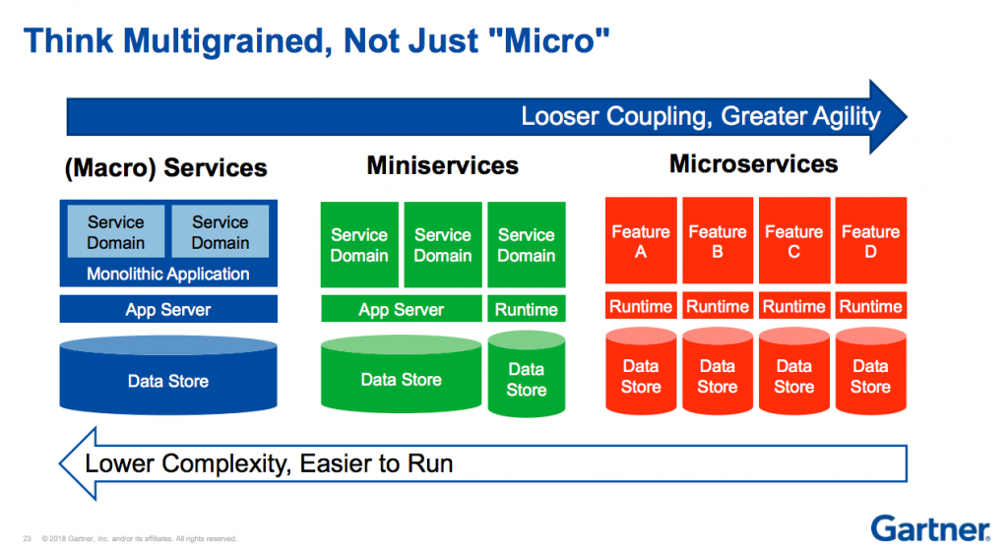
Macro, mini, micro services

Slide 7
Micro services patterns
Decomposition
Integration
Database
Observability
Cross-cutting concerns
Decompose by business capability
API gateway
Database per service
Distributed tracing
External configuration
Service discovery
Circuit breaker
Blue-green deployment
Health check API
Log aggregation
Performance metrics
Shared database per service
CQRS
Event sourcing
Saga
Aggregator
Chained microservice
Branch
Client-side UI composition
Decompose by subdomain
Decompose by transactions
Strangler pattern
Bulkhead pattern
Sidecar pattern

Slide 8
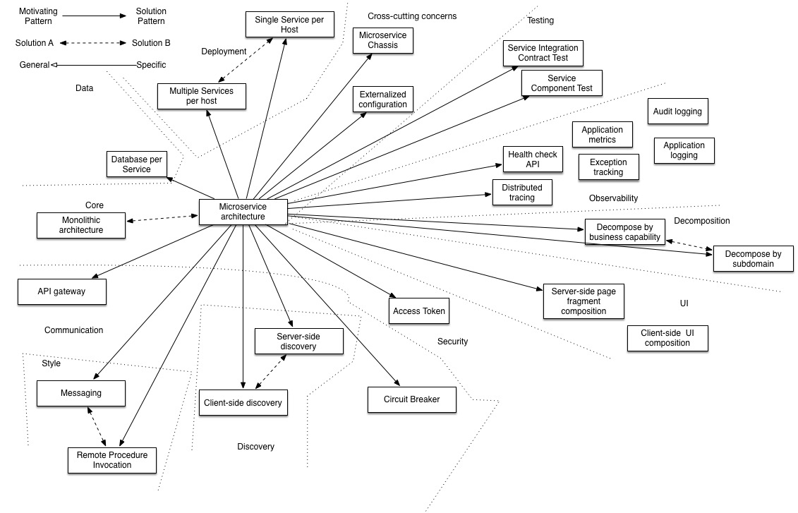
Micro services patterns

Slide 9
Spring Cloud
Centralized configuration
Service registration and discovery
Routing
Service-to-service calls
Load balancing
Circuit breakers
Distributed tracing

Slide 10
Browser/Client
Reads
Config Server
Zuul
Eureka
Reads
Gateway
Service Discovery
Ribbon
8888
20202
8761
Client Load Balancer
Reads
Web Api
8100
Registers
Sends heartbeats
Fetches service routes
Reads
org.springframework.cloud:
spring-cloud-config-server
spring-cloud-config-client
spring-cloud-starter-netflix-eureka-server
spring-cloud-starter-netflix-eureka-client
spring-cloud-starter-netflix-ribbon
spring-cloud-starter-netflix-zuul
spring-cloud-starter-openfeign
spring-cloud-starter-sleuth
Reviews Service
Items Service
9090
8080
9095
8085
Notes:
Tutorial
Kör i din egen takt så långt du hinner – ingen stress
Går utmärkt att fortsätta hemma
Är det någon som inte kör Intellij?
Är det någon som inte har Git?
Hur många jobbar med java idag?
Är maven konstigt?

Slide 11
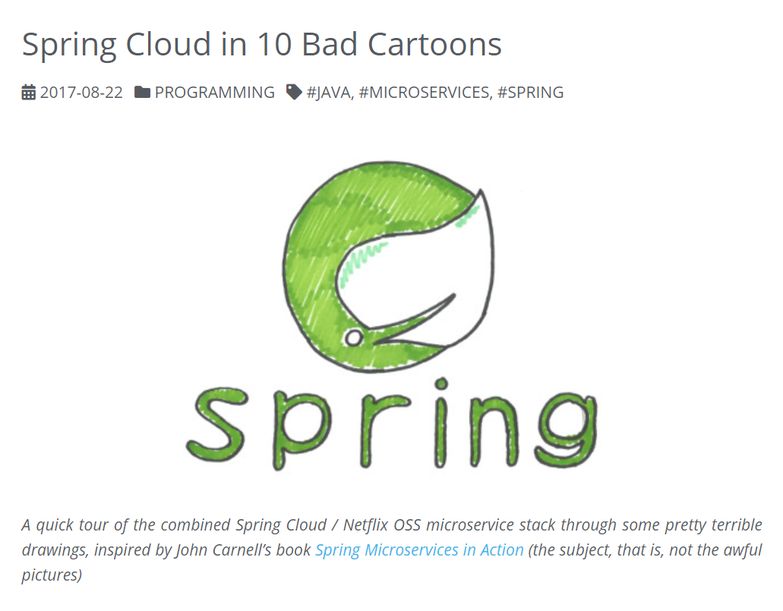
http://lucasmatt.com/2017/08/22/spring-microservices/

