Slide 1
Minesweeper Implementation CPTS 440: Term Project
Project Team 11
Allysa Sewell
Connor Hill
Jacob Ibach
Kenan Anderson

Slide 2
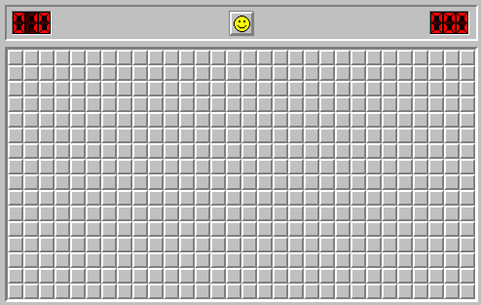
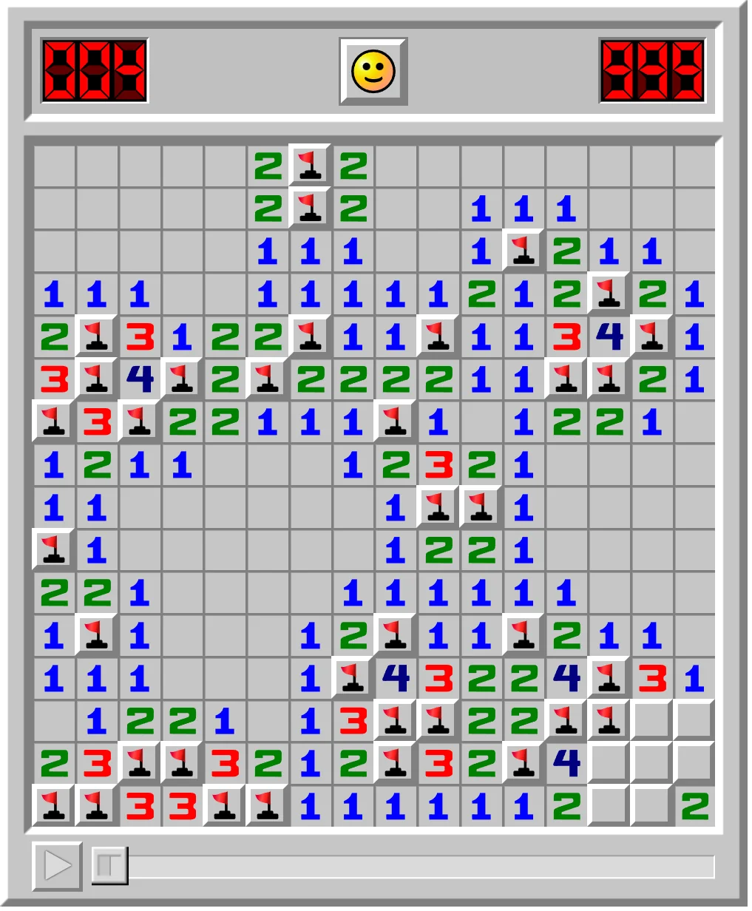
Introduction to Minesweeper:
Minesweeper is a puzzle game from 1990 where the user is shown an empty board of tiles
When the user selects a tile it will display how many mines it is adjacent to, allowing the user to then select any of these adjacent tiles
The goal is to clear the entire board without hitting a mine
To achieve this the user must analyze the probabilities of any given tile being safe
The game is well suited to be played by an AI agent due to its analytical nature

Slide 3
Goals and Desired Outcomes:
The primary goal of this project was to create an agent that can make the most statistically logical move within a game of Minesweeper
This was achieved by using a combination of probability calculations to determine the likelihood of a tile being a mine and a best-first search algorithm to select the best move possible.

Slide 4
Minesweeper Recreation:
In order for our agent to be able to play Minesweeper a recreation of the game was made in Python so that our agent could interact with the game directly.
This required the creation of:
A class to hold the values for the tiles of the board
A function to populate a board with tiles and mines in a way that adheres to the rules of the game
The ability for tiles to be identified and retrieved
Notes:
The class holding the values has a solution array, neighbors array, a list of positions and a list of mines

Slide 5
Best-First Search Implementation:
Since the agent can determine the probability of any frontier node being a mine, these probabilities are put into a list and the lowest probability can be selected as the best possible move.
Example Frontier:
[(0.0, (3, 8)), (1.0, (2, 8)), (1.0, (2, 6)), (1.0, (2, 8)), (1.0, (2, 8)), (1.0, (3, 9)), (1.0, (3, 7)), (1.0, (3, 8)), (1.0, (3, 6))]
Notes:
The tiles that are calculated to have no risk are always placed at the beginning of the list. Tiles with some risk are entered to the front from least risky to most risky while guaranteed mines are placed and left at the back of the frontier.

Slide 6
Probability Calculations:
In order for the agent to make informed decisions it must be able to determine the probability that a tile is unsafe.
This requires:
A frontier of tiles to be created for the agent to reference
For each tile on the frontier the agent must be able to see how many mines its revealed neighbors border
A function to generate all possible configurations of mine locations in the frontier
The probability of a frontier tile being a mine is the ratio of models in which a given square is a mine divided by the total number of consistent models.

Slide 7
Constraint Satisfaction
The CheckConsistency() function is called when determining probabilities to ensure that a given assignment of Mine versus not Mine to a cell does not result in an unsatisfiable configuration, such as a square having a number of adjacent mines that is greater than its allowed number.

Slide 8
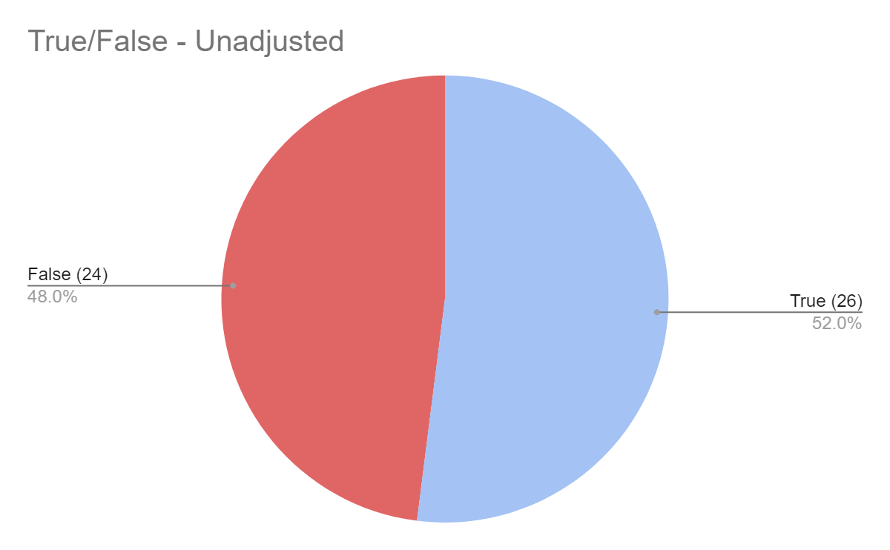
Results
Our model was able to run through 50 implementations with an initial success rate of 52.0%
Each game played took an average of 37.74 seconds. Unsuccessful runs took 61.76 on average, with the Successful runs averaging 15.58 seconds.
Notes:
Mention the luck involved in minesweeper

Slide 9
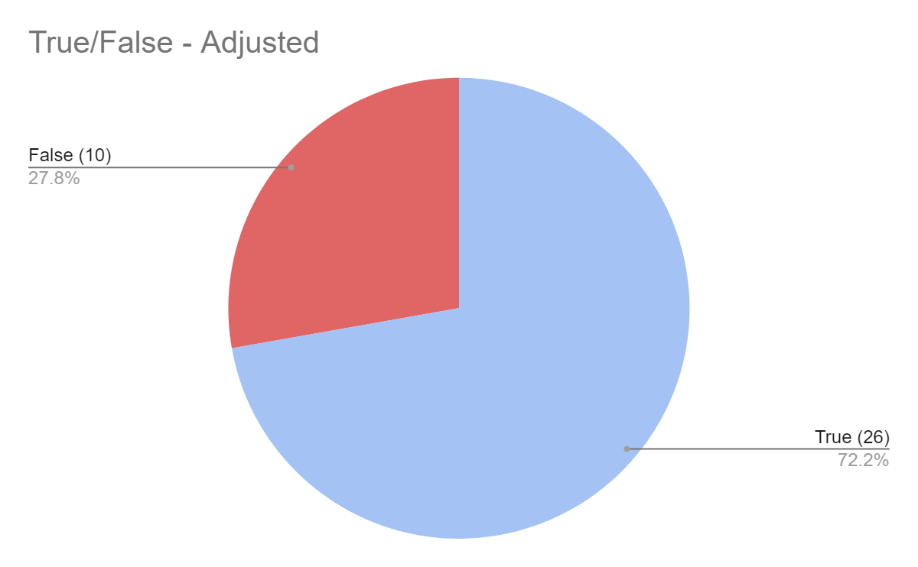
Results cont.
Many of the False results are due to existing outside of our time threshold of 60 seconds. Adjusting the results to stay within the scope of our test model, we get a new average time of 12.89 seconds, with the True average at 15.58 seconds and the False average at 5.89 seconds.
Notes:
Mention the luck involved in minesweeper

Slide 10
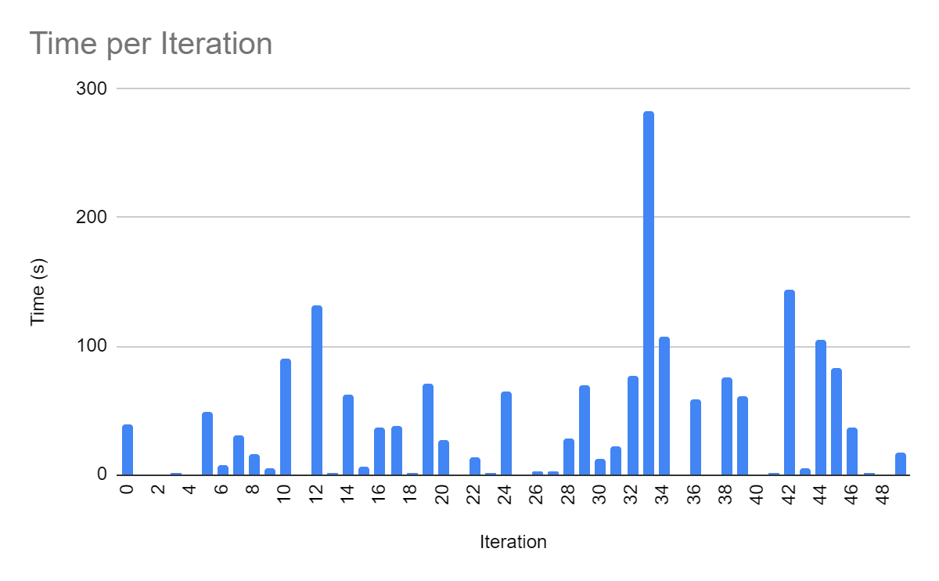
Results cont.
This is an acceptable adjustment as it is impossible to determine results for iterations that took longer than our threshold. We simply stay within a tighter scope for the sake of testing. The following figure reflects the temporal results for our 50 test iterations
Notes:
Mention the luck involved in minesweeper

Slide 11
Conclusion:
Our results, based on 50 game iterations, show a success rate exceeding 72%, which shows the effectiveness of the AI strategies employed. The average time of 12.89 seconds per iteration is acceptable given the number of calculations done.
In conclusion, our project has successfully demonstrated the application of artificial intelligence techniques to solve the Minesweeper puzzle. Through the implementation of best-first search, constraint satisfaction, and Naive Bayes calculations, we have developed a program that not only solves the game with high efficiency but also serves as a practical example of these concepts in action.

