Slide 1

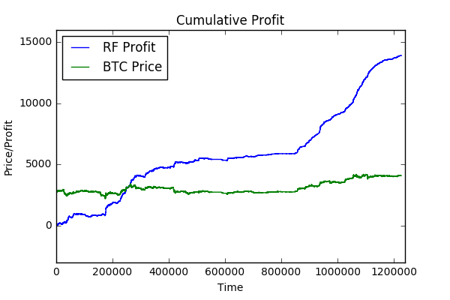
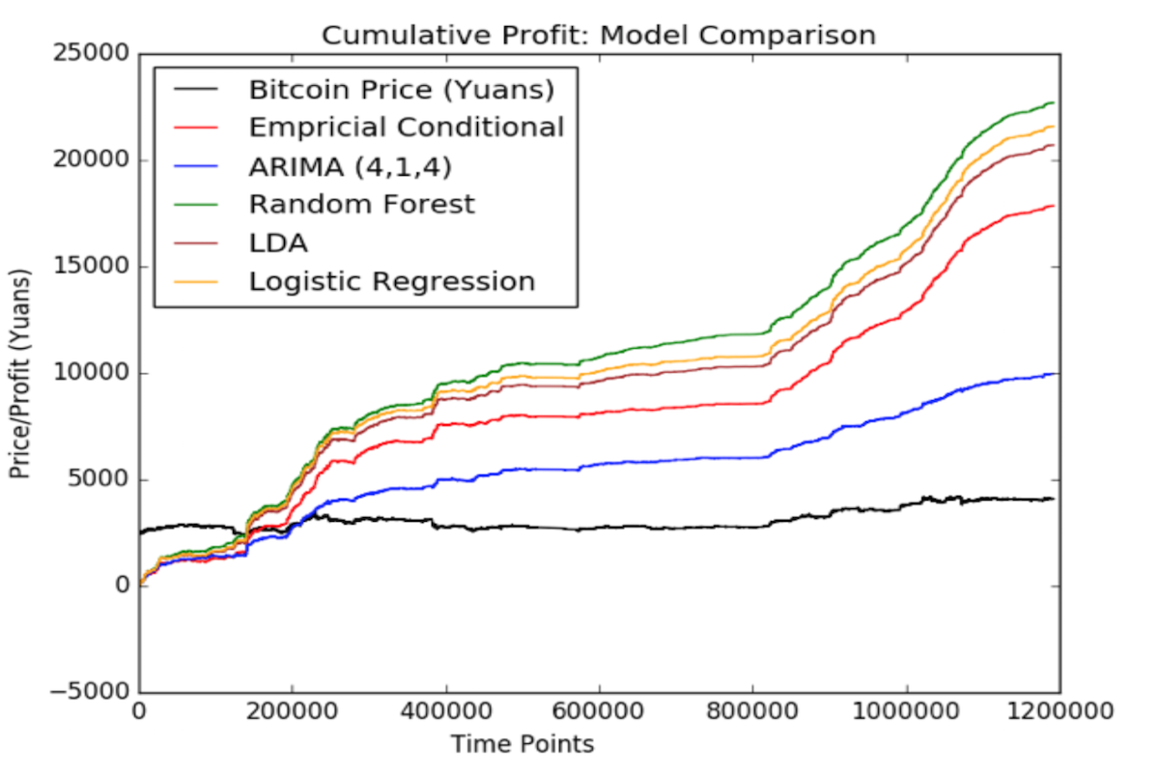
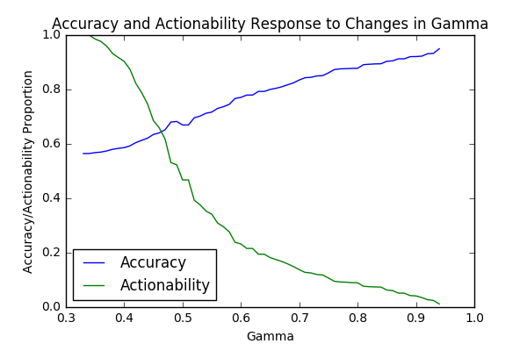
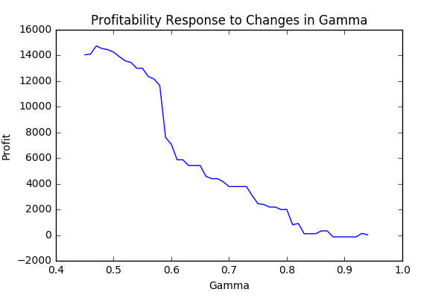
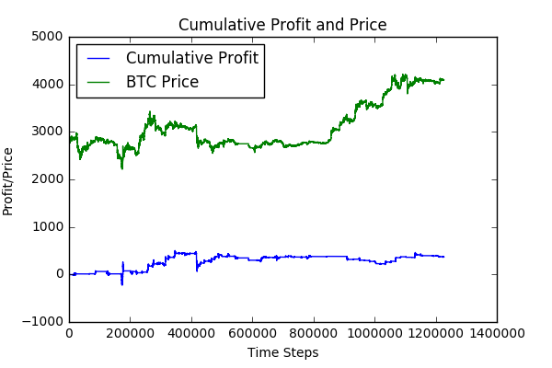
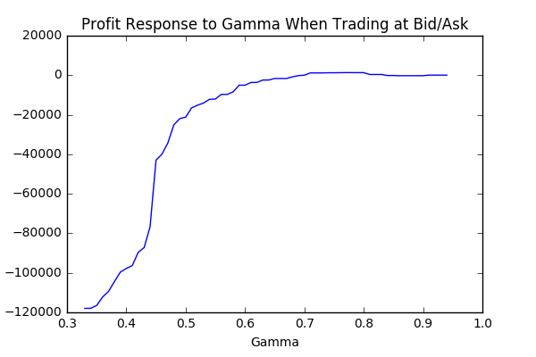
Assessing a Bitcoin Price Prediction Model and Trading Strategy
Eric Mitchell
Advised by: Arvind Narayanan
Department of Computer Science
Introduction & Motivation
Experimental Results
Assessing Strategy Quality
In the past decade, high-frequency trading (HFT) has changed the fundamental behavior of stock markets, collapsing average asset holding times by orders of magnitude (Patterson 2012). In light of this, Amjad and Shah (2016) claim HFT strategies can trade Bitcoin extremely profitably (>500% return in ~2 months). These results far outperform current state-of-the-art trading strategies, and considering the notorious volatility of Bitcoin, there is reason for skepticism (Butler 2016). We re-implement the model and strategy described by Amjad and Shah in order to validate their results under varied conditions. Finally, we conduct a financial analysis of our findings in order to explain the outcomes that we observe.
All charts from period: 04/01/2014 – 06/11/2014
We evaluate the performance of the strategy with a few measures of quality:
In a single train-validate-test cycle, the shape of the profit curve across the duration of the test period using γ
The shape of the end-profit curve produced by trading at many different values of γ
Performance of the strategy when trading at bid and ask prices, as opposed to the mid of the bid and ask
‘Optimal’ profit with validation-selected γ (0.51), trading at mid price
Discussion & Analysis
Research Questions
Reproducing the strategy: Our implementation of the model and strategy described by Amjad and Shah yields similar results to those described in the paper; however, the magnitude of our profit varies from that of Amjad and Shah, sometimes significantly.
γ-stability: The strategy shows reasonable stability when faced with changes to the parameter γ (center, left). Our analysis agrees with that of Amjad and Shah, namely thatγis effective at controlling the aggressiveness of the strategy.
Trading in real-world conditions: Trading at the bid and ask prices consumes almost all of the profit reported when trading at the mid price. A potential reason is that the effective liquidity of the exchange is not high enough to support trading with the strategy; using mid prices for feature generation doesn’t generate sufficient accuracy to account for the spread (effectively a transaction fee).
Accuracy/actionability, profit response to γ, trading at mid price
Can we reproduce the results of the strategy described by Amjad and Shah?
Does the strategy respond stably to changes in the ‘risk-profile’ parameter γ?
Does the strategy perform similarly when trading at the bid and ask prices of a real Bitcoin exchange instead of the mid?
Data Specifications
The exact price history we used was the Bitcoin/Chinese Yuan exchange rate from the Bitcoin exchange OKCoin. We acquired data from the Bitcoin historical data provider Coinigy (market code OK:BTC/CNY). A small amount of data was acquired from Amjad and Shah. For this study, the price history was converted into discretized price changes ({-1, 0, 1} for {decrease, no change, or increase}). Processing performed in Python with pandas and NumPy.
`Optimal’ profit with validation-selected γ (0.81), profit response to γ, trading at bid/ask
Takeaways
Seemingly innocuous assumptions can impact the results of our strategy significantly
When applying analysis techniques across domains, we must ensure that we are tracking the correct signal
High-frequency trading is hard!
Implementation
Prediction model: Random Forest of Decision Trees
Feature generation: Explicit features were extracted from a length-d sub-history of price changes:
The last price change direction
Tallies of decrease, no change, and increase movements
Longest run of consecutive decreases, no changes, or increases
Trading strategy: For predictions with confidence greater than γ, set BTC position to 1 (buying if necessary) if an increase in price is predicted and set BTC position to 0 if a decrease in price is predicted (selling if necessary). Trades performed at 5s time scale.
References
Trading Period | Buy Price | Sell Price | Profit
04/01/2014 - 06/11/2014 | mid | mid | 13,905 Yuan
01/15/2015 - 03/31/2015 | mid | mid | 3,450 Yuan
04/01/2014 - 06/11/2014 | ask | bid | 451 Yuan
01/15/2015 - 03/31/2015 | ask | bid | -17 Yuan
Coinigy. (2016) Downloadable trade history. [Online]. Available: http://www.coinigy.com/bitcoin-data/
M. J. Amjad and D. Shah, “Trading bitcoin and online time series prediction,” in Proceedings from the 2016 NIPS Conference. Conference on Neural Information Processing Systems, 2016.
N. Butler, Personal communication (in person), 2016, 2016-12-01.
S. Patterson, Dark Pools. New York, NY: Crown Business, 2012, pg 46. [Online]. Available: https://books.google.com/books?id=geCHWBx- e9EC&printsec=frontcover&source=gbs ge summary r&cad=0#v=onepage&q&f=false
Generous Thanks to the University of Texas, Austin for the base template design

