Slide 1

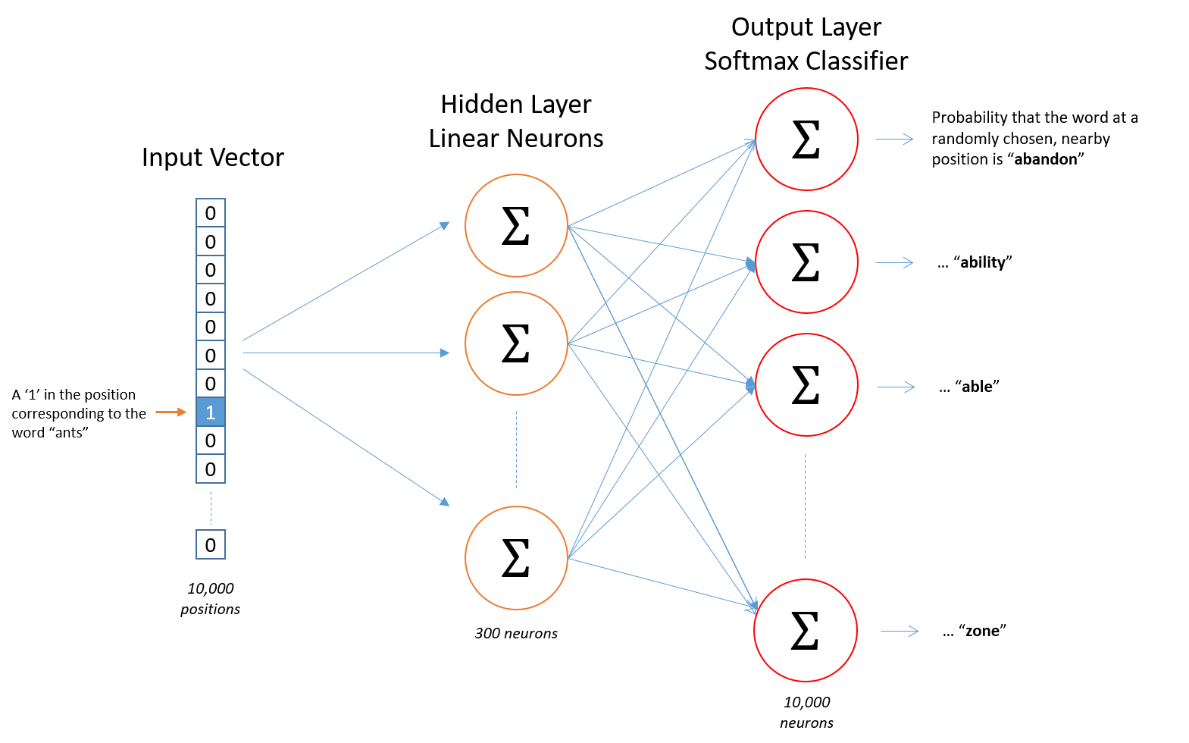
Detecting Quora Duplicate Questions
Kenan Farmer
Department of Computer Science
Charles Stahl
Department of Physics
Meir Hirsch
Department of Computer Science
Introduction & Motivation
Data
Methodology
Quora is a website that strives to connect people from different backgrounds to be able to answer questions whose answers are "either locked in people’s heads, or only accessible to select groups" [1]. 100 million people visit Quora every month to ask , answer, or view questions. Once these questions are answered, any other person should be able to find the responses. However, sometimes people are unable to find the questions they want and end up asking the same question again. This counteracts Quora's vision of having "only one version of each question\dots [not] a left wing version, a right wing version, a western version, and an eastern version” [1].
The data were made available by Quora on Kaggle, a website that hosts data analysis competitions [2].
Training data consists of 404,302 question pairs labeled as duplicates or not.
Most non-duplicates are near-duplicates, while
“What is the step by step guide to invest in share market in india?” and “What is the step by step guide to invest in share market?” are not duplicates
“How can I be a good geologist?” and “What should I do to be a great geologist?” are duplicates
Testing data consists of 2.3 million pairs, made from 4.2 million distinct questions. The testing set is unlabeled.
Feature vectors from all
Linear regression – baseline
Logistic regression
Stochastic gradient descent
Random forest of decision trees
Assessment
Results
All methods were cross validated using the training data. Quora also provides an unlabeled test set. The website accepts submissions of probabilities for each pair in the test set.
Submissions to Kaggle were scored with a log-loss score, penalizing incorrect guesses with higher certainty.
Our best method, \_\_\_\_, achieved a log-loss of \_\_\_\_, putting us at \_\_\_\_ on the leaderboard for the challenge.
Method 1 – Word Counts
Research Questions
What common features indicate that two questions are duplicates?
How does word embedding improve prediction capability?
Is there latent structure indicating the meaning of a question? How do we access it using machine learning methods?
What advantages does interpretable learning offer that neural networks do not?
Discussion & Analysis
Feature Engineering
Simple similarity score using bag-of-words, tf-idf
word2vec: Embeds words in pre-trained vector space
Focusing on word differences
Parts of speech
Wordnet
Method 1 – Word Counts
Looking Forward
Near future: finish training a word2vec model and getting a submission from that. Hopefully this will improve our standing.
Farther out: More thoroughly compare our interpretable results with the results from neural networks. On which pairs does the NN perform better? On which does our perform better?
References
https://www.quora.com/about
https://www.kaggle.com/c/quora-question-pairs
http://mccormickml.com/2016/04/19/word2vec-tutorial-the-skip-gram-model/
[3]
Generous Thanks to the University of Texas, Austin for the base template design

