Slide 1
Introduction to Multimedia Homework 3
104062361
陳永恒

Slide 2
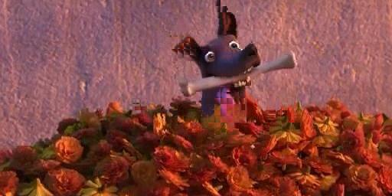
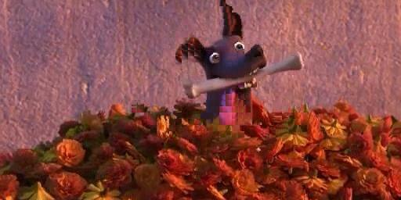

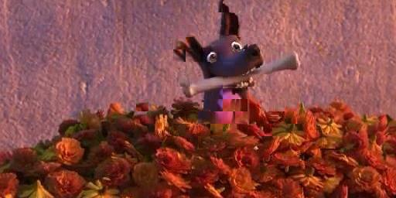
Predicted images (full search)
Block size=8; Range=8
Block size=8; Range=16
Block size=16; Range=8
Block size=16; Range=16

Slide 3




Predicted images (3-step search)
Block size=8; Range=8
Block size=8; Range=8
Block size=16; Range=8
Block size=16; Range=16

Slide 4
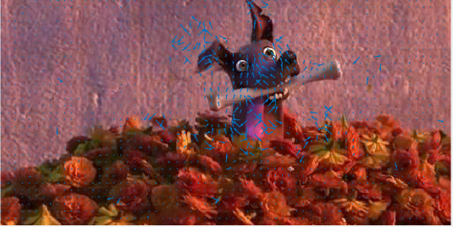
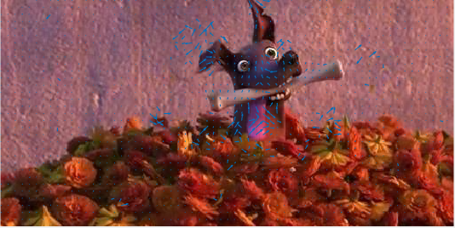
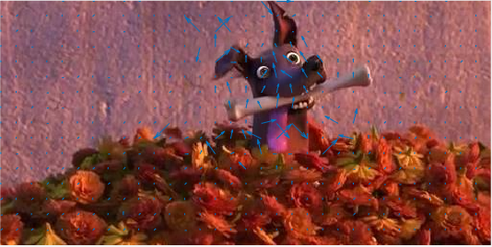
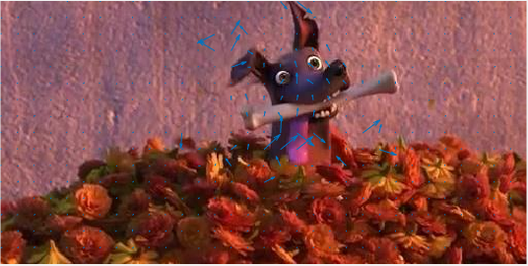
Motion Vector (full search)
Block size=8; Range=8
Block size=8; Range=16
Block size=16; Range=8
Block size=16; Range=16

Slide 5
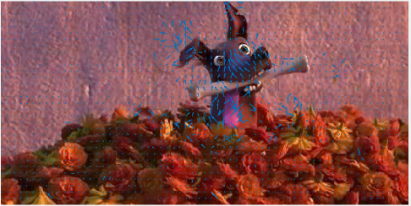
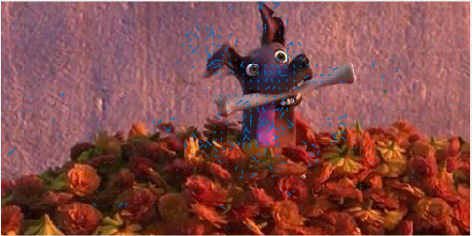
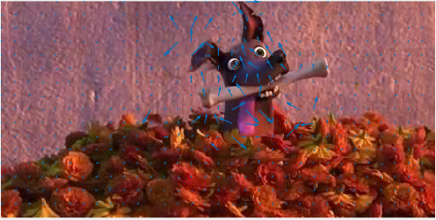
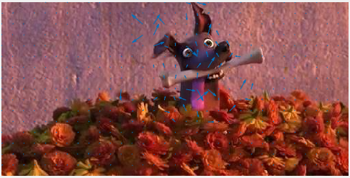
Motion Vector (3-step search)
Block size=8; Range=8
Block size=8; Range=16
Block size=16; Range=8
Block size=16; Range=16

Slide 6
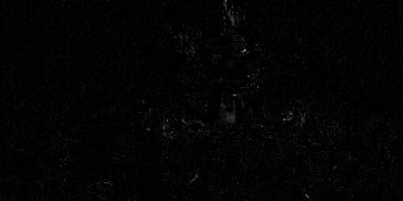
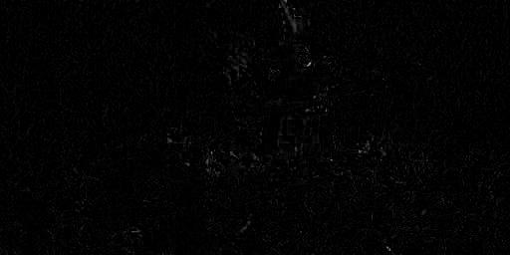
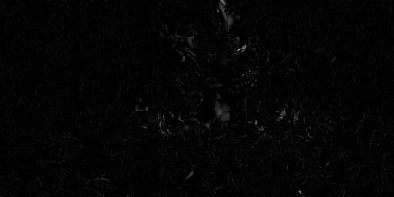
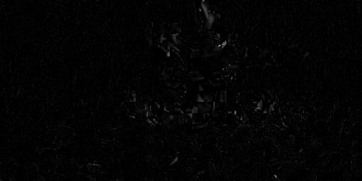
Residual image (full search)
Block size=8; Range=8
Block size=8; Range=16
Block size=16; Range=8
Block size=16; Range=16

Slide 7
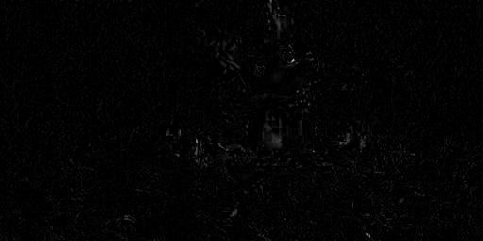
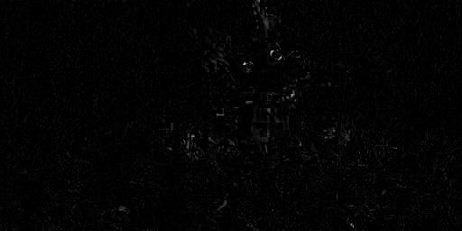
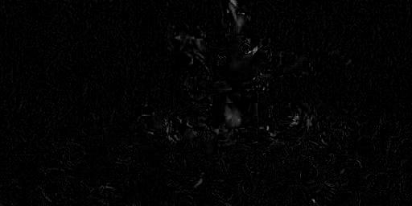
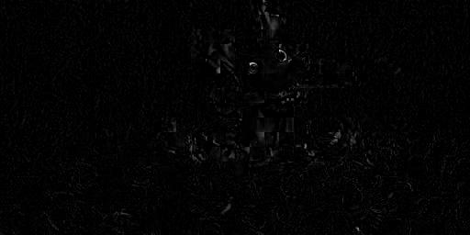
Residual image (3-step search)
Block size=8; Range=8
Block size=8; Range=16
Block size=16; Range=8
Block size=16; Range=16

Slide 8
Implement Full Search
Divide target frame in blocks
For processing each target frame block, draw the search range in reference frame
Compare every pixel for target frame and reference → we can get SAD
Use the smallest SAD and put the block from reference to estimated frame.
Motion Vector = motion_estimation = difference between reference frame block and target frame block

Slide 9
Implement Three-step search
Same as full search, just edit some parts
Three-step-search when draw the search range: (skip p pixel)
for ii=center_py-search_range : search_range : center_py+search_range
for jj=center_px-search_range : search_range : center_px+search_range
Full search search when draw the search range: (every pixel)
for ii=y_start-range : y_start+range
for jj=x_start-range : x_start+range

Slide 10
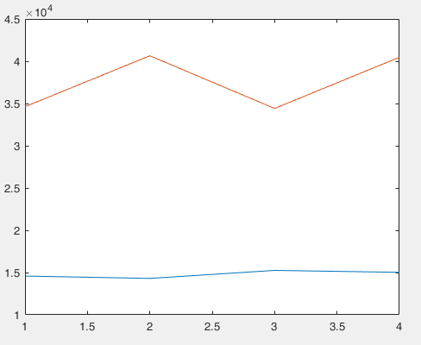
Total SAD
1: Block size=8; Range=8
2: Block size=8; Range=16
3: Block size=16; Range=8
4: Block size=16; Range=16
Orange: Full
Blue: Three-step

Slide 11
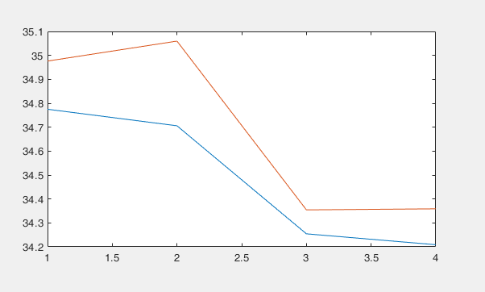
PSNR
1: Block size=8; Range=8
2: Block size=8; Range=16
3: Block size=16; Range=8
4: Block size=16; Range=16
Orange: Full
Blue: Three-step

Slide 12
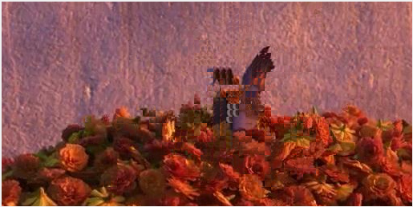
For frame432 and frame 439
PSNR = 33.9985

Slide 13
Execution time for two search algorithms
 | Block size=8 Range=8 | Block size=8 Range=16 | Block size=16 Range=8 | Block size=16 Range=16
3-Step search | 1.1010 | 1.2919 | 0.3694 | 0.4957
Full search | 9.2096 | 33.1688 | 2.8472 | 10.3994

Slide 14
Compare and discuss the execution time with the theoretical time complexity
3-Step search is much faster than Full search
Full search scan every pixel in the search range, 3-step skips and reduce search range for every loop
Block size larger, less execution time
Range larger, more execution time

