Slide 1
Introduction to Multimedia Homework 2
104062361
陳永恒

Slide 2
Q1. Create FIR filters to filter audio signal

Slide 3
Determine the filters
There are 3 songs combined into 1 music file. This is clear that they are in 3 separate frequency boundary.
As the Ideal Filters are provided, I choose Low-pass, High-pass and bandpass filter.

Slide 4
Implement the Filter and convolutions
Ideal Filter is rectangle function in frequency domain. In theory, we have to apply DFT(frequency domain) and inverse DFT(time domain) in the filter. Lecture notes provides the algorithm implementation for time domain. So I can follow the formula provided and apply convolution.
if strcmp(filterName, 'low-pass') == 1
for n = -floor(N/2)+1: floor(N/2)
if (n==0) fltr(middle) = 2*fcutoff1;
else fltr(n+middle) = sin(2*pi*fcutoff1*n)/(pi*n);
end
end
elseif strcmp(filterName, 'high-pass') == 1
…
elseif strcmp(filterName, 'bandpass') == 1
…
end

Slide 5
Implement the Filter and convolutions
Before apply convolution, window function are necessary to make the impulse response finite (a sin function goes on infinitely in +ve and –ve directions.)
Call the convolution function conv_imple.m, apply the filter on input audio.
if strcmp(windowName,'Blackman') == 1
for n = 1: N
fltr(n)=fltr(n)*( (0.42)-0.5*cos((2*pi*n)/(N-1))+0.08*cos((4*pi*n)/(N-1)));
end
end

Slide 6
Apply the filter to separate the mixed song
 | Low-pass Filter Low frequency song | High-pass Filter High frequency song | Bandpass Medium boundary song
N(Window size) | 1999 | 1999 | 1999
Cutoff frequency (Hz) | 350 | 800 | 400-700
If N is higher, the higher possibility to give a sharp cut for separating the song.
To get the cutoff frequency, it is necessary to listen the output audio and repeat the process to get the best result.

Slide 7
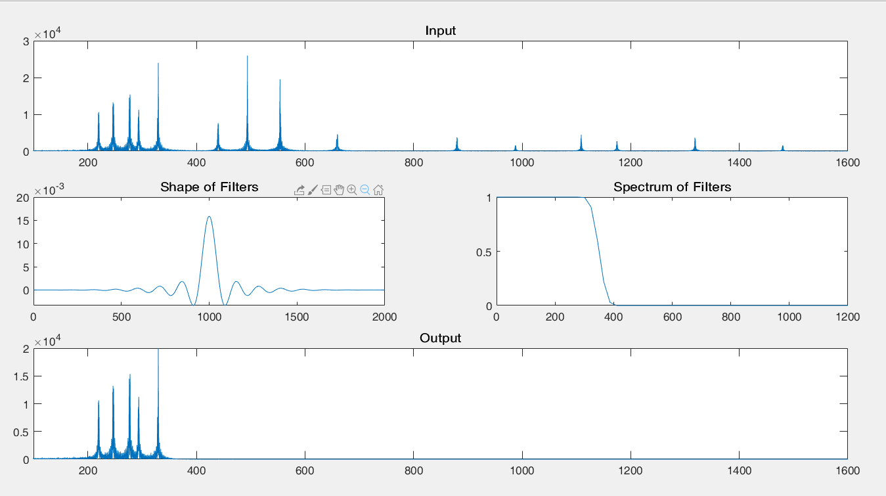
Compare spectrum and shape of filters– low pass
The spectrum of filter is correctly. It filters out the signal above 350Hz.
The shape of filters meets my expectation as it is the same the figure given in lecture notes.

Slide 8
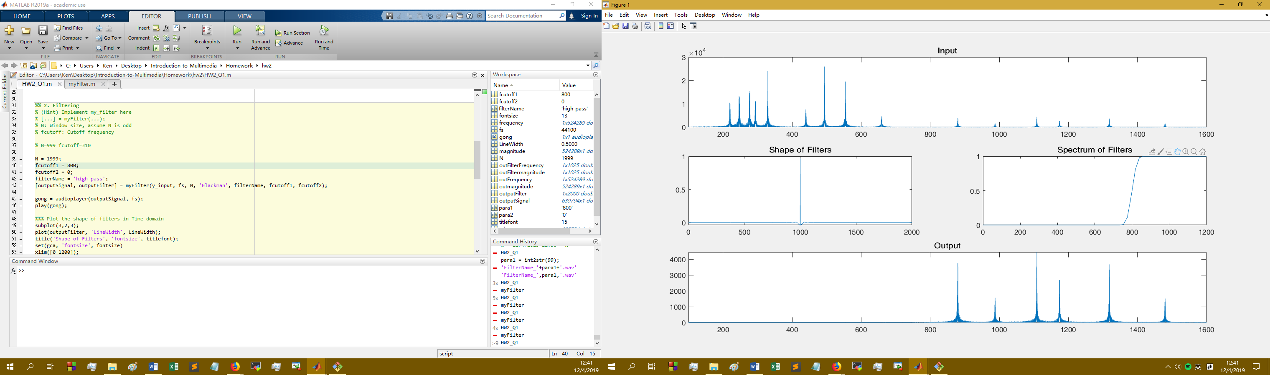
Compare spectrum and shape of filters– high pass
The spectrum of filter is correctly. It filters out the signal below 800Hz.
I don’t know if the shape of filters(amplitude vs time) is reasonable because applying filter convolution to audio, audio in the section in 1000 will be remained, and minimize in others.

Slide 9
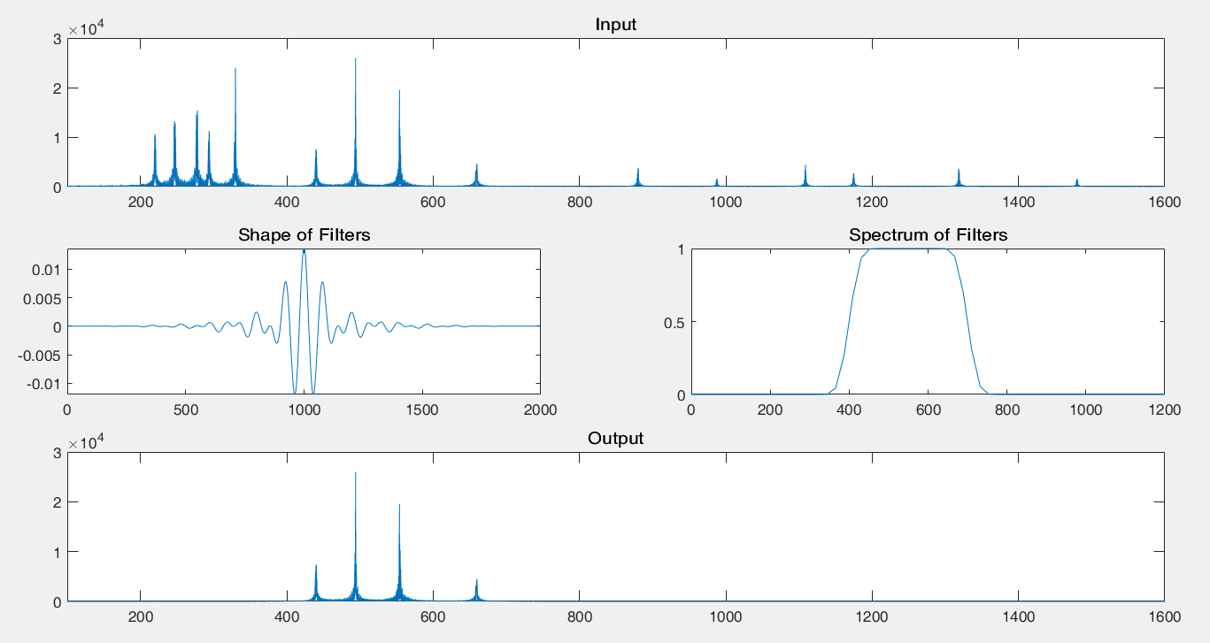
Compare spectrum and shape of filters– bandpass
The spectrum of filter is correctly. It remains the signal between 400 and 750Hz.
The shape of filter: Mentioned in preious page, I don’t know if the shape of filters(amplitude vs time) is reasonable.

Slide 10
Implement the one/multiple fold echo
% one-fold echo
[row, col] = size(outputSignal);
oneEcho = zeros(row, 1);
for n = 1: row
if (n-3200 > 1)
oneEcho(n, 1) = outputSignal(n, 1) + 0.8*outputSignal(n-3200, 1);
end
end
fs=44100Hz, time difference of echo and original signal = 3200/fs = 0.07s
Adding signal before 0.07s is so weak, nearly no effect.
Reference: http://mirlab.org/jang/books/audiosignalProcessing/filterApplication_chinese.asp?title=11-1%20Filter%20Applications%20(%C2o%AAi%BE%B9%C0%B3%A5%CE)

Slide 11
Implement the one/multiple fold echo
% multiple-fold echo
multiEcho = zeros(row, 1);
for n = 1: row
if (n-3200 > 1)
multiEcho(n, 1) = outputSignal(n, 1) + 0.8*multiEcho(n-3200, 1);
end
end
0.8*multiEcho(n-3200, 1) brings the previous signal that can give a really strong effect.

Slide 12
Reducing sampling rate
Low-pass (~350Hz): No difference
Bandpass (400~750Hz): No difference
High-pass (800Hz~): Some high pitch signals are filtered out.
From the graph, we can see that there are highest frequency signals component is 1500Hz. By Nyquist’s Sampling Theorem, the sampling rate must at least twice highest frequency component ~= 3000Hz > 2000Hz.
So, the result within expectation.
Note: 2kHz music only works with Windows Media Player, MATLAB audioplayer(), player() and iTunes(Windows)

Slide 13
Q2. Audio dithering and noise shaping

Slide 14
Implement Bit Reduction
input8bits = uint8( (input + 1)/2 * 255 );
audiowrite('Tempest_8bit.wav', input8bits, fs, 'BitsPerSample', 8);
The raw data(16-bit) is normalized between -1 to 1. Apply the function above which can transfer data into 0 to 255. uint8() means data are in 8-bit.

Slide 15
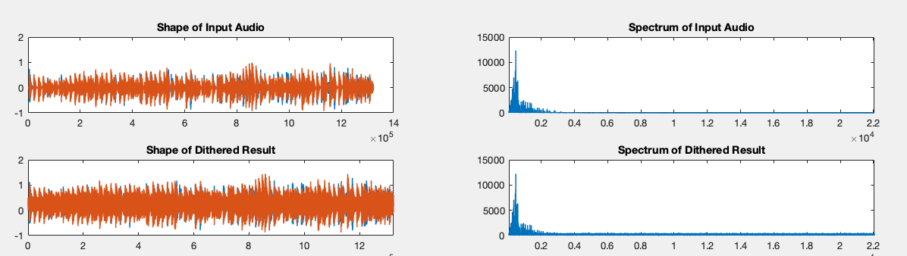
Implement Audio Dithering
input8bits_dither = input8bits_nor + rand(size(input8bits_nor))/5;
Audio Dithering is add random noise. We can see that the amplitude of audio is larger than the input significantly. (Shape of Audio)
Magnitude in high frequency is also larger than the input. (Spectrum of Audio)

Slide 16
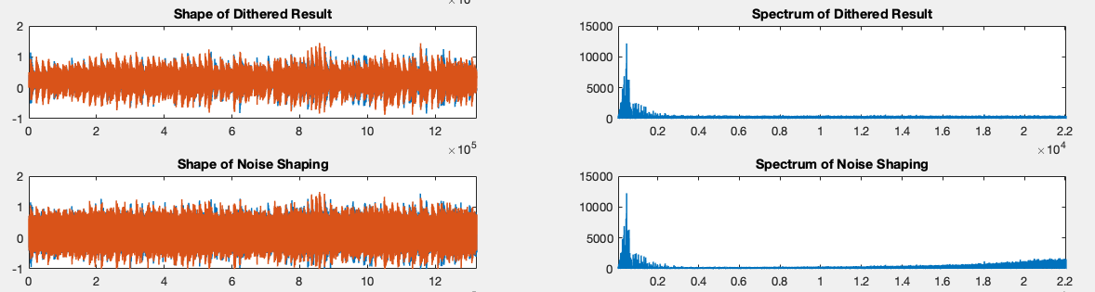
Implement Noise Shaping
for C = 1: col
for R = 1: row
if (R-1 >= 1)
shapingOutput(R, C) = shapingOutput(R, C)+
c*(input8bits_nor(R-1,C)-shapingOutput(R-1,C));
end
end
end
Redistribution the quantization error so that the noise is concentrated in the higher frequencies.

Slide 17
Implement Low-pass Filter
Same way in Q1. However, this is stereo audio(two sound play together). I have modified the code to fulfill this situation.
Implement of Audio Limitation
This is hard clipping. As the data has been normalized during audioread() i.e. data should be -1<y[x]<1. After audio dithering, random sharping, applying low-pass filter will be excess the boundary. Every number less than -1 will assign as -1, larger than 1 will be assign as 1.

Slide 18
Implement Normalization
desireMax = .5;
for C = 1: col
ampM = max(limitingOutput(:,C));
normalizeOutput(:,C) = limitingOutput(:,C)*(desireMax/ampM);
end
Find the highest amplitude sample, determine the rate of amplify and raise all samples with amplify rate.

Slide 19
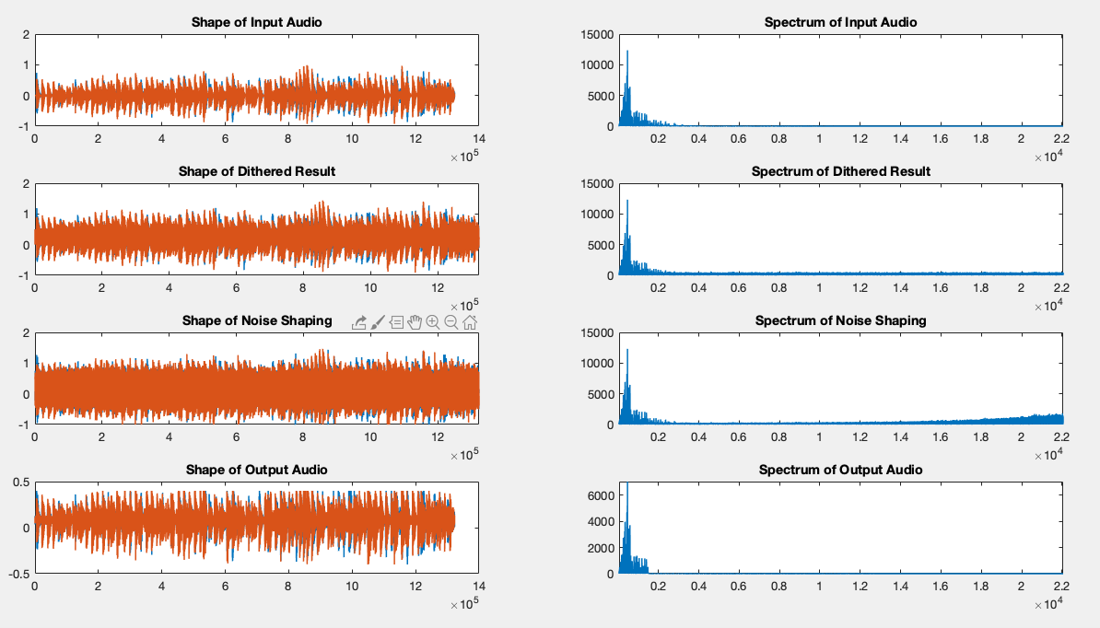
Final Result
In Spectrum of Output, thanks for Low-pass Filter, the high frequency noise is filtered out.
Normalization used to set the Maximum amplitude(0.5 in this case).
Note: All spectrum in Q2 has been chipped because amplitude of 0Hz is extremely high, which is not helpful for analysis.

