Slide 1
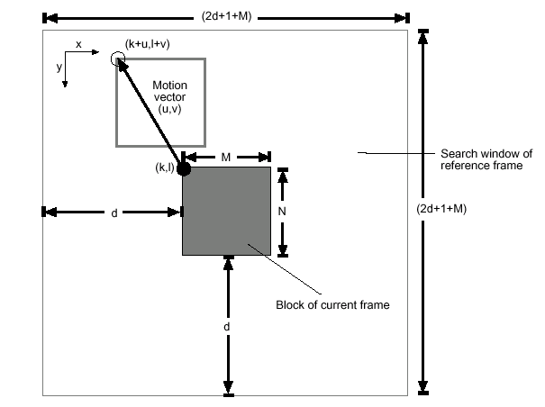
Full Search

Slide 2
The Exhaustive Block-Matching Algorithm
Reference Frame
Current Frame
Motion
Vector
|A|=12
12 22 33 44 55 66 77 88
12 22 33 44 55 66 77 88
12 22 33 44 55 66 77 88
12 22 33 44 55 66 77 88
11 23 34 44 55 66 77 88
11 23 34 44 55 66 77 88
11 23 34 44 55 66 77 88
11 23 34 44 55 66 77 88
11 22 33 44 55 66 77 88
11 22 33 44 55 66 77 88
11 22 33 44 55 66 77 88
11 22 33 44 55 66 77 88
11 22 33 44 55 66 77 88
11 22 33 44 55 66 77 88
11 22 33 44 55 66 77 88
11 22 33 44 55 66 77 88
1 0 0 0 0 0 0 0
1 0 0 0 0 0 0 0
1 0 0 0 0 0 0 0
1 0 0 0 0 0 0 0
0 1 1 0 0 0 0 0
0 1 1 0 0 0 0 0
0 1 1 0 0 0 0 0
0 1 1 0 0 0 0 0
Search Range

