Slide 1
Research Ethics in Computer Science
Nan Guan
Department of Computer Science
City University of Hong Kong

Slide 2
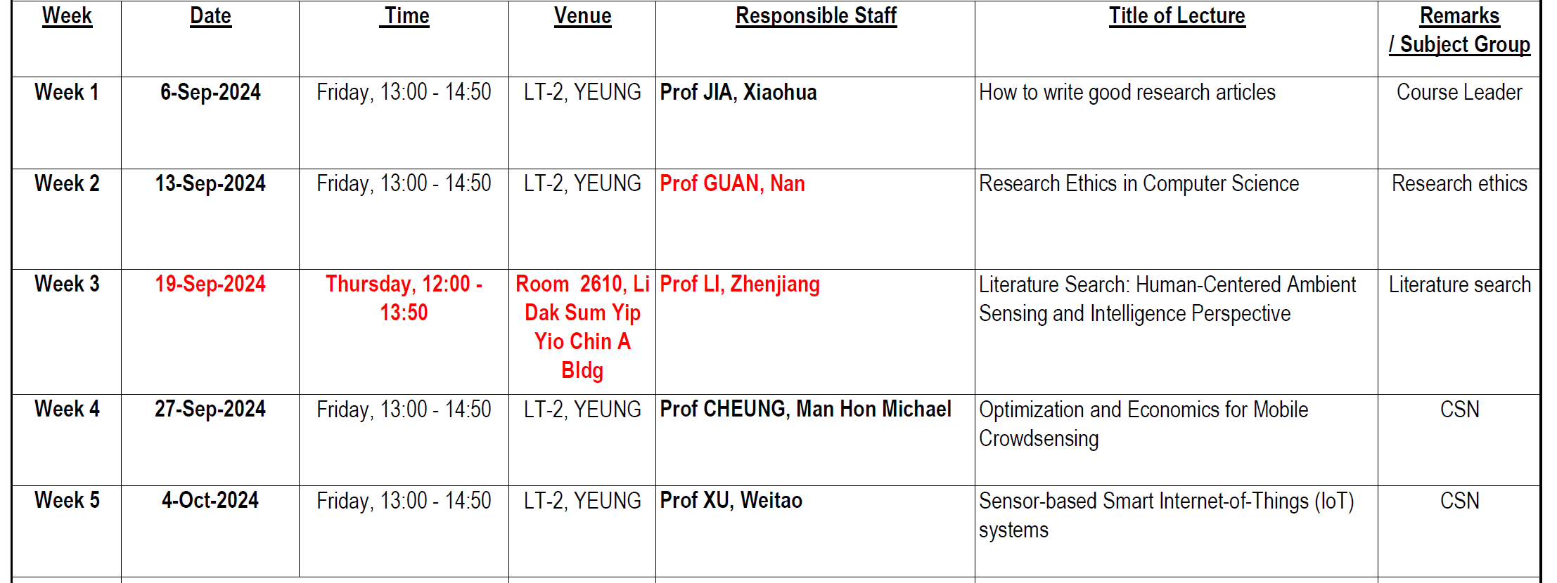

Slide 3
Ethics
Ethics (moral philosophy) is a branch of philosophy that "involves systematizing, defending, and recommending concepts of right and wrong behavior".
Ethics seeks to resolve questions of human morality by defining concepts such as good and evil, right and wrong, virtue and vice, justice and crime.
-- From Wikipedia

Slide 4
Some Issues in Research Ethics
Publication
Authorship
Conflicts of Interest
Peer Review
… …

Slide 5
Publication
Authors should endeavor to publish accurate, complete, clear, and unbiased representations of their work
Including the background, the methods used, the findings, and the significance and contributions of the work
Threshold
Publications should present substantive and new results or analysis

Slide 6
Authorship
Credit and responsibility
Credit: the author list identifies those who deserve credit for the work being published
Responsibility: the authors bear responsibility for any deficits in the integrity or quality of the work
Who should be an author?
Because authorship is a matter of public credit and responsibility, those and only those who have met accepted criteria for authorship should be included as authors.

Slide 7
Authorship
Acknowledgment
Many elements essential for a publication should be credited, but do not warrant authorship.
People who provide facilities or resources, for instance, should be credited in the Acknowledgments section.
Transparency
Research groups and collaborators should be clear about the criteria and plans for authorship;
Should discuss authorship during the planning of any collaboration and continue those discussions as the research project evolves.

Slide 8
Conflict of Interests (COI)
What is COI?
Challenging situations that risk bias or poor judgment
financial interest in the outcomes of research may result in unethical behavior or even criminal misconduct
Non-financial interests also could compromise the responsible conduct of research
career advancement
fame
power
family and friendships
research opinions

Slide 9
Conflict of Interests (COI)
Comply with regulations
Researchers should ask about and adhere to various requirements for identifying, disclosing, and managing conflicts of interest.
Avoid and minimize conflict
Although it is not possible to avoid all sources of conflict, it is in the best interests of the scientific community and of individual scientists to recognize COI and nullify or mitigate those conflicts.

Slide 10
Conflict of Interests (COI)
Disclose interests
If conflicts cannot be avoided, then those conflicts should be disclosed
At minimum, the institution and any other parties with a significant interest should be made aware of the extent and nature of the conflict
Manage conflicts
Disclosure is essential, but often not enough.
For every step of the research process, attempts should be made to isolate the conflicted individuals from all decision-making functions

Slide 11
Peer Review
Peer review is a system based on trust
Each party relies on the others to operate professionally, ethically, and confidentially
Responsibilities of the Reviewer
Provide a prompt, thorough, and impartial review of the article
Constructive feedback with reasonable suggestions and professional tone
Alert the editor to any suspected ethical issues
Maintain confidentiality by safeguarding the unique contributions of the author’s work

Slide 12
Peer Review
Responsibilities of the Author
Accurately report research findings
Ensure that the article meets all publication requirements and adheres to ethical standards
Revise the article as per reviewers’ suggestions (or give a reason why not)
Honestly report COI

Slide 13
Research Misconduct
Fabrication: making up data or results and recording or reporting them
Falsification: manipulating research material, equipment, or processes, or changing or omitting data or results such that the research is not accurately represented in the research record
Plagiarism: the appropriation of another person’s ideas, processes, results, or words without giving appropriate credit
Self-plagiarism: re-use the same or similar sections of text from own previously published work without acknowledging the previous one

Slide 14
Research Misconduct
Misuse of copyrights: using copyrighted material without obtaining proper licenses for the use, or reuse figures or tables from their own previous work without acknowledgment
Not only in papers, but also in codes, webpages, presentation slides …
Particularly important regarding open-source artifacts
Duplicate publications: publishing the same work in more than one journal or conference proceedings
Double submission: submit the same work to different venues with overlapped timing

Slide 15
Research Misconduct
Misleading reporting: exaggerating or distorting the significance of results, or failing to report important limitations or weaknesses of the study
Publication bias: selectively publishing only positive results, while ignoring negative or inconclusive results
Predatory publishing: publishing in fake or low-quality journals with questionable peer-review processes

Slide 16
Research Misconduct
Inadequate record-keeping: Important research materials such as data, software, or even complete lab notebooks may not be available at a later date, making it impossible for others to verify the accuracy of results and replicate the experiment
Citation manipulation: selectively cite previous works that support their hypothesis or ignore crucial publications or results in their field, or pad their publication record by citing their own unrelated papers
suggesting irrelevant references in the review process

Slide 17
Research Misconduct
Misleading Acknowledgements: acknowledge individuals or institutions that did not contribute to the study, or may withhold acknowledgments to individuals or institutions who actually did contribute to the research
Salami slicing: dividing a single study into several publications, often with minor variations in data or methodology, in order to increase the number of publications and enhance the researcher's CV

Slide 18
Research Misconduct
Misrepresentation of funding sources: fail to disclose or inaccurately describe their funding sources for different reasons, often to avoid funding-related scrutiny or to promote a particular industry agenda
Misrepresentation of degrees, titles, and affiliations: falsely claim professional licenses, credentials or degrees that they do not actually have, or list inaccurate affiliations with institutions or organizations to bolster their credentials or reputations

Slide 19
Research Misconduct
Gift authorship: This involves adding someone as an author of a paper who did not make a significant contribution to the research; this is often done to return a favor to a colleague or to increase the chances of acceptance
Ghost authorship: This is where an individual who made a significant contribution to the research is not acknowledged or listed as an author. It's often used to hide conflicts of interest or to enhance a paper's credibility by getting a well-known author to attach their name to it

Slide 20
Research Misconduct
Lack of ethical approvals: not obtain required ethical approvals from the relevant ethics committee or institutional review board, endangering the welfare of the study participants and undermining the validity of the results

Slide 21
General Advice
Be honest
Be transparent
Be accountable
Be responsible
Be constructive
Be respectful
Be speculative
Seek advice and support whenever possible

Slide 22
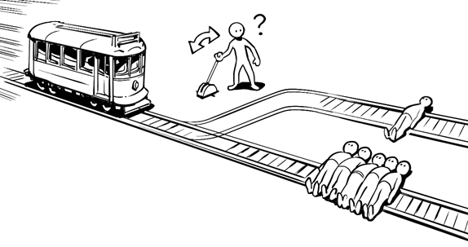
Ethics
The Trolley problem

Slide 23
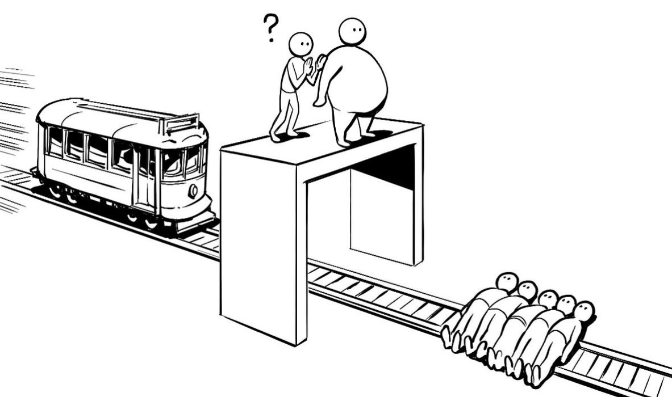
Ethics
The Trolley problem

Slide 24
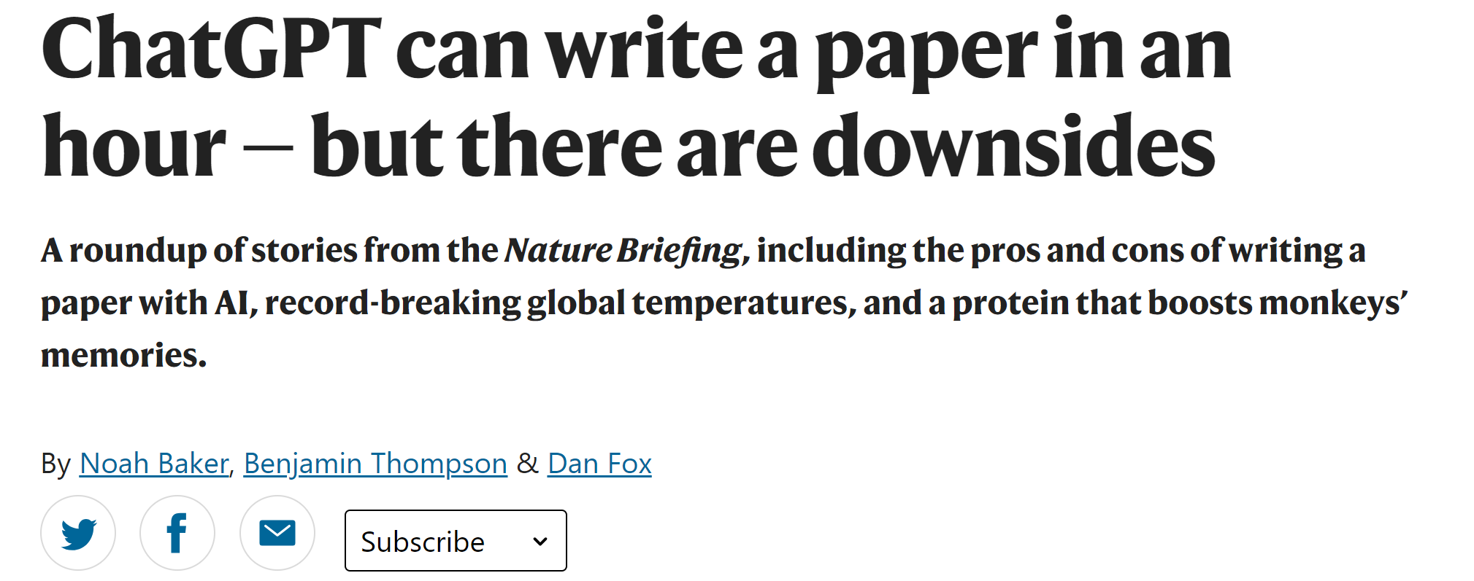
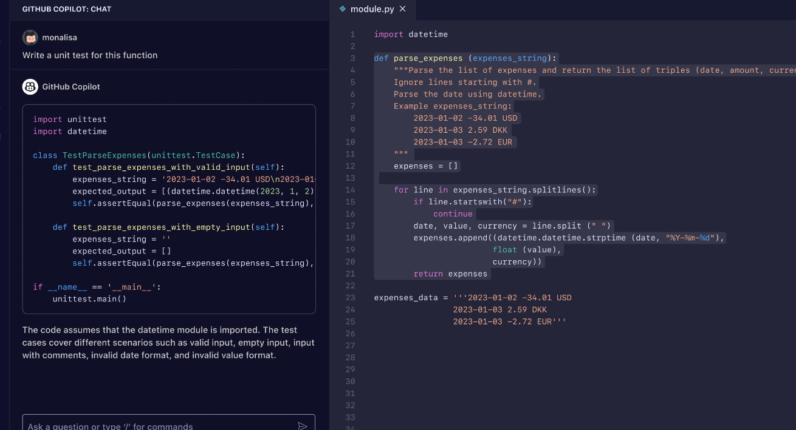
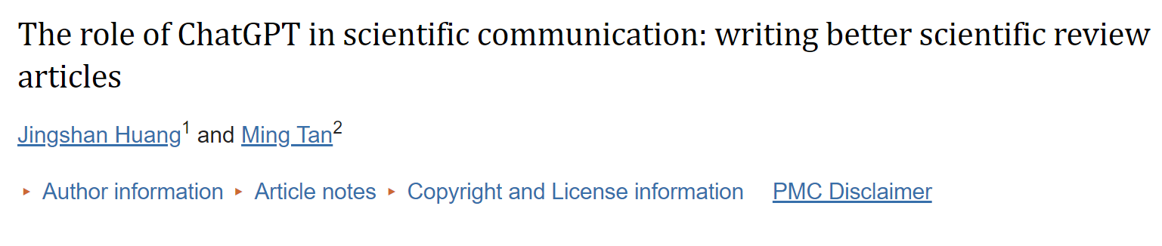
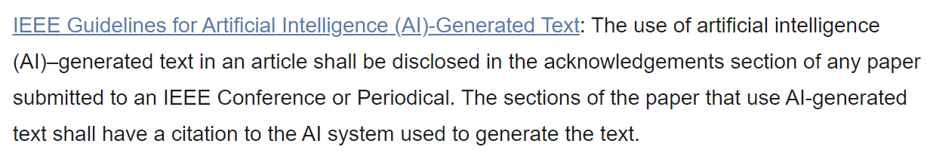
Discussions

