Slide 1
Ray-based global illumination
Various ray-based methods for global illumination
  Kenneth Rohde Christiansen
  Master student at Rijksuniversiteit Groningen
kenneth@gnu.org

Slide 2
Schedule

Slide 3
Schedule
Raytracing methods
Distributed raytracing
Path tracking
Integrating radiocity and raytracing
Photon tracing
Light fields

Slide 4
Raytracing
methods

Slide 5
Raytracing
Introduction
Ray space
methods
Discrete
Ray tracing
We find the intensity for each pixel by tracking rays though the scene
We find the nearest object and normally follow 3 rays:
Shadow feeler rays to all point light sources
Specular reflection rays
Refraction rays (for transparent objects) using Snell's Law
Advantages and disadvantages
Photo-realistic images in computer graphics
Computational intensive (mostly ray-object intersection calculations)
Uses “Ambient” light and doesn't consider global aspects of diffuse light transport
Much research done in order to minimize ray-object intersections

Slide 6
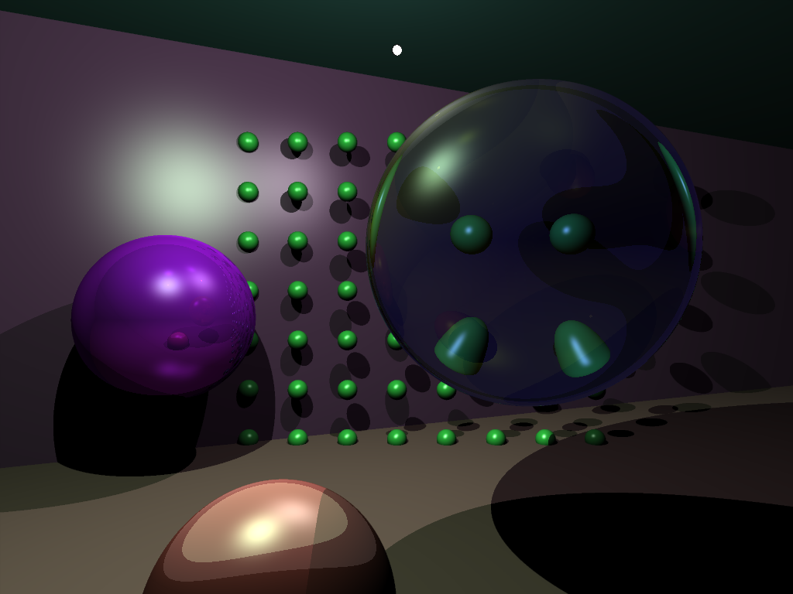
Raytracing - example
Introduction
Ray space
methods
Discrete
Ray tracing
A scene (converted to xml) found on internet and rendered with my Solstrale raytracer, written in C# during one weekend

Slide 7
Raytracing methods
Introduction
Ray space
methods
Discrete
Ray tracing
Recall the ray classification schemes explained by Roerdink
Primary space of interests were the ray space
The Arvo and Kirk algorithm exploited ray-coherence:
Rays close to each others are likely to intersect the same objects.

Slide 8
Raytracing methods
Introduction
Ray space
methods
Discrete
Ray tracing
Breadth-first ray tracing is another ray-space method developed by Muller and Winckler (1992)
Idea is to save memory with huge object databases and not for speed reasons
Rays are kept in main memory and objects are on disk
A ray is stores as: origin, parameters (line equation), intersection point along the ray, and the object that it is intersecting.
Object read from disk, intersected by primary rays. Repeated for shadow feeler rays, reflected rays etc
Breadth first approach
Avoids recursion and can deal with large dbs of objects, but generally slower

Slide 9
Discrete Raytracing 1
Introduction
Ray space
methods
Discrete
Ray tracing
Volume visualization approach
The fundamental entity is a voxel and not a pixel as traditionally. It might contain color info and info about which object it belongs to
Display space is 3D
In practice: Voxels are small, non-overlapping. So small that only one object can intersect the voxel.
Breadth first approach

Slide 10
Discrete Raytracing 2
Introduction
Ray space
methods
Discrete
Ray tracing
Rendering as traditional raytracing
Ray follows voxel path until it reaches a non-empty voxel
Shadow feeler rays are pre-computed
Advantages:
Intersection computation is no longer dominant. We don't test objects but search along a voxel path
Ray tracing time is independent of the object number. The more objects – the better, as there are less empty voxels
Many view-independent attributes are pre-computed: shadow feelers, normals, textures
Is still view-dependent

Slide 11
Distributed raytracing

Slide 12
Monte-Carlo methods
Monte-Carlo
Aliasing
R&L model
Depth of field
Motion blur
Estimation method based on statistical sampling
Famous example: Calculate pi by throwing pins at square box with area of 4, and with circle with area of pi. The proportion of pins landing in the circle is pi/4. And pi can be estimated this way.
Same technique can be employed to the radiance equation.
Can be done in different ways: we consider distributed raytracing
We trace multiply rays and use the average
This makes the following possible:
  Glossy reflection instead of specular reflection
  Translucence instead of sharp transparency
  Shadow penumbras instead of umbras
  Depth of field
  Motion blur

Slide 13
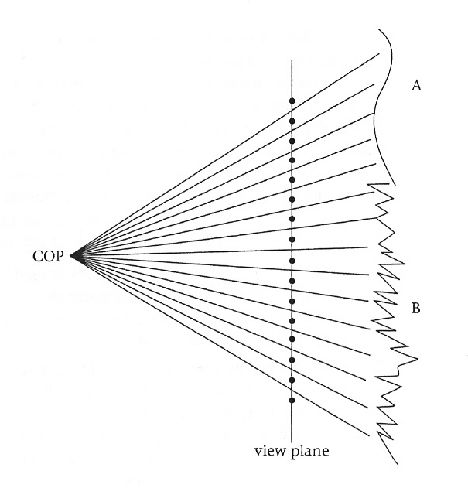
Aliasing 1
Monte-Carlo
Aliasing
R&L model
Depth of field
Motion blur
The illustration shows 2 objects A and B.
The “signal” that comprises the scene is continues, but we are sampling on a discrete set of pixel points
A can be reproduced exactly, B cannot as the signal has more than one cycle between each pixel points.
The Nyquist limit states that max one cycle between two pixel points is allowed for the signal to be reproducable. Thus undersampling produces aliasing effects.
We can supersample instead
  Split the pixel into subpixels and later average
  There will still be signal that breaks the sampling limit
  There is a better way

Slide 14
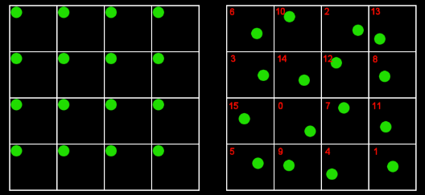
Aliasing 2 – Distributed RT
Monte-Carlo
Aliasing
R&L model
Depth of field
Motion blur
In distributed raytracing a stochastic sampling scheme is employed
It is possible to distribute the points uniformly over the pixel area
Another option is stratified sampling which produces a smaller variance
We sample randomly within known strata as randomness does not imply even spread (think about the lottery)
Jittered sampling, a stratified sampling scheme:
Random location is chosen within each subpixel
We are guaranteed appropiate area coverage
Can dramatically reduce the aliasing effect since there is the probability that any part of a cycle might be sampled

Slide 15
Reflection and lighting model 1
Monte-Carlo
Aliasing
R&L model
Depth of field
Motion blur
Glossy reflections
  An ideal specular reflection surface only has one reflection direction
  A glossy reflection reflects rays in a distribution around the perfectly specular ray
  We can use the jittered sampling pattern together with averaging to accomplish this
Translucent surfaces
  Most surfaces are not purely transparent
  View through the surface is hazy and seldom sharp
  Same ideas can be applied
Shadow penumbras
  The real world also has area lights
  A point on the surface may be visible to part of the light
  Same ideas can be applied
  It is too computational intensive to thread an area light as a collection of point lights, so only some points are considered
  We use jittered sampling for these points

Slide 16
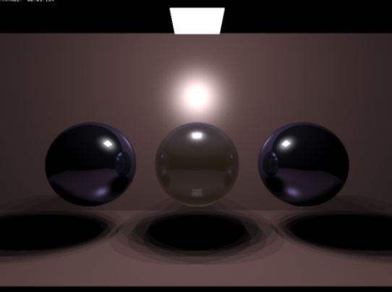
Reflection and lighting model 2
Monte-Carlo
Aliasing
R&L model
Depth of field
Motion blur
An image snowing area lights: 3x3 sampling
Notice the banding.
Can be improved with higher sampling rates but banding will always be present

Slide 17
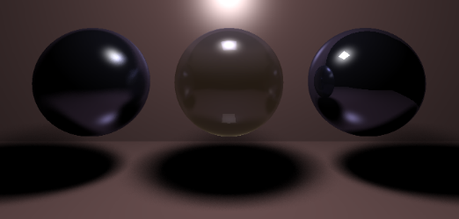
Reflection and lighting model 3
Monte-Carlo
Aliasing
R&L model
Depth of field
Motion blur
Distributes raytracing is the solution – jittered sampling
Also called soft shadows

Slide 18
Depth of field
Monte-Carlo
Aliasing
R&L model
Depth of field
Motion blur
Distributed ray tracing can simulate views through a lens system
With a pinhole camera the whole scene is in focus
Where as a scene formed though a lens typical only parts will be in focus
Explained on blackboard!

Slide 19
Motion blur
Monte-Carlo
Aliasing
R&L model
Depth of field
Motion blur
When working with moving camera or objects motion blur can be handy
Lets assume that time T is [0, 1]
The idea is that each of the sub-pixels in averages jittered sampling scheme will be used at different time steps.
Each sub-pixel gets a time index. Lets say there are 16 sub-pixels, so we randomly distribute the numbers from 1...16 over the sub-pixels
Time is calculated as T = (index – 0.5) / 16 +/- (1/32) random
When T is found the cameras and objects are moved and the contributions is calculated.

Slide 20
Path Tracking

Slide 21

Path tracking
Kajiya unified a number of graphics lighting models into one model based on a rendering equation for the intensity of light
I(x,y): x and y are surfaces in the scene (or x may be on the view plane). I(x,y) is the intensity of light passing from y to x.
Integral over the union of all points on surfaces S – including a surface encapsulating the whole scene.
g(x,y): geometry term that is 0 if x and y are not visible from each other and 1/r^2 otherwise, with r being the distance between x and y.
epsilon(x,y) is intensity of emitted light from y to x
rho(x, y, z) is representing the unoccluded reflectance from z to x via y.

Slide 22





Path tracking 2
The radiance equation can be derived from this I(x,y) equation
The equation can be viewed as a decomposition of radiance in a certain direction from a certain position into the emitted and reflection portion
We consider an integral operator R which returns the reflection component
Now we can rewrite the function to
And we can rewrite and rearrange this further using normal rules from operator theory

Slide 23


Path tracking 3
”1” is the identity operator that returns L as L itself
The operator expression can be expanded in a power series:
Lets consider
RL_e is the total radiance reflected from point p in direction omega that had its origin in the light source

Slide 24
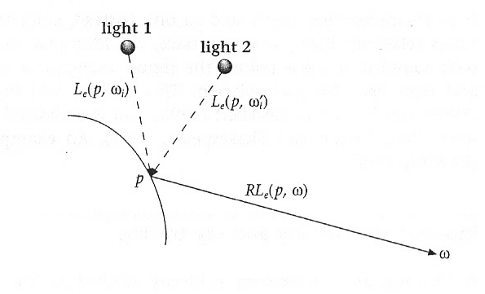
Path tracking 4
Illustration showing this

Slide 25
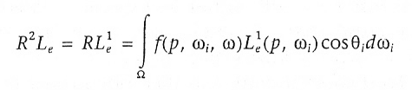
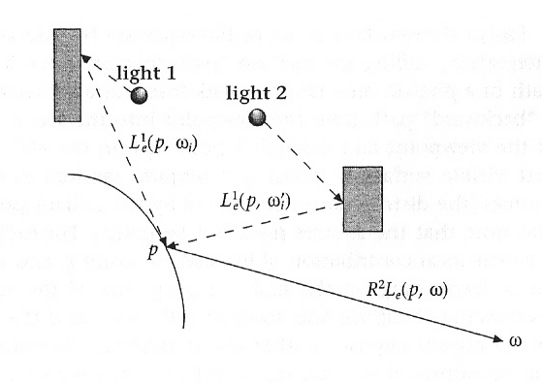
Path tracking 5
RL_e^1 is reflected light that is just one step removed
Illustration showing this

Slide 26
Path tracking 6
We have seen that R^{i}L_{e}(p, omega) is the contribution of radiance from p in direction omega from all light paths of length i + 1 back to the original sources
We can approximate the radiance function by the series at successive terms
Only one term: we only render objects directly emitting light (”flat shading”)
2 terms: only direct reflection courses by light sources, no inter-object reflection (Standard pipeline)
Kajiya showed how to solve the equation by Monte Carlo integrating and named the method for ”Path Tracking” as it involves following the path of a photon on a random walk from surface to surface – like in ray tracing

Slide 27
Path Tracking 7
Recipe:
  Compute random rays to each light source. The distribution depends on the radian properties of the sources
  Compute the local intensity contribution and add it for point p
  Choose another ray at random, depending on material properties (diffuse, reflection, refraction)
  Repeat the process and each time add to the intentity
N paths are followed for each pixel. Kajiya used N = 20.
Paths are truncated at lenght n + 1
Advantages:
  All types of surfaces can be considered
  Greater weight is attached to more important rays – less time wasted following rays that contribute almost not at all

Slide 28
  Integrating radiosity and raytracing

Slide 29
Integrating radiosity and ray tracing
Ray tracing is ideally adapted for the simulation of specular surfaces
Radiosity for diffuse surfaces
Real scenes integrate light between both of these types of surfaces and realistic scenes have to simulate this
Specular effects can be added to radiosity as a post-process but that doesn't properly model diffuse-specular interreflections (independent processes)
Heckbert notation: L = light, E = eye, S = specular surface, D = diffuse.
Any viewable path is L(S|D)*E (regular expression)
Ray tracing can simulate: LD?S*E
Radiosity can simulate: LD*E
Adding ray tracing pass to radiosity algorithm results in: LD*S*E

Slide 30
Bi-directional ray tracing
Heckbert found a solution called bidirectional ray tracing.
The idea:
First pass (light tracing):
Photons are distributed from the light sources and reflected when encountering a specular surface
When encountering a diffuse surface the photon energy is stored in a rex (adaptive radiosity texture) associated with the surface
At the end of the pass the rexes will store the radiosity solution.
Second pass (eye tracing)
Conventional Path Tracing from the eye to form an image.
However, the rexes are also used to illuminate the specular surfaces
Light face simulates L(S*D)* and eye face DS*E, so we end up with L(S*D)*S*E = L(S|D)*E

Slide 31
Photon Tracing

Slide 32
Photon Tracing
The Heckbeck method uses some kind of density estimation of the radioance, by storing the estimation in the textures
Photon tracing (Shirley et al and Wanter et al, 95, 97) has made an explicit and full density estimation technique
Involves producing a fine triangulation of all objects in the scene
Photons are traced from light sources with energy determined from the energy distribution of the emitters
Monte Carlo based tracing is used for intersections until particle is absorbed
The info is stored in the corresponding triangle where the particle hits
Each triangle (potentially) has an associated distribution of particle hits which is used to estimate the radiance density function
A tolerance criterion is used for merging triangles
Scene is rendered with Gouraud shading

Slide 33

Photon Tracing 2
Advantages
  Very photo realistic images
  from http://graphics.ucsd.edu/~henrik/images/global.html

Slide 34
Photon Tracing 3
Disadvantages
  Specular reflection and transmitting surfaces are used correctly in the particle tracing phase, but due to Gouroud Shading not displayed as such.
  Relies on all primitives to be polygons
  Darker regions may not receive enough particles hits to be illuminated at all

Slide 35
Photon Maps
A photon is a packet of flux energy also containing the position where it strikes a surface
A photon map is a spatial data structure (in fact a KD-tree) representing a large number of photons.
The Jensen and Christensen method two such maps are used
  Caustic Map for paths of the form LS*D.
  A lake from a large distance is a diffuse surface as you don't see the individual waves and ripples any longer. But a beam of light hitting the wake will form a pattern which are very difficult to model correctly.
  Lots of resources are used to deal correctly with these
  Global Map for all other paths.
  Made with much less density
  Only used for indirect reflections (not ending up in eye)
  Can be thought of as rough solution to the radiance equation
A variant of path tracing is used in the rendering phase

Slide 36
Light Fields

Slide 37
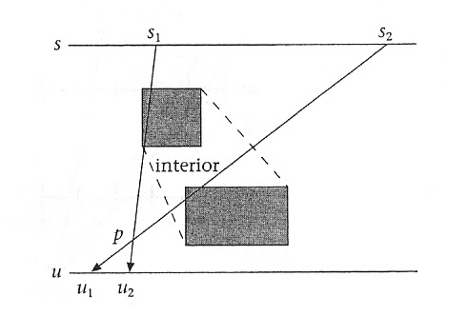
Light Fields
Levoy and Hanrahan and later Gorther et al introduced Light Fields as a kind of brute force solution to the radiance equation.
The radiance equation L(p, omega) is a recursive expression
Any p and omega pair together form a ray
So we can think of L(p, omega) as all rays that have origins on surfaces
Radiance is constant in free space (thus no discontinuties due to intersections with objects)

Slide 38
Light Fields 2
All such rays intersected the scene (look at example with two boxes in 2D) can be parameterized (in 2D) by using (s,u). ie L(s,u) is known
To form an image we place an image plane and COP in the scene and collect all those rays passing though COP which intersects the image plane
Views from inside the convex hull is not possible as the radiance is not constant there.
If we want to do that we need all rays between the dashed lines
In order to do this we need 4 pairs of (s, u) – so-called light slabs. One like on the picture, one reversed and and two others with for instance 2 vertical lines on each side of the scene.
Such a representation is called a Light Field!

Slide 39
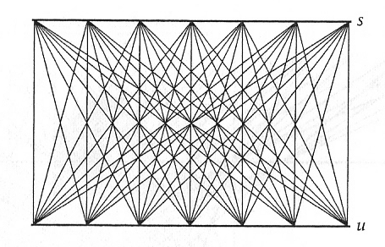
Light Fields 3
For computational purposes we need a discrete representation so we use grids.
The radiance for each ray can be estimated by choosing grid point s_i on s as a center of projection with u as the image plane.
This way each ray intersecting the convex hull has a radiance determined by the 'rendering' of the image formed by a set of perspective projections
The system can easily be expanded to the case of 3D

Slide 40
Light Fields 4
It is possible easily to construct new images from a virtual camera which does not correspond to the cameras on the s plane.
Was constructed to form new views of images from real scenes
It provides a way to walk though a globally illuminated scene in real time – and it is the only method that makes that possible!

Slide 41
Questions and Answers

