Slide 1
A look at Programming Methods for solving problems of currect Software Development
  Kenneth Rohde Christiansen and Niek Oost
  Master students at Rijksuniversiteit Groningen
  kenneth@gnu.org - uml@home.nl

Slide 2

Schedule
Introduction
Subject-oriented programming
Hyper modules and slices
Aspect-oriented programming
Superimposition
Conclusion
Discussion

Slide 3
Introduction

Slide 4
Software Engineering
Main objectives :
  Improve software quality
  Reduce costs
  Facilitate easy maintenance
Biggest problems relate to :
  Code understanding
  Maintenance
  Extendibility
  Reuse

Slide 5
Four proposals
  Subject-oriented programming
  Harrison and Ossher, 1993
  Hyper modules and slices
  Harrison et. al., 1999
  Aspect-Oriented programming
  Kiczales et. al., 1997
  Superimposition
  Bosch, 1998

Slide 6
Subject-Oriented Programming

Slide 7
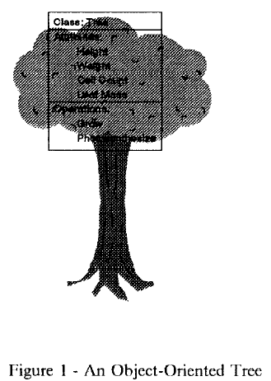
Object-oriented model
  Classical model :
  Objects have intrinsic properties and behaviours
  Problems :
  Need to anticipate all future applications
  Need to treat extrinsic properties as intrinsic

Slide 8
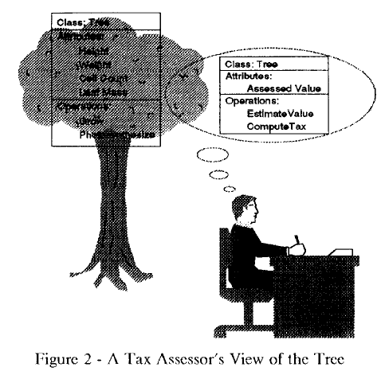
Subjective views
  Subject-Oriented model:
  Every subject views an object differently.

Slide 9
Goals
Facilitate the development and evolution of suites of cooperating applications
Important requirements :
Compose applications
Independent of other applications
Cooperation
Extending compositions without invalidating persistent objects
Extending applications
Encapsulation, polymorphism and inheritance

Slide 10
Subjects
  A collection of state and behaviour specifications reflecting a particular perception of the world as seen by a particular application or tool
  Only object identity is shared between subjects
  Activation
  Composition
  State
  Class matching

Slide 11
Conclusion
Subject-Oriented Programming
Classmatching seems complicated
Problem with saving/serializing objects

Slide 12
Hypermodules and hyperslices

Slide 13
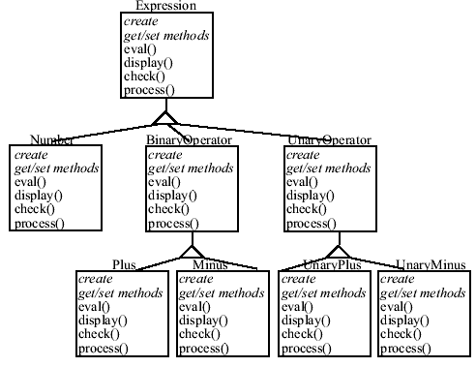
An example : SEE
SEE : Software Engineering Environment
Specification of expression programs
Evaluation, displaying and checking ability

Slide 14
Multi-dimensional separation of concerns
  Decomposition and composition
  Artifacts and concepts
  Units
  Separation of concerns
  Dimensions of concern
  Dominant dimension

Slide 15
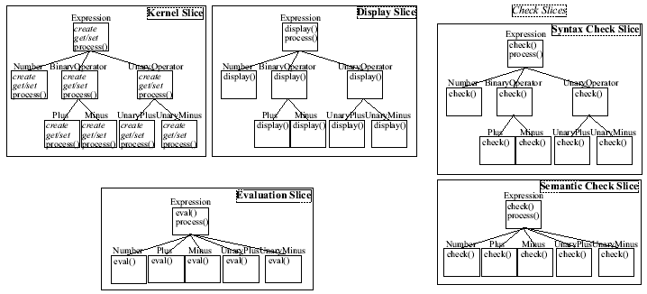
SEE with hyperslices

Slide 16
Hyperslices and hypermodules
Hyperslice:
  a set of conventional modules, written in any formalism
System:
  a collection of hyperslices
Hypermodules:
  a set of hyperslices, together with a composition rule that specifies how the hyperslices must be composed to form a single, new hyperslice that synthesizes and integrates their units.

Slide 17
Conclusion
Hyperslices and -modules:
Powerful method to solve some of the separation of concern problems
A usable Subject-oriented programming
Problems
Will it be over-used?
How to solve class inheritance
Compose ability of hyperslices

Slide 18
Aspect-Oriented Programming

Slide 19

What is Aspect-Oriented Programming?
The need for optimized code (for instance for performance)
Optimizations often cross-cut different components
Problem: When reducing the amount of procedure calls we get scattered code that is
  Hard to understand
  Hard to maintain
Aspect-Oriented Programming is a sollution that gives
  Easy maintainable code
  Highly optimized code

Slide 20
Real-life Example
Example: A module of an OCR applications
The need to processing an image though various filters
Problems with naïve implementation:
  Each filter produce a new short-living image
  The image is immediately copied to a new filter
  Result: Excessive memory references which can result in for instance cache misses and page faults – we want to avoid that!
Sollutions
  Merging filter loops and re-using so much memory possible; results in scattered, hard-maintainable code
  Use Aspect-Oriented Programming!

Slide 21
Some numbers
An implementation of the OCR module by Kiczalen et al
Naïve, in-efficient implementation: 768 lines of code
Hand-optimized version: 35213 lines of code
Aspect-Oriented version: 1039 lines of code
The Aspect-Oriented version is
Easy maintainable, understandable
Almost so efficient as the hand-optimized version (practically the same)
Easier to develop

Slide 22
So, how does it work?
In the example we want to merge filters, thus merge loops
We introduce
A component language
An aspect language
And a so-called weaver
The component language is
Similar to your normally used language
Has higher level constructs. In the example a pixelwise construct
Can be implemented by preprocessing

Slide 23
So, how does it work?
The aspect language is
A language with conditions on when to merge and when not to
More general: Conditions to be used when comparing nodes in the data flow
If two of the filters fullfill the condition (ex. both are pixel wise) merging it performed by the weaver
The weaver is
An application that uses unfolding to generate the flow graph which is then processed by the aspect rules, generating the actual code.
It is possible to implement the weaver so that the weaving is done runtime!

Slide 24
So, what is the catch!?
Some facts about Aspect-Oriented Programming
There are many different aspects that can be encapsulated in general components. Loop merging is just one!
Others include: Minimizing network traffic, sync. constrains, error handling.
The aspects seem separate.
Problems
Need to invent non-standard programming languages (component and aspect language)
Need to implement a weaver that deals with your aspects of concern.
Relative young idea. (mid 90's)

Slide 25
Work in progress
New languages as the .NET language C# supports
Metadata
Introspection
This means that it is possible to implement Aspect-Oriented Programming without
inventing new component and aspect languages!
Without weaving the classes works like normal classes.
There is an implementation in the works by DotNetGurus called AspectDNG
More info at http://blogs.dotnetguru.org/jbevain
Runtime weaving in still not implemented

Slide 26
Simple Example of AspectDNG
// base.cs
namespace AspectDNG.Sample {
public class EntryPoint {
public static void Main() {
System.Console.Write("World");
}
}
}
// aspect.cs
namespace AspectDNG.Sample.Aspect {
public class HelloAspect {
[AspectDNG.InlineAtStart("* *.EntryPoint::Main(*)")]
public void Hello() {
System.Console.Write("Hello ");
}
[AspectDNG.InlineBeforeReturn("* *.EntryPoint::Main(*)")]
public void Emphase() {
System.Console.WriteLine(" !");
}
}
}

Slide 27
Simple Example of AspectDNG
Result:
jbe@monkey:~/Devel/weave $ ls
aspect.cs AspectDNGAttributes.dll AspectDNG.exe base.cs
jbe@monkey:~/Devel/weave $ mcs base.cs
jbe@monkey:~/Devel/weave $ mcs aspect.cs -r:AspectDNGAttributes.dll -t:library
jbe@monkey:~/Devel/weave $ mono base.exe
World
jbe@monkey:~/Devel/weave $ mono AspectDNG.exe -dw base.exe aspect.dll
jbe@monkey:~/Devel/weave $ mono base.exe
Hello World !

Slide 28
Conclusion
Aspect-Oriented Programming
A very promising new methods
Unfortunately, there hasn't – as far as we know – been performed much research in how to solve many of the other aspects than for instance loop fusion
There is the question whether people can easily learn to analyze and identify aspects in their programs
New debugging methods might need to be developed

Slide 29
Super-imposition

Slide 30
Welcome to the world of Components
The main objectives of Software Engineering
Improve Software quality
Reduce costs
Facilitate easy maintainance and evolution of the product
Possible sollution: Develop re-usable components!
Can be used in many different projects
Will often be more well-tested
Helps insuring low cost and improved software quality!

Slide 31
Adapting Components
Components are not the holy grail
Components needs to be adapted to the system requirements
This, often requires knowledge of how the components are designed
In what ways do we want to adapt?
Jan Bosch uses five criteria for classifying the adaption
Transparency: Component shouldn't feel alian to the product
Black-Box: User should only need to know the interface
Composability: It should be possible to compose the adaptions
Configurability: The adaptation technique should be configurable
Re-usability: The adapted component should itself be reusable

Slide 32
Introducing Super-Imposition
Super-Imposition
Is a way of describing the adaption as some kind of mapping
Makes is easy to compose diff. Adaptations and satisfy our earlier stated requirements
Each object is described
As an interface
A set of methods
A set of states (instance variables)
And a mapping from the interface to the methods
The actual adaptation is performed by modifying these by standard mathematical operators
Please consult the paper from Jan Bosch for examples

Slide 33
Examples! Everyone want examples!
Demonstration of the idea: Restriction of an interface
Can be described as a set of interfaces we want to keep
Plus a functions that performs the operation
Adaptions can be categorized
Changes to component interface (like function renaming)
Component composition (like delegation of request)
Component monitoring (like reacting on certain conditions in the state of the component)

Slide 34
Conclusion
Super-Imposition
Sounds like a good way to improve component adaptation
Makes it possible to reduce overhead when combining components (direct binding, only one wrapping)
Still requires you to understand the component interface before you do the adaptation
If not enough is exposed you still need to deal with the internals
Works in practise?
What about different data types between program and component? (for instance, different string representation)

Slide 35
Conclusion of the Presentation

Slide 36
Conclusion
4 proposals which provide interesting new idea
The majority of the ideas differs a lot
Some are very theoretical – will they work in practise?
  Subject-Oriented vs. Hyper modules
Aspect-Oriented programming seems the most usable as it targets practical problems
  Already in use by various projects
  New native .NET version that shows a lot of promise
We look forward tracking the development of these new ideas!

Slide 37
Questions and Answers

