Slide 1
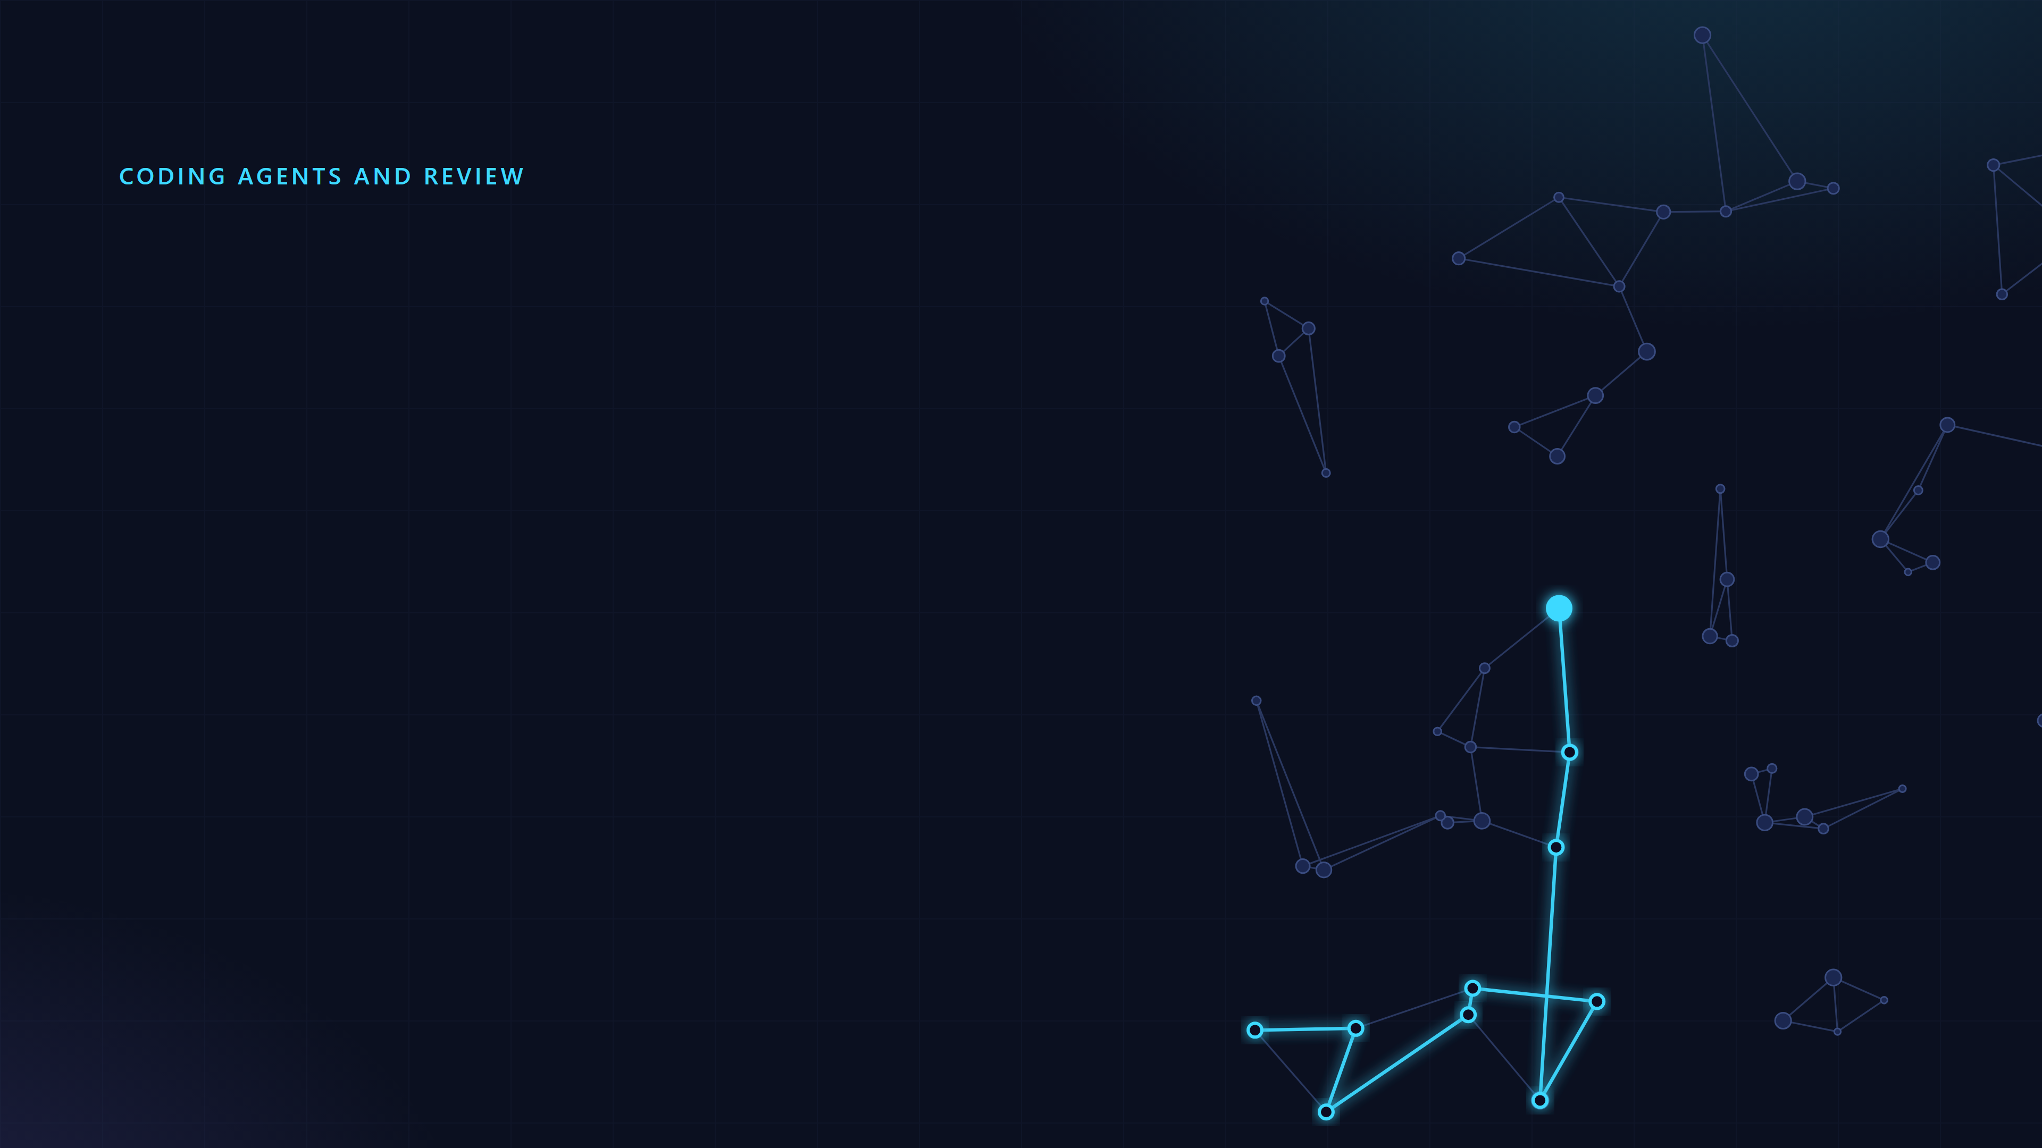
The review loop
How to check what an agent wrote, and make every review better than the last.
Kenneth Rohde Christiansen
review-loop · open source, Apache-2.0

Slide 2

The agent writes the change in minutes. Someone still has to be sure it is right.
This talk is about that someone, and how to stop them being a bottleneck.

Slide 3
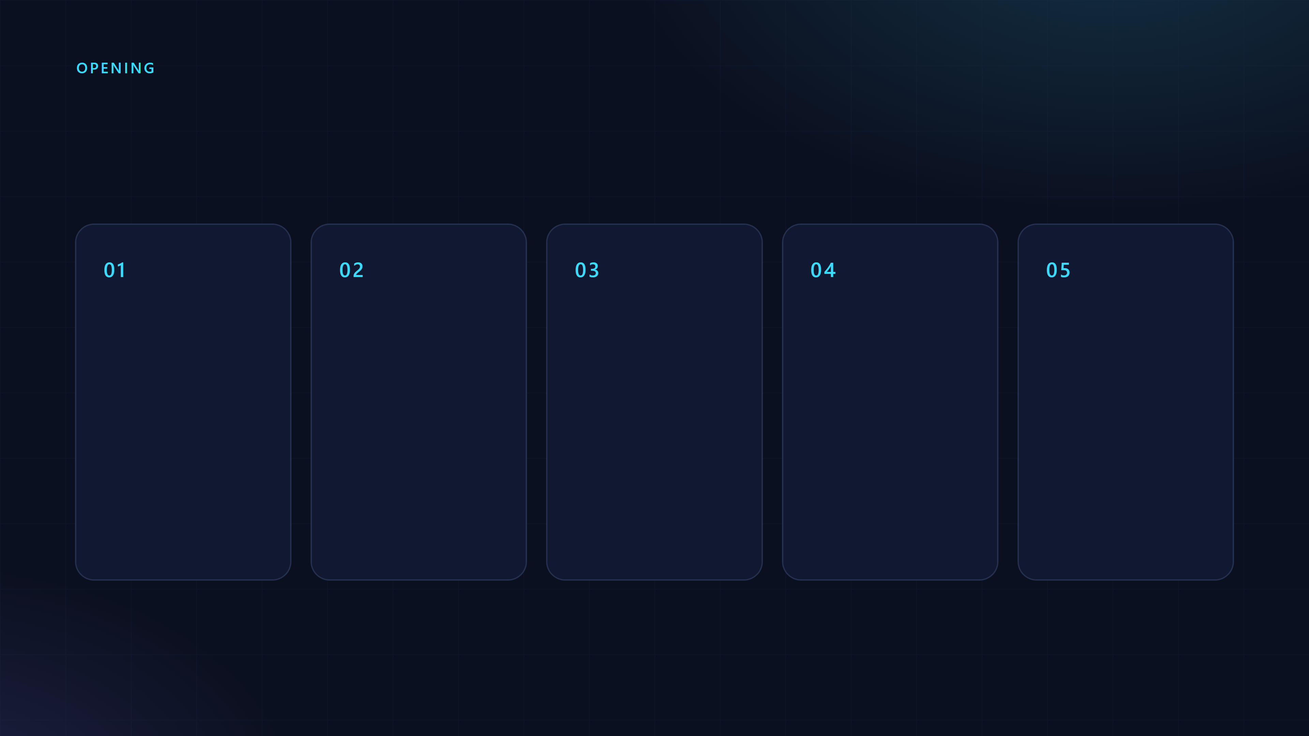
Where we are going
The problem
Why it matters
The loop
In practice
For managers
What a review is made of, and what it costs.
Four levels, and learning from outside review.
Writing got cheap. Reading did not.
What one team found, and how review-loop answers it.
What to measure, who owns it, how to start.

Slide 4

The problem
Writing got cheap. Reading did not.

Slide 5

A change you did not type is a change you have to read.
And an agent produces them faster than anyone can read.

Slide 6
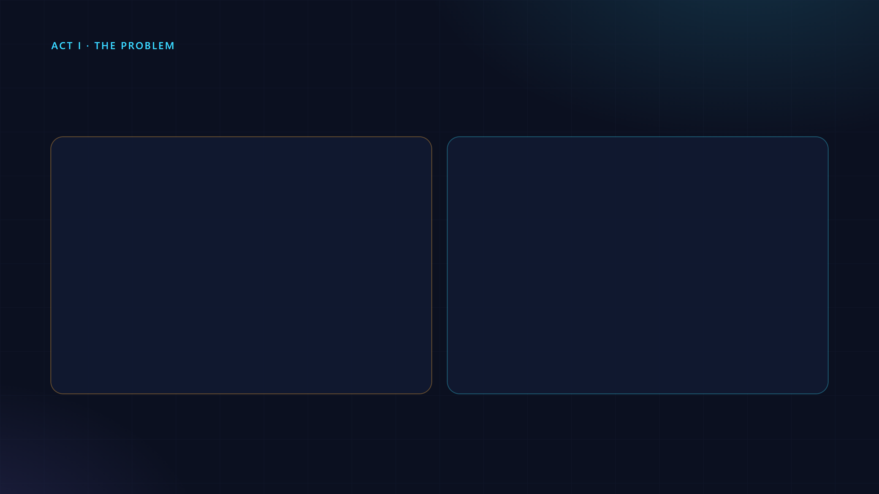
Two moments to find out a change is wrong
After it goes out
Before it goes out
A reviewer, a bot or a user finds it
The same checks run first
You fix it in another round
It is fixed in the same round
The next change gets the same comment
The class of bug gets a check

Slide 7
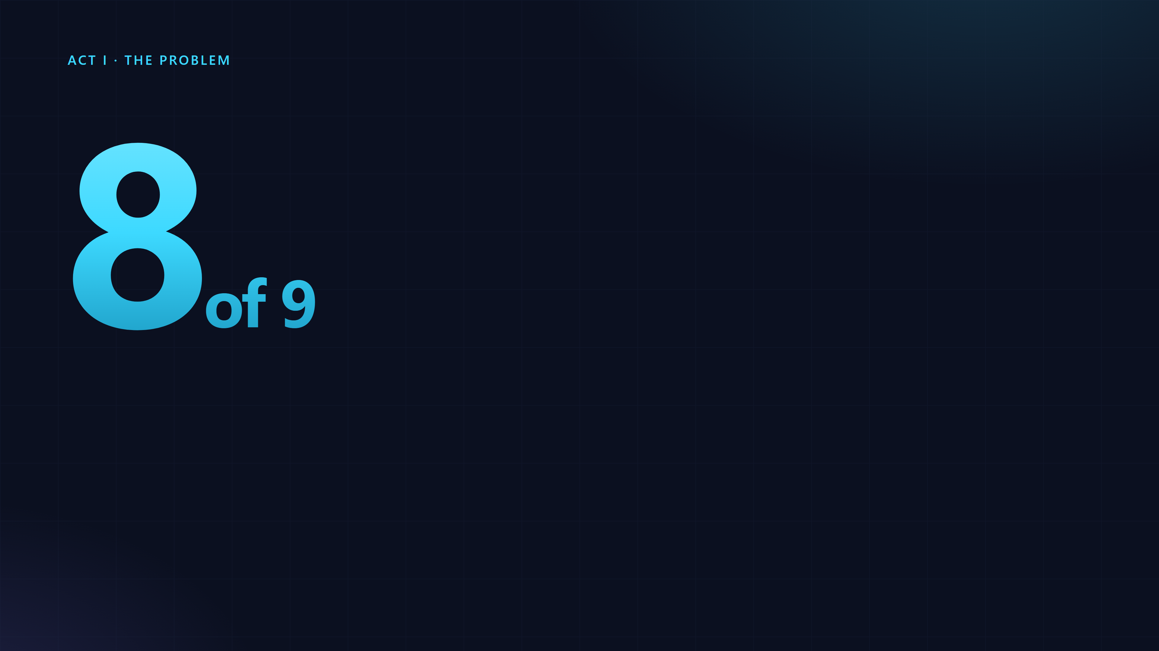
All eight were fixed. None of them changed the next review. The fixes disappeared into the pull requests.
outside review comments on three pull requests were right.
Our own: a real round on one of our projects, from the review-loop README. Copilot comments on three pull requests.

Slide 8
Fixing a comment fixes one line. The next change gets the same comment.
Nothing in the process remembers.

Slide 9
Most of our time goes on reading, and how we read is almost never discussed.
So it is never improved.
Tudor Girba and Simon Wardley, "Rewilding software engineering", chapter 1, 2025.

Slide 10
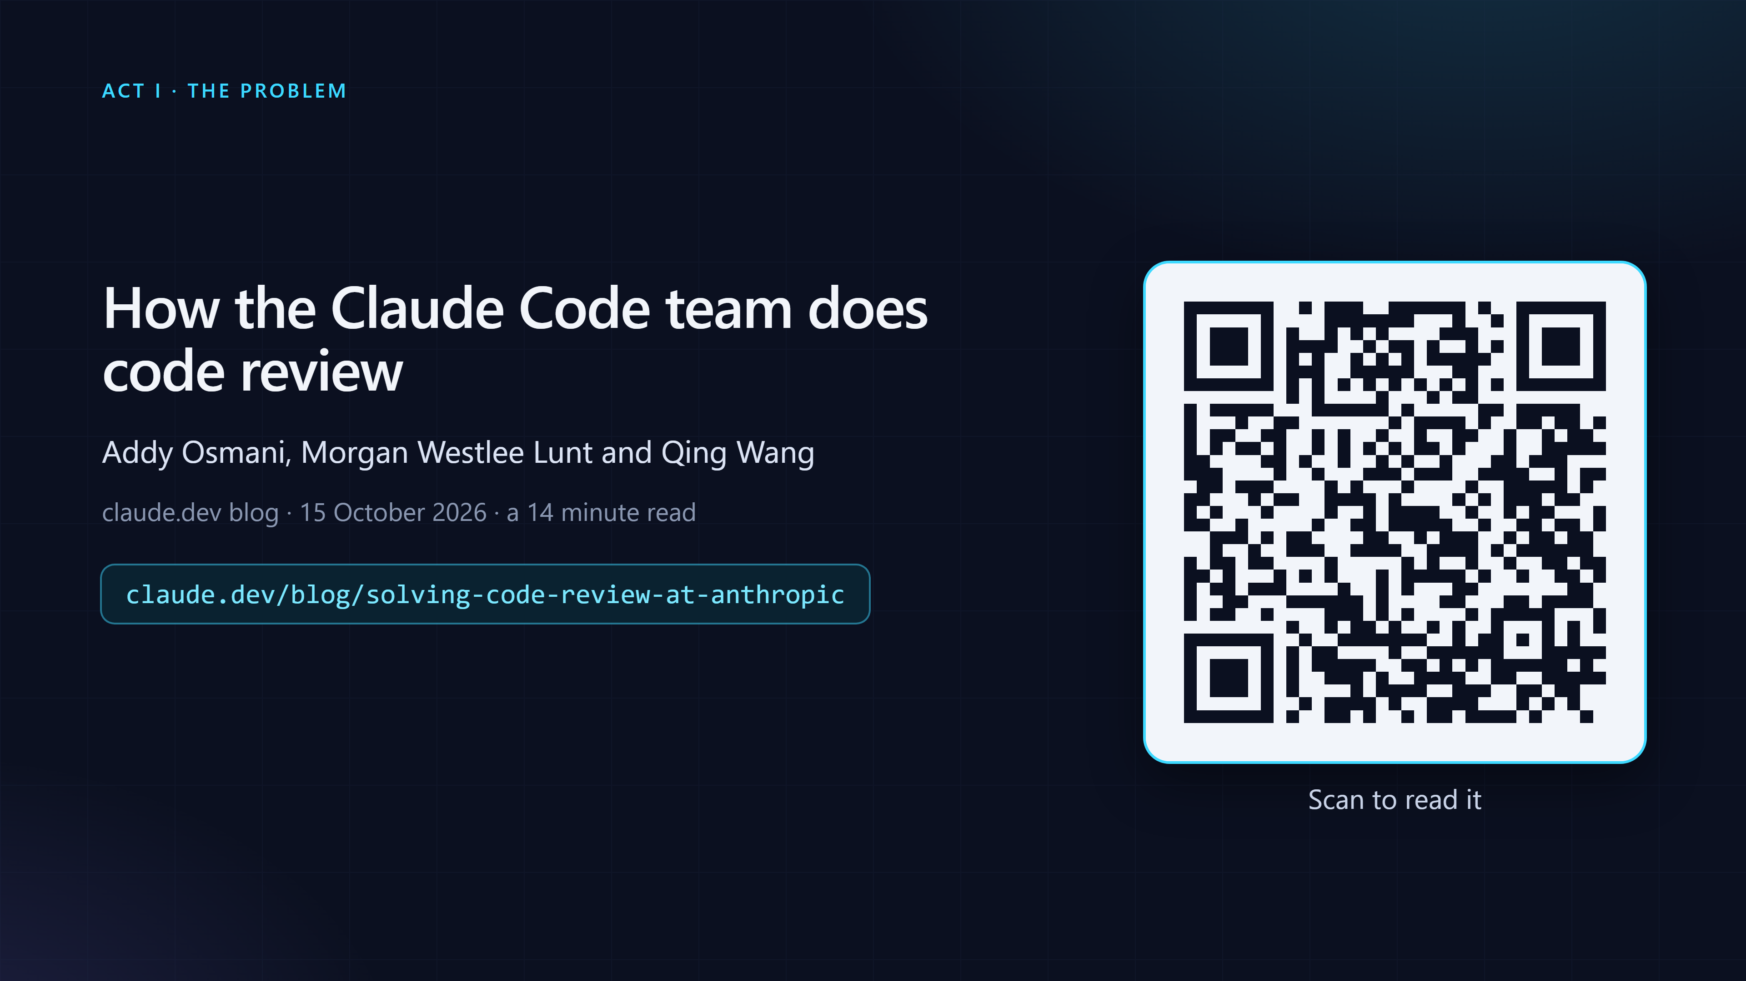
The post this talk keeps coming back to
Osmani, Lunt and Wang, claude.dev, 15 October 2026.

Slide 11
The Claude Code team reviews its agent-written code in layers.
Verify before the pull request. An AI review on every pull request, its findings checked by other agents. A file that says what matters. Past incidents as the test set.
Osmani, Lunt and Wang, "How the Claude Code team does code review", claude.dev, 15 October 2026.

Slide 12
Several of these points are also our own conclusions, from working on our own products.
We hit the same problems: comments that taught the next review nothing, one reader finding only part of what outside reviewers found, three readers costing three times one. review-loop is what we built.
The numbers shown for review-loop are our own measurements, small and early.

Slide 13
Not a step at the end. A loop that gets better each round.
Check it yourself. Let others check it. Turn what they find into a check that runs.

Slide 14

Why it matters
What one team found when agents wrote most of the code, and how review-loop answers it.

Slide 15
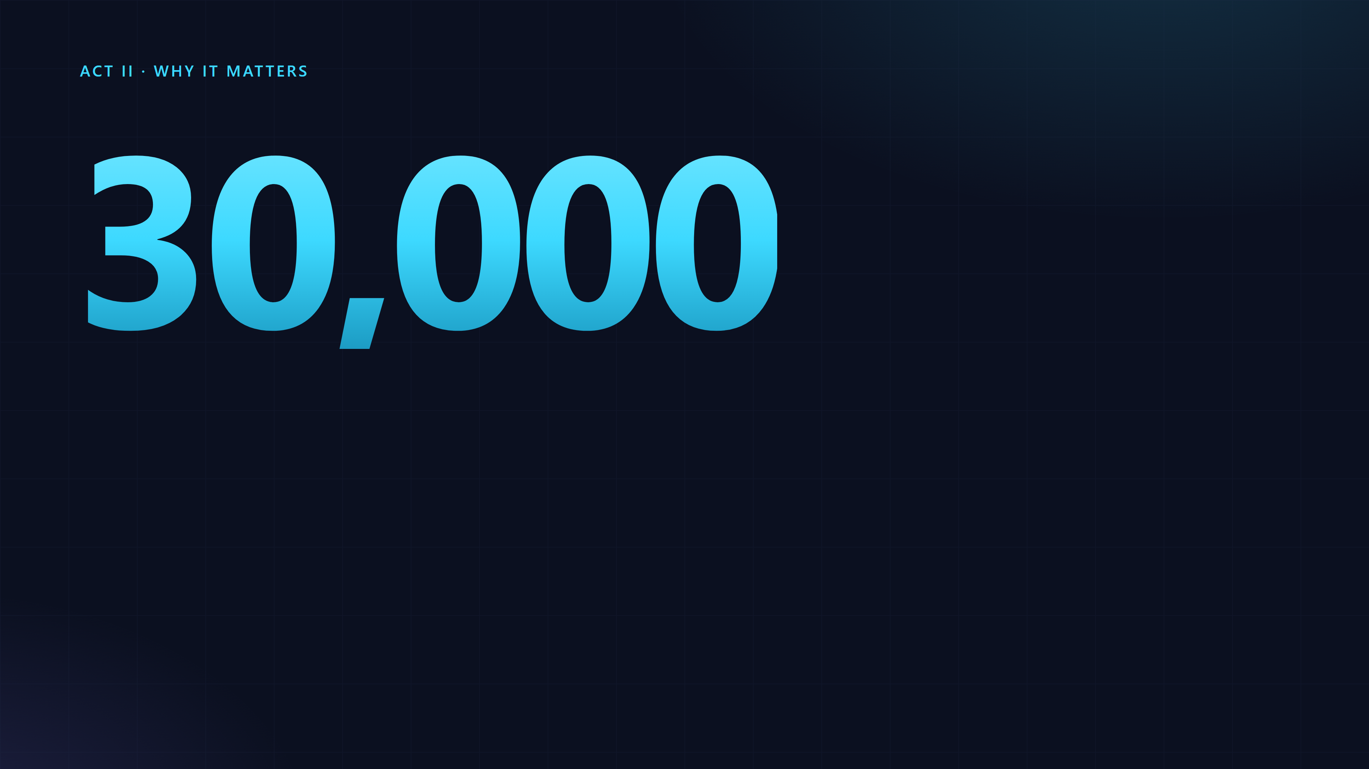
Claude writes about 90% of Claude Code's own code. Claude Code has its own repository, and the post says it feels the same pressure.
changes a day landing in Anthropic's monorepo in September, up from about 2,500 in May.
Osmani, Lunt and Wang, "How the Claude Code team does code review", claude.dev, 15 October 2026. The 30,000 is for the monorepo, not for Claude Code's repository.

Slide 16

When you ship this fast, line-by-line review is incredibly difficult, if not impossible.
They did not drop review. They moved most of the reading to machines and kept people for what machines cannot decide.
Osmani, Lunt and Wang, "How the Claude Code team does code review", 15 October 2026.

Slide 17
The goal: less human time per change, and no more reverts than before.
Reverts and incidents are the guardrail. Human approvals per pull request, human comments and the wait for a person are what they push down.
Osmani, Lunt and Wang, "How the Claude Code team does code review", 15 October 2026.

Slide 18
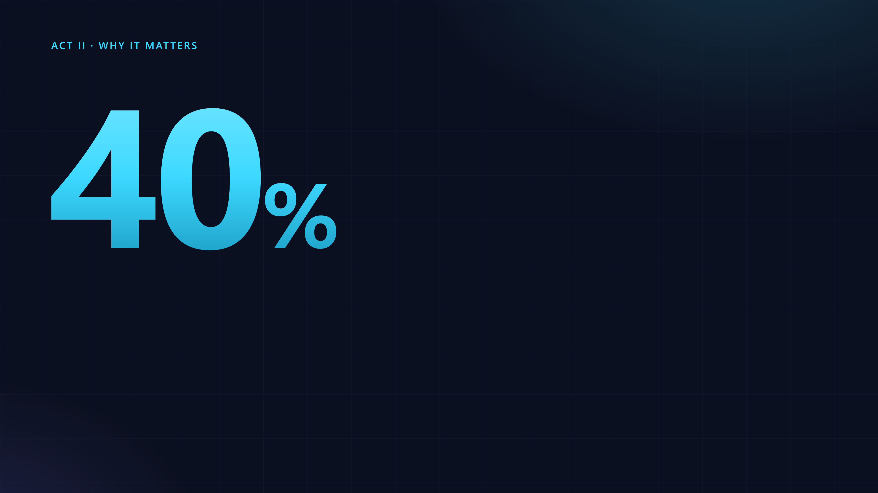
Claude Code repositories, June to September. The post gives the direction and the share, not the counts.
drop in the share of merged pull requests that had to be reverted, while the number merged more than doubled.
Osmani, Lunt and Wang, "How the Claude Code team does code review", 15 October 2026.

Slide 19
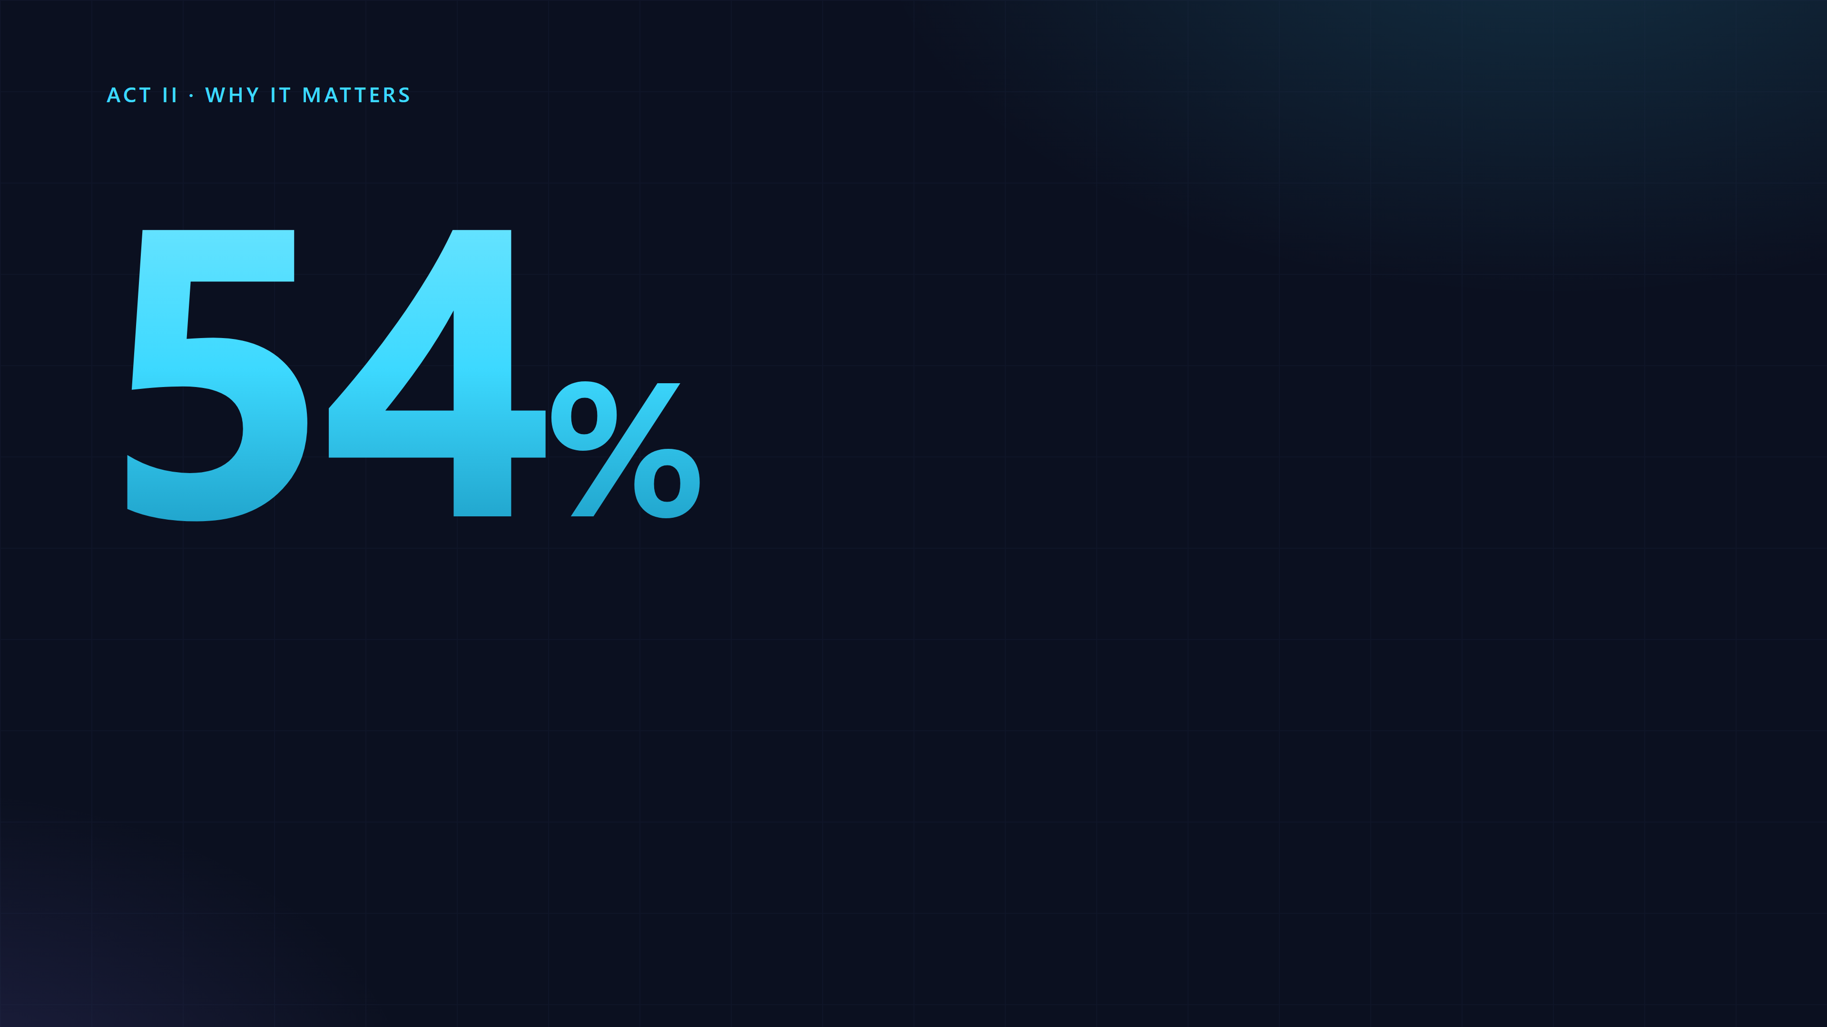
At the launch of the research preview of their AI review. The post does not say whether 54% is the current figure.
of internal pull requests got substantive review comments, up from 16%.
Osmani, Lunt and Wang, "How the Claude Code team does code review", 15 October 2026.

Slide 20
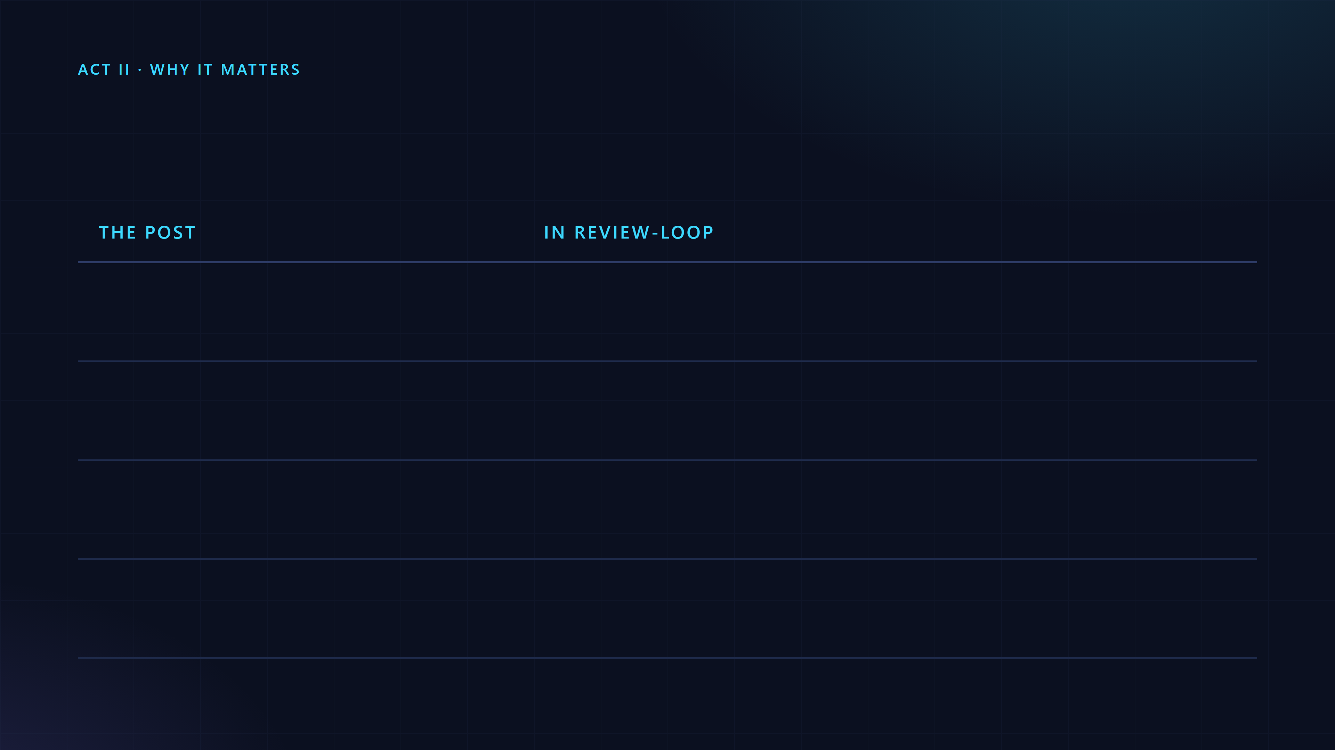
What the post does, and where it lives here
Verify before the pull request, with a fresh reader
/pre-pr-review
A REVIEW.md written by the code owners
REVIEW.md, created by review-loop init
Parallel reviewers, a vote, findings tagged Important, Nit or Pre-existing
multipass: three readers, a vote, the same labels
Every finding fixed, or resolved with a reason
review-loop gate: a report with Open: 0
Practices from Osmani, Lunt and Wang, 15 October 2026. The right column is review-loop's own README.

Slide 21
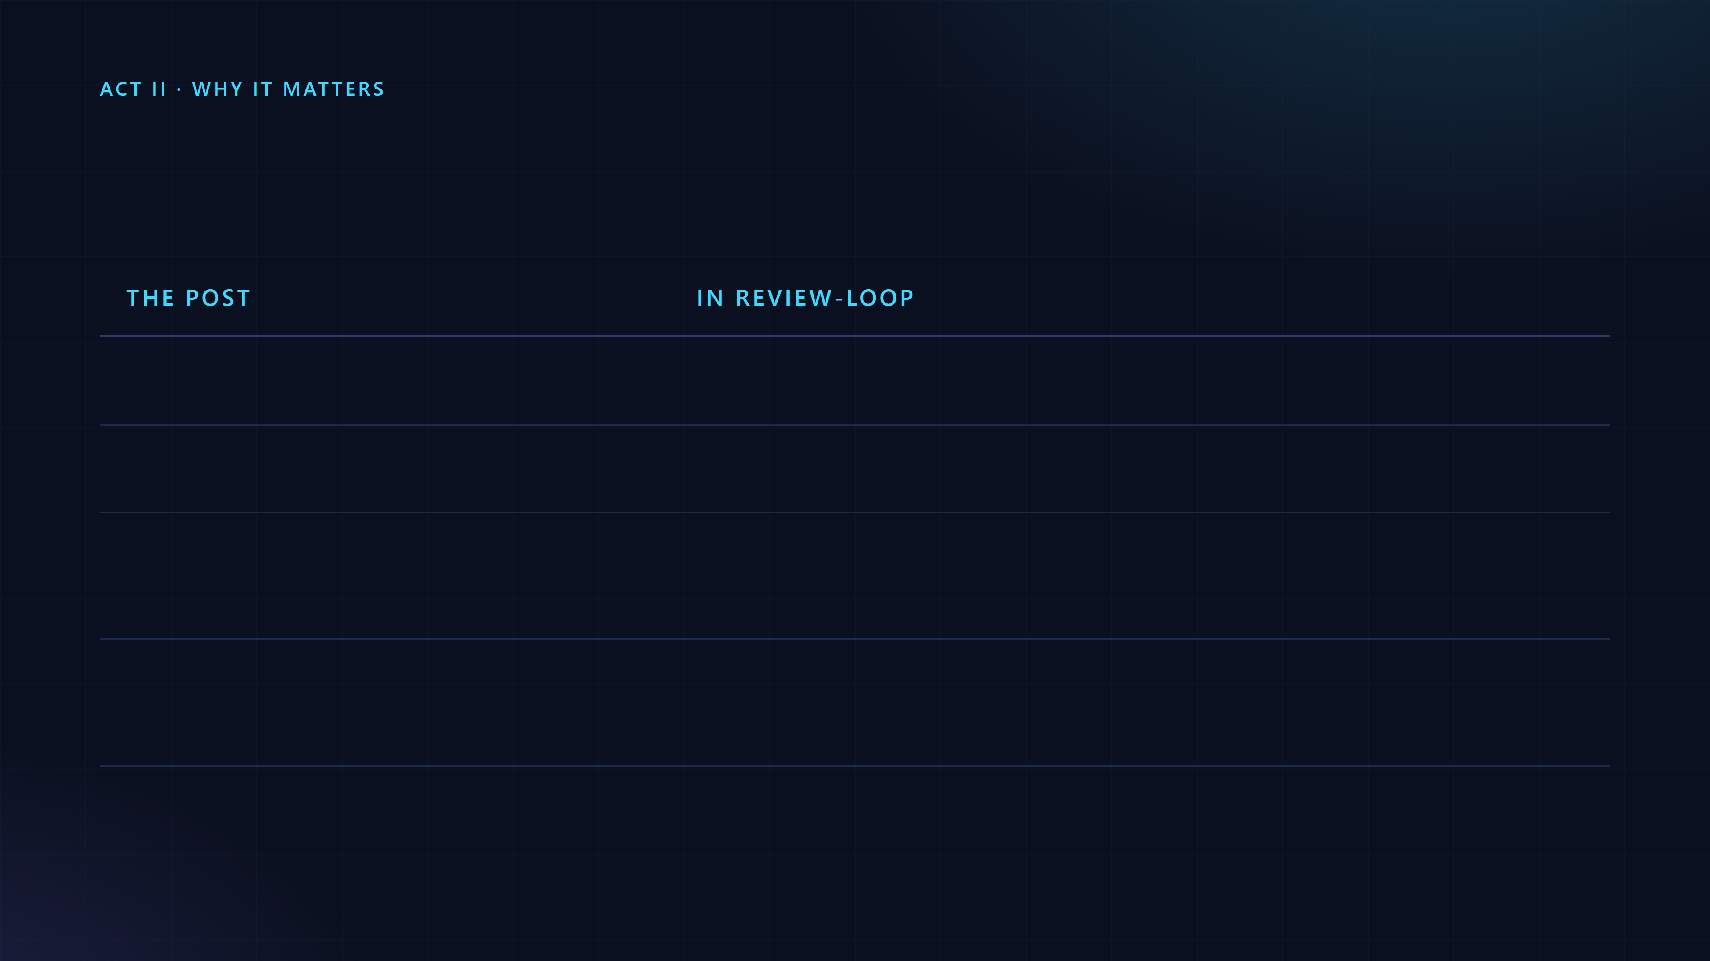
...and the rest of the map
Fix recurring findings at the source
Sweeps in REVIEW.sweeps, and /retro
Review has to converge
Three cycles, only the new diff, fix the class
Past incidents as the reviewer's test set, noise measured
/review-eval: recall and noise
Merge queue, feature flags, gradual release
Not covered. Risk tiers: planned
Practices from Osmani, Lunt and Wang, 15 October 2026. The right column is review-loop's own README.

Slide 22
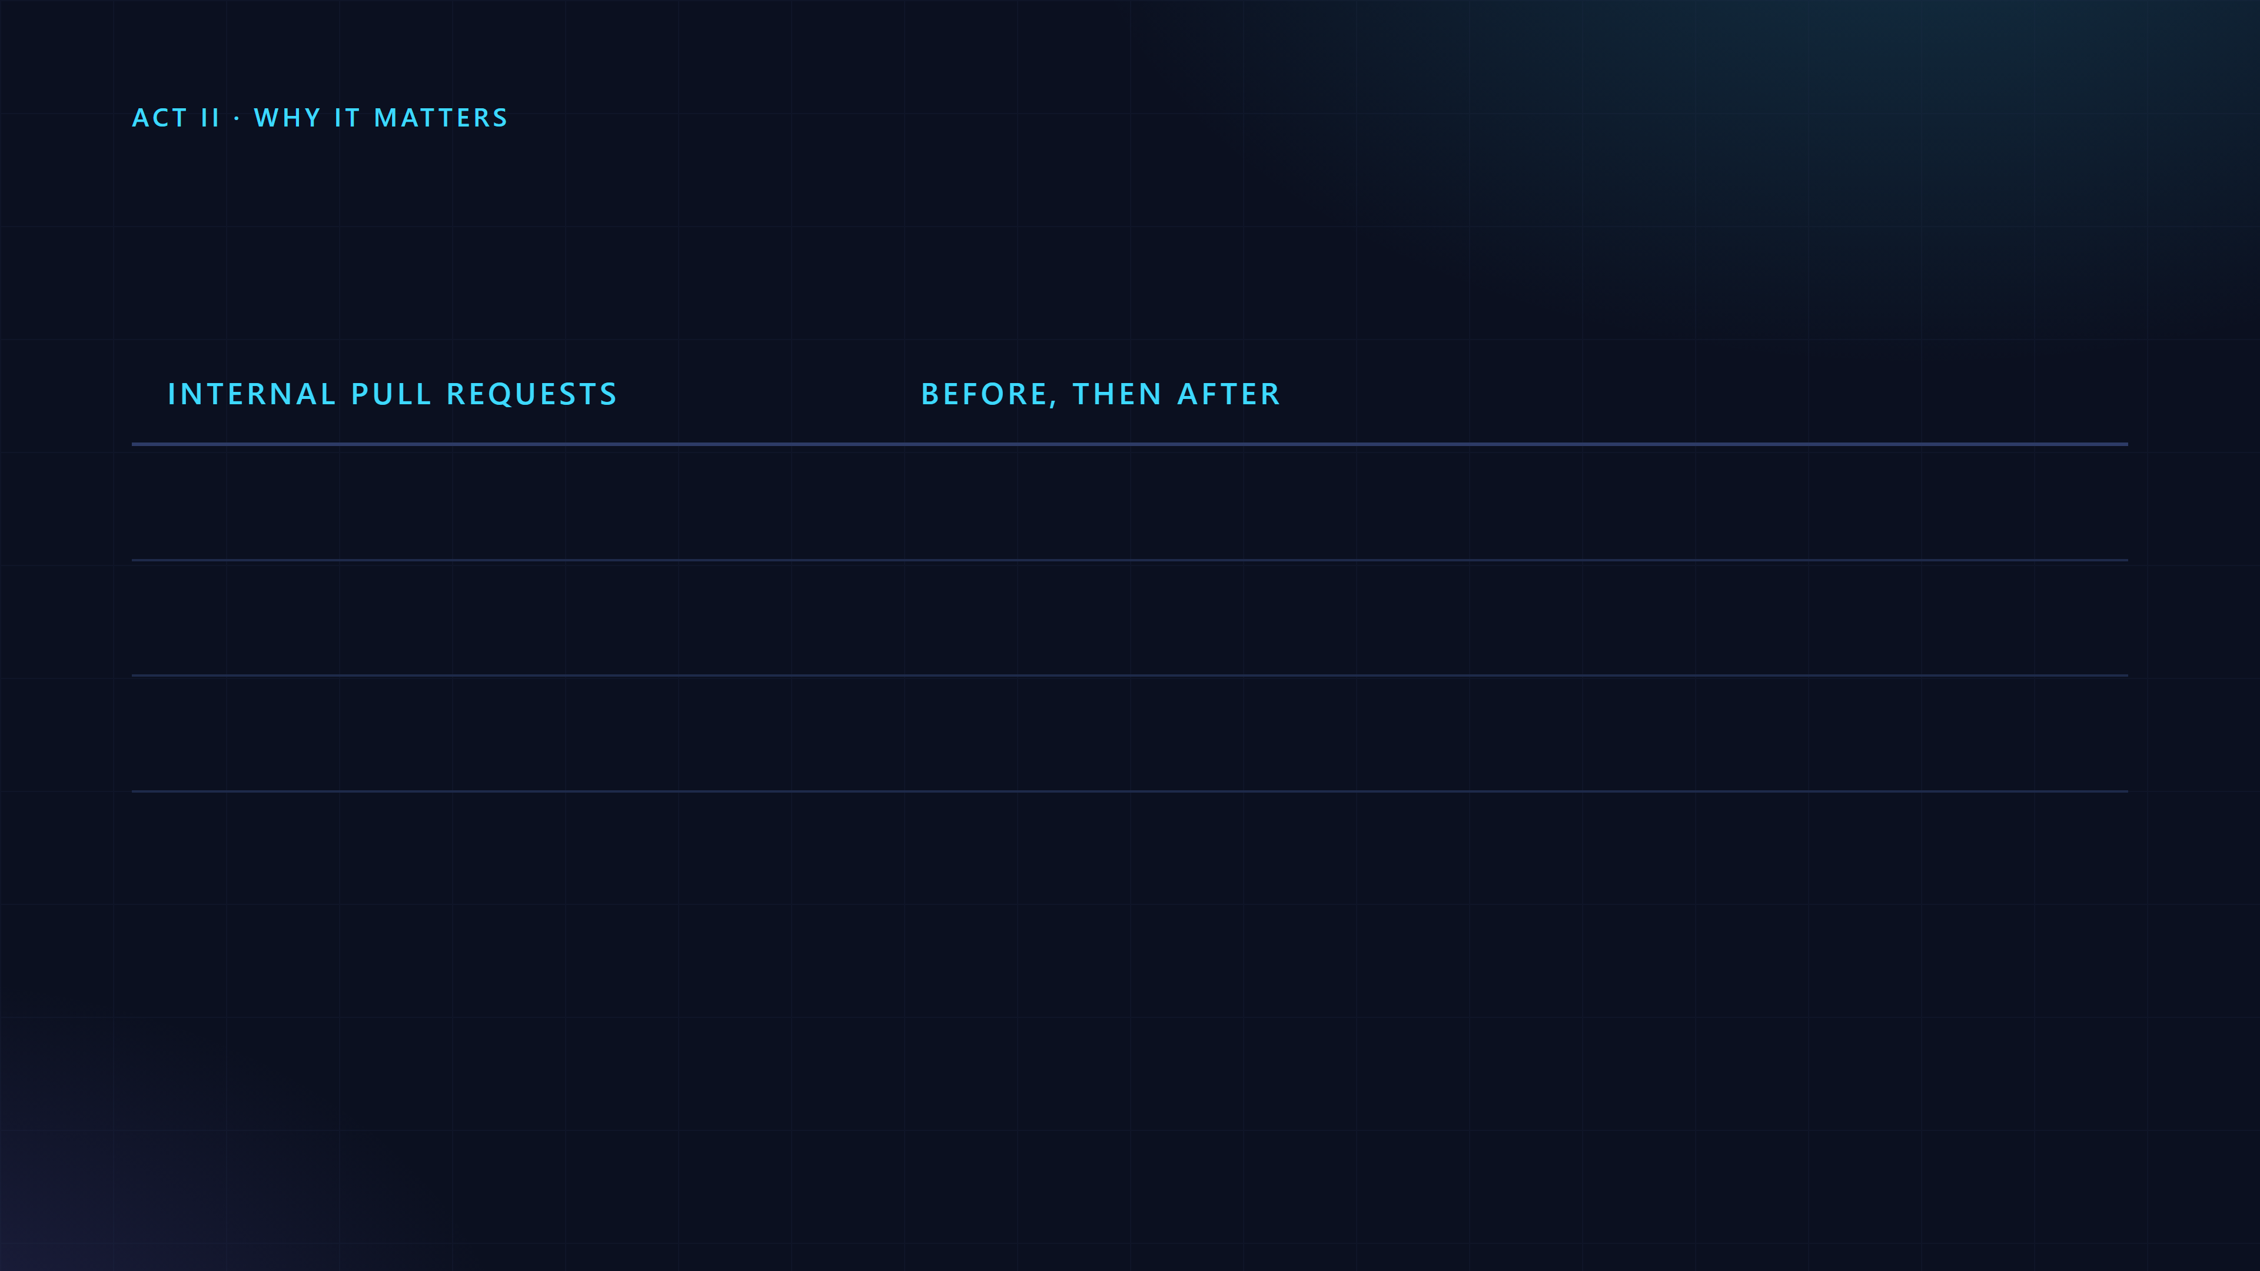
Review has to converge
Pass after one review-and-fix round
65%, then 78%
Need five or more rounds
8.9%, then 1.5%
Mean number of reviews to pass
2.08, then 1.32
Osmani, Lunt and Wang, "How the Claude Code team does code review", 15 October 2026. Before and after the team's convergence work.

Slide 23
One pull request went through more than fifty rounds of review and fixes overnight.
A person dismisses a nit in seconds. An agent makes another commit and starts another round. review-loop stops at three cycles, reads only the new diff, and fixes the class of a bug, not the line.
Osmani, Lunt and Wang, "How the Claude Code team does code review", 15 October 2026.

Slide 24
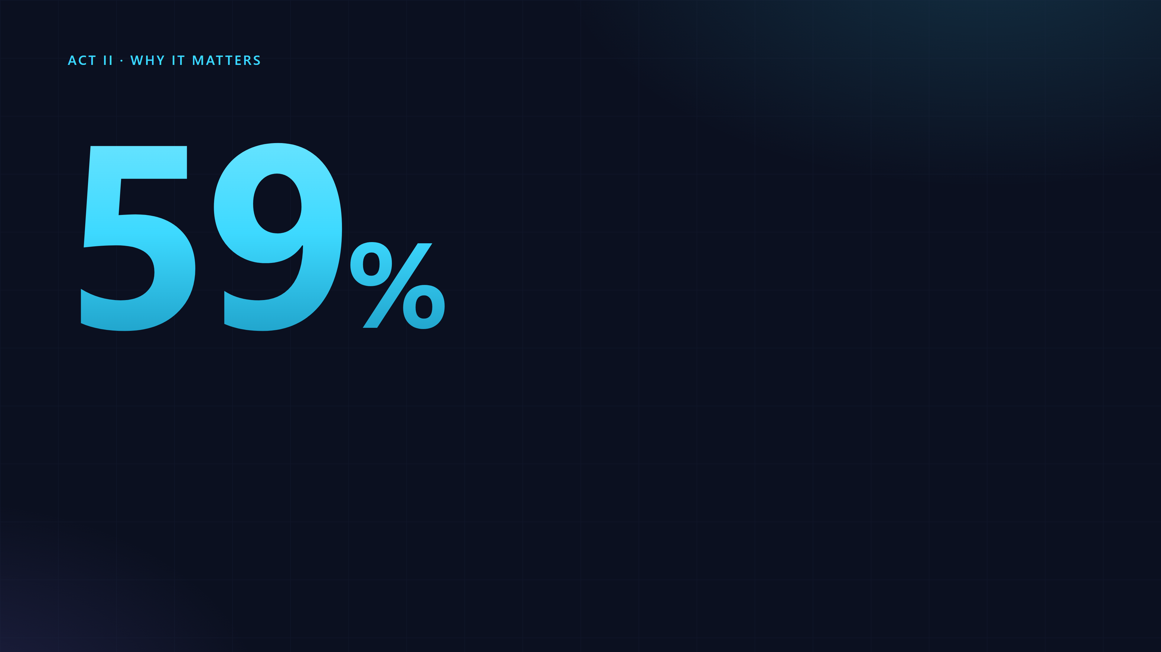
review-loop marks it Pre-existing and keeps it out of the author's count, so a round does not grow on code the change never touched.
of what the reviewer kept flagging was old code, there since the first pass.
Osmani, Lunt and Wang, "How the Claude Code team does code review", 15 October 2026. By git blame, on the pull requests the team studied.

Slide 25

The loop
What one review is made of, and what it costs.

Slide 26
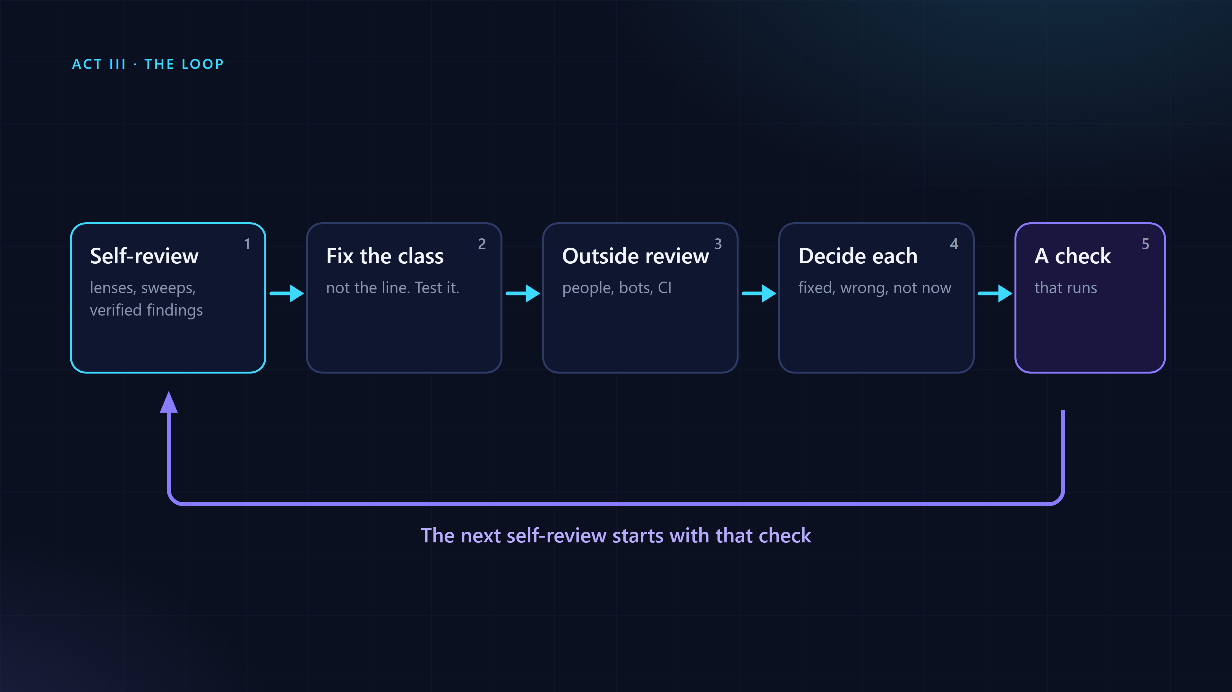
Five parts, one loop

Slide 27
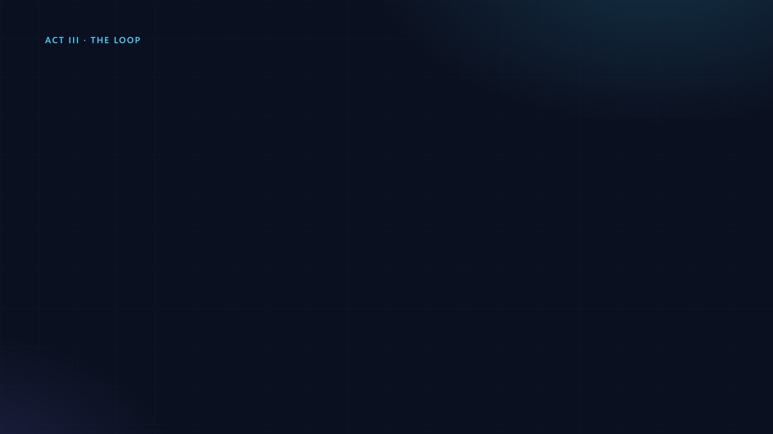
A good reviewer reads whole functions, not diff lines.
The callers and siblings needed to answer a question. The report says what was read in full and what was only skimmed.

Slide 28
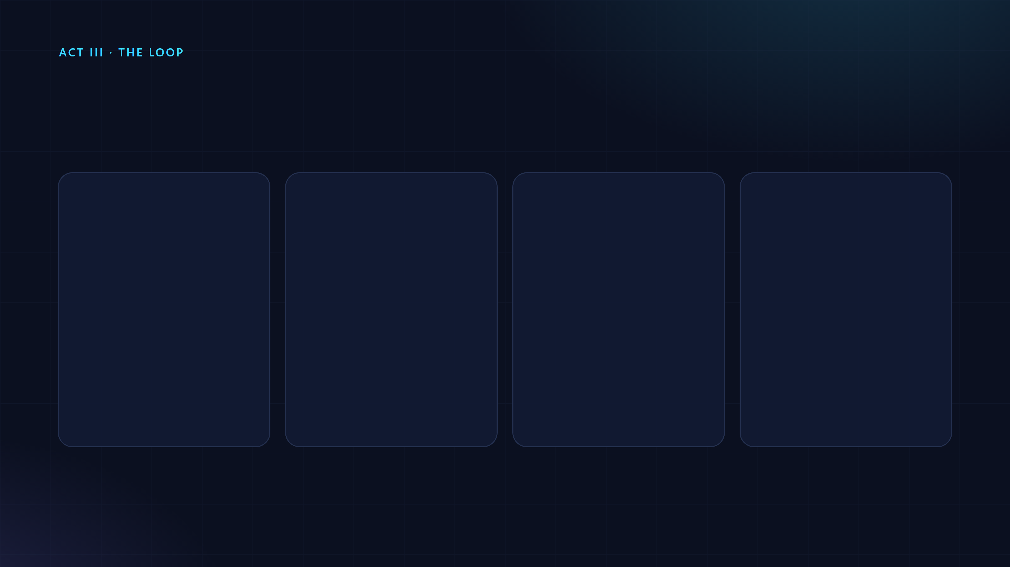
Nineteen lenses. One question each.
Untrusted input
Error paths
State
Claims
Can it report success after the write failed?
Every writer of a flag, and every reset of it.
A comment says "never". Is that true for every caller?
Missing, null, the wrong type, huge, negative, NaN?
skills/pre-pr-review/SKILL.md, section 3. Others: limits, cost, routing, platform, tests, concurrency, UI, dead code, other doors to the same resource.

Slide 29
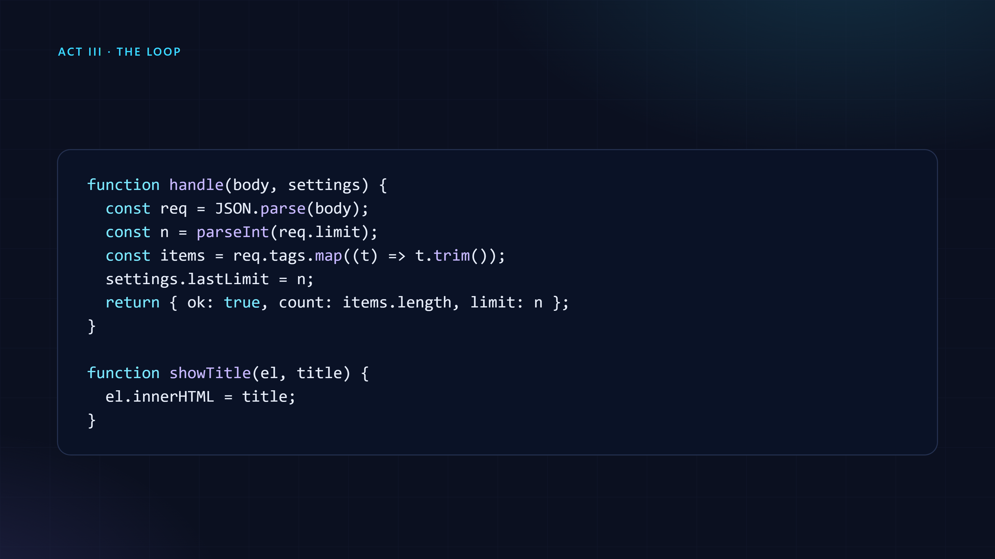
A small change, three problems
Twelve lines. Read it through the lenses and ask, for each line, what input breaks it.
A small example change made for this talk.

Slide 30
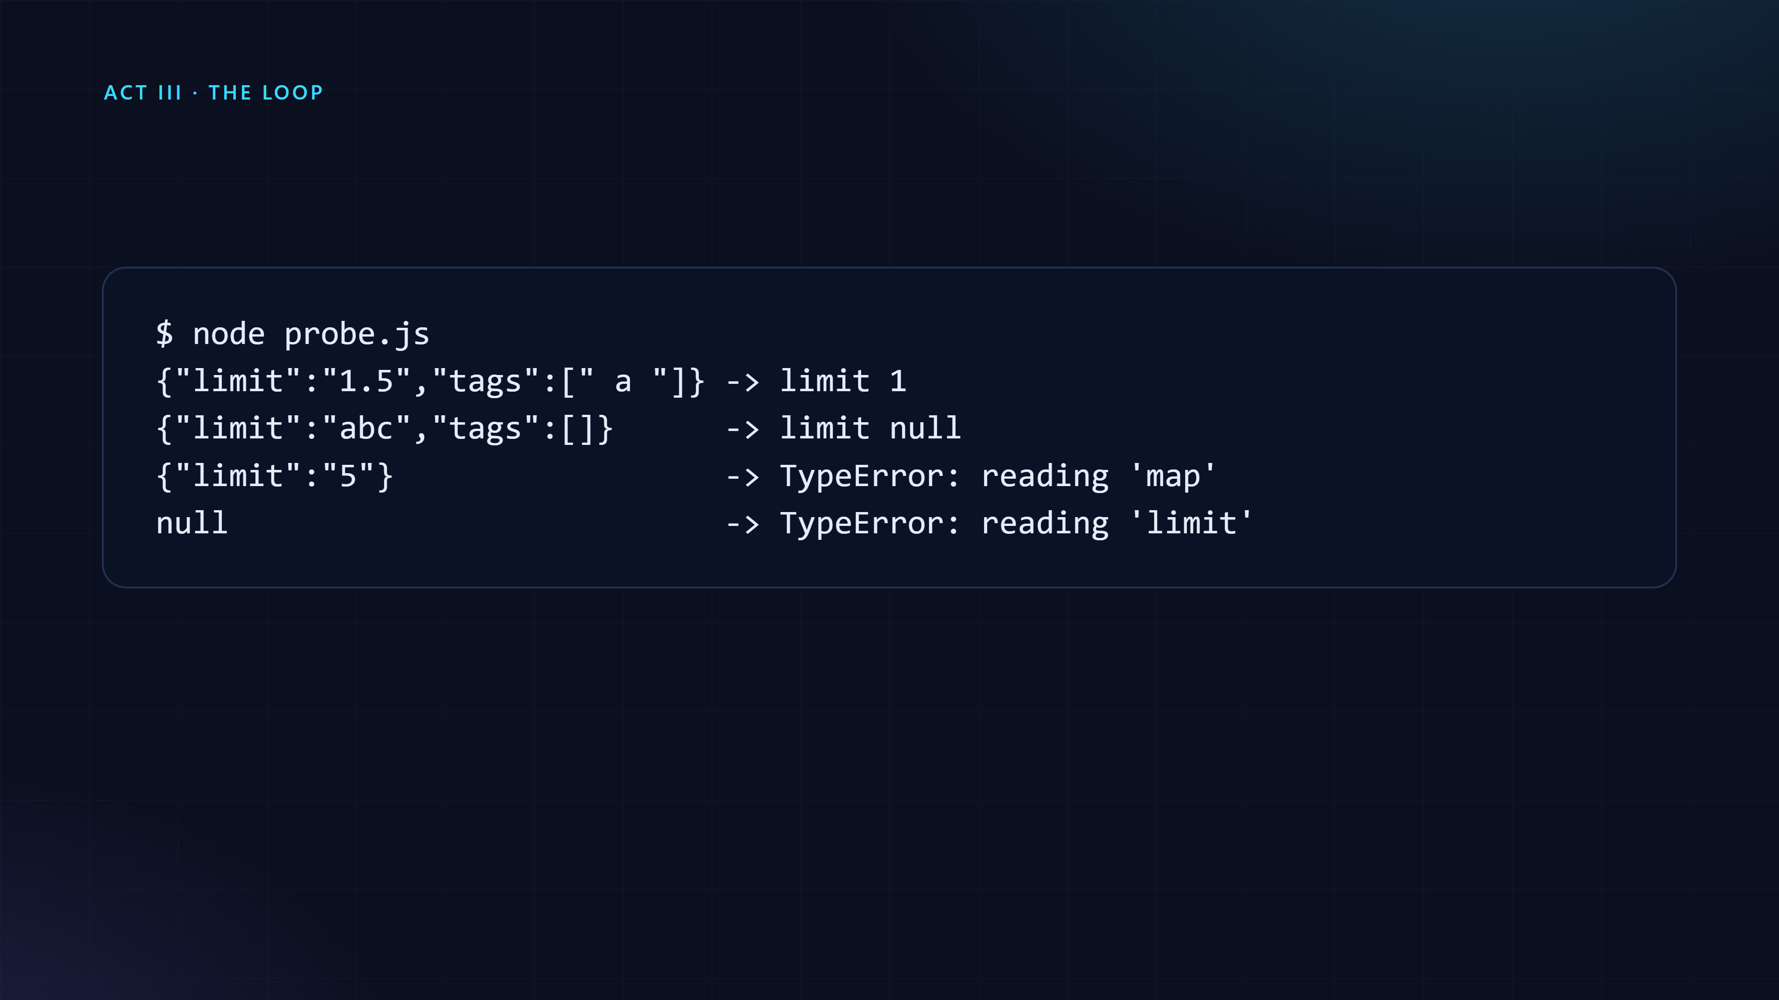
Verify: write the failure, then run it
Every finding names the input that breaks it. What cannot be made concrete is dropped, or listed as "could not confirm".
Output of the probe on the example change, Node 22.

Slide 31
Outside reviewers are cheap and sometimes wrong. Yours should not be.
A finding without a concrete failure does not go in the report.

Slide 32
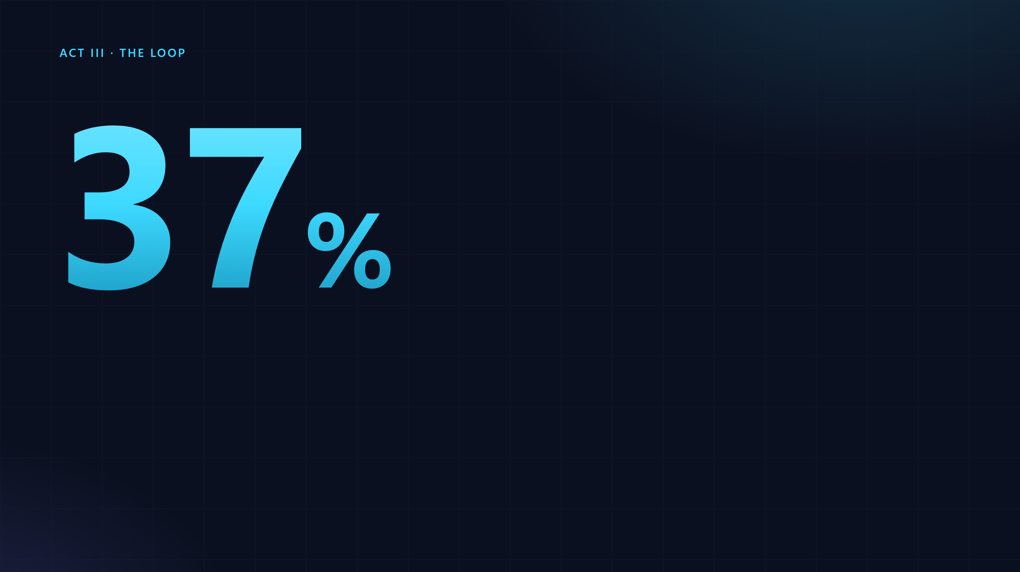
Our first baseline, code only, the cheapest model for every reader. A small set of cases. It is the reason for the next slide, not a general result.
of the real problems found by one cheap reader.
review-loop's own first baseline, in skills/pre-pr-review/references/multipass.md.

Slide 33
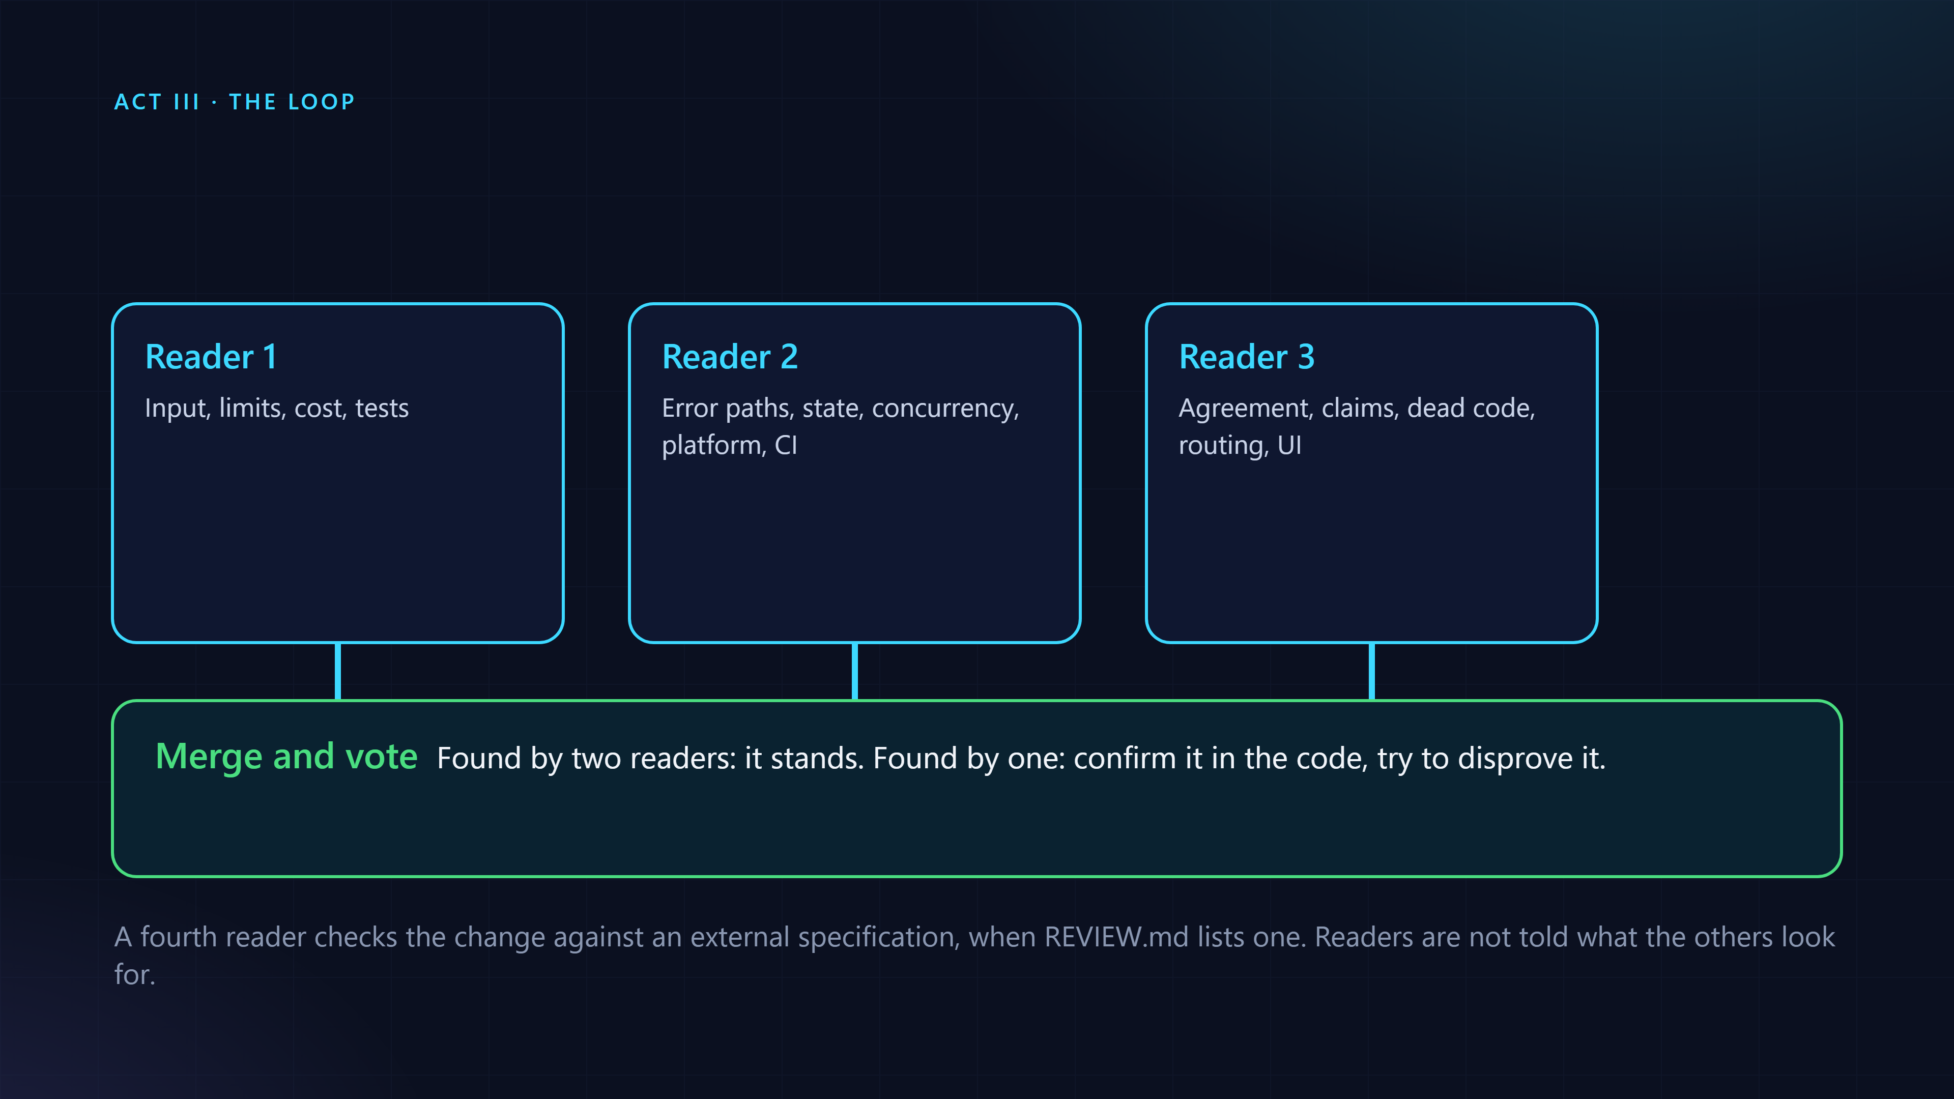
Three readers, each with one job, then a vote

Slide 34
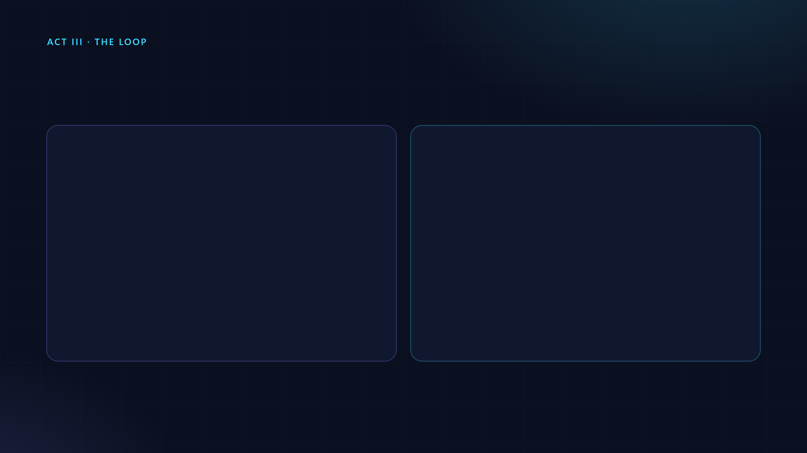
Pay for three readers only when it matters
One reader
Three readers and a vote
Documentation and tests
A larger change
A small code change, away from any guard
Always, for a path marked as a guard
Costs about three reads
Costs one read of the diff
review-loop depth, skills/pre-pr-review/scripts/review-depth.sh. Default limit: 60 changed code lines.

Slide 35
It asks before you spend
The last commit, the last seven and the last twenty of a real game.
Run on Neon Smash (github.com/kenchris/soma-breakout), October 2026.

Slide 36
Three cycles at most. Then ask whether the approach is wrong.
After the first pass, read only the new diff. Fix the class of a bug, not the line.

Slide 37
What failure means here goes in one short file.
REVIEW.md: what counts as a failure, which paths guard something, what to ignore, which classes were raised before. The reviewer reads it first.

Slide 38
Checks that run
Attention is expensive. A search is free.

Slide 39
If a search can find the pattern, do not ask a reader to remember it.
A line in a prompt costs attention on every review. A sweep costs a second and no model.

Slide 40
Sweeps: the added lines, run through search rules
No model, no cost. Each hit is a question.
Run on Neon Smash (github.com/kenchris/soma-breakout), last 20 commits, output shortened.

Slide 41
A hit is a question, not a finding.
Both of these are fine. The parse sits in a try and clamps the value. The listeners are added once, in a page that lives as long as the game. Answering takes a second.
js/assist.js and js/secretCode.js in Neon Smash.

Slide 42
Depth and sweeps on a real game
Last commit: one reader. Last seven: three. Then the added lines run through the sweeps: two questions, no model.
Windows 11, Git Bash. The output is real; the typing is replayed. Neon Smash, github.com/kenchris/soma-breakout

Slide 43
Your own sweep is one line
name ## which files ## regex ## why. It goes in REVIEW.sweeps at the root of the repository.
The format of REVIEW.sweeps.

Slide 44
The gate: "reviewed" becomes a rule
A report in reviews/ with Open: 0 must cover every commit.
Run on the example change made for this talk.

Slide 45
The gate checks that a review was written. Not that it was good.
It is a hand-over rule. Quality comes from the lenses, the readers, the verification and the eval.

Slide 46
The gate fails, then passes
No report: it stops. A report with Open: 0 that covers the commit: it passes.
Windows 11, Git Bash. The output is real; the typing is replayed. The report was written by hand.

Slide 47
In practice
Four levels. Stop when it is enough.

Slide 48
Each level adds one thing
Ask for a review
Tell it about your repo
Make "reviewed" a rule
Learn from outside review
One command, no setup.
Two minutes, once.
Optional, pays off after a few rounds.
For teams.

Slide 49
Ask for a review
The current branch, a pull request, a range, or three readers and a vote. Fix what it finds and run it again.
These are typed to the agent (Claude Code, or VS Code), not to a shell.

Slide 50
Install
Needs bash and git. On Windows, install.cmd finds the bash of Git for Windows.
README, Install.

Slide 51
Tell it about your repository
It never overwrites. Edit REVIEW.md a little: the reviewer reads it first.
Run on Neon Smash (github.com/kenchris/soma-breakout).

Slide 52
A REVIEW.md for a small game
Short on purpose. A reviewer that has to read a long file reads it badly.
REVIEW.md written for Neon Smash for this talk.

Slide 53
Level 2 in ten seconds
init creates REVIEW.md, REVIEW.sweeps, REVIEW.gate and reviews/. doctor checks the install.
Windows 11, Git Bash. The output is real; the typing is replayed. Neon Smash, github.com/kenchris/soma-breakout

Slide 54
The same checks inside VS Code
Terminal, Run Task, review-loop: sweeps. The wait for the terminal is cut. The hits are added as warnings on the lines, in the Problems panel and in the editor.
VS Code on Windows 11, a clean profile, Neon Smash. Recorded live: the task output and the warnings are real.

Slide 55
/pre-pr-review in Copilot chat
Agent mode in VS Code, on the last commit of Neon Smash. The report: no Important or Nit findings, and it says it could not run the tests.
VS Code on Windows 11, recorded live. Typing 2 times and the agent's work 6 times faster, still stretches cut. /pre-pr-review HEAD~1..HEAD, a ten-line change.

Slide 56
Not every project wants this yet. One or two developers can try it first.
Keep REVIEW.md, the sweeps and the reports in a separate private repository. The skills are installed per developer, so the project itself does not change.
review-loop reads its settings from a file outside the repository when REVIEW_LOOP_CONFIG names one.

Slide 57
The project stays as it is
Our idea: a review-loop-private repository with one folder per project.

Slide 58
One file says where everything is
The reviewer reads REVIEW.md from there, the sweeps run from there, the reports and eval cases are kept there.
review-loop help, Configuration.

Slide 59
Same commands, nothing added to the project
A sweep from the private file fires. The project has no new files and nothing to commit.
Run on Neon Smash, HEAD~7 to HEAD, with the private files in a separate folder. Output shortened, paths shortened.

Slide 60
What a private setup gives, and what it does not
Works the same
Does not, until it moves in
/pre-pr-review, depth and sweeps
CI and the gate cannot see files that are not in the repository
Reports, scores and eval cases
Teammates review with their own settings
/retro on the outside comments you get
Nothing is shared yet
Our reading of the configuration. Not tested in CI.

Slide 61
Moving in later is a copy.
When the team says yes, copy the files to the project root and delete the config file. The root is the default place for all of them.
review-loop help: the defaults are REVIEW.md, REVIEW.sweeps, reviews/ and evals/ at the repository root.

Slide 62
Make "reviewed" a rule
Commit the report. Check before a hand-over or merge.
Run on the example change made for this talk. The report is written by the agent, here by hand.

Slide 63
In CI the scripts run. The skills do not.
Sweep hits appear as warnings on the changed lines of a pull request. The gate can be a required check.
docs/ci.md. The sample workflow is a sketch, not yet run on GitHub.

Slide 64
Plain SKILL.md files. They work where an agent loads skills.
Claude Code, VS Code (Copilot agent mode and the Claude Code extension), other agents that read a skills folder. The scripts need only bash and git.
README, VS Code.

Slide 65
Learning
Every outside comment is a check you did not have.

Slide 66
From a review thread to the next review

Slide 67
Level 4: four commands
Download the open threads. See what is undecided. Decide each one. Then ask the agent what would have caught them.
docs/learning-from-reviews.md. Needs node 18 and a token that can read the pull requests.

Slide 68
A verdict is your decision about one thread
fixed
Right, and fixed. Give the commit.
rejected
Wrong. Say why: it is remembered.
caught
My own review had already reported it.
deferred
Real, but not now.
docs/learning-from-reviews.md. Also: missed, and new for undecided.

Slide 69
The cheapest change that would have caught it

Slide 70
What /retro said about a real round
Three
One
One
Result
The lens covered it, the reader skipped it.
A one-line search would find it: a pointer cast with no family check.
A deleted test file nobody had noticed.
A ranked list of changes, instead of nine fixes that teach nothing.
The Copilot round from slide 7: nine comments, eight right. The README does not break down the other three.

Slide 71
Measure the reviewer too. Recall and noise. Both.
Recall: of the real problems, how many it reported. Noise: of what it reported, how much was wrong. Raising recall is easy. Noise is what it costs the author.
skills/review-eval/SKILL.md.

Slide 72
A rejected comment keeps your reason. It is not fixed twice.
And a change to the lenses is kept only if the eval says it helped.

Slide 73
It pays off after a few rounds. With one or two comments there is nothing to learn from yet.
Start with review-loop threads sync.

Slide 74
For managers
What to decide, what to measure, how to start.

Slide 75
The question is not "did a human read it?" It is what could go wrong, and which check should catch it.
The post calls reading by a person an imprecise proxy for that question.
Osmani, Lunt and Wang, "How the Claude Code team does code review", 15 October 2026.

Slide 76
Who does what
Machines read
People keep
Routine mistakes in a diff
Whether to build it at all
Mechanical patterns, as sweeps
Risky code: billing, the updater, CI workflows
Whether the tests ran and passed
Architecture
Owning the outcome
The split is from Osmani, Lunt and Wang, 15 October 2026.

Slide 77
Whoever prompted the change is on the hook for it. An agent's approval never counts as a person's.
The gate checks that a review was written. It never replaces the person who signs off.
Osmani, Lunt and Wang, "How the Claude Code team does code review", 15 October 2026.

Slide 78
What to measure
Human comments, and the time a PR waits on a person
Your tracker. review-loop does not measure it
Recall and noise of the review
review-loop eval report
Findings and outcomes per round
review-loop score show
Reverts and incidents: the guardrail
Your data. Turn each into an eval case
The measures are from Osmani, Lunt and Wang, 15 October 2026. The right column is review-loop's README.

Slide 79
The cost argument is human time, not tokens.
A senior engineer pulled out of deep work to catch a routine mistake costs far more than an automated review. The post gives no dollar or token figures, and neither does this talk. review-loop records the tokens each run used, so you can measure your own.
Osmani, Lunt and Wang, "How the Claude Code team does code review", 15 October 2026.

Slide 80
A way to roll it out
Week 1
Then
One repository, or one or two developers with the files kept privately. Levels 1 and 2.
Level 3: the gate, for the paths that guard something.
Weeks 2 to 4
After a few rounds
Tune REVIEW.md as reviewers disagree with it.
Level 4: learn from outside review.
The post: start with one repository, tune REVIEW.md for a few weeks, then widen. The mapping to levels is ours.

Slide 81
Start strict, loosen with evidence.
In review-loop a guard path always gets three readers. Automatic risk tiers from the paths a change touches are planned, not built.
Osmani, Lunt and Wang, "How the Claude Code team does code review", 15 October 2026.

Slide 82
Four questions for your team
Ownership
Guards
Measures
Memory
Who owns a change an agent wrote?
Which paths always need a person?
What would make us tighten review?
Where do review findings go after the round?

Slide 83
Limits
What it does not do.

Slide 84
A small, generic version of some of these pieces
It does
It does not
Lenses, sweeps and verification
Merge queues and staged rollout
Several readers and a vote
Feature flags
A report, a gate and a score
Risk-tiered approval (planned)
Retro and eval
Explainers for modules (planned)
README, Background, and PLAN.md.

Slide 85
Three readers cost about three times one. Say so before launching.
The tool asks first for a large diff, suggests a model per reader, and the eval records the tokens each run used.

Slide 86
On Monday
Free, free, and one reader. Fix what it finds. Stop here if that is enough.
Levels 1 and 2 of the README.

Slide 87
Start at level 1. Stop when it is enough.
github.com/kenchris/review-loop

Slide 88
Read more, and try it

Slide 89
Hands-on
On your own branch. About 20 minutes.

Slide 90
Six steps
Install
Ask
Compare
Setup
Rule
Learn
review-loop doctor shows 8 ok.
/pre-pr-review on a branch with changes.
review-loop depth, then sweeps.
review-loop init, edit REVIEW.md.
Save a report, run the gate.
Optional: threads sync, then /retro.

Slide 91
Install, ask, compare
Did the review find something the sweeps did not? Did the sweeps ask something the review answered?

Slide 92
Setup, then the rule
Edit REVIEW.md first: three lines on what failure means in your project.

Slide 93
For those with open pull requests and review comments.
review-loop threads sync --repo owner/name, then decide each thread. Then /retro, and read the list before you apply anything.

