Slide 1

Broadcom Inc.
Ticker: AVGO
Target Price: $172.8 (+16%) - BUY
Analyst: Hongjia CUI

Slide 2
AVGO business breakdown
Networking thrives on Artificial Intelligence needs
Wireless is cyclical, others are in decline
Significant increase in software revenue due to VMware acquisition

Slide 3
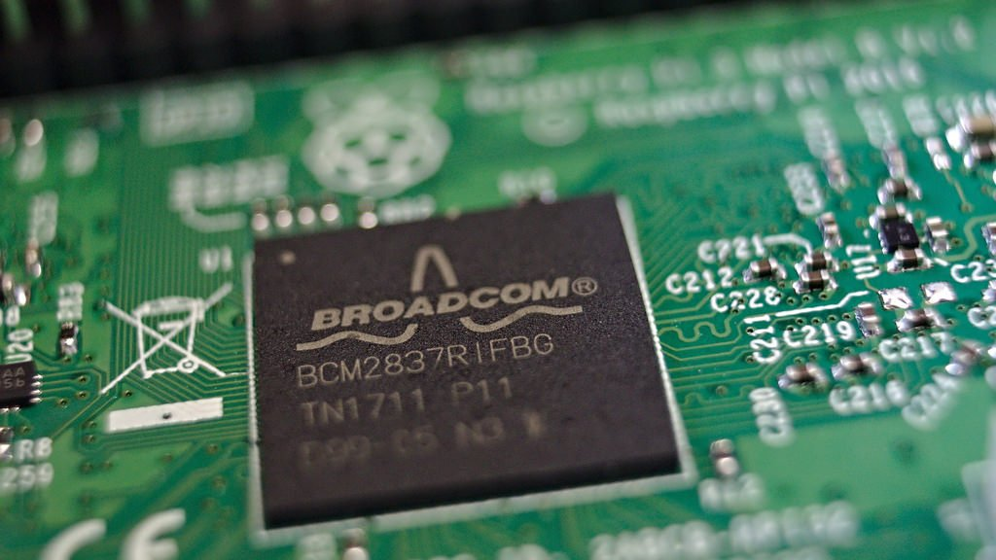
Custom ASICs & Networking Solutions
Custom ASICs
Custom-designed semiconductor chips that are created for a specific application or purpose.
Broadcom is the industry leader with more than three decades of ASIC design experience, a state-of-the art hierarchical design methodology, and an extensive IP portfolio

Slide 4
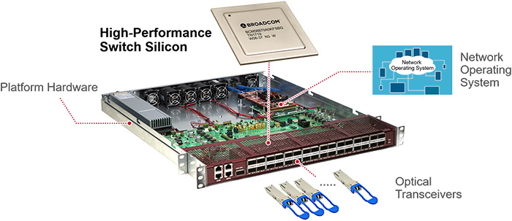
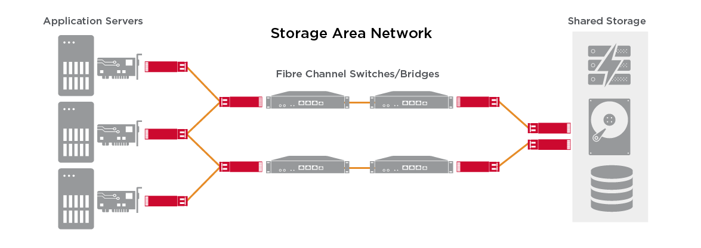
Custom ASICs & Networking Solutions
Networking Solutions
Designed to manage and facilitate communication between different devices in a network.
Ethernet Switch Chips
To manage the flow of data between devices on a local area network
Mainly used in data centers, enterprise networks, and service providers
Ethernet NICs (Network Interface Cards)
To allow a computer or server to connect to a network via Ethernet.
Mainly used in servers within the data center
Fiber Channel Networking Chips
To provide high-speed, reliable connectivity between servers and storage devices
Mainly used in large enterprises and data centers

Slide 5
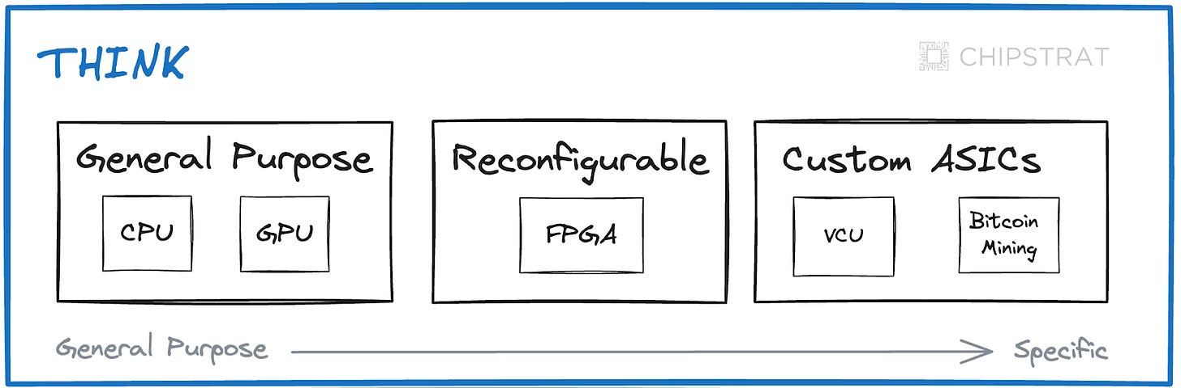
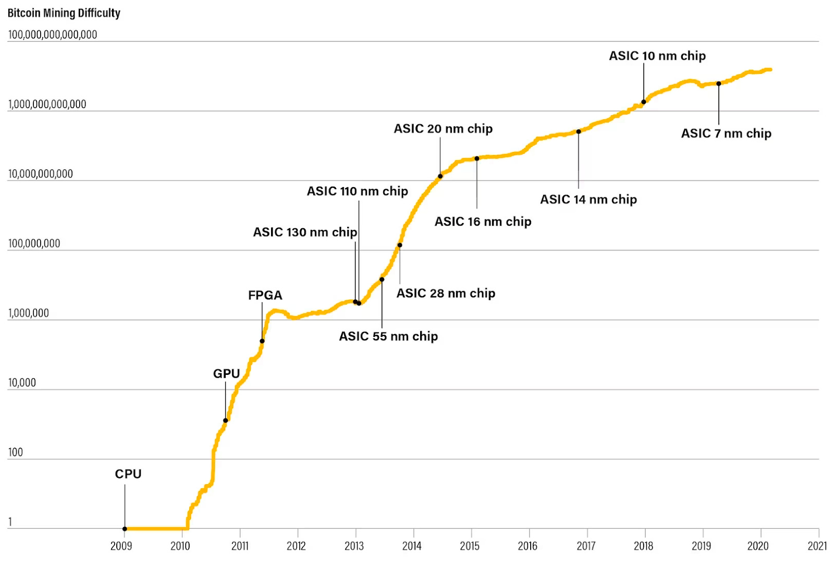
Advantages for ASICs vs. CPU, GPU
Higher Performance for Specific Tasks
Custom ASICs are designed for specific tasks
CPUs and GPUs are versatile but less efficient at specific tasks
Lower Power Consumption
ASICs can be optimized for power efficiency by simplifying circuitry and eliminating unnecessary components
CPUs and GPUs tend to consume more power
Security and Reliability
CPUs and GPUs Often include enhanced security features at hardware level

Slide 6
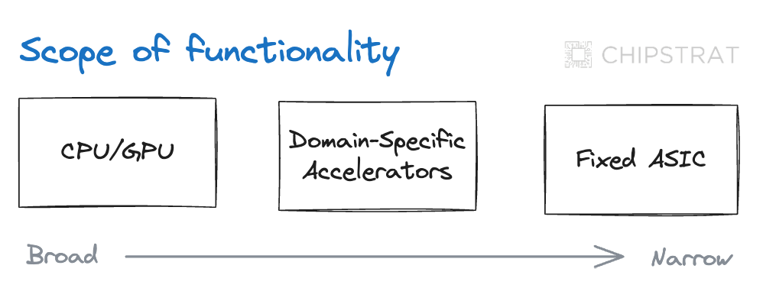
Disadvantages for ASICs vs. CPU, GPU
Lack of Flexibility
CPUs and GPUs can be used for a wide range of applications
High Development Costs & Longer-Time to Market
Designing and manufacturing a custom ASIC is expensive and time-consuming
CPU and GPU are mass-produced and have shorter development cycles and can be more easily adapted to new applications

Slide 7
Competitive Advantages for Broadcom
Customization and Specialization
More than 3 decades experiences
Proven Expertise and Innovation
Long history of innovation, especially in networking and data center
Integration with Existing Infrastructure
To integrate seamlessly with the existing infrastructure of these tech giants.
Reliability and Security
Hardware level security
Stable product iterations
2-year of iteration

Slide 8
AVGO Competitors

Slide 9
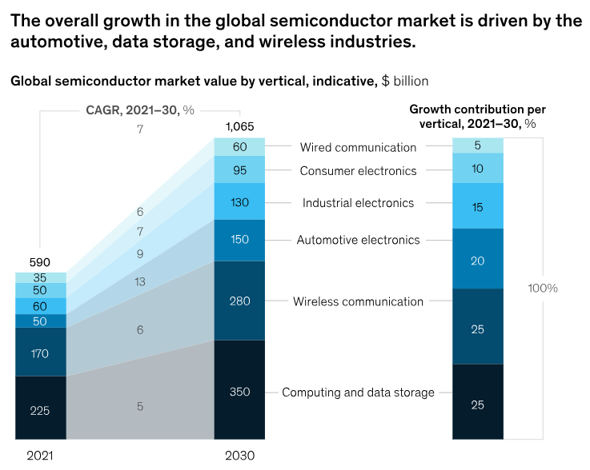
Investment Thesis #1
Significant growth on global semiconductor market, especially AI-Driven chip demand
From 2021 to 2030, CAGR from 6% to 8%
A $1 trillion dollar industry by the end of the decade
Potential Collabs with leading tech companies
For every dollar a company spends on GPUs, it typically spends an additional 25 to 30 percent on the networking equipment needed to make those GPUs work efficiently together
9

Slide 10
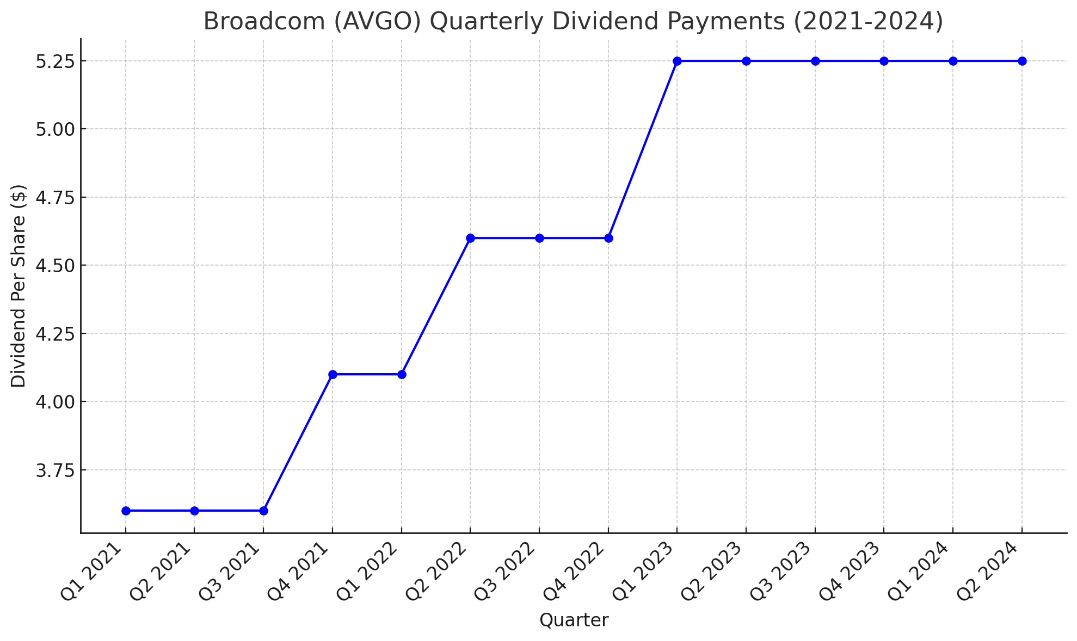
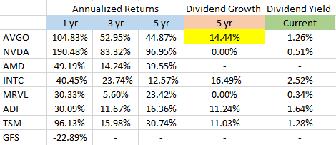
Investment Thesis #2 & #3
Strategic M&A Enhances Growth Potential
CA Technologies (2018):
Acquired for $18.9 billion → significant expansion into enterprise software
Symantec Enterprise Security Business (2019):
Acquired for $10.7 billion → strengthened Broadcom software and cybersecurity offerings
VMware (2023):
Acquired VMware for $61 billion → enhancing capability in software and cloud services space
Strong Shareholder Returns Through Repurchases and Dividends

Slide 11
Catalysts
Subscription model transition
Close to 3,000 of the largest 10,000 customers signed up for contracts
VMware will partner with public cloud server providers – less expenses
Hyperscale customers are accelerating their investments – in collaboration with partners like Arista Networks, Dell, Juniper, and Supermicro
Notes:
https://www.spglobal.com/commodityinsights/en/ci/research-analysis/argentinas-reforms-likely-to-catalyze-oil-and-gas-export-boom.html

Slide 12
Risks
Channel Partner Risks
Customer Concentration Risks
Price concern on VMware subscription

Slide 13
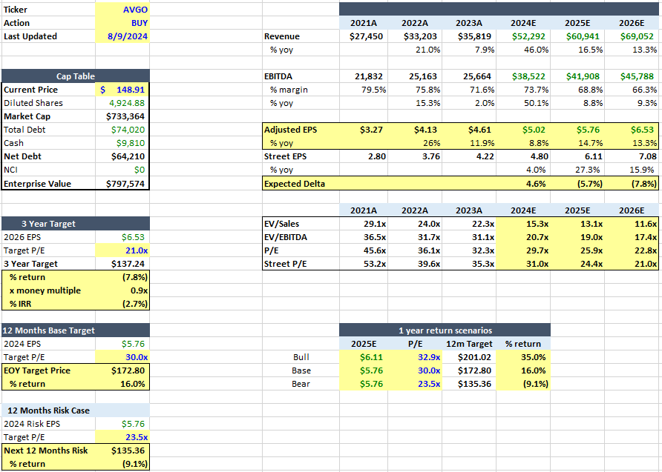
Valuation

Slide 14
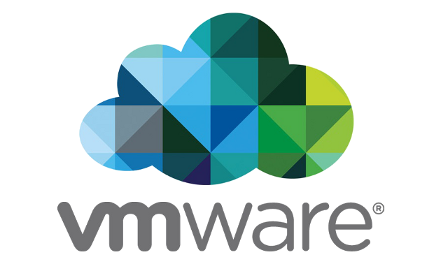
VMware
Competitive Advantages:
Market Leadership in Virtualization & SD-WAN
Hybrid Cloud Capabilities and Partner Network
AWS, Azure, Google Cloud, Oracle
Intrinsic Security Features

Slide 15
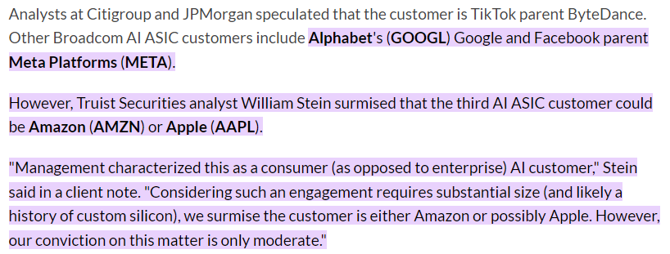
Appendix
Apple – 20% total revenue
RF Front-End Modules (Including FBAR Filters) – wireless networks, including 5G
WIFI & Bluetooth Chips – wireless connectivity for devices
Touch Controllers – detect and process user interactions

Slide 16
Thank You

