Slide 1
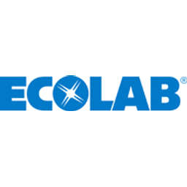
Ecolab Inc.
Ticker: ECL
Target Price: $221.93 (-7.6%) - HOLD
Analyst: Hongjia CUI

Slide 2
ECL Business Segments
Global Industrial: +1.4%
Water: +4%
Food & Beverage: +0%
Paper: -1%
Global Institutional & Specialty: +7.2%
Institutional: +6%
Specialty: +7%
Global Healthcare & Life Sciences: -0.3%
Healthcare: -3%
Life Sciences: +4%
Global Pest Elimination Segment: +9.9%

Slide 3
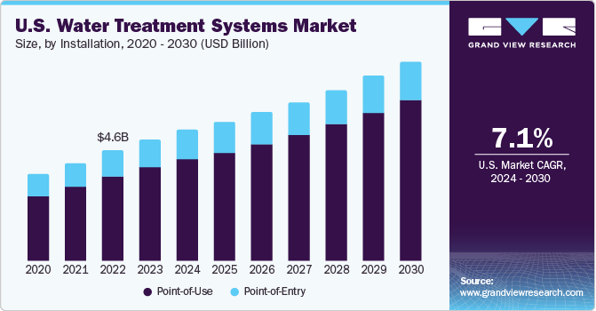
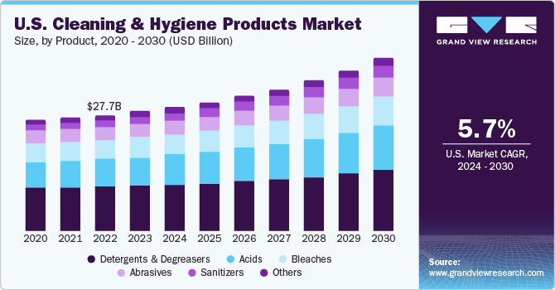
ECL Regional Breakdown

Slide 4
Competitors & Advantages
Competitive Advantages:
Diverse Portfolio of Products and Service Offerings
Strong Global Presence
Ecolab operates in over 170 countries
Customer Relationships & Brand Awareness
Established in 1923
Current Customers: Microsoft, Home Deport, Walmart, Alphabet A, Marriot A, Coca-Cola, etc.
Innovation and Technology
Digital tools, such as data analytics, remote monitoring, and automation

Slide 5
Investment Thesis #1
One Ecolab Initiative –advanced solutions to 5% to 7% long-term organic sales growth
Integrating various products and services into more comprehensive solutions
Labor-saving technology and automation
Automated Cleaning Systems
CIP (Clean-In-Place) Systems
Automated Disinfection Systems
Digital Monitoring Tools
Cross-Selling and Integration
5

Slide 6
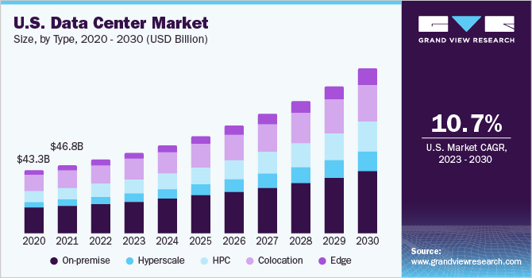
Investment Thesis #2
Water Treatment Demand Driven By Data Center
Pretreatment treating the influent water & cooling system management
Semiconductor, Ecolab can provide ultrapure water

Slide 7
Catalysts
Portfolio Restructure - Sale of global surgical solutions business to Medline
Lower Raw Material Costs until 2025
Shares Repurchases- 10.72 million shares

Slide 8
Risks
FX Risk - 47% of revenue comes from outside of U.S. in 2023
Global economic recession & Severe public health like COVID-19
Lack of capacity when there is a new COVID
Geopolitical risk – import raw materials from China recently

Slide 9
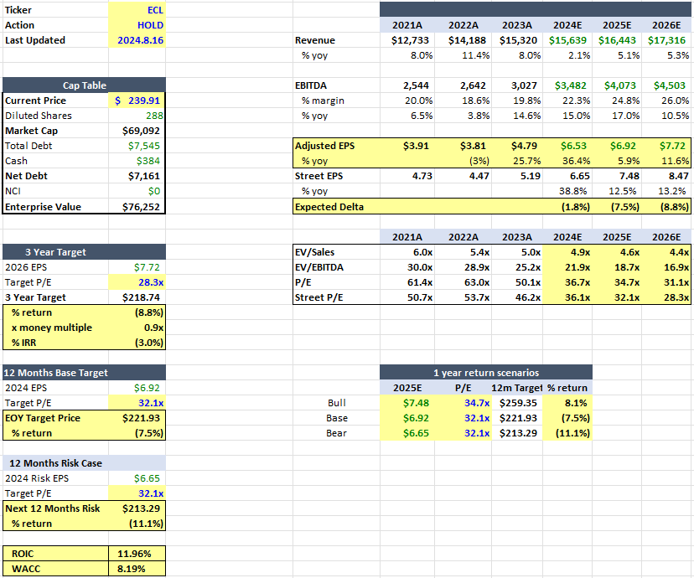
Valuation

Slide 10
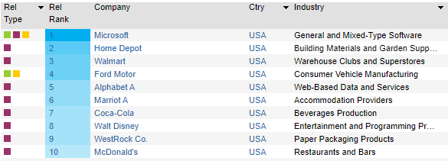
Appendix #1
Potential growing on Global Industrial mainly due to water treatment demand of data center
Mainly serving the U.S. market

Slide 11
Thank You

