Slide 1
Vista Energy SAB de CV - ADR
Ticker: VIST
Target Price: $45.05 (+13%) - BUY
Analyst: Hongjia CUI

Slide 2
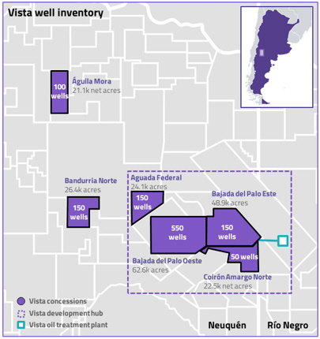
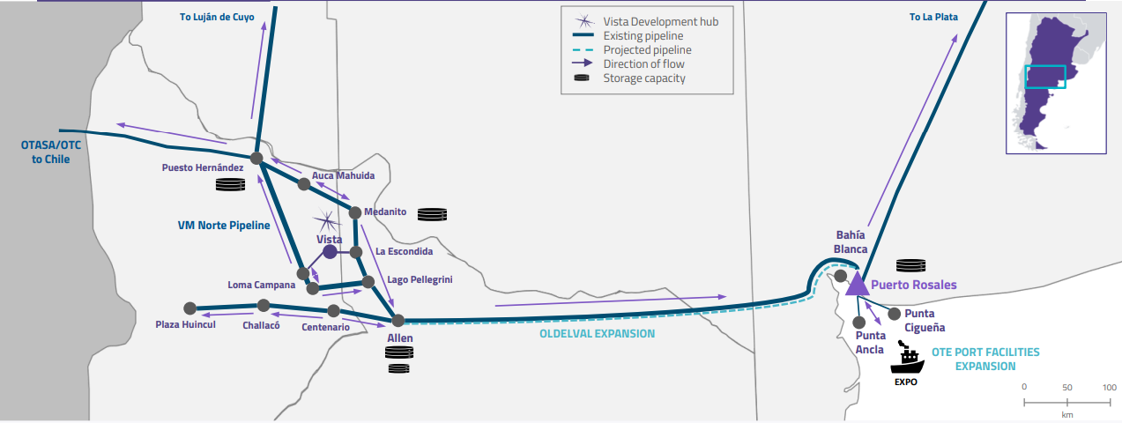
Vista Intro
1. Main assets placed in Neuquén Basin
2. Vista has up to 1150 locations under development in Vaca Muerta
3. Vista owns development rights to approximately 205,600 acres

Slide 3
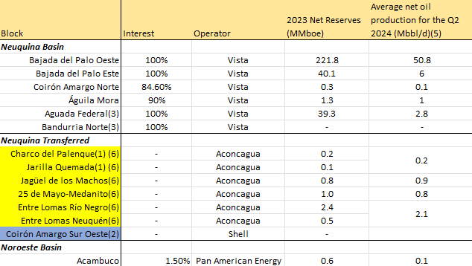
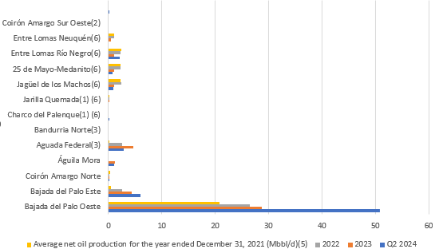
Vista Assets

Slide 4
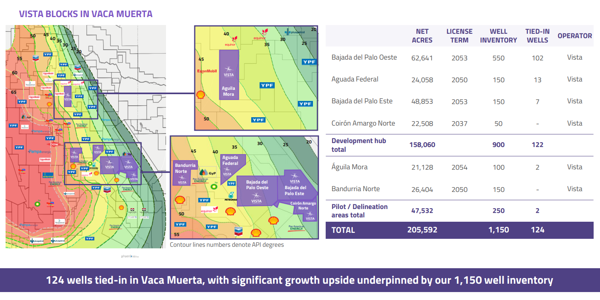
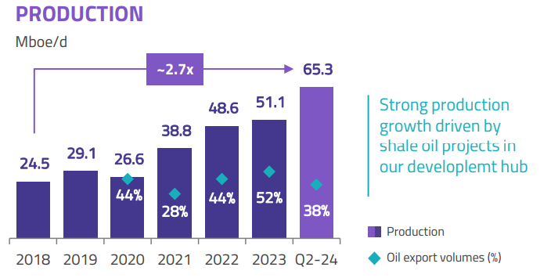
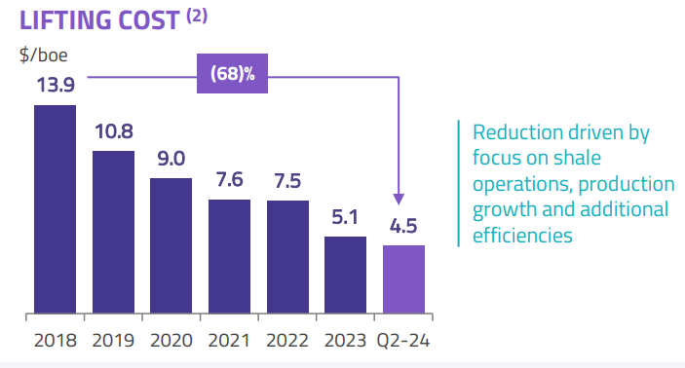
Vista Performance
4
8/17/2024

Slide 5
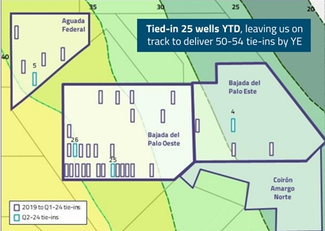
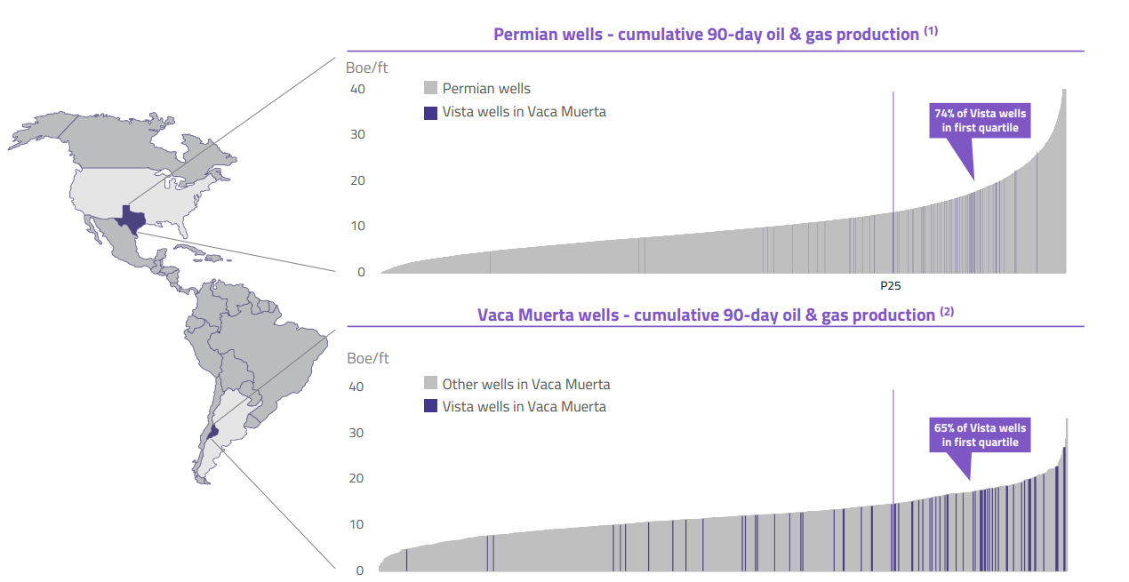
Investment Thesis #1
Ensure solid tie-ins and sustain peak efficiency
A consistent initiative to tie-in new wells, thereby enhancing overall productivity.
68-70Mboe/d (from guidence)
50-54 tie-ins in 2024 (25 completed already)
Second frac fleet secured
Top productivity compared to both Permain and Vaca Muerta wells
5

Slide 6
Investment Thesis #2
Additional midstream capacity
Oldelval Expansion – 25E
Current capacity is ~285Mbbl/d, target ~540 Mbbl/d
OTE Port Expansion – 25E
Current capacity ~130Mbbl/d, target ~430 Mbbl/d

Slide 7
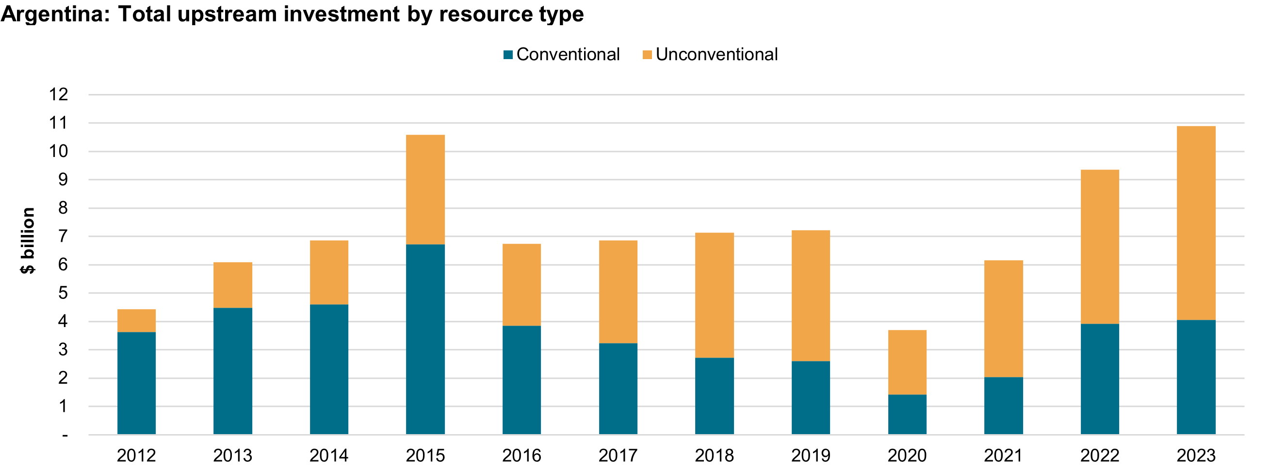
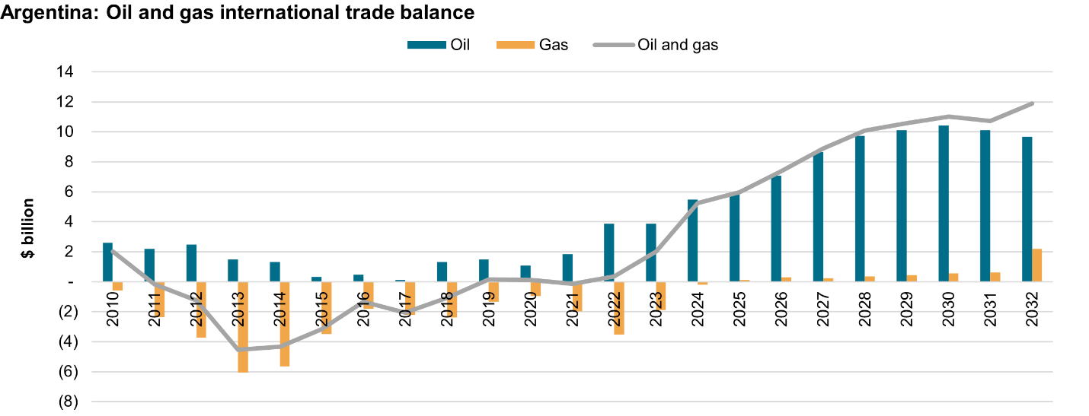
Catalysts
No price intervention and freedom of exports in Argentina
Changes in domestic oil pricing dynamic
Notes:
https://www.spglobal.com/commodityinsights/en/ci/research-analysis/argentinas-reforms-likely-to-catalyze-oil-and-gas-export-boom.html

Slide 8
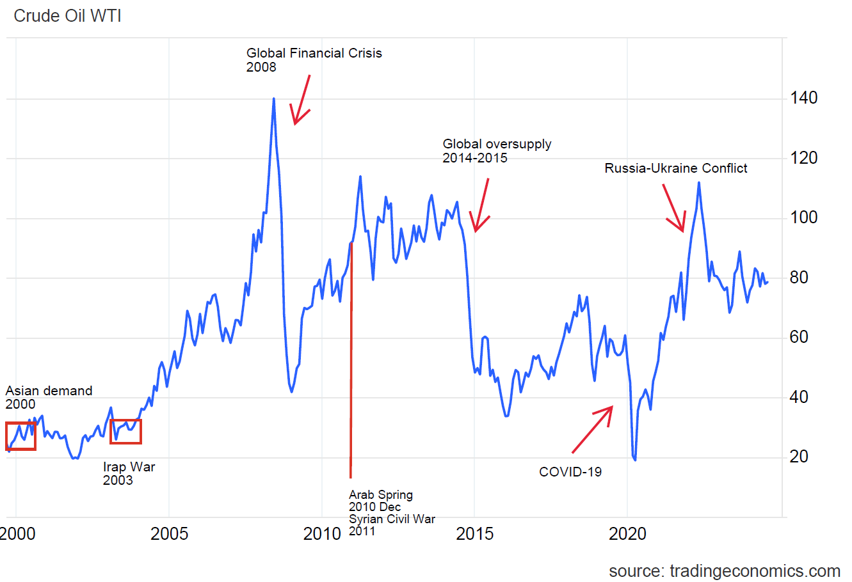
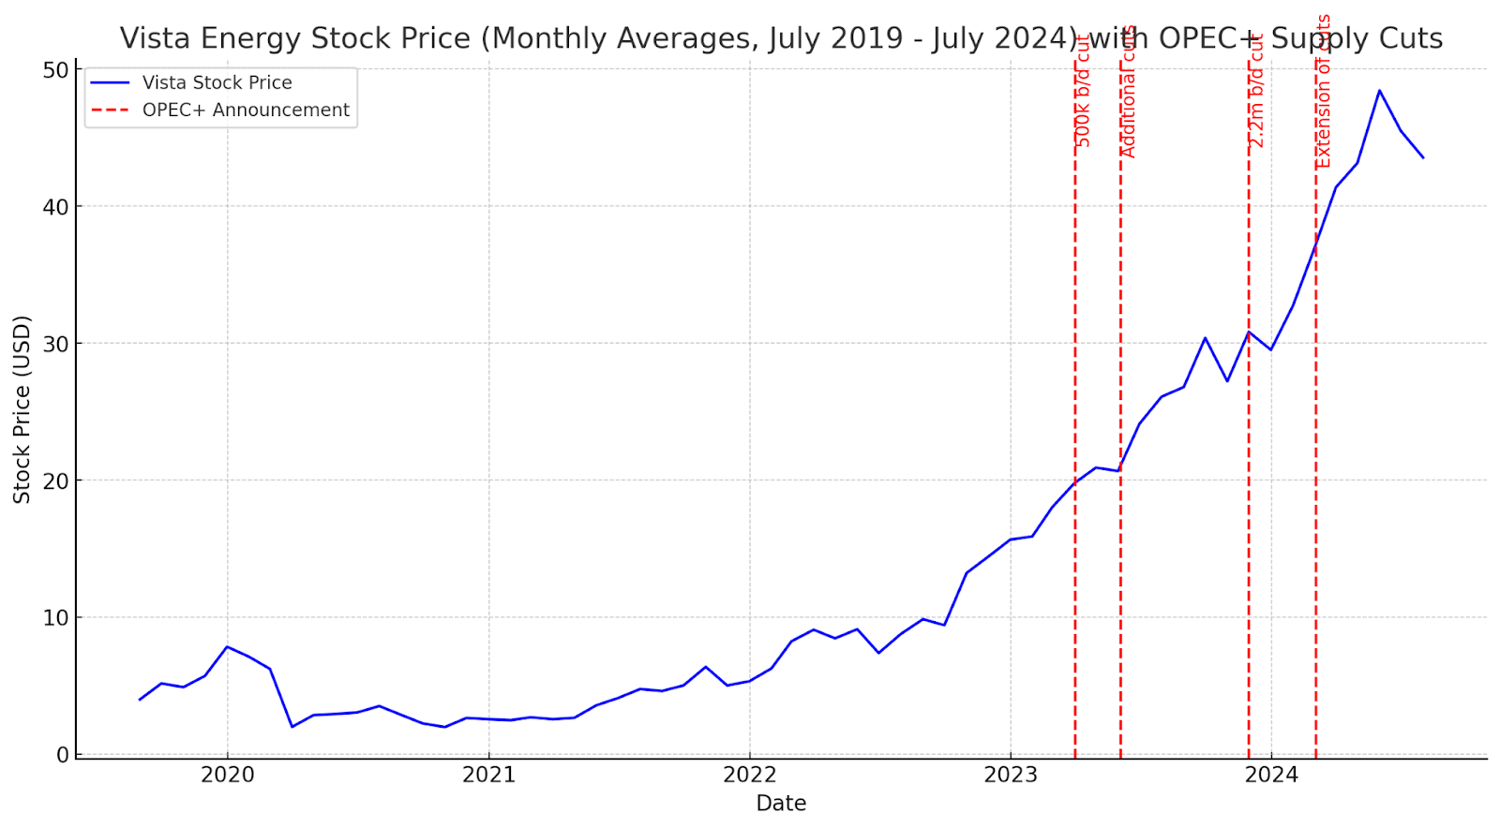
Catalysts
Conflict in Middle East (Hamas top political leader is killed in Iran in strike)
OPEC+ extends supply cut into 2025

Slide 9
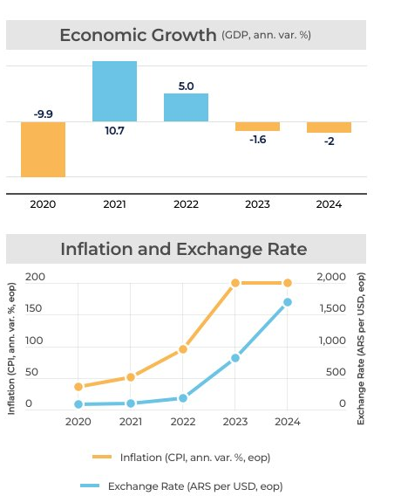
Risks
Argentina's macro situation
Oil price fluctuation

Slide 10

Valuation
Bear Case
Average productivity – 64500 BOEs/d
Export rate – 55%
Average realized price – $59.8
Base Case
Average productivity – 66300 BOEs/d
Export rate – 60%
Average realized price – $60.1
Bull Case
Average productivity – 70000 BOEs/d
Export rate – 65%
Average realized price – 60.4

Slide 11
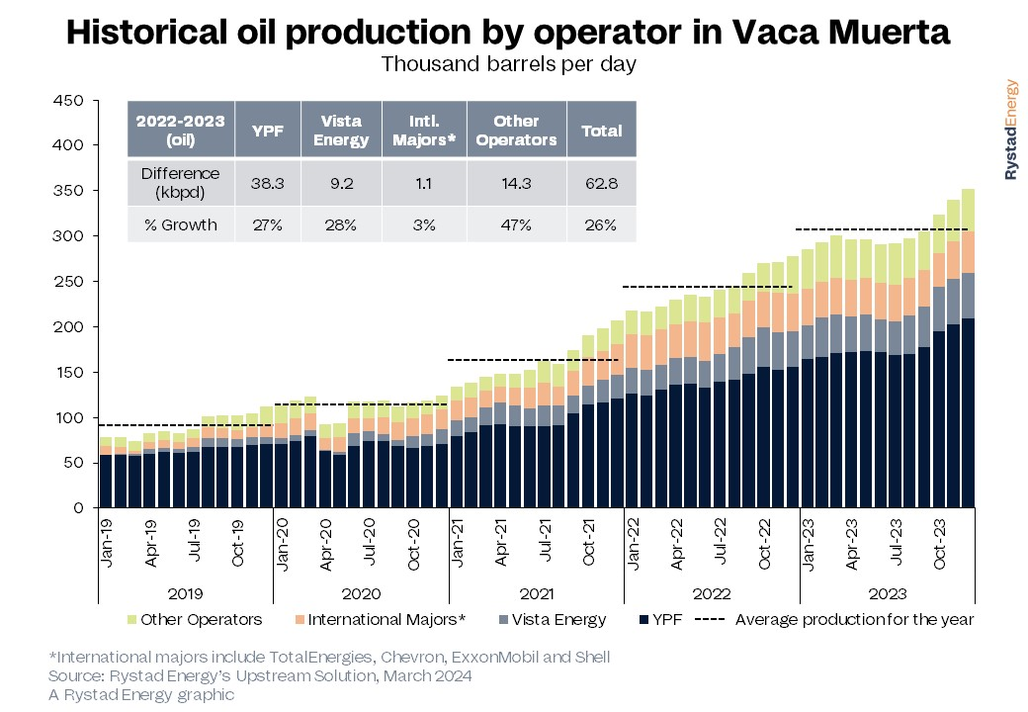
Appendix

Slide 12
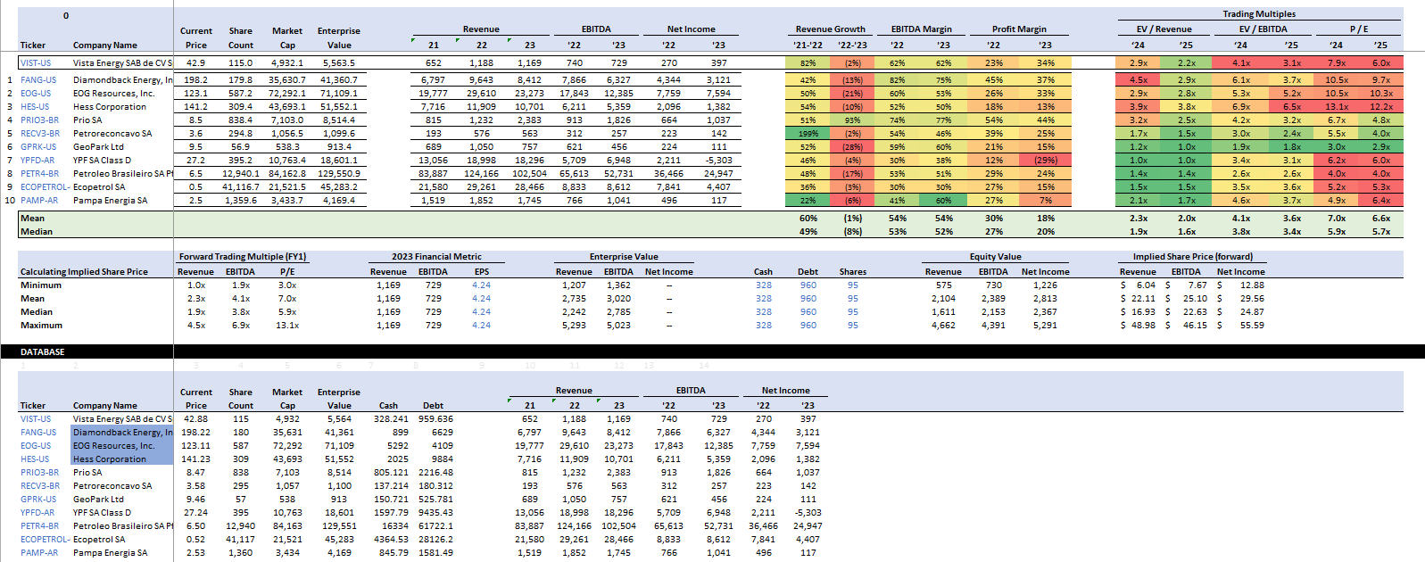
Appendix

Slide 13
Thank You

