Slide 1
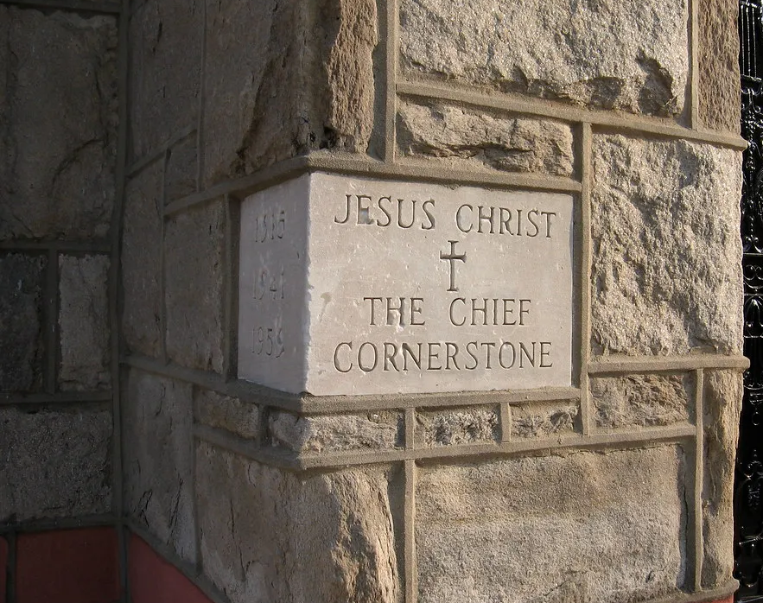
Cornerstone

Slide 2
C / Am / F / G
C
My hope is built on nothing less
F G
Than Jesus' blood and righteousness
Am Em
I dare not trust the sweetest frame
F G C
But wholly trust in Jesus' name

Slide 3
C F Am G
Christ alone, Cornerstone
C F Am G
Weak made strong in the Savior's love
C F
Through the storm
Am G C
He is Lord Lord of all

Slide 4
C
When darkness seems to hide His face
F G
I rest on His unchanging grace
Am Em
In every high and stormy gale
F G C
My anchor holds within the veil
My anchor holds within the veil

Slide 5
C F Am G
Christ alone, Cornerstone
C F Am G
Weak made strong in the Savior's love
C F
Through the storm
Am G C
He is Lord Lord of all

Slide 6
Am
He is Lord
F G
Lord of all

Slide 7
C F Am G
Christ alone, Cornerstone
C F Am G
Weak made strong in the Savior's love
C F
Through the storm
Am G C
He is Lord Lord of all

Slide 8
C
When he shall come with trumpet sound
F G
Oh may I then in Him be found
Am Em
Dressed in His righteousness alone
F G C
Faultless, stand before the throne
F / Am / G/ C

