Slide 1
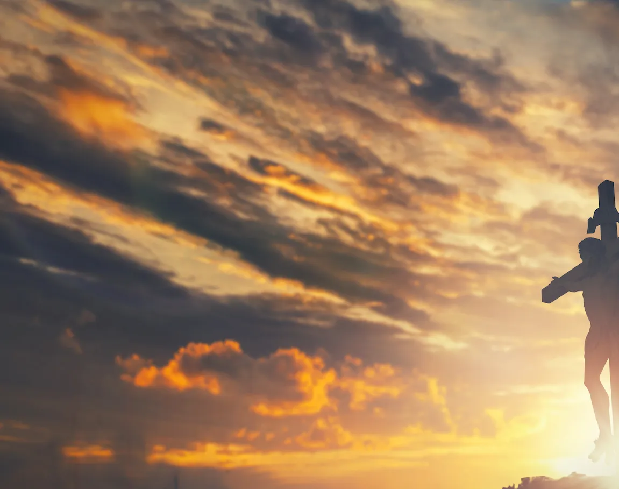
Untitled

Slide 2
G C / G C CAPO 4th
G D
How great the chasm that lay between us
C Em D
How high the mountain I could not climb
G D
In desperation, I turned to heaven
C D G
And spoke Your name into the night

Slide 3
C G D Em
Hallelujah, praise the One who set me free
C G D Em
Hallelujah, death has lost its grip on me
C G
You have broken every chain
D Em D
There's salvation in Your name
C D G
Jesus Christ, my living hope

