Slide 1
Improving Classification of Seizure Activity
Kendall Lipsey, Alex Jones, Carl Palombaro
Notes:
Hi everyone. For our project this semester Carl, Kendall, and I decided to work on improving classification of Seizure activity. Before we get into the project too much, lets go over some background information about seizures.

Slide 2


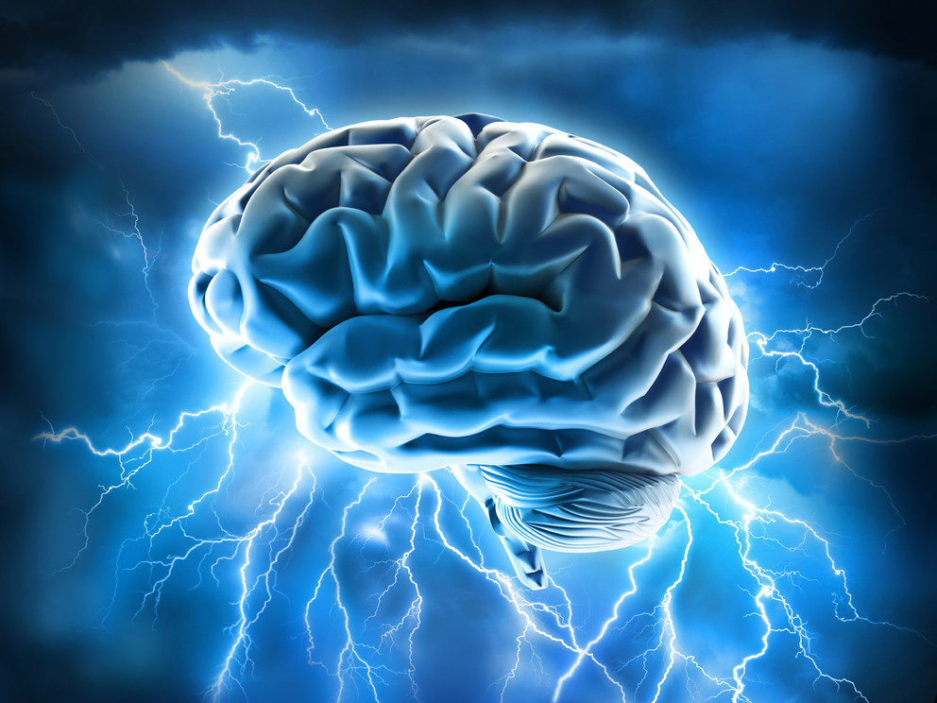
What are Seizures and Why do they happen?
Disturbance in the electrical activity in the brain
“Electrical Storms”
Notes:
https://www.epilepsy.com/learn/about-epilepsy-basics/what-happens-during-seizure
What are seizures exactly and why do they occur in individuals brains? Seizures are an uncontrolled electrical disturbance in the brain that happens suddenly, sometimes referred to as an “Electrical Storm” in someone’s brain, but why they occur is not fully understood. Seizures can occur after a stroke, or a head injury, or even because of an infection, and much of the time the cause is completely unknown.

Slide 3

Symptoms
Loss of consciousness
Inability to swallow
Tremors and Convulsions
Difficulty Breathing
Notes:
Some general symptoms of seizures include a loss of consciousness, the inability to swallow, tremors throughout their body, and difficulty breathing. While those are all definitely symptoms of a seizure and good to know, not all seizures have the same symptoms or severity.

Slide 4
Types of Seizures
Focal Seizures
Generalized Seizures
Absence Seizures
Tonic Seizures
Atonic Seizures
Clonic Seizures
Myoclonic Seizures
Tonic-Clonic Seizures
Notes:
There are two main types of seizures known as Focal Seizures and Generalized Seizures. Focal Seizures occur when there is abnormal electrical activity in only one area of the brain and the symptoms are often confused with other neurological disorders like migraines or narcolepsy, while Generalized Seizures occur throughout the entire brain. Within Generalized Seizures there are six different types of seizures including Absence Seizures (which were previously known as petit mal seizures), Tonic Seizures, Atonic Seizures, Clonic Seizures, Myoclonic Seizures, and Tonic-Clonic (which were previously known as grand mal seizures). If we focus on the first and the last type of seizure within generalized seizures, it is easy to see the range in severity of seizures. The Absence seizures have symptoms such as staring off into space or increased blinking and can result in a brief loss of awareness. The last type of Seizure, the Tonic-Clonic seizures, is the type that most people associate with seizures. It causes an immediate loss of consciousness and a stiffening and shaking of the entire body.

Slide 5
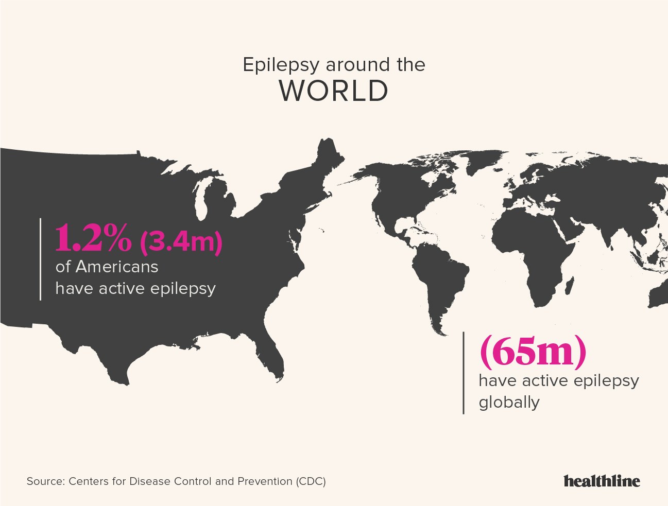
Prevalence
Fourth most common neurological disorder
1 million Emergency department visits annually
280,000 hospital admissions annually
$2.5 billion on hospital stays annually
Notes:
While the Tonic-Clonic seizures are not necessarily common, they do not make up all of the seizures that occur. In fact, Seizures are the fourth most common neurological disorder causing more than 1 million Emergency room visits, 280,000 hospital admissions, and $2.5 Billion in hospital costs each year.

Slide 6
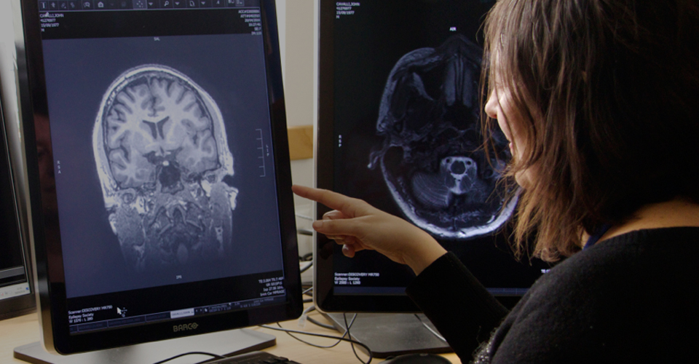
Diagnosis
Few guidelines on Diagnosis
Neurological Test
Lumbar Puncture
Magnetic Resonance Imaging (MRI)
Electroencephalogram (EEG)
Many Others
Notes:
https://www.epilepsysociety.org.uk/epileptic-seizures#.Xpm7DlxKjIW
For Diagnosis of this neurological disease, there are not standard procedures that are followed, and there are many different tests to determine if an individual has seizure activity in their brain. Common tests that are done include an MRI and Electro-Encephalo-Gram, more commonly referred to as an EEG.

Slide 7
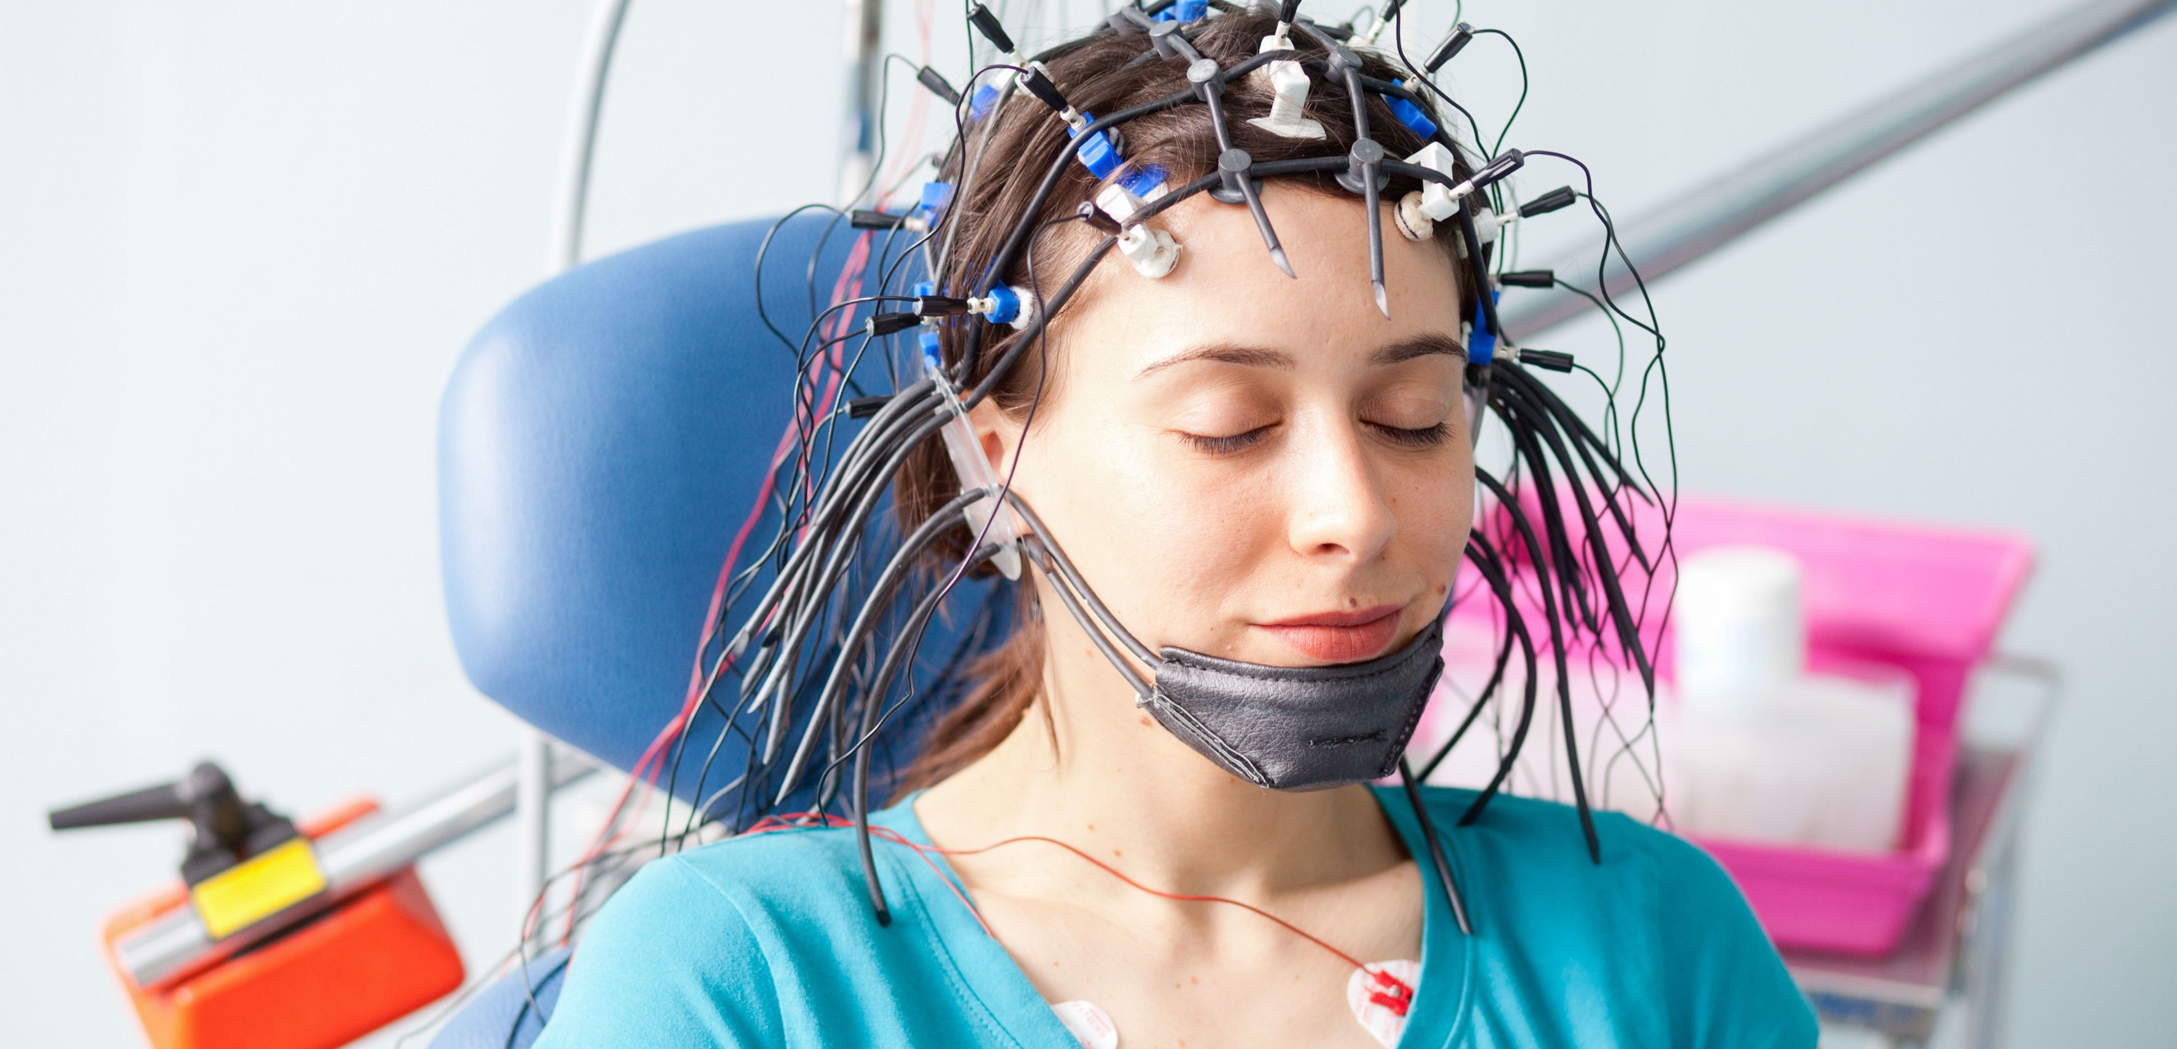
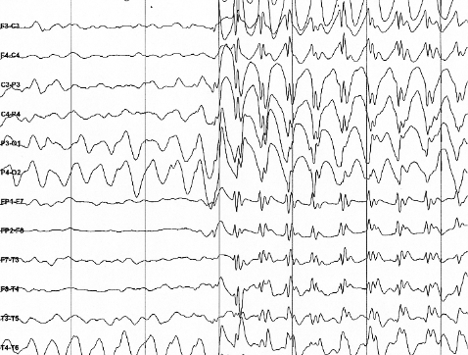
Electroencephalogram
Detects Electrical activity in the brain using small metal disks attached to scalp
Notes:
The EEG records the electrical activity in the brain and it is collected using small sensors that are attached to the patients head. This data is what we will be using in our project.

Slide 8
Overview
Improve Classification
Data Processing & Exploration
Logistic Regression
K Nearest Neighbors
Decision Tree & Random Forests
Convolutional Neural Network
Evaluation
Notes:
A quick overview of our project is below
To improve the medical response and treatment of seizures, and ultimately improve people’s lives affected by seizures, diagnosis of seizures must be improved.
Our goal for this project was to improve the classification of seizures based off of brain wave activity.
To do this, we started with Data processing and Data exploration to fully understand the data provided.
We then performed a logistic regression with varying hyperparameters.
Next we executed K Nearest Neighbors with different distance metrics.
We then performed Decision Trees and Random Forests with pruning techniques.
Finally, we executed a convolutional neural network and evaluated our algorithms.

Slide 9
Overview
Accuracy
Computational Complexity
Additional Data
Predictions
Notes:
For this evaluation, we not only had to balance the accuracy of our the algorithm, but also the computational complexity of each process.
Lastly, we will share our ideas on how this project could be applied to the industry, where additional data would aide in this project,
and how predictions could be useful instead of just classifications.
*We will explain all of these ideas further in the following slides.

Slide 10

Our Data
University of California Irvine Machine Learning Repository
500 patients
20% Seizure Occurrence
23 seconds of EEG readings
178 recordings per second
Notes:
Our data comes from the university of california irvine machine learning repository. The UCI Machine Learning Repository is a collection of databases, domain theories, and data generators that are used by the machine learning community for the empirical analysis of machine learning algorithms.
Our dataset consists of EEG readings from 500 patients. 20%, or 100 patients, had confirmed seizures while the other 400 did not. Each patient has 23 seconds of brain activity recorded, with each second consisting of 178 points.

Slide 11
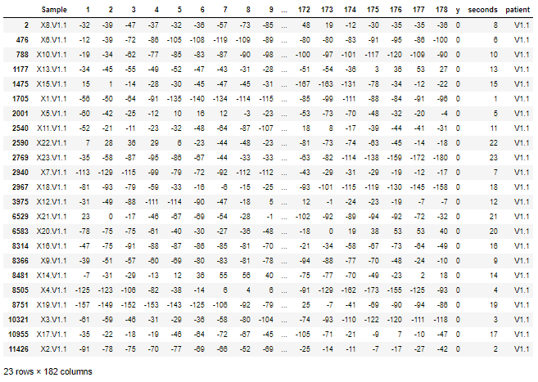
Our Data - Cleaning
Sample column broken into seconds and patient
Y column turned binary
Notes:
To make the data usable we were able to break down the sample column into a patient column and a second column using regular expressions. We then turned our y column into a binary response of 1 having a seizure, and 0 being no seizure. Here is an example of how one patient's data looks.
You can see that one patient has 23 rows, for the 23 seconds, and each second contains 178 columns, for the 178 data points taken for each second

Slide 12
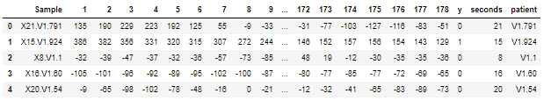
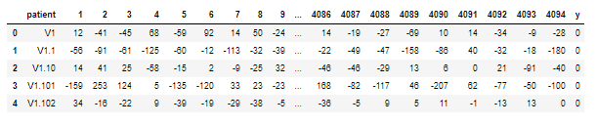
Our Data
11500 x 182
500 x 4096
Notes:
So instead of each row being one second, we transformed the data so each row was one patient's complete data. This means that instead of each row containing 178 points for one second, they now contain 4094 points for one patient, with one response of 1 or 0. Transforming the data in this way allowed for us to graph the data in a way that was more recognizable, and allowed for better results later on.

Slide 13
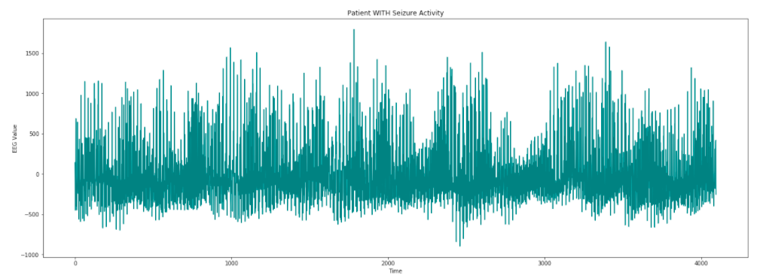
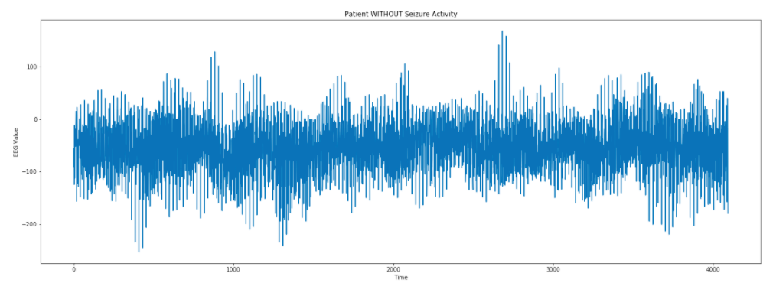
Data Processing
Notes:
Here we show two examples of how the data now graphs with the x axis being time 1-23 seconds, and the y axis being the EEG value. Even for someone with no experience reading EEG's, or understanding how brainwaves work, you can see that the top graph appears to have values ranging from –1000 to 1500 while the bottom graph appears to stay within the –200 to 350 range. The top graph shows an individual who is experiencing a seizure during the 23 seconds, and the bottom graph is considered normal brainwave activity. From here we wanted to use machine learning algorithms to classify seizure activity.

Slide 14
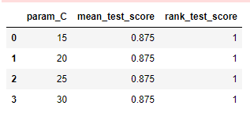
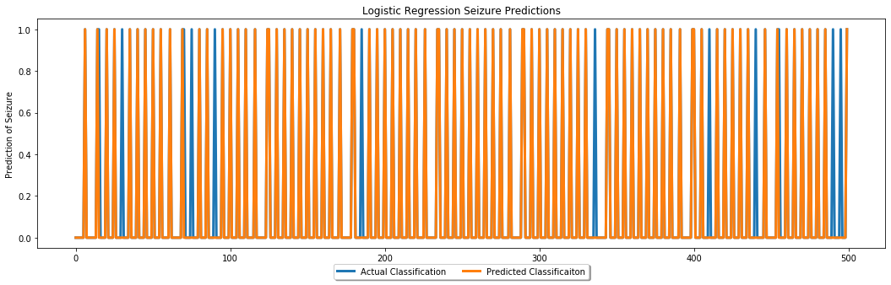
Logistic Regression Results 88% Accuracy
Notes:
*For our Logistic Regression we performed a grid search for the optimal hyperparameter regularization constant, also known as the letter C
As you can see in the top right figure,
*The 5-fold grid search for an optimal regularization constant, exhibited no increase in overall accuracy
Once the logistic regression was run, the accuracy on the test data was 88%.
The accuracy can be visualized in the bottom figure,
X-axis: indicates each of the 500 patients
Y-axis: response of ‘seizure’ or not ‘seizure’
blue lines: represent the actual seizure classification labels
orange lines: represent the prediction from the logistic regression model
Where the blue lines show (without orange overlapping) indicates an inaccurate prediction.

Slide 15
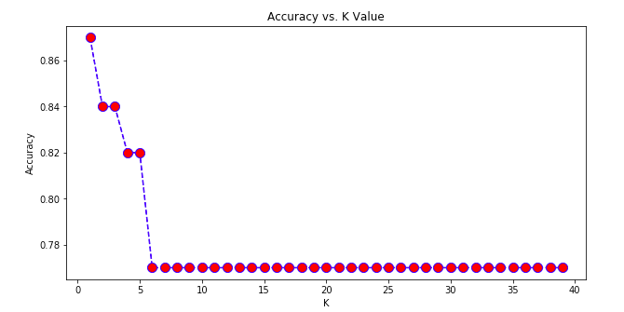

KNN Euclidean

Slide 16
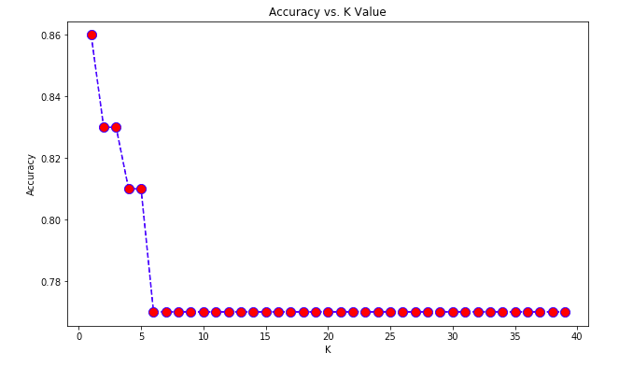

KNN Manhattan

Slide 17
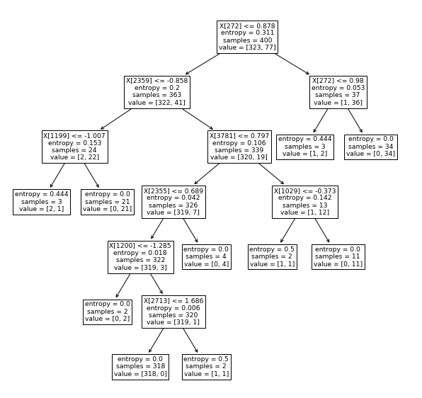
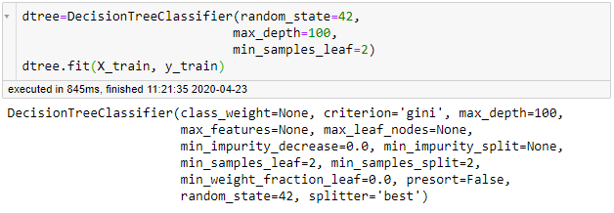
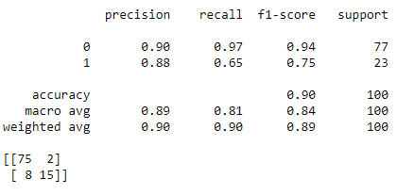
Decision Tree
Notes:
Our next algorithm we used was the decision tree. We found that the regular decision tree did well, but by pruning the tree with a max depth, and min samples feature added, we were able to reach 90% accuracy. This is an improvement from the K nearest neighbor algorithm, but it still missed 10 observations.

Slide 18
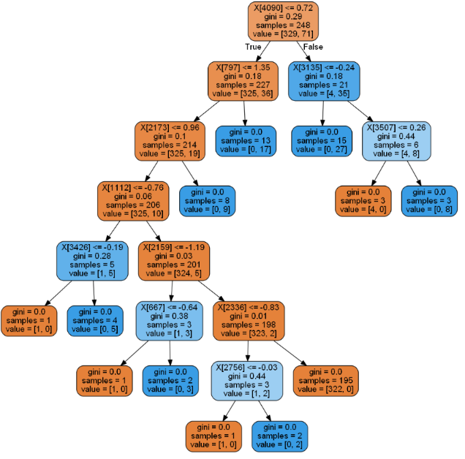
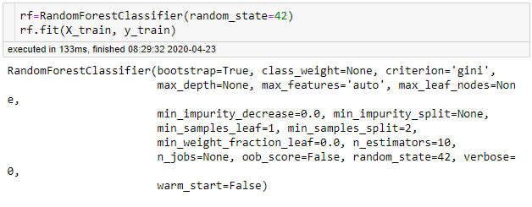
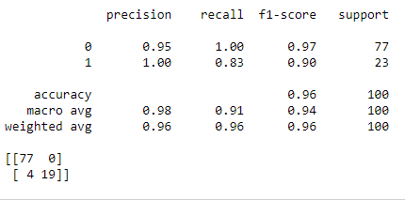
Random Forest
Notes:
With the decision tree reaching 90% accuracy, we decided to include a random forest classifier which is a group of decision trees. This classifier needed no adjustments to its default features. As seen the default features made for 96% accuracy missing only 4 observations. The image on the left is one of the decision trees included in the random forest.

Slide 19
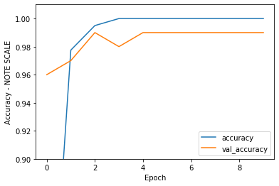
Convolutional Neural Network
99% Accuracy
1 hour, 48 minute runtime
Notes:
*In order to do a Neural Net, additional Preprocessing was required. All data was turned into numpy arrays and dimensional adjustments were made to the arrays.
*We then built the CNN with several layers
*trained the CNN on the training data, and validated it on the test data, where the evaluation metric was set to accuracy
*Ran on 10 epochs which took a total of 1 hour and 48 minutes,
*Figure:
X-axis: Epoch
Y-axis: Accuracy. Note the scale here as this figure has zoomed in above 90% to show detail
Blue line: accuracy
Orange line: validation accuracy, or the accuracy applied to the test data
*you can see the accuracy on the training data leveled off at only 3 epochs
*overall, this neural net was able to obtain 99% accuracy

Slide 20
Conclusions
88% Accuracy not the whole story
Decision Tree and Random Forest
Convolutional Neural Network
Notes:
In this project we reached several broad conclusions.
For the simpler models employed such as Logistic Regression and K-Nearest Neighbors), the accuracy resulted in around 88%.
At first glance this looks like a promising baseline, however a further investigation shows that non-seizure activity accounted for 80% of the data.
Therefore, if you predicted everything was non seizure activity you would result in 80% accuracy.
A more nuanced look requires looking deeper.
When looking at the confusion matrix for the K-Nearest neighbors (Euclidean Distance), 56.5% of seizure activity was put into non-seizure activity.
This shows that our variable of interest which is correctly classifying seizure activity, performed quite poorly.
Moving to more complex algorithms such as Decision Trees and Random Forests, we begin to see a shift in the classification accuracy moving away from false negatives.
The Random Forest predicted 82.6% of seizure activity correctly. This indicates more complex trends exist that aren’t necessarily detectable by simpler algorithms.
Our most complex algorithm, the Convolutional Neural Network, performed best with an accuracy of 99%.
However, this increase in accuracy came at the expense of increased computational time.
The overall runtime of the neural net with 10 epochs was 1 hour and 48 minutes. However, the accuracy leveled off at only 3 epochs.
Therefore, to obtain the same level accuracy, this neural could be run in just over 30 minutes.

Slide 21
Future Works
More Data
Prediction vs. Classification
Balanced Data

Slide 22


Questions

