Slide 1
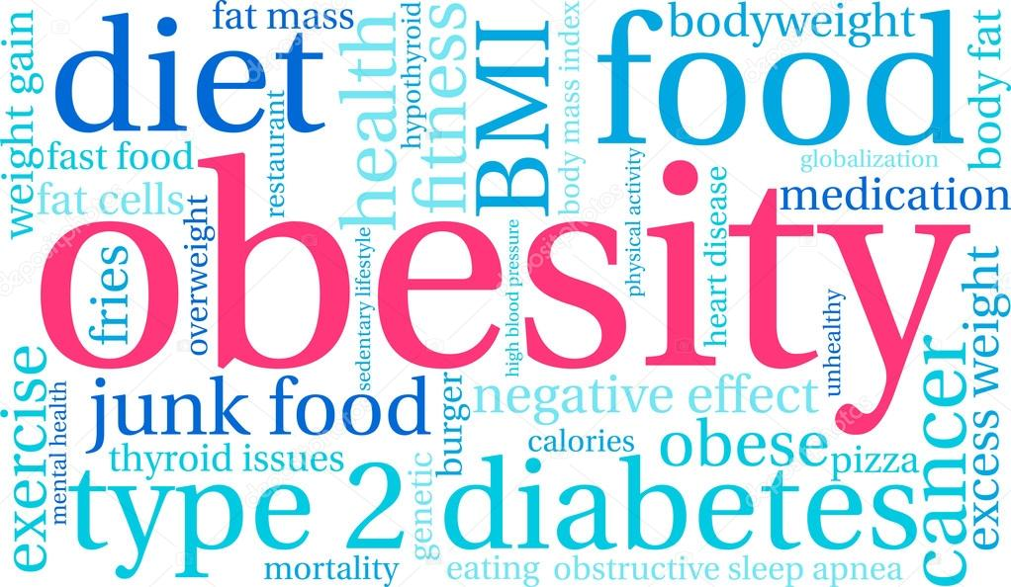
Kendall Lipsey, Kayla Kirk,Tanner Miles
Notes:
Kayla 1-5, 16-19
Tanner 6-8
Kendall 9-15

Slide 2
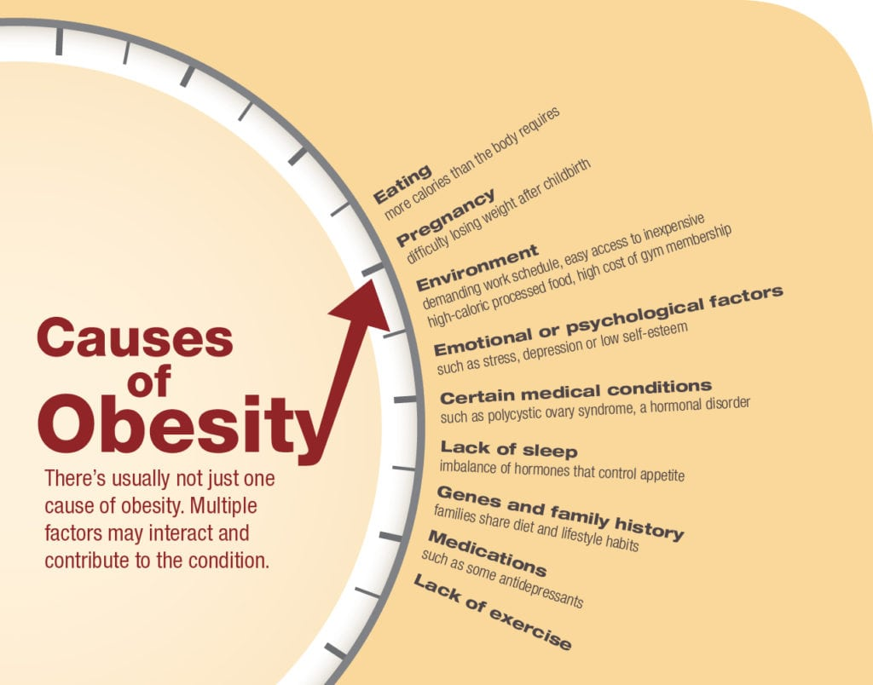
Notes:
Kayla

Slide 3
Background
~40% of US Population = Obese
100 million people
7 states report an obesity rate of 35% +
Linked to 60 chronic diseases
Diabetes
Sleep apnea
$147 billion per year in Medical Expenses
Genetic and environmental factors influence obesity
Notes:
Tanner

Slide 4


Why is it important to study this topic?
Personal stories
Most people have at least one family member at risk
Higher costs
Healthcare
Diet
Lifestyle modifications
Higher risk of medical condition
Heart disease
Cancer
Notes:
Kayla

Slide 5

Questions we intend to investigate
1) What is the rate of obesity per state in the United States?
Highest & Lowest
2) What factors are most strongly correlated with Obesity?
3) Investigate, on a state level: Race, Gender, Income, Age, and Educational Attainment
4) Visualize the data
Illustrative graphs to represent different correlations
5) [bonus 5 points] In one state, look at lower level (county-basis and/or metropolitan-status) community indicators, such as access to fresh and affordable foods
6) Consider years 2011-2016 for trends within these states
Notes:
Graphs represent categorical data currently..

Slide 6

Data
Where we obtained it
CDC
Behavioral Risk Factor Surveillance System
Data cleaning
Removing US territories
Making it more 'readable'
Stratifications
Education
Income
Age
https://www.cdc.gov/brfss/index.html
Notes:
--BRFSS: collects state data about U.S. residents regarding their health-related risk behaviors, chronic health conditions, and use of preventive services
--'readable' = changing column names, removing columns we are not interested in..
--talk about other stratifications as well.. Race, gender..

Slide 7
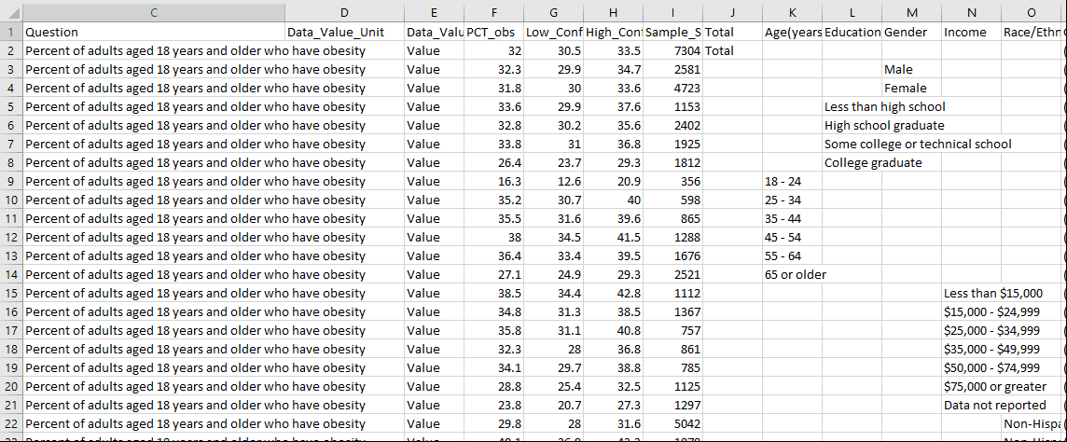
Data Issues
Long Questions
Irregular Order
Inconsistent among years
Weird floating Data
Multiple Stratifications

Slide 8
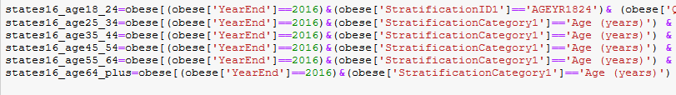
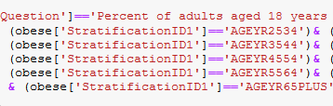
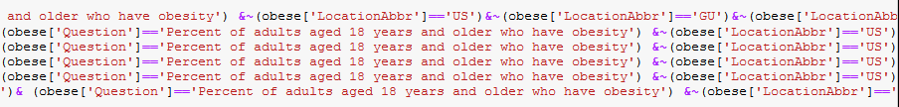
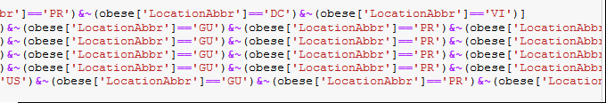
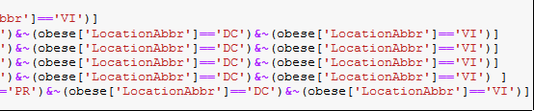
Data Issues
MANY Boolean conditions to extract any usable data
Notes:
6-8 tanner

Slide 9
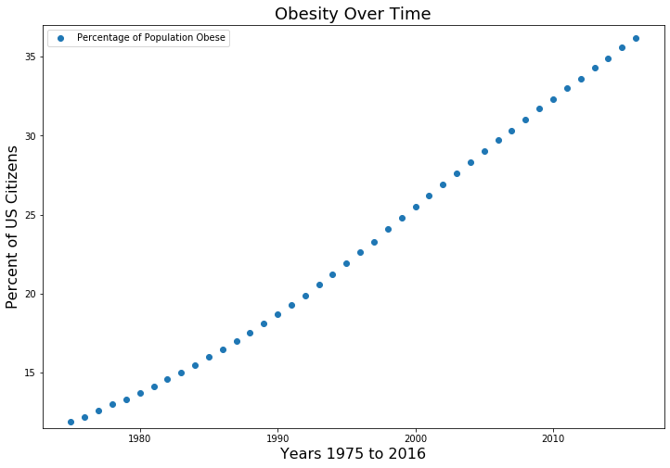
Obesity 1975 to 2016
Notes:
#1975 11.9%
#1993 20%
#2007 30%
#2016 36%

Slide 10
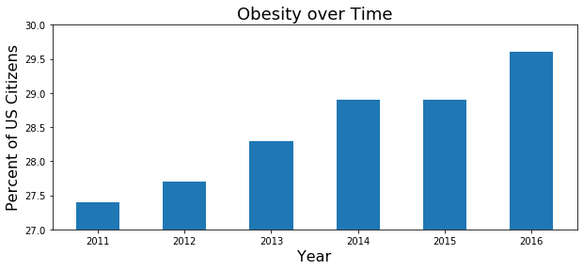
US Average Obesity Over Time
BMI over 30
Notice Y-Axis Values
Steady increase over time
Notes:
https://www.cdc.gov/obesity/adult/defining.html

Slide 11
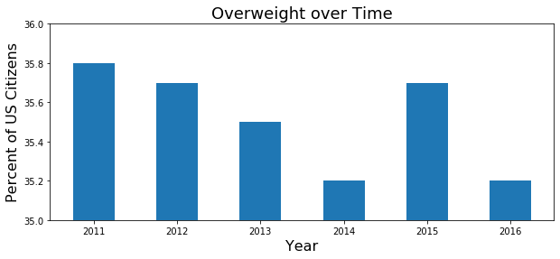
US Average Overweight Over Time
BMI 25-30
Notice Y-Axis Values
Decreasing 2011-2014?
Losing or gaining weight?
Notes:
https://www.cdc.gov/obesity/adult/defining.html

Slide 12
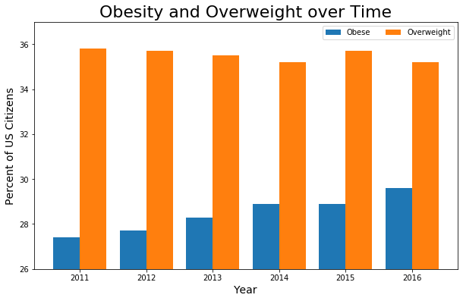
Notice Y-Axis Values
Decreasing 2011-2014?
Losing or gaining weight?

Slide 13
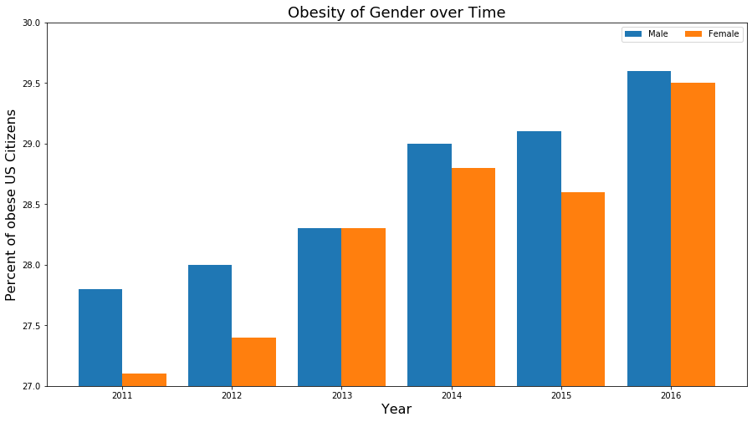
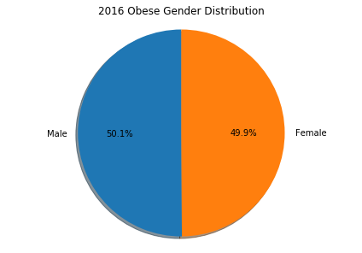

Slide 14
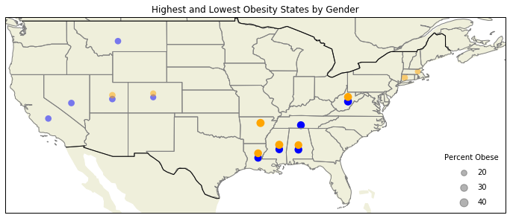
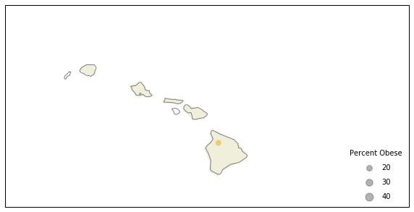
Obesity by Gender
Male
Female

Slide 15
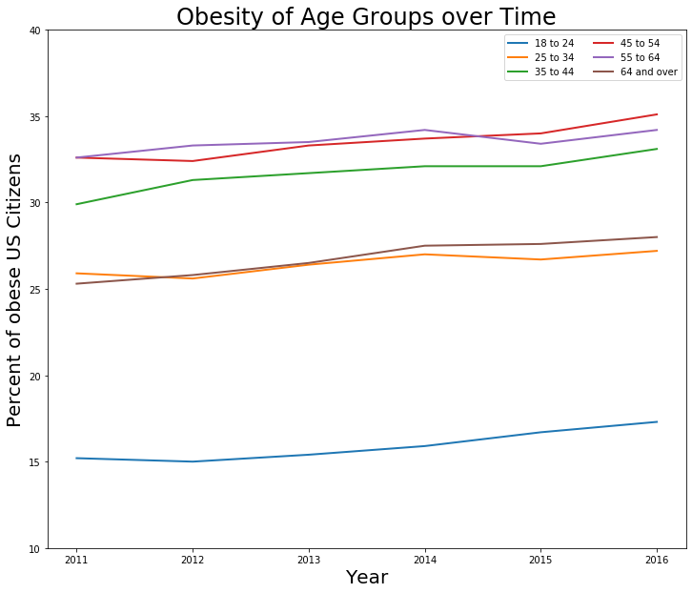
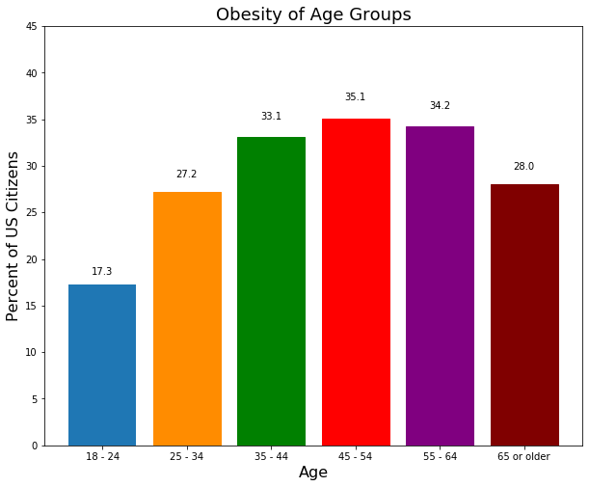

Slide 16
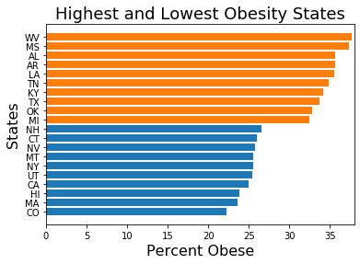
Notes:
Kayla

Slide 17
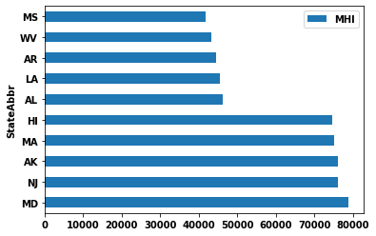
5 Lowest & 5 Highest Income States
Notes:
MS =mississippi
MHI= median household income

Slide 18
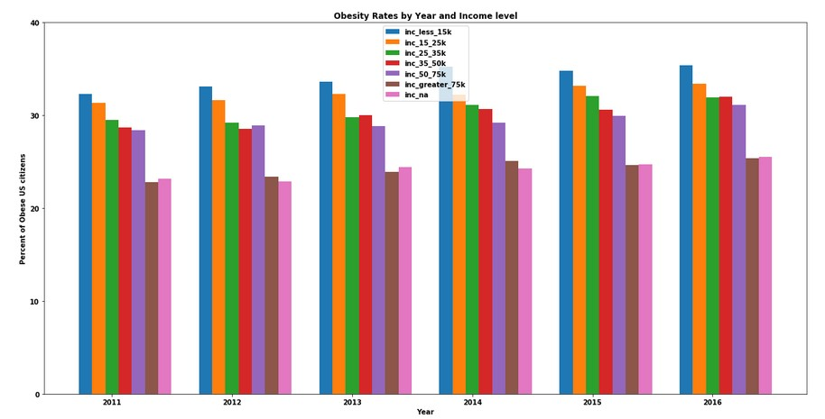
Notes:
Graph is showing obesity rates by year and income level… as you can see for every step up in the income bracket, there’s a drop in the obesity rate. The most significant drop is when you get to the highest-level income bracket (inc_greater_75k)… there’s also a low percent of obesity in the unknown income level bracket.

Slide 19
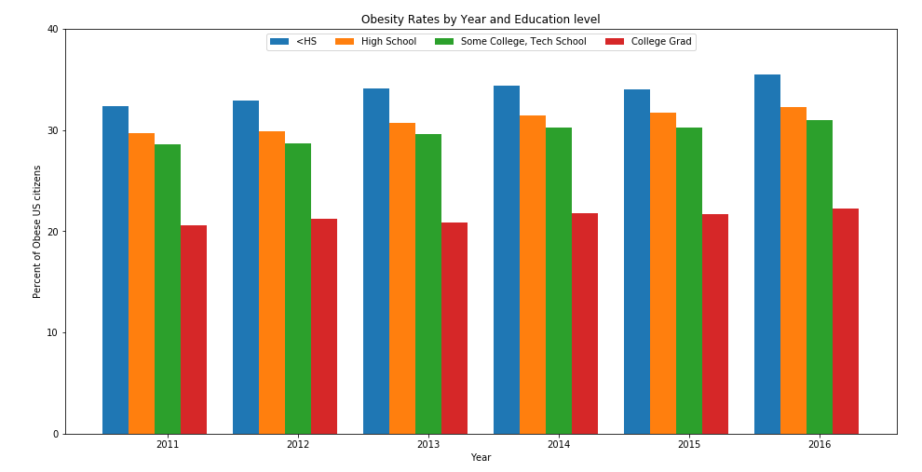
Notes:
Point out highs and lows in graphs

Slide 20
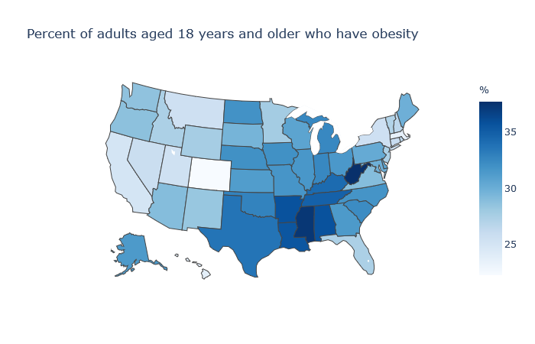
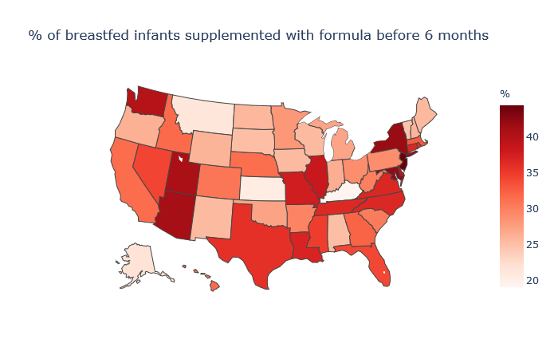
US Obesity Map vs Breastfeeding Map

Slide 21
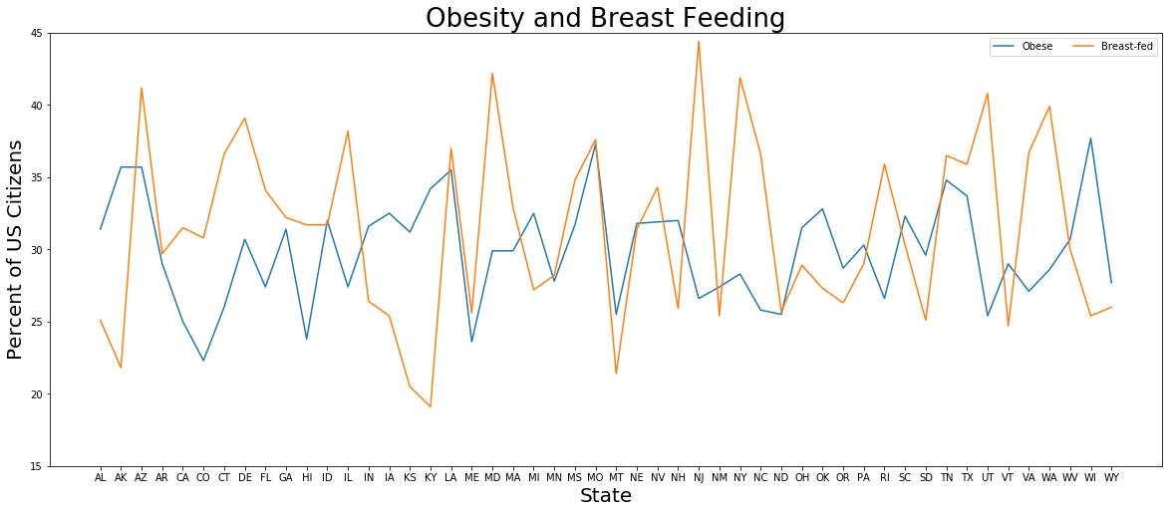

Slide 22
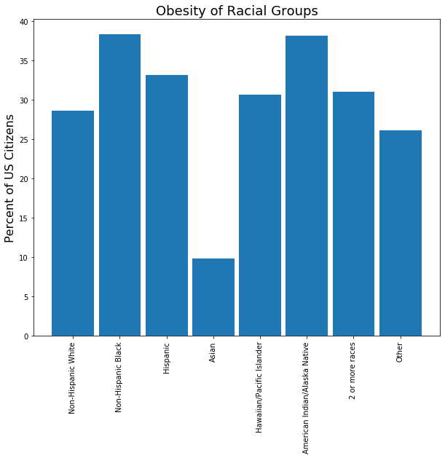
Notes:
For year 2016

Slide 23

Observations and findings
Gender
Distribution over time - relatively equal
Income
Significantly smaller rate for higher incomes
Education
Less than HS education = greater obesity rate
College education = smaller obesity rate
Age
Younger = less likely to be obese
Middle age = higher obesity rate
Race
Asian American have lowest rate
Non Hispanic Black and American Indian almost 40%

Slide 24
Conclusion
Obesity rate has increased more than 50% in <40 years
Nationwide epidemic
What can stop the cycle?
Education
Risks
Costs
College Degree
Expensive, but...
Greater quality of life
Access to better healthcare and dietary options

Slide 25
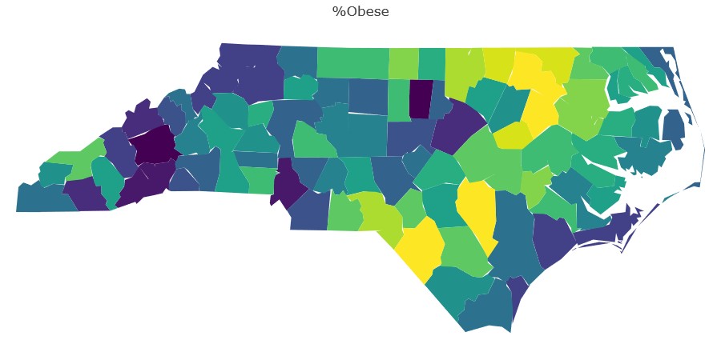

Notes:
Talk about why we thought this would be important/interesting …. Note out
Really dark/really light counties…. Talk about why we think this would be interesting … add a slide about it

Slide 26
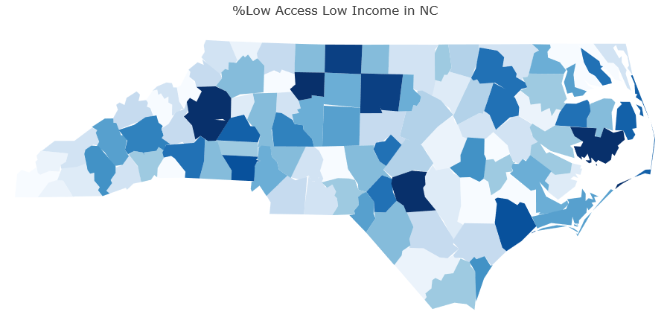
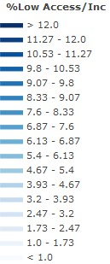
Notes:
Talk about why we thought this would be important/interesting …. Note out
Really dark/really light counties…. Talk about why we think this would be interesting … add a slide about it

Slide 27
Future work
Run correlations between variables
Education, income..
These are categorical
States with lowest rate
What are they implementing policy wise?
Policies that affect food access
Subsidies
Income
Notes:
20-28 tanner

Slide 28



