Slide 1



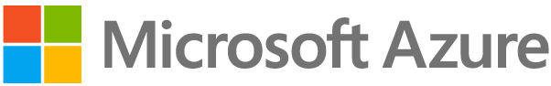

https://example.northeurope.azurecontainerapps.io
Container App Environment
Ingress
Ingress
Self-Hosted Gateway Container App
Bacon API Container App
Sync Configuration
Azure API Management
Ingress
External Ingress – Exposed Publicly
Ingress
Internal Ingress – Exposed insides Container Environment

