Slide 1

HAM
Http Answering Machine
Notes:
Prerequisites: Java 11 & Maven

Slide 2



Based on

Slide 3








Tried with

Slide 4
Installation and demo setup
10 minutes to start
Docker based or stand-alone
Fully functional demo
Completely Rest API based
Fully functional UI

Slide 5
What it contains
Embedded HTTP Server
Embedded HTTPS Server
Embedded DNS Server
Dynamic Javascript plugins
Recorder/replayer API
Editable requests and reponses
Full (Rest API based) UI
Automatic TLS generator
Embedded Socks5 proxy
Embedded fake Oidc provider
Java plugins
Customizable through plugins
Multi staged execution point cuts
Serializable request/responses
Easy Docker integration
DNS Hijacking
TLS Hijacking
Man in the middle http/s/dns inspections
Access the docker instances via local OpenVPN
Json modular configuration
Dynamic logging levels
Dynamic DNS editing
Dynamic TLS editing
Automatic PACT testing
Automatic Null Infrastructure testing
Transparent (no 30x) redirect (host/port/protocol)
Tomcatless

Slide 6

Use cases

Slide 7
All through the HAM UI!!
Production UI with local Backend (and the opposite too!)
DNS/TLS hijack, socks5 proxy, http transformations
Replicable, identical, consistent UI tests (always)
Socks5 proxy, recording/replaying
Simulate real complex environments locally with no config changes
DNS/TLS hijack (or hosts file), docker,
Generate APIs dynamically with integrated JS engine
Js Plugin
Record full offline simulations for demo purpose
Socks5 proxy, recording/replaying

Slide 8
All through the HAM UI!!
PACT verification
Socks5/Docker, replayer/recorder, requests/responses editing, js plugins
Null infrastructure
Socks5/Docker, replayer/recorder, requests/responses editing, js plugins
Inspection of pre-existing applications
Socks5/Docker, replayer/recorder, requests/responses editing, js plugins

Slide 9

Let’s do it
Setup the environment
Browse the incriminated section
Set the DNS and SSL records
Record the interactions
Do your testing
Notes:
Checkout the project ( git clone https://github.com/kendarorg/HttpAnsweringMachine.git )
Build.sh (docker too)
Setup the hosts file
Notepad as admin on C:\Windows\System32\drivers\etc\hosts
127.0.0.1 www.local.test
127.0.0.1 www.sample.test
127.0.0.1 gateway.sample.test
127.0.0.1 be.sample.test
Run.sh

Slide 10

Just…
Install Maven, git, Chrome and JDK11
git clone https://github.com/kendarorg/HttpAnsweringMachine.git
cd HttpAnsweringMachine
Make.sh/.bat (no docker)
RunStandalone.sh/.bat
From command line run chrome with the following parameter:
--proxy-server=socks5://localhost:1080
Start navigating the target website

Slide 11

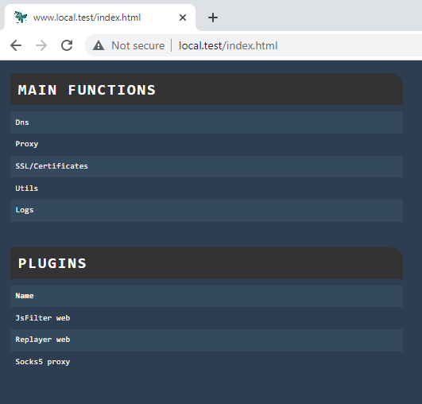
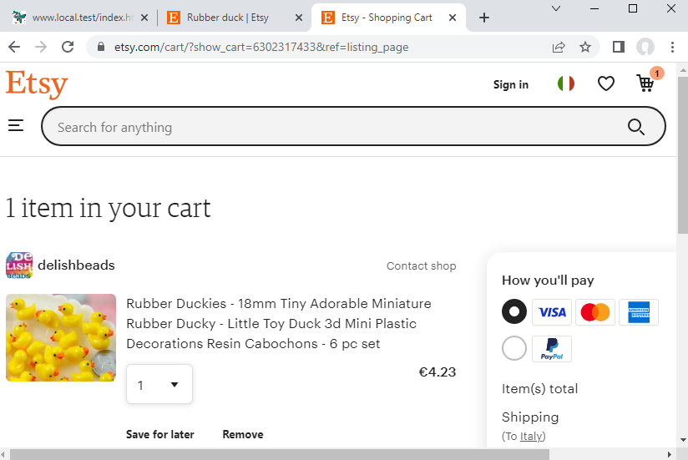
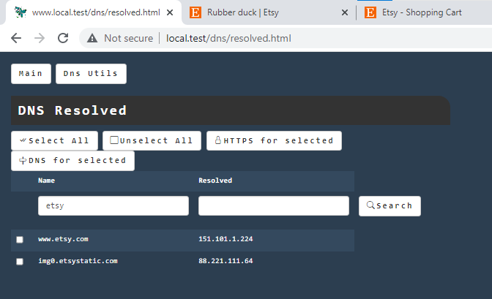
Look! A UI!
Notes:
Esty.com, rubber duck->rubber duckies->Quantity 1->add to cart
Look at dns, save them as dns and as https
Reopen clean data and start recording
Booking London 23-29-chapter levisham

Slide 12

The sample application architecture
FE (Jquery)
GATEWAY (API gateway)
BE (backend)
H2 In memory DB
Notes:
We will consider the Backend as a service developed by another team/departement

Slide 13

Notes:
Recording Insert Mario Rossi and an appointment, with text Meeting, and move it to the final state then delete appointment and the user
Simulate the UI too stopping all backends
Save the result and prepare the UI test (UI.json), removing all but gateway calls, then run the UI only without BE
Reload the original and setup the test with gateway (stimulator) and be (stimulated) and run it on the ui. Create by hand a user showing the NOT increased id
Reload the original and setup the test with pacts be, change the script with the step by step UI and run it. Create by hand a user showing the INCREASED id
Modify the template on one of the pacts returned data to show the errors

Slide 14

Thanks
HAM: https://github.com/kendarorg/HttpAnsweringMachine
Linkedin: https://www.linkedin.com/in/enricodaros/
E-mail: enrico.daros@lastminute.com
Notes:
And now enter the TARDIS with HAM!

