Slide 1
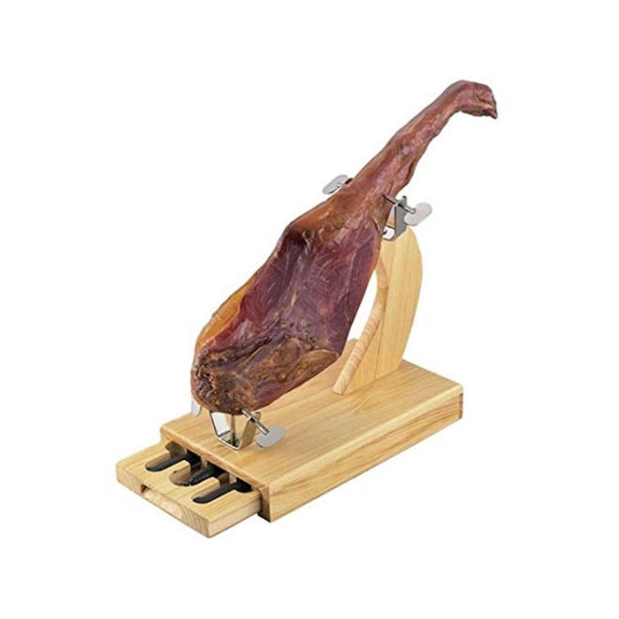
HAM
Http Answering Machine

Slide 2
What it is
Think about a mix between
Mitm Proxy ( https://mitmproxy.org/ )
Traffic Parrot ( https://trafficparrot.com/ )
Pact ( https://pact.io/ )
But with lots of extra!

Slide 3
Comparison-MITM Proxy
Has
Intercept decoded http(s) requests
Intercept and rewrite any request/response
Logging all requests
Custom interceptors
Web UI
Not
Intercept -any- request. You need to add the DNS names to HAM
Export to HAR files

Slide 4
Comparison-TrafficParrot
Has
Record/Replay calls
Intercept http requests
Dynamic Custom Interceptors
Docker integration
REST API
Web UI
Add new protocols plugins
Editing request/responses
Not
Integrations with…basically everything but at a cost (not disclosed!)
Editing multipart-form data
Java API

Slide 5
Comparison-Pact
Has
Mock any http request
Compare responses to “pacts” and react
Docker integration
REST API
Web UI
Not
Java API

Slide 6
Comparison-HAM Only 1
Verify response bodies against templates or Json-Schema/XSD
Easy JAR plugins (just put them in libs at startup)
Dynamic JS plugins
DNS Server (ready for docker lack of static IPs :P )
Runtime generation of HTTPS certificates
Transparent proxying towards arbitrary targets
Oidc Always Authorized Server
Json based configuration

Slide 7
Comparison-HAM Only 2
Event based communication between plugins
Embedded derby DB
Resources or File System based static websites
Automatic identification of “stateful” request while recording/replaying
Multiple insertion points during the request/response cycle
Utils to verify schemas matching and regexp
Handling of DNS loops (because of docker…mainly)
Automatic generation of curl requests/JUnit tests/”Pacts” filters (working on it)
Generation of docker files for applications (working on it)

Slide 8
How it’s made
Java 11
Spring Boot with custom loader
Tomcatless (simple HttpServer and HttpsServer classes)
Extreme DI usage
BouncyCastle for all certificates handling
Rhino JS engine
Custom routing annotations for Java (like Spring but more fit for the usage)
Multithreaded server
Lock free (CAS) approach to leverage runtime changes without restarts

Slide 9
Usage Scenarios-Null infrastructure test 1
The idea is to record all the API calls to the external applications and replay them when running the tests to be sure that there are not breaking changes.
Using the recording from HAM as mocks the effort of writing real mocks decrease considerably AND does not need a real infrastructure.
This approach is valid for UI testing too. Is even possible to handle OIDC authentication, and would be easy to add other authentication handlers like Oauth.

Slide 10
Usage Scenarios-Null infrastructure test 2
Setup:
Create BDD test on dev machine (DM) with API calls to the application under test (AUT)
Setup a docker image with the AUT and HAM
Add DNS/SSL for all external services on config
Run single BDD tests and record on HAM all the interactions with remote servers, one for each test
In each BDD test add a call to HAM APIs to load the recording for the tes
In CI/CD
Load a docker image with AUT and HAM and the config file with DNS/SSL
Run the BDD tests against the AUT

Slide 11
Usage Scenarios-Pacts verification 1
The idea is to run real tests against the real infrastructure, verifying that the data returned by the external calls meets the requirements known at the time of the functionalities development.
From the recorded API calls can be created JS Filters able to intercept the real call and match it against the recorded one.
This validation can be any (combination) of the following
custom
based on the schema generated by the recorded one
json/xsd schema
When a match is not met an event is sent, that could invoke a REST Api or send an email

Slide 12
Usage Scenarios-Pacts verification 2
Setup:
Create BDD test on dev machine (DM) with API calls to the application under test (AUT)
Setup a docker image with the AUT and HAM
Add DNS/SSL for all external services on config
Run single BDD tests and record on HAM all the interactions with remote servers, one for each test
For each recorded external call generate the POST_RENDER JS Filter to verify the real response against the recorded one
Modify the JS Filter to add extra validations
Inside each BDD test add the upload of the related JS Filters

Slide 13
Usage Scenarios-Pacts verification 3
In CI/CD
Load a docker image with AUT and HAM and the config file with DNS/SSL
Run the BDD tests against the AUT
Wait for emails or notifications in case of errors

Slide 14
Usage Scenarios-Inspection
Setup a local HAM
Modify the hosts file to include the DNS of external hosts
Configure DNS/SSL
Enable full logging
Look what is happening running test or directly calling the APIs

Slide 15
Usage Scenarios-What if
Setup a local HAM
Modify the hosts file to include the DNS of external hosts
Configure DNS/SSL
Enable full logging
Create Mocks for the API calls not yet implemented or changed or that needs investigation
Test everything and create a confident pull request

Slide 16
Thanks
My email: enrico.daros@lastminute.com
The project: https://github.com/kendarorg/HttpAnsweringMachine
CA Generator: https://github.com/kendarorg/JavaCaCertGenerator

