Slide 1


How much time spent to
Setup REST API mocks for every possible situation
Write PACT verifications
Prepare the QA environment to test
Background services
UI
Wait for QA to be up again
Wait for external APIs to be developed
Find what happens for each FOR REAL during API call
Prepare Integration Tests in CI
…need a time machine to solve this?

Slide 2

HAM
Http Answering Machine
Notes:
Prerequisites: Java 11 & Maven

Slide 3

Let’s do it
Setup the environment
Record the interactions
Prepare the UI backend (and manually test)
Prepare the QA backend and tests
Prepare the PACT tests
Notes:
Checkout the project ( git clone https://github.com/kendarorg/HttpAnsweringMachine.git )
Build.sh (docker too)
Setup the hosts file
Notepad as admin on C:\Windows\System32\drivers\etc\hosts
127.0.0.1 www.local.test
127.0.0.1 www.sample.test
127.0.0.1 gateway.sample.test
127.0.0.1 be.sample.test
Run.sh

Slide 4

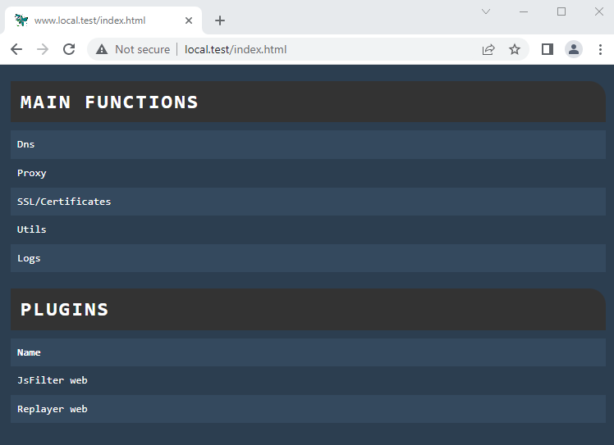
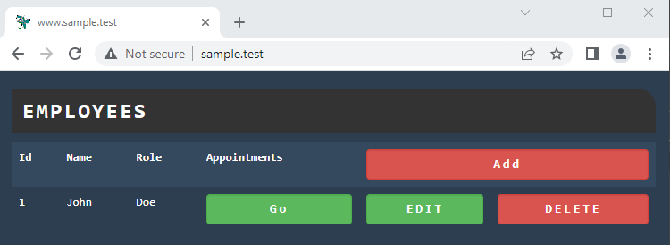
Look! A UI!
Notes:
Little tour on the Sample APP ( http://www.sample.test )
Little tour on the HAM app ( http://www.local.test )

Slide 5

The sample application architecture
FE (Jquery)
GATEWAY (API gateway)
BE (backend)
H2 In memory DB
Notes:
We will consider the Backend as a service developed by another team/departement

Slide 6

Notes:
Recording Insert Mario Rossi and an appointment, with text Meeting, and move it to the final state then delete appointment and the user
Simulate the UI too stopping all backends
Save the result and prepare the UI test (UI.json), removing all but gateway calls, then run the UI only without BE
Reload the original and setup the test with gateway (stimulator) and be (stimulated) and run it on the ui. Create by hand a user showing the NOT increased id
Reload the original and setup the test with pacts be, change the script with the step by step UI and run it. Create by hand a user showing the INCREASED id
Modify the template on one of the pacts returned data to show the errors

Slide 7

Thanks
HAM: https://github.com/kendarorg/HttpAnsweringMachine
Linkedin: https://www.linkedin.com/in/enricodaros/
E-mail: enrico.daros@lastminute.com
Notes:
And now enter the TARDIS with HAM!

