Slide 1


UI Testing
Want to see what is happening “in the real life”
Want to know why the UI does not work in prod
Want to check if your fix would work in production?

Slide 2

HAM
Http Answering Machine
Notes:
Prerequisites: Java 11 & Maven

Slide 3

Let’s do it
Setup the environment
Browse the incriminated section
Set the DNS and SSL records
Record the interactions
Do your testing
Notes:
Checkout the project ( git clone https://github.com/kendarorg/HttpAnsweringMachine.git )
Build.sh (docker too)
Setup the hosts file
Notepad as admin on C:\Windows\System32\drivers\etc\hosts
127.0.0.1 www.local.test
127.0.0.1 www.sample.test
127.0.0.1 gateway.sample.test
127.0.0.1 be.sample.test
Run.sh

Slide 4

Just…
Install Maven, git, Chrome and JDK11
git clone https://github.com/kendarorg/HttpAnsweringMachine.git
cd HttpAnsweringMachine
Make.sh/.bat (no docker)
RunStandalone.sh/.bat
From command line run chrome with the following parameter:
--proxy-server=socks5://localhost:1080
Start navigating the target website

Slide 5

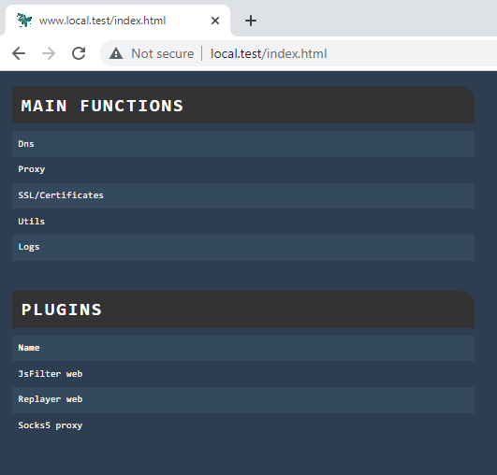
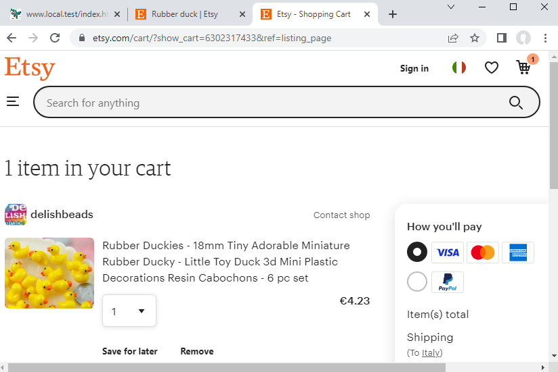
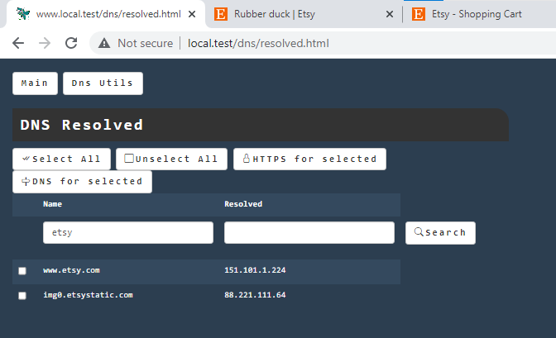
Look! A UI!
Notes:
Esty.com, rubber duck->rubber duckies->Quantity 1->add to cart
Look at dns, save them as dns and as https
Reopen clean data and start recording
Booking London 23-29-chapter levisham

Slide 6
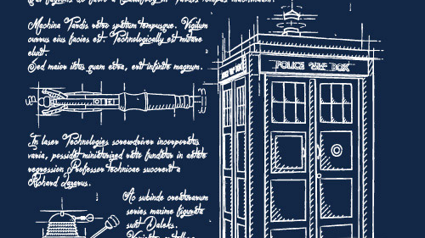
The sample application architecture
FE (Jquery)
GATEWAY (API gateway)
BE (backend)
H2 In memory DB
Notes:
We will consider the Backend as a service developed by another team/departement

Slide 7

Notes:
Recording Insert Mario Rossi and an appointment, with text Meeting, and move it to the final state then delete appointment and the user
Simulate the UI too stopping all backends
Save the result and prepare the UI test (UI.json), removing all but gateway calls, then run the UI only without BE
Reload the original and setup the test with gateway (stimulator) and be (stimulated) and run it on the ui. Create by hand a user showing the NOT increased id
Reload the original and setup the test with pacts be, change the script with the step by step UI and run it. Create by hand a user showing the INCREASED id
Modify the template on one of the pacts returned data to show the errors

Slide 8

Thanks
HAM: https://github.com/kendarorg/HttpAnsweringMachine
Linkedin: https://www.linkedin.com/in/enricodaros/
E-mail: enrico.daros@lastminute.com
Notes:
And now enter the TARDIS with HAM!

