Slide 1
enigma chess “free Chess for all”
Team Members:
Sam Bateman, Kylee Bennett,
Tanay Choudhary, Sheena Hann

Slide 2
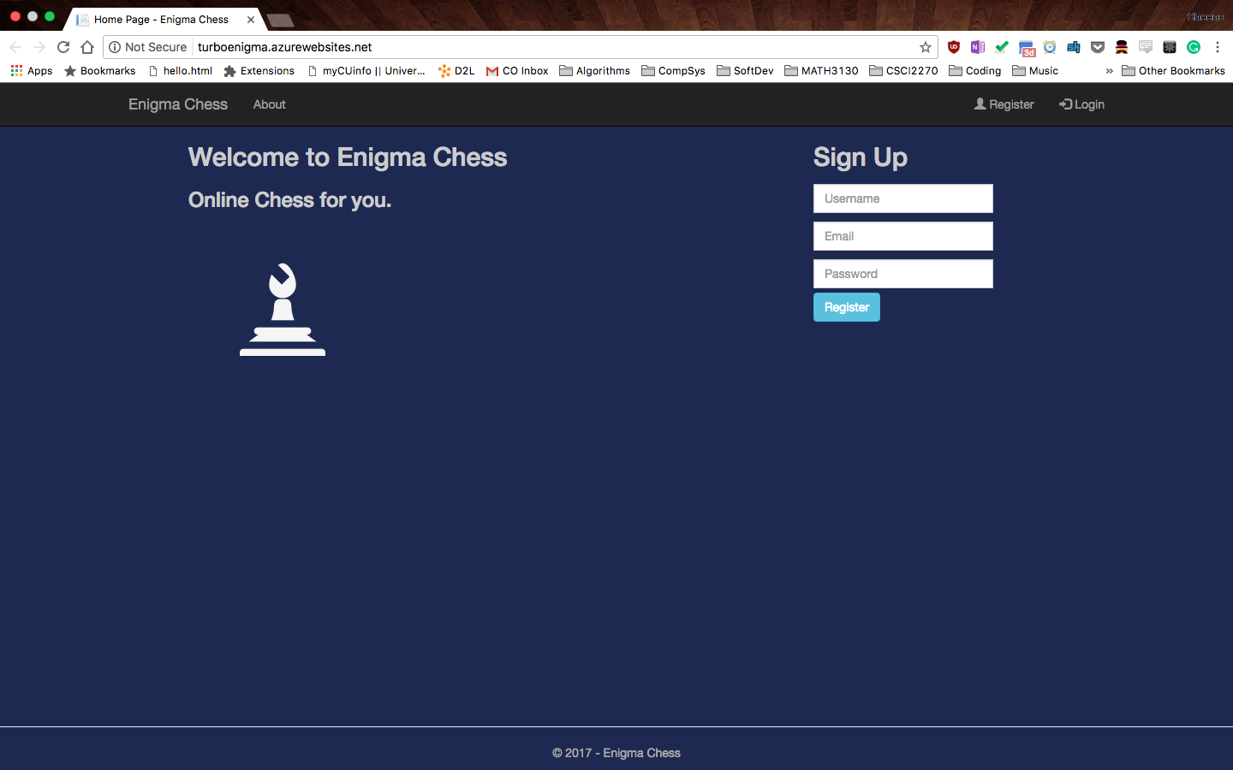
landing page

Slide 3
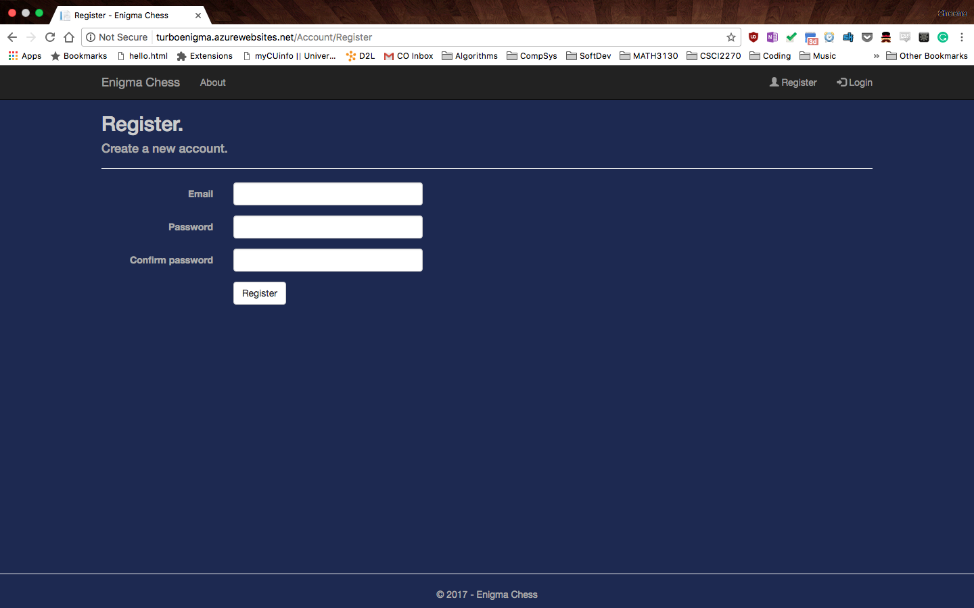
registration page

Slide 4

User accounts

